Slide 1
SMT Update To AMWG
JUNE 2017

Slide 2
Monthly SMT Data Timelines AMWG CR 2014 002 End to End File Processing Completeness – JUN 2017
% Timely Market Delivery - % of files posted to market (FTPS) by 11:00pm out of # of files received by SMT by 11:00pm.
% Portal Data Availability - % of files loaded to the database for data availability on portal by 6:00am next day for the files received by 11:00pm
* A LSE file includes usage data for up to 50,000 ESIIDs.
2

Slide 3
SMT API and FTPS Services Availability – JUN 2017
The service availability is measured as a percentage of number of minutes the service was available out of the total number of minutes in a month, excluding planned outages.
Observed Anomalies:
Mar-Apr 2015: SMT outage and subsequent recovery/catch-up impacted API availability. FTPS was available for most of the part except on 03/21-03/22 for 36 hours.
26 Jul 2015: Services were unavailable for 12 hours due to Flash storage issue
25 Jan 2016: Services were unavailable for 19 hours due to storage configuration issue
07 Mar 2016: API Services were unavailable for 7hours due to Oracle archiver issue.
Notes:
3

Slide 4
SMT Number of Accounts by Type AMWG CR 2014 009 – June 2017
Registered Users | ONC | CNP | AEPN | AEPC | TNMP | TOTAL
Active Residential Accounts | 54631 | 27471 | 1892 | 5513 | 3524 | 93031
Active Residential English Accounts | 54431 | 27296 | 1886 | 5403 | 3515 | 92531
Active Residential Spanish Accounts | 200 | 175 | 6 | 110 | 9 | 500
Non Active Residential Accounts | 22907 | 15380 | 1777 | 3911 | 943 | 44485
Total Residential Accounts | 77538 | 42851 | 3669 | 9424 | 4467 | 137516
TDSP User | 315 | 31 | 10 | 18 | 1 | 375
TDSP Admin | 4 | 4 | 4 | 4 | 3 | 19
Small Business User | 96 | 47 | 1 | 1 | 2 | 147
Small Business Admin | 2967 | 1583 | 85 | 316 | 142 | 5255
Total Agreements (Includes Active and Pending) | 8126 | 2521 | 56 | 181 | 775 | 11659
Energy Data Agreements (Includes Active and Pending) | 8125 | 2278 | 56 | 181 | 775 | 11415
Han Device Agreements (Includes Active and Pending) | 0 | 242 | 0 | 0 | 0 | 242
Han Service Agreements (Includes Active and Pending) | 1 | 1 | 0 | 0 | 0 | 2
IN SMT
ESI IDs | 3541864 | 2465122 | 197988 | 868624 | 247288 | 7320886
Meters | 3482336 | 2465044 | 198796 | 868984 | 246811 | 7261971
HAN Devices | 3489 | 4463 | 138 | 283 | 29 | 8402
Acknowledgement | 0 | 0 | 0 | 0 | 0
Pending | 0 | 8 | 0 | 0 | 0
Meter Ready | 14 | 2 | 41 | 102 | 17
Provisioned | 3475 | 4453 | 97 | 181 | 12
HAN Messages (MTD) | 0 | 0 | 0 | 0 | 0 | 0
HAN Messages (YTD) | 67 | 0 | 0 | 0 | 0 | 67
HAN Messages (Cumulative) | 447 | 7405 | 0 | 0 | 0 | 7852
Simple Text Messages | 151 | 2930 | 0 | 0 | 0
Load Control Messages | 131 | 2658 | 0 | 0 | 0
Pricing Messages | 99 | 53 | 0 | 0 | 0
Cancellation Messages | 66 | 1764 | 0 | 0 | 0
Supplemental – (Friends)
Total Agreements | 1861 | 1454 | 81 | 96 | 65 | 3557
Accepted Agreements | 782 | 562 | 37 | 29 | 22 | 1432
Pending Agreements | 1 | 1 | 0 | 0 | 0 | 2
Revoked Agreements | 322 | 282 | 10 | 8 | 6 | 628
Expired Agreements | 718 | 578 | 32 | 59 | 37 | 1424
Terminated Agreements | 38 | 31 | 2 | 0 | 0 | 71
 | TDSPs | REP | Small Business | Regulatory | Third Party
Registered Entities | 5 | 115 | 5076 | 2 | 151
Registered Users | 375 | 839 | 147 | 8 | 26
Registered Admins | 19 | 175 | 5093 | 3 | 141
HAN Messages Sent By | 410 | 7418

Slide 5
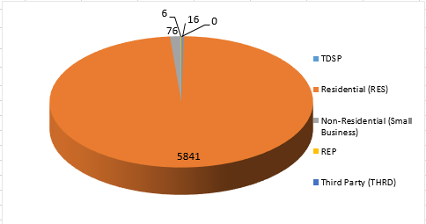
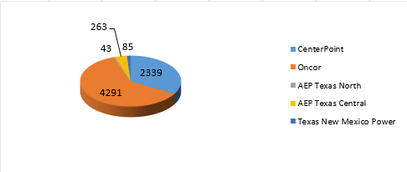
SMT ODR Details – JUN 2017
Total ODR Requests TDSP wise statistics:
Total ODR Requests User type statistics:

