Slide 1
Weather Scenarios in Economic Planning
Tim McGinnis
July 2017
CMWG Meeting

Slide 2
Agenda
Background
Proof of Concept Study
Latest Forecasted Input Data
Next Steps
Comments/Questions

Slide 3
Background
The Brattle Group prepared for ERCOT, Recommendations for Enhancing ERCOT’s Long-Term Transmission Planning Process, in October, 2013
Among the recommended
improvements, one involved
the use of weather-related
load fluctuations
Perform economic analyses
using varying load totals and
hourly profiles to help capture
the full range of value of
transmission investments
Load in Economic Models
Current Process
Enhanced Process
2019
2022

Slide 4
Proof of Concept Study
Developed a 2021 economic model based on 2015 RTP topology and updated with 2016 generation database
Used peak loads, demand energy, and wind and solar generation that are forecasted if 2003, 2004, and 2006 weather occur again in 2021
2003, 2004, and 2006 weather scenarios were selected to have a range of values in the input data
For each economic project tested, found the 2021 production cost savings to capital cost ratio for three weather scenarios and averaged the results

Slide 5
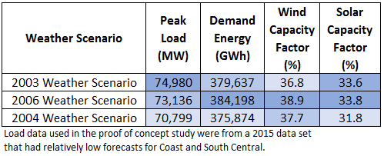
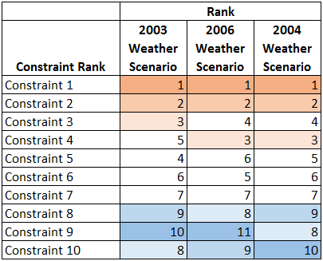
Proof of Concept Study Inputs and Results
2021 Input Data
2021 Results
Top 10 Constraints Ranked by Average Shadow Price ($/MWh)

Slide 6
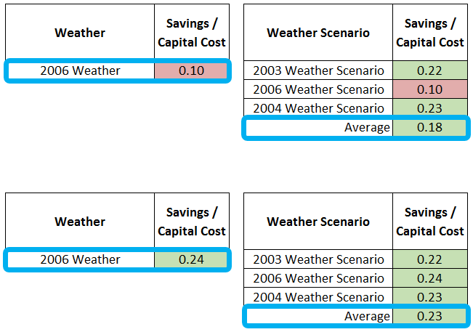
2021 Economic Analysis Results for Two Projects
For projects requiring Savings/Capital Cost ≥ 0.15
Current Process
Updated Process
Tier 4 Project
Example
Tier 1 Project
Example

Slide 7
Selection of Weather Scenarios
Compiled forecasted input data
Selected three weather scenarios that provided a range of values in the input data
Avoided outliers in terms of demand energy (2011, 2004)
Reviewed selection of weather scenarios with stakeholders

Slide 8
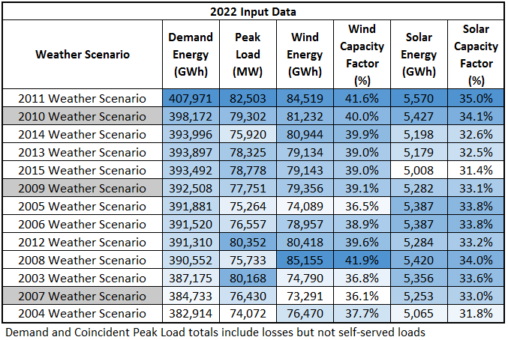
Latest Forecasted Input Data
Goal is to better reflect future conditions by choosing more than one weather scenario
2010
Ranks
Demand: #2
Peak Load:#4
Wind CF: #3
Solar CF: #2
2009
Ranks
Demand: #6
Peak Load:#7
Wind CF: #6
Solar CF: #8
2007
Ranks
Demand: #12
Peak Load:#9
Wind CF: #13
Solar CF: #9

Slide 9
Next Steps
Obtain stakeholder feedback
Build economic models with input data for three weather scenarios
Start using weather scenarios as needed per study scopes for RTP and RPG Project Reviews

Slide 10
Comments/Questions

Slide 11
Appendix:
Additional Information and Data

Slide 12
Protocol Section 3.11.2 (5)
To determine the societal benefit of a proposed project, the revenue requirement of the capital cost of the project is compared to the expected savings in system production costs resulting from the project over the expected life of the project. Indirect benefits and costs associated with the project should be considered as well, where appropriate. The current set of financial assumptions upon which the revenue requirement calculations is based will be reviewed annually, updated as necessary by ERCOT, and posted on the Market Information System (MIS) Secure Area. The expected production costs are based on a chronological simulation of the security-constrained unit commitment and economic dispatch of the generators connected to the ERCOT Transmission Grid to serve the expected ERCOT System Load over the planning horizon. This market simulation is intended to provide a reasonable representation of how the ERCOT System is expected to be operated over the simulated time period. From a practical standpoint, it is not feasible to perform this production cost simulation for the entire 30 to 40 year expected life of the project. Therefore, the production costs are projected over the period for which a simulation is feasible and a qualitative assessment is made of whether the factors driving the production cost savings due to the project can reasonably be expected to continue. If so, the levelized ERCOT-wide annual production cost savings over the period for which the simulation is feasible is calculated and compared to the first year annual revenue requirement of the transmission project. If this production cost savings equals or exceeds this annual revenue requirement for the project, the project is economic from a societal perspective and will be recommended.

Slide 13
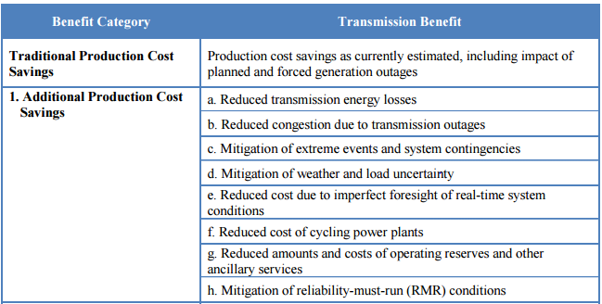
Recommendations for Enhancing ERCOT’s Long-Term Transmission Planning Process, p. 35
Source: Recommendations for enhancing ERCOT’s Long-term Transmission Planning Process, The Brattle Group
http://www.brattle.com/system/publications/pdfs/000/004/964/original/Recommendations_for_Enhancing_ERCOT%E2%80%99s_Long-Term_Transmission_Planning_Process.pdf?1386013201

Slide 14
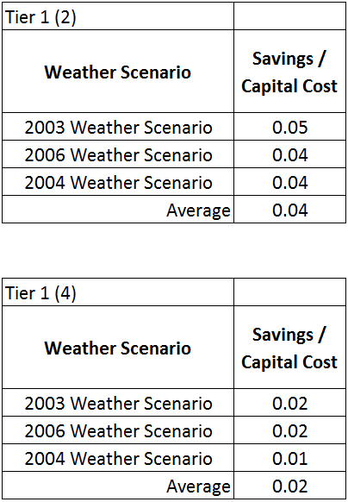
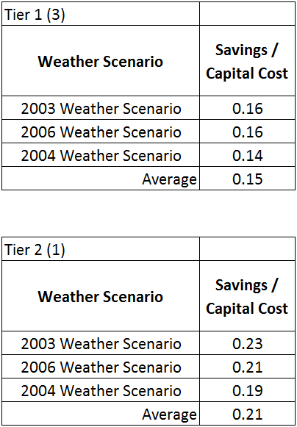
Economic Analysis Results for more Projects

Slide 15
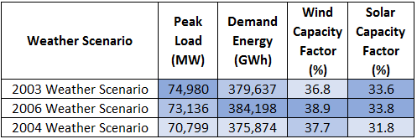
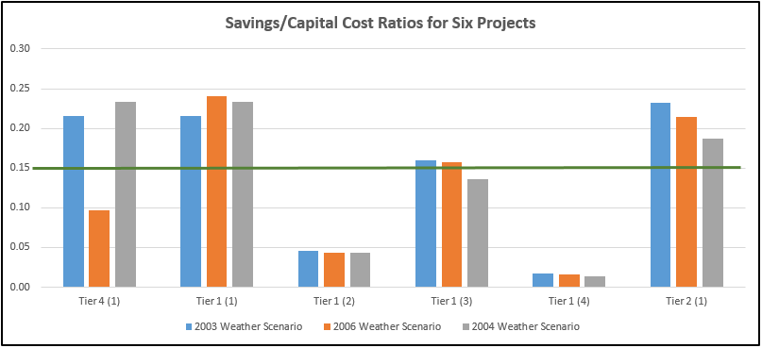
Economic Analysis Results for more Projects

Slide 16
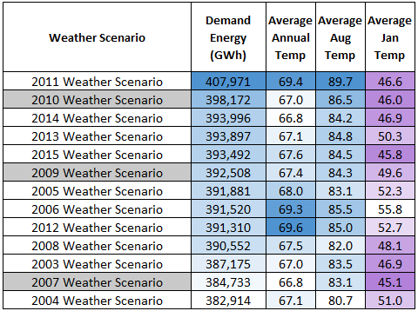
Input Data and Temperature Data

