Slide 1
NPRR833 Workshop
June 27, 2017

Slide 2
Agenda
Purpose of contingency analysis
SPS/RAS processing – high level overview
Discuss example contingencies and processing
#1 Outages branches only
#2 Outages branches and load
#3 Outages branches, load, generation, and resource node
#4 Outages unit

Slide 3
Purpose of contingency analysis
ERCOT is required to maintain N-1 security in Real-Time where possible
Contingency Analysis tool is used to identify transmission branch overloads under various “what-if” scenarios
If SPS/RAS cannot resolve transmission branch overloads then transmission constraints are provided to optimization engine to resolve. Note that in Real-Time, the Operator reviews transmission constraints before activating
ERCOT approach to meeting reliability is “Preventative” dispatch

Slide 4
SPS/RAS Processing
Real-Time | DAM | CRR
If SPS/RAS triggering condition satisfied then simulate SPS/RAS action and resolve powerflow Evaluate whether any transmission branch overloads exist after simulation of SPS/RAS action If transmission branch overload exists, then, Operator can pass transmission constraint to SCED to resolve | If SPS/RAS triggering condition satisfied then assume that SPS/RAS action would resolve any transmission branch overloads and no constraints passed to DAM optimization engine for this contingency | For each CRR network model, the emergency ratings for the set of transmission branches associated with each SPS/RAS are set to 9999 MVA. This effectively blocks overloads on these transmission elements from being considered in the optimization engine
NERC/TRE reliability standard: IROL and SOL Mitigation in the ERCOT Region (IRO-006-TRE-1)
“To provide and execute transmission loading relief procedures that can be used to mitigate SOL or IROL exceedance for the purpose of maintaining reliable operation of the bulk electric system in the ERCOT region”
Contingency Analysis tool identifies transmission branch overloads
Transmission branch overloads are mitigated Overloads ide#3 Outages branches, load, generation, and resourceused to identify node
#4 Outages unit

Slide 5
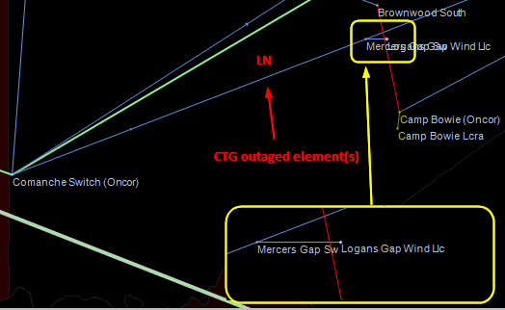
#1 Mercers Gap Switch to Comanche Switch

Slide 6
#1 Mercers Gap Switch to Comanche Switch - Processing
Outaged equipment | SCED | DAM | CRR
Comanche Switch to Mercers Gap 138 KV | Change topology by removing branch from base case, then run post-contingency power flow if there are violations, develop constraints and send to optimization engine to resolve | Same as real-time | Same as real-time

Slide 7
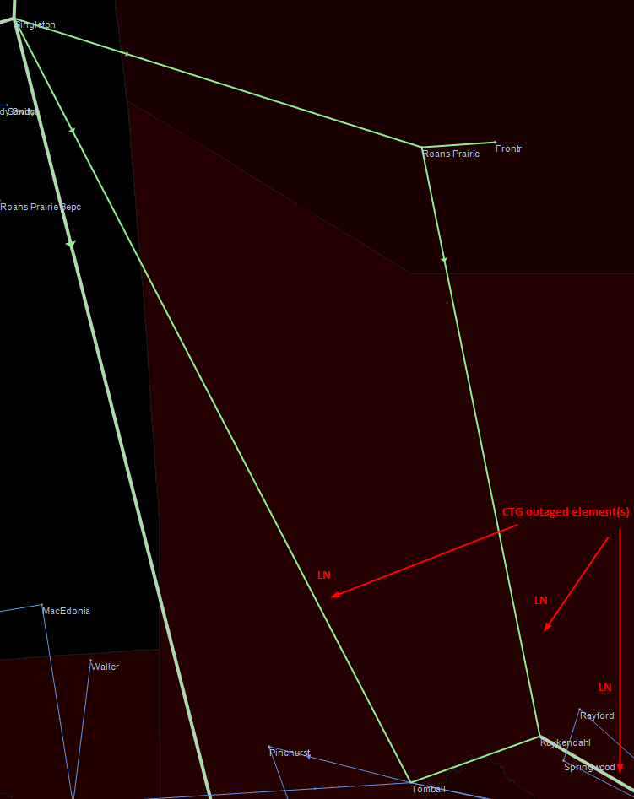
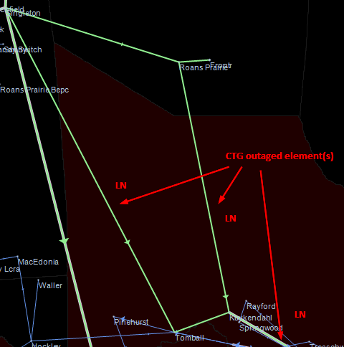
#2 DRNS_TB5

Slide 8
#2 DRNS_TB5 - Processing
Outaged equipment | SCED | DAM | CRR
Lines Tomball to Singleton 345 kV Kuykendahl to Rothwood 345 kV Kuykendahl to Roans Prairie 345 kV Load Kuykendahl 345 kV KDL_TR2 ~45 MW Series Device KDLTAP74_1 | Change topology by removing branch from base case If load rollover scheme available, implement load roll over. If load rollover not available then this load is lost and post contingency power flow will back generators to meet adjusted load. If there are violations (after SPS/RAS processing), develop constraints and send to optimization engine to resolve | Change topology by removing branch from base case If load rollover scheme available, implement load rollover. If load rollover not available then this load is redistributed to all other loads in the same load zone. Load Zone Shift Factors impacted by LDFs adjusted by load rollover or redistribution to all other loads in Load Zone Run post-contingency power flow, if there are violations (after DAM SPS/RAS processing), develop constraints and send to optimization engine to resolve | Same as DAM, except doesn’t implement load rollover.

Slide 9
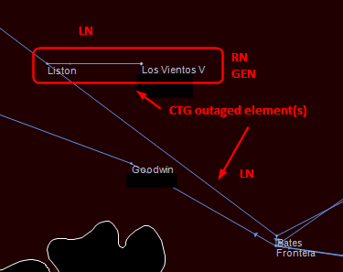
#3 Liston to Bates

Slide 10
#3 Liston to Bates - Processing
Outaged equipment | SCED | DAM | CRR
Lines Liston to Bates 138 kV Liston to Los Vientos V 138 kV Resource Node LV5_UNIT1 Generator LV5 Unit Load LV5_LV5_LD | Apart from the steps above for processing of outaged branches and loads in the post contingency power flow, the “pickup” effect is used for the outaged generator. -if there are violations in the post contingency power flow (after SPS/RAS processing) – develop constraints and send to optimization engine to resolve. | Apart from the steps above for processing of outaged branches and loads in the post contingency power flow, the “pickup” effect is used for the outaged generator, DAM energy only offers/Bids and PTP. Note – this is already being done for generator and DAM energy only offers/bids -if there are violations in the post contingency power flow (after DAM SPS/RAS processing) – develop constraints and send to optimization engine to resolve. PTP will be considered in this constraint | Apart from the steps above for processing of outaged branches and loads in the post contingency power flow, the “pickup” effect is used for CRR -if there are violations in the post contingency power flow – develop constraints and send to optimization engine to resolve CRR will be considered in this constraint

Slide 11
#3 Liston to Bates - Processing
This type of contingency, where the Resource Node is outaged, is when the proposed change ERCOT would implement with NPRR833 occurs would take effect by:
Changing the way we calculate LMP for the settlement point (RT/DAM)
Changing the processing of PTP/CRR in DAM/CRR when contingency disconnects settlement point (DAM/CRR)
These changes bring the clearing price and the settlement price into alignment.

Slide 12
#4 STP Unit 2 - Processing
Outaged equipment | SCED | DAM | CRR
Resource STP G2 The Resource Node remains energized | In the post-contingency power flow, the “pickup” effect is used for the outaged generator | Contingency not considered (no change proposed) | Contingency not considered (no change proposed)

Slide 13
Summary of Contingency Processing
Contingency effect | SCED | DAM | CRR
#1 Outages branches | If violations, constraints developed | Same as real-time | Same as real-time
#2 Outages branches and load | Implement load rollover if available, otherwise generators back down. If violations, constraints developed | Implement load rollover scheme if available, if not load is redistributed in load zone. If there are violations, constraints developed | Same as DAM, except doesn’t implement load rollover.
#3 Outages branches, load, generation, and resource node | Pickup used for outaged generator, constraint developed | Pickup used for generator and for transactions at resource node. PTP will be included in the pickup. | Similar to DAM
#4 Outages unit The Resource Node remains energized | Pickup used | Contingency not considered (no change proposed) | Contingency not considered (no change proposed)

Slide 14
Summary of Contingency Processing - continued
Contingency effect | SCED | DAM | CRR
#3 Outages branches, load, generation, and resource node | Resource Node Settlement Point Price calculation uses “pickup” Shift Factor | Resource Node Settlement Point Price calculation uses “pickup” Shift Factor | Not applicable as CRR has “path” prices
#4 Outages unit The Resource Node remains energized | Resource Node Settlement Point Price calculation uses topology Shift Factor | Contingency not considered (no change proposed) | Contingency not considered (no change proposed)

Slide 15
Calculation of “Pickup”
SCED | DAM | CRR
The amount of outaged MW distributed to each of the other k online generators with AGC_FLAG set to “true” is given by $${PickupMW}_{k}=OutageMW×\frac{\left({HSL}_{k}−{MW}_{k}\right)}{\sum_{k}{\left({HSL}_{k}−{MW}_{k}\right)}}$$ | The amount of outaged MW distributed to each of the other k online generators with AGC_FLAG set to “true” is given by $${PickupMW}_{k}=OutageMW×\frac{\left({HSL}_{k}\right)}{\sum_{k}{\left({HSL}_{k}\right)}}$$ | Similar to DAM
Posting of the list of generators whose AGC-FLAG is set to “true” and max MW capability (from CDR?) – more discussion needed

