Slide 1
LTSA Scenario Development Workshop
Sandeep Borkar
June 2017, RPG Meeting

Slide 2
Agenda
Summary of LTSA Survey
Generation Expansion Methodology
Breakout sessions – scenario assumptions

Slide 3
2018 LTSA: Key drivers – survey responses

Slide 4
2018 LTSA: Top sensitivities – survey responses

Slide 5
2018 LTSA: Assumptions – survey responses
 | Most likely | Least likely | Low | High | Notes
NG Price | 2017 EIA AEO average of HOG and Ref Case (6.10 $/MMBtu by 2033) | 2017 EIA AEO Reference Case (7.23$/MMBtu by 2033) | 2017 EIA AEO High Oil and Gas production Case (4.97$/MMBtu by 2033) | 2017 EIA AEO Reference Case (7.23$/MMBtu by 2033) | sub 4$ prices in 2033 for Current Trends
EE adoption | Business as usual (0.25%/year) | Aggressive (1.5%/year) | Business as usual (0.25%/year) | Aggressive (1.5%/year)
Distributed PV | Mid-case scenario (12.3 GW by 2033) | Low cost renewable energy (21.1 GW by 2033) | High cost renewable energy (2.5 GW by 2033) | Low cost renewable energy (21.1 GW by 2033) | 5 GW by 2033 for Current Trends
Carbon price | 10$ | >30$ | - | 40$
Environmental Regulations | None | - | - | CPP, CSAPW, Regional Haze, MATS | SO2 regulation for non-attainment for SO2 around coal plants & Carbon capture scenario

Slide 6
Potential Scenarios for 2018 LTSA
Current Trends
High Economic Growth along with growth in Industrial, LNG terminal and oil & gas load
High Cost of Renewables
High Renewable Penetration with increase in Distributed PV

Slide 7
Generation Expansion Methodology
Develop scenarios based on Stakeholder input
Develop a list of potential sensitivities
  Natural gas price
  Capital costs
  Load growth
  Other
Create matrix of potential model runs
Run a new generation expansion for each potential run
  Look for large changes in expansion results from the different sensitivities (including retirements)
  Runs with large differences would be passed on for transmission analysis

Slide 8
Generation Expansion Methodology
Example matrix

Slide 9
Breakout Sessions
Signup sheets – used to create small breakout groups
Handouts – Input trends/forecasts presented in May RPG meeting
Template – to organize assumptions
30 Minutes per group
Each group presents their scenario assumptions with a brief rationale
Thoughts
  Rely on information backed by references for key assumptions
  Think about “stretch” assumptions when appropriate

Slide 10
Scenario Assumptions
General | Scenario Name | Scenario Name
 | Participants | Identify participants for this particular workshop
 | Sensitivities | Identify any Sensitivities that should be considered when studying this scenario. Prioritize sensitivities.

Slide 11
Scenario Assumptions: cont.
Load Forecasting | System Load Growth (Peak and Total Energy) | What forecast of the one’s presented at the May RPG meeting would you recommend? Current forecast, High overall growth, Industrial Growth?
 | Geographic distribution of load growth | Indicate geographic distribution: along I35 corridor, Houston, West Texas, Rural v/s Urban
 | LNG export terminal additions | Any new LNG Terminals to be added? If so where and what size?
 | Weather assumptions | What weather year (90th percentile, 50th percentile etc.) should be considered for this scenario?

Slide 12
Scenario Assumptions: cont.
Environmental Regulations/Energy Policy | Environmental Regs | What regulations to include: CSAPR, Regional Haze, CPP, MATS etc.. SO2 non-attainment zones
 | Emission Cost | Carbon and SO2 price for the scenario
 | Renewable incentives | Whether to extend PTC/ITC beyond its current life? Any new or other subsidies to model?
 | Reserve margin mandates | Should reserve margins be mandated in this scenario? If so how much?
 | DC Tie additions | Should new DC ties be added to the scenario? If so then define location and capacity.

Slide 13
Scenario Assumptions: cont.
End Use/Demand Side Management | Distributed PV | How much of the load will be served by Distributed PV? What's the annual growth rate? Etc.
 | EE Growth | How much load reduction would be accounted to EE? Annual growth rate?
 | DR Growth | How much price responsive DR should be modeled?

Slide 14
Scenario Assumptions: cont.
Alternative Generation | Renewable and storage capital cost | Specify capital cost projections - baseline or aggressive or muted growth
 | Limitation on renewable development | Any limitations on renewable (Wind and Solar) development in ERCOT grid? Annual caps? Caps on growth rate?
Fuel price forecast | NG price forecast | NG Price projections in 10 and 15 years
 | Coal price forecast | Coal Price projections in 10 and 15 years

Slide 15
2018 LTSA Schedule (tentative)
Task | Date
Draft LTSA Scope | March 2017
LTSA Workshop #1 | May 2017 RPG Meeting
LTSA Workshop #2 | June 2017 RPG Meeting
Finalize scenarios | August 2017 RPG Meeting
Current Trends Gen expansion and Load forecasting complete | 4th Quarter 2017
Current Trends transmission basecase ready | 4th Quarter 2017
Gen expansion and Load forecasting complete | 1st Quarter 2018
Transmission Expansion Complete | 2nd Quarter 2018

Slide 16
Questions
Sandeep Borkar
Sandeep.Borkar@ercot.com
512.248.6642
Priya Ramasubbu
Priya.Ramasubbu@ercot.com
512.248.4661
Julie Jin
Julie.Jin@ercot.com
512.248.3982
Tim McGinnis
Tim.McGinnis@ercot.com
512.248.6642
?
Doug Murray
Douglas.Murray@ercot.com
512.248.6908

Slide 17
Appendix

Slide 18
Appendix: Forecasts and trends research
ERCOT staff research/presentations (http://www.ercot.com/content/wcm/key_documents_lists/108868/LTSA_Input_Assumptions_Initial_Data.pptx)
Oil and Gas Development presentation by Gurcan Gulen of Bureau of Economic Geology (http://www.ercot.com/content/wcm/key_documents_lists/108868/051617_Gulen_-_ERCOT_LTSA_workshop.pdf)

Slide 19
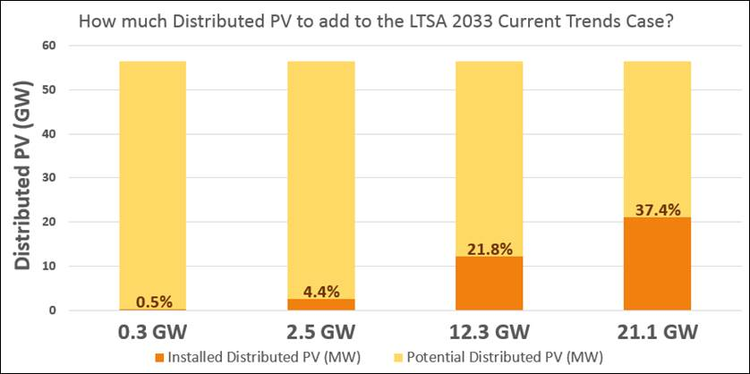
Distributed PV: Projections v/s Potential Capacity
Chart is based on NREL Projections of 56.4 GW of Potential Capacity

