Slide 1
Update of Regional Planning Group Reviews
NPRR and PGRR
Summary of Significant Changes

Slide 2
Background
Current RPG review process largely unchanged since 2008
Current Tier dollar thresholds may no longer reflect what is appropriate for the given level of review
Over the years issues have come up that need to be addressed or clarified in the rules

Slide 3
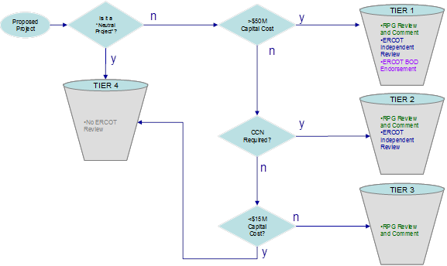
Current Tier Classification

Slide 4
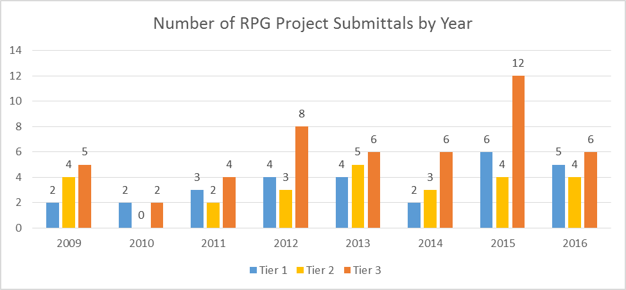
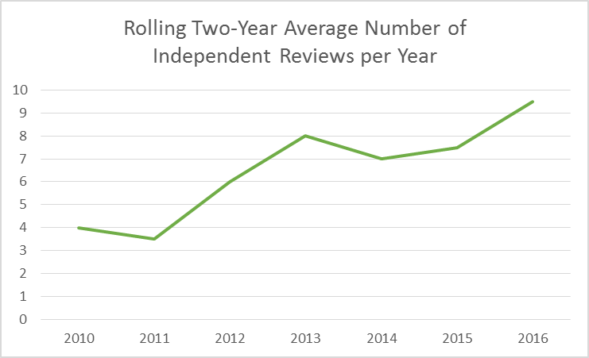
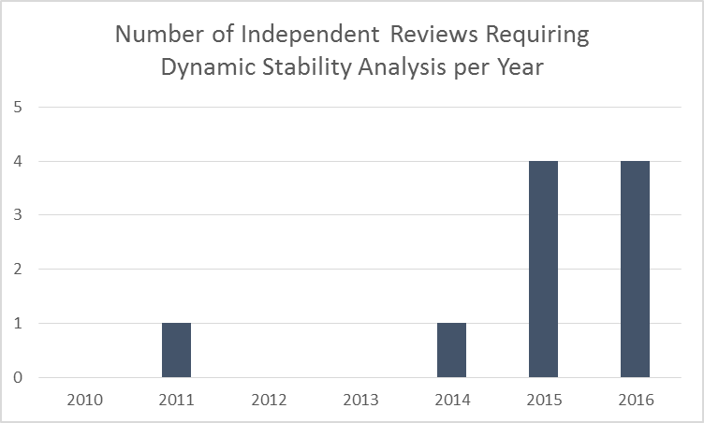
Increasing Number of RPG Projects

Slide 5
2013-2016 Tier 1 and 2 Projects
Tier 1 Project | Initial Cost Estimate ($M) | Days to complete IR
Barilla Junction | $112 | 205
TNMP Line 69H | $51 | 123
Hidalgo-Starr | $151 | 237
LRGV Area | $622 | 296
AEP Live Oak | $33 | 159
San Antonio | $237 | 238
Jones Creek | $80 | 62
Leander-RR | $51 | 86
Houston Import | $532 | 188
Permian Basin-Moss | $75 | 189
Sinton-Beeville-Kenedy | $89 | 125
Kenedy-Nixon-Seguin | $55 | 97
Tier 2 Project | Initial Cost Estimate ($M) | Days to complete IR
Riverton-Sand Lake | $26 | 256
Salt Creek | $17 | 196
Katz to Tardis | $30 | 91
Greenville | $27 | 260
TNMP Flat Top | $29 | 121
SU North Loop | $11 | 84
Brady | $18 | 201
Denton Area | $45 | 127
Howard to Somerset | $18 | 70
Katy Area | $20 | 115
McQueeny-Geronimo | $8 | 78

Slide 6
Changes to Tier definitions
Tier 1
Tier 2
Tier 3
Tier 4
Threshold changes from $50 million to $100 million
Independent review increases from 90 to 120 days
Threshold changes from $15 million to $25 million
Adds provision for aged infrastructure projects
Independent review increases from 90 to 150 days
Now includes 345 kV projects below $25 million
Still no cost threshold

Slide 7
Other Changes
Provision added for non-TSP funded projects
Provision added for RPG notification of endorsed-project cost estimate changes
Project submittals should be sent to generic email address
Comment period timelines changed from calendar days to business days
Other clarifications added to better reflect current practice or to clean up potentially confusing sections

Slide 8
Questions?

