Slide 1
Calculating CRR Auction Portfolio Exposure:
Possible Solutions for Market Participants
6/19/2017

Slide 2
Review - how does it work now?
CRR system requests ACi99 and ACP coefficients for existing OBL Baseload paths in auction, and publishes them 5 business days before bid window closes
When final bid window closes, CRR system requests the rest of the ACi99 and ACP coefficients for the OBL Buy bids not previously requested from baseload, then calculates the portfolio credit exposures for each CounterParty, then for each Account Holder
If the exposure for the CounterParty is greater than locked credit, a budget record is created and sent to the engine for that CounterParty
If an Account Holder locked credit as well, a budget record for the Account Holder is also sent to the engine when the portfolio value is greater than what was locked
OBL buy bids have credit exposure, but only OBL buy bids need ACi99/ACP coefficients
OBL Sell Offers and OPT buy bids also have credit exposure, but do not use ACi99/ACP coefficients
OPT sell offers have no credit exposure
Exposure calculation uses ‘maximum stack exposure’ for each product for the credit evaluation as opposed to each individual bid getting its own calculation (bid stack is multiple bids for same product where only MW and/or price vary) – this was initially implemented with NPRR357

Slide 3
Review – timeline of credit lock for CRR auctions
Credit window for CounterParty (and Account Holder, if desired) opens when Market Notice is published and closes with the first bid window close
Credit window is not open during a 2nd Round Transaction window
CRR system sends “Locked” credit to the CMM system for each auction immediately after the bid window closes at 5:00pm, and then daily at 8:00am until it is released
CRR credit is ‘released’ from the CRR system at 8:00am the day after auction results are posted (day invoices are sent)
Credit displayed in the CRR system in the upper pane of the Credit Limit editors labelled “Locked” is the value sent to CMM during the lock period
Credit displayed in the CRR system in the lower pane of the Credit Limit Editors labelled “Current” is not sent to the CMM system
CRR system calculates the portfolio valuation at the time the engine macros are run, not when the bid window closes
CRR system does not send portfolio valuation to CMM; it only sends the Locked Credit

Slide 4
ERCOT’s assumptions -What is not working well for Market Participants?
Not having ACi99/ACP paths for expected OBL Buy bid paths (not in current OBL baseload), and having to manually calculate each of them
Calculating portfolio exposures with confidence
Calculating maximum stack exposure when bid stacks are used
Calculating CounterParty exposure when there is more than one Account Holder

Slide 5
What issue is being addressed by a more automated solution?
Not locking enough credit for each auction and being subject to credit constraint during optimization
Not getting CRR awards because of unexpected budget constraint
Locking too much credit for each auction and having it held for 8-16 days and not available to other markets
These issues become magnified with the unavoidable overlapping credit windows; beginning in November, virtually every month has a 1 day credit overlap between a monthly auction and an LTAS auction:
  2017: 11/16
  2018: 1/18, 2/15, 3/22, 4/19, 5/17, 6/21, 7/19, 8/23, 9/20, 10/18, 11/15
  2019: 1/17, 2/14, 3/21

Slide 6
Possible Solutions – better information on ERCOT websites
1. CRR team update auction portfolio exposure calculation methodology on ERCOT/CRR website.
Pros:
  Low cost (none, in fact)
  More transparent examples on how portfolio exposures are calculated following exact methodology used in the CRR application
Cons:
  Decouples exposure calculations from system that actually computes it
  Still requires that Market Participant compute or obtain ACi99/ACP values
  No validation of correctness of data entry (ACi99/ACP values, bid paths, dates, total bid hours, etc.)
  Highly error prone (data has to be entered correctly and completely, and instructions meticulously followed)
  Has to be manually recomputed for every portfolio change – difficult to do “what-if” scenarios
System Impact:
  None
Note: CRR team will update excel spreadsheet (pre NPRR357) to compute each bid’s exposure – however, user will still need to enter the portfolio, and the ACi99/ACP values on their own. This spreadsheet will calculate bids/offers line by line, and not perform ‘stacked bids’ exposures as that would take a macro or other programmatic solution. See Appendix for sample file for monthly auction.

Slide 7
Possible Solutions – ERCOT provide calculator outside of CRR system
2. ERCOT to write a web-based tool to estimate auction portfolio exposure for Market Participant, external to the CRR system
Pros:
  More accurate than Market Participants computing values on their own
  What-if scenarios
Cons:
  Still just an aid as it is decoupled from system that is actually calculating credit exposure
  Highly error prone (e.g., Market Participant calculates wrong portfolio, or changes portfolio, or transposes the credit values from the tool to the CRR Credit Limit Editor, or forgets to enter value into CRR system, etc.)
  Requires ACi99/ACP values, and depending on the complexity of implementation, this could have database performance issues, system-to-system communication delays, etc.
  Multiple teams involved (CMM, CRR, Security, MIS, TIBCO, RM, DB, Replication, Project Management)
  Some limitations would still be necessary – such as limiting the requests to the portfolio size (i.e., use auction bid limits), as well as only requesting the coefficients twice per day
System Impact:
  CMM, TIBCO, MIS
  NPRR484 Phase B (2019 timeframe)

Slide 8
Possible Solutions – CRR application calculates periodically during credit window (Vendor solution)
3. Credit calculated ‘periodically’ by CRR system during open credit window by the CRR system
Pros:
  Validates submitted bids (e.g., biddable settlement points only, ESSPs) and uses same exposure calculation for forming budget constraint (would need to be on submitted bids due to DB design constraints)
  Timely credit exposure calculation to assist in locking the right amount of credit
  Computes credit for Counterparty
  What-if scenarios
Cons:
  Vendor solution, and likely to be somewhat expensive – unknown if this would even be possible in new Framework
  Performance issues with database, especially when competing with bid submissions on bid close day – current CRR database is not designed for this level of resource competition
  System-to-system communication issues
    No guarantee that data gets delivered ‘on time’, or that Market Participants don’t change portfolios after request has been made
    Market Participants submitting bids ‘too late’ to get calculations
  Possible Protocol revisions
    Might need some Protocol language to cover situations where DB could not perform calculations – auctions would not be delayed or postponed, Market Participants still need to supply credit limit even if system is unable to perform the exposure calculations ‘on time’
    Might want some Protocol language on bid submission and credit windows (e.g., extend bid window; have credit window and bid window be the same period; have credit window close after bid window)
System Impact:
  CRR Vendor solution
  CRR, CMM, TIBCO
  Cannot be estimated until Framework Upgrade is completed in Jan 2018
  NPRR484 Phase B (2019 timeframe)

Slide 9
Summary
Option | Systems Impacted | Developed by | Dependencies | ETA
1) ERCOT provides better instructions and excel templates | None | ERCOT | Finish CRR framework upgrade testing (CRR team) | 2017
2) ERCOT provides external calculation tool for portfolio exposure, automatically fetching ACi99/ACP values as part of the tool | CMM | ERCOT | NPRR484 Phase B | 2019
3) CRR system improvement (written by vendor) to calculate exposure value as part of auction bid window activities | CRR, CMM | Vendor | NPRR484 Phase B | 2019

Slide 10
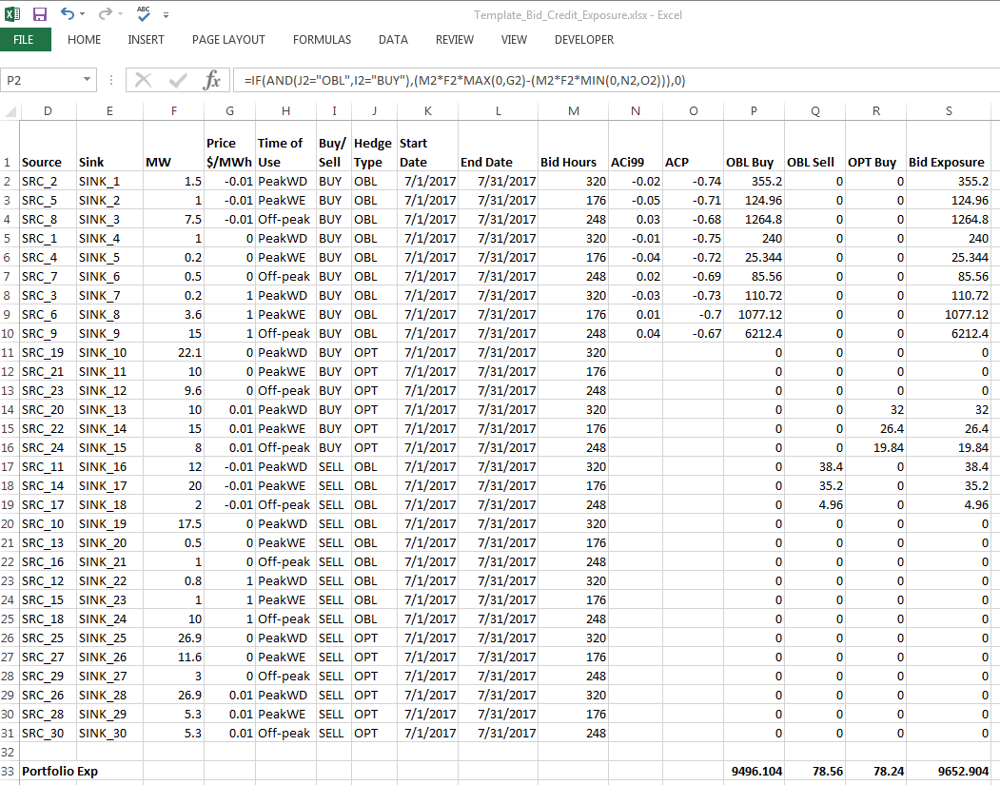
Appendix: Sample Excel spreadsheet for Monthly Auction Estimated Exposure (no stacks) – LTAS multi-month OBL Buy bids need 6 values for Hours, ACi99 and ACP; Monthly 24-Hour OBL Buy bids need 3

