Slide 1
Project Update and Summary of
Project Priority List (PPL) Activity
June 15, 2017

Slide 2
Project Update Agenda
Project Portfolio Update p. 3-8
Recent / Upcoming Project Implementations
2017 Release Targets
2018 Release Targets
2017 Project Spending Forecast
Revision Request Funding Placeholder Status
Priority/Rank Options for Revision Requests with Impacts
Appendix
Project Portfolio Gantt Chart p. 9-17
Location of Project Priority List (PPL): http://www.ercot.com/services/projects/index

Slide 3
Recent / Upcoming Project Implementations
2017 June Off-Cycle Release – 6/1/2017 Complete
NPRR744 – RUC Trigger for the Reliability Deployment Price Adder and Alignment with RUC Settlement
2017 June Release – 6/27/2017-6/29/2017 In Flight
NPRR573 – Alignment of PRC Calculation
NPRR789 – Publish All Mid-Term Load Forecast Results
NPRR797 – Actual Load by Forecast Zone Report and Display
NPRR801 – Non-Controllable Load Resource MW in PRC
Note: Projected Go-Live dates are subject to change. Please watch for market notices as the effective dates approach.

Slide 4
2017 Release Targets – Board Approved NPRRs / SCRs / xGRRs
March 3/7 – 3/9 | May 5/1 – 5/11 | June 6/27 – 6/29 | August 8/29 – 8/31 | October 10/31 – 11/2 | December 12/5 – 12/7
NPRR272 NPRR649 NPRR753 NPRR764 NPRR785 RMGRR134 NPRR790 | SCR790 NPRR746 NPRR786 NPRR792 NOGRR164 PGRR051 RRGRR003 RRGRR006 RRGRR007 RRGRR009 RRGRR010 PGRR046 | NPRR573 NPRR789 NPRR797 NPRR801 NPRR744 | NPRR758 NPRR775 NPRR782 NPRR812 | NPRR778 NPRR808 NPRR812 | SCR789 PGRR052
7 | 12 | 5 | 3 | 3 | 2
ü
ü
ü
ü
ü
ü
ü
ü
ü
ü
ü
ü
ü
ü
ü
ü
ü
ü
ü
E
E
E
E
E
E
E
P
NS
NS
I
NS
2/1
5/29 – 6/2
9/16 – 9/17
(Retail)
11/11 – 11/12 (Retail)
12/9 – 12/10 (Retail)
ü
5/8 – NMMS Upgrade
ü
TBD Items (and point at which they became “TBD”)
2014 | 2015 | 2016 | 2017
NPRR664 | None | SCR781 P | NPRR702 P, NPRR809
Go-live dates can differ from Protocol effective dates – Please refer to market notices for more details
APPENDIX
Red Text: New additions and target release changes
Strike-Through Text: Previous target release changes
(a), (b), etc. indicates multiple phases
Project Status Codes
NS = Not Started
I = Initiation
P = Planning
E = Execution
H = On Hold
Release targets are subject to change

Slide 5
2018 Release Targets – Board Approved NPRRs / SCRs / xGRRs
March Dates TBD | May Dates TBD | June Dates TBD | August Dates TBD | October Dates TBD | December Dates TBD
NPRR749 NPRR776 SCR777 SCR777 | NPRR519 NPRR620 NPRR683 NPRR741 NPRR743 NPRR755 NPRR760 NPRR800 NPRR810 | NPRR749 NPRR809
2 | 9 | 2 | 0 | 0 | 0
NS
E
E
E
E
E
E
E
E
E
NS
NS
NS
CMM Release 1
January
(Off-cycle)
Dates TBD
(Retail)
Dates TBD
(Retail)
Dates TBD
(Retail)
Dates TBD
(Retail)
Dates TBD
(Retail)
Dates TBD
(Retail)
Go-live dates can differ from Protocol effective dates – Please refer to market notices for more details
APPENDIX
Red Text: New additions and target release changes
Strike-Through Text: Previous target release changes
(a), (b), etc. indicates multiple phases
Project Status Codes
NS = Not Started
I = Initiation
P = Planning
E = Execution
H = On Hold
Release targets are subject to change

Slide 6
2017 Project Spending
2017 PPL Budget = $20.5M
“Potential Demand” represents internal ERCOT projects that have not been fully approved

Slide 7
Revision Request Funding Placeholder Status
In 2017, ERCOT forecasted $4.0M for Revision Request work
Yearly Revision Request Spending Forecast Summary
Project Status | 2017
YTD Actuals | $0.92M
Approved – In-Flight / Complete | $2.31M
Approved – On Hold | $0.00M
Approved – Not Started | $0.24M
Remaining Funding | $1.45M
Total Allocation | $4.00M
As of 5/31/2017

Slide 8
Priority / Rank Options for Revision Requests with Impacts
Options for…
Revision Request | Description | Priority | Rank | Comments
 | None this month
PPL Rank Information
Next available Rank in Business Strategy =
Next available Rank in Regulatory =

Slide 9
Appendix
5/31/2017 Project Gantt
In-flight items sorted by Project End Date
“On Hold” projects listed separately
None at this time
“Not Started” items sorted by Project Start Date

Slide 10
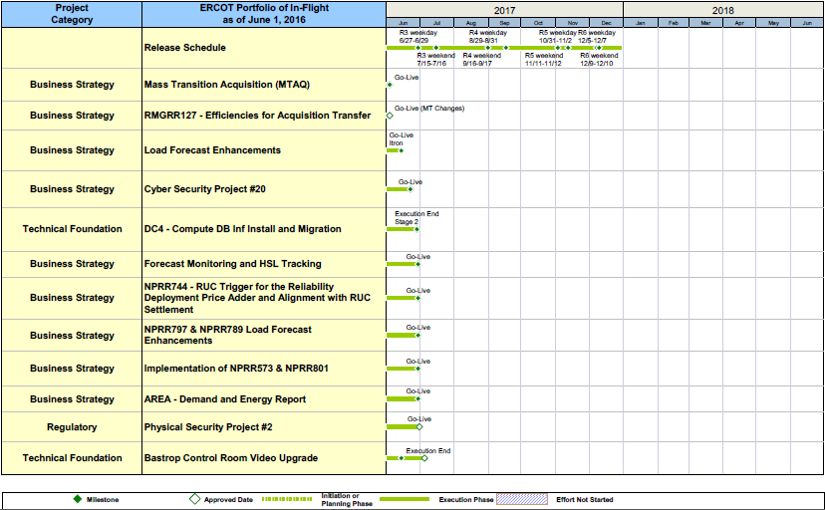
Project Portfolio Status – as of 5/31/2017

Slide 11
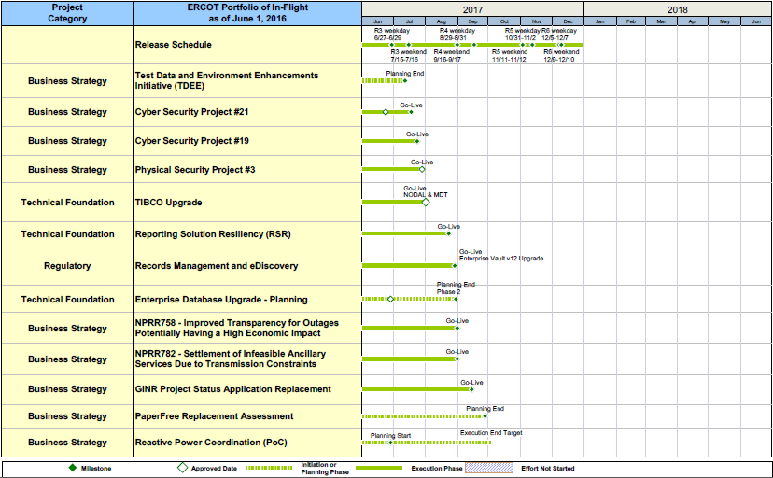
Project Portfolio Status – as of 5/31/2017

Slide 12
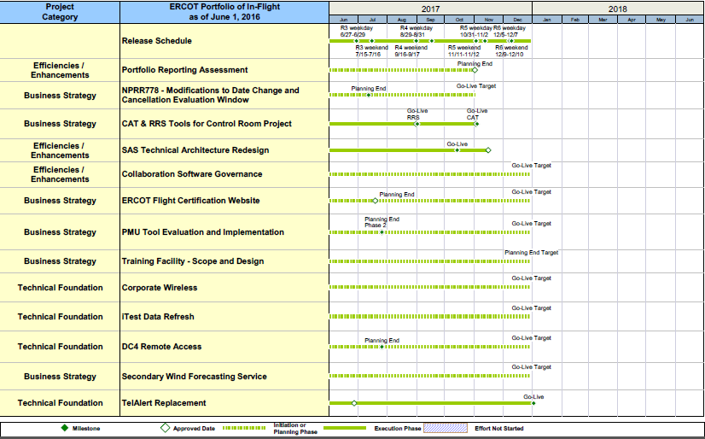
Project Portfolio Status – as of 5/31/2017

Slide 13
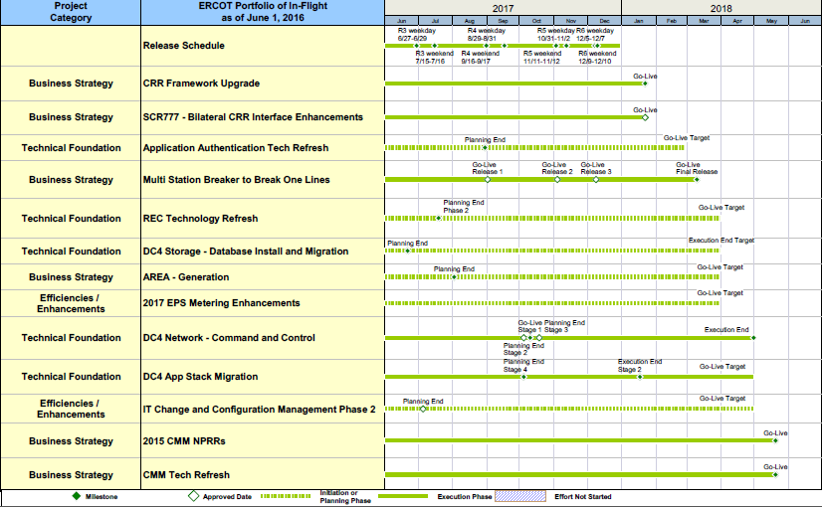
Project Portfolio Status – as of 5/31/2017

Slide 14
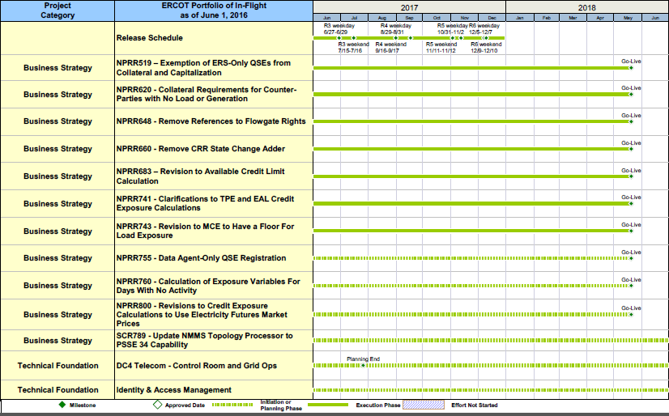
Project Portfolio Status – as of 5/31/2017

Slide 15
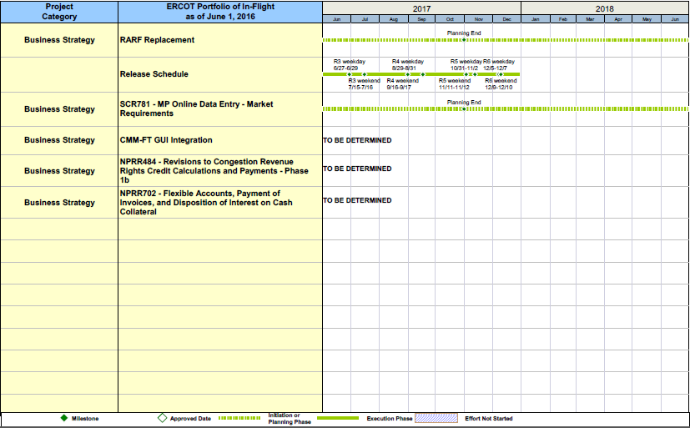
Project Portfolio Status – as of 5/31/2017

Slide 16
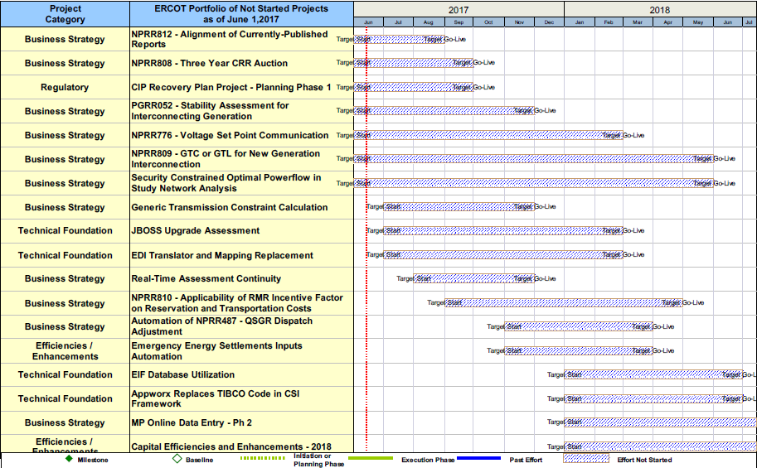
Project Portfolio Status – as of 5/31/2017

Slide 17
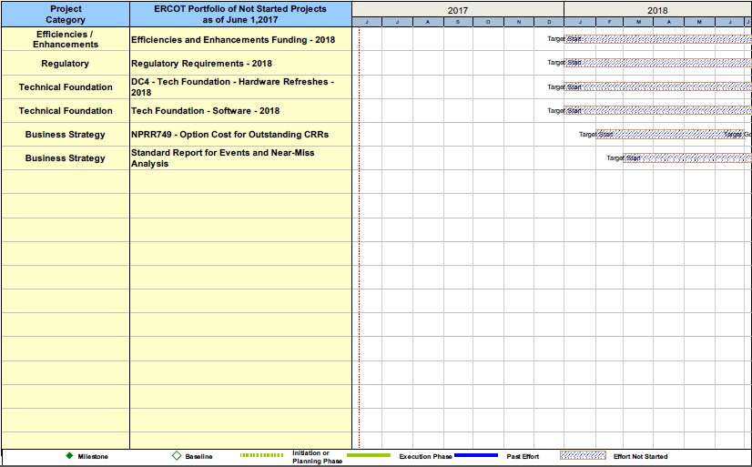
Project Portfolio Status – as of 5/31/2017

