Slide 1
2018 LTSA Scenario Workshop Initial Data
May, 2017
RPG Meeting
Notes:
Welcome to

Slide 2
Cost assumptions for new resources
Doug Murray

Slide 3
Initial Data
These are preliminary numbers and are subject to change until shortly after the last scenario workshop (for Current Trends scenario).
Some of them could have a significant impact on scenario results. Your feedback is greatly appreciated.

Slide 4
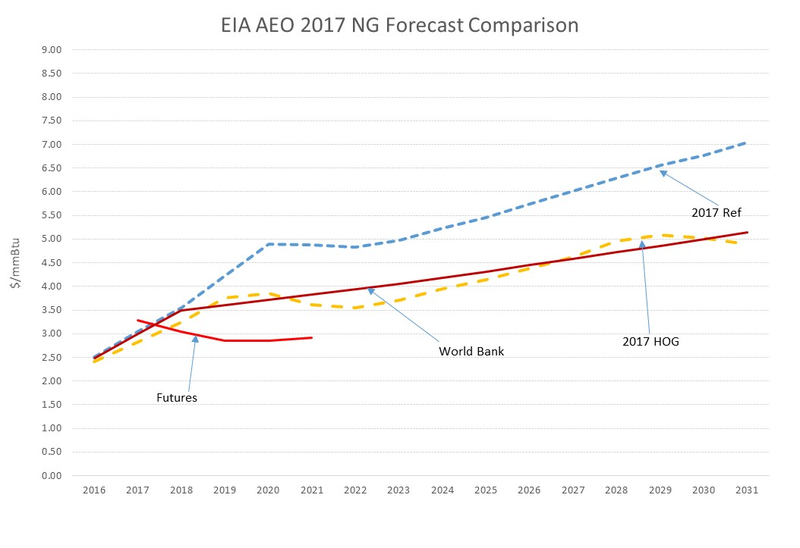
Natural Gas Price Assumptions
REF is the EIA Reference Case and HOG is the High Oil and Gas Production Case
Futures from Nymex and World Bank forecast are from Mid April

Slide 5
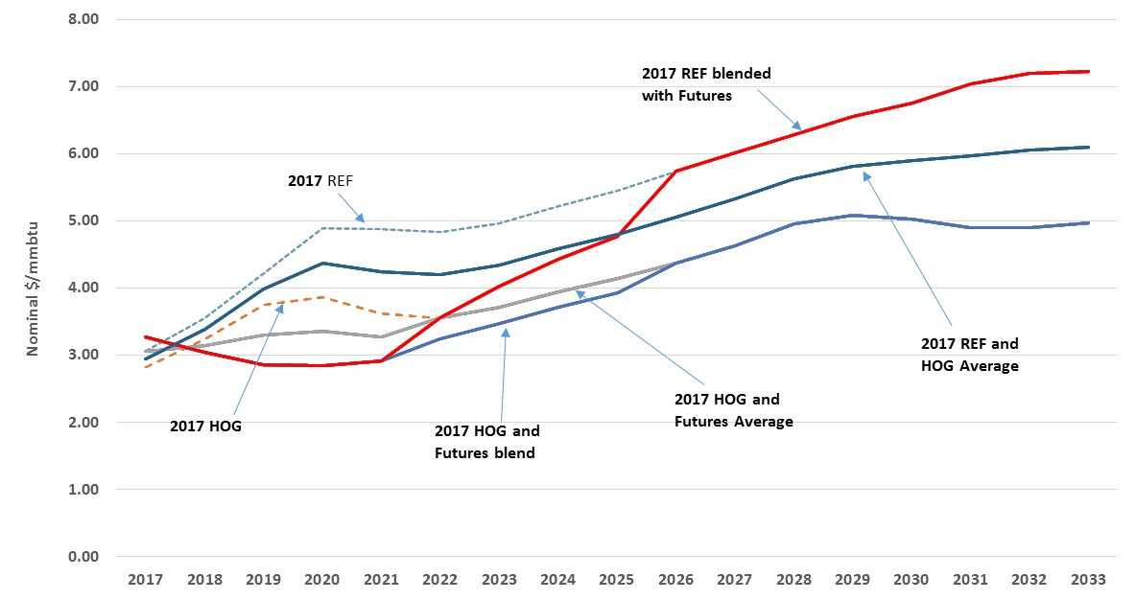
Natural Gas Price Assumptions
Potential Current Trends Natural Gas Forecasts

Slide 6
Natural Gas Price Assumptions
Potential Current Trends natural gas forecasts

Slide 7
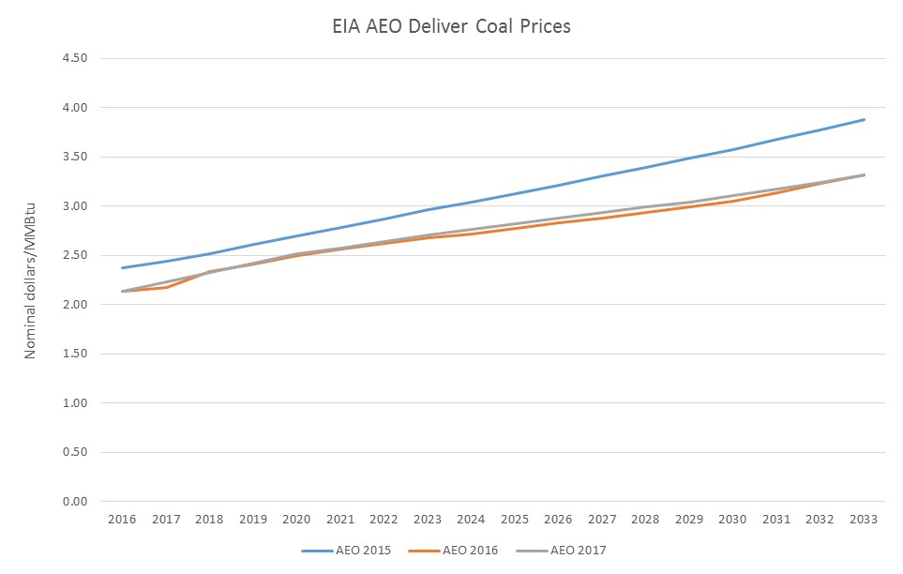
Coal Price Assumptions

Slide 8
New Unit Capital Costs
Sources of capital cost assumptions,
  EIA 2017 Annual Energy Outlook
  Lazard’s Levelized Cost of Energy Analysis, December 2016
  Solar Energy Industries Association, 4th QTR 2016 Solar Market Insights
Costs are $/kW in nominal dollars

Slide 9
Environmental Issues
Regulations for most environmental rules that would affect ERCOT scenarios are in limbo.
Current Trends Scenario will likely not be including any new environmental regulations (to be determined in the scenario workshops).
Other scenarios may include certain environmental rules and costs.

Slide 10
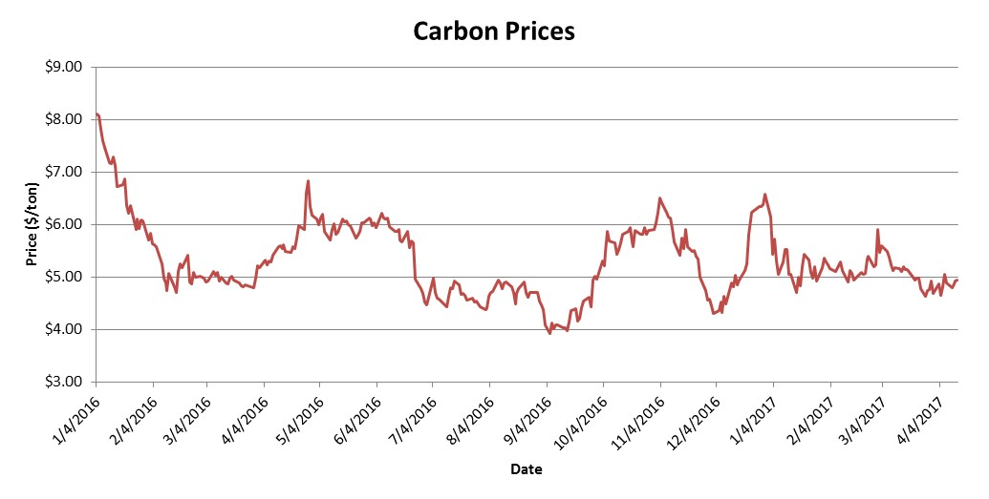
Carbon Costs
Investing.com carbon prices
RGGI CO2 latest auction price settled at $3.00/ton (March 2017)
California Cap and Trade auction price settled at $13.57/ton (February 2017)

Slide 11
SO2 and NOx Costs
Recent auction prices from the EPA website show SO2 allowances dropping to below $0.10/ton in some cases. This is a stark difference from a few years ago when prices were above $1,000/ton.
Prices for seasonal and annual NOx allowances have also dropped recently. Annual NOx prices are now below $10/ton and seasonal prices in a range between $200 and $250 per ton.

Slide 12
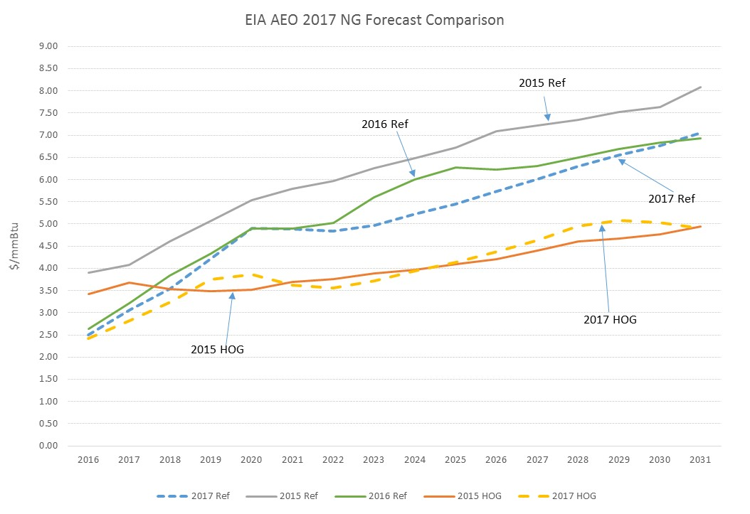
Natural Gas Price Assumptions
EIA AEO last three natural gas forecasts
REF is the EIA Reference Case and HOG is the High Oil and Gas Production Case

Slide 13
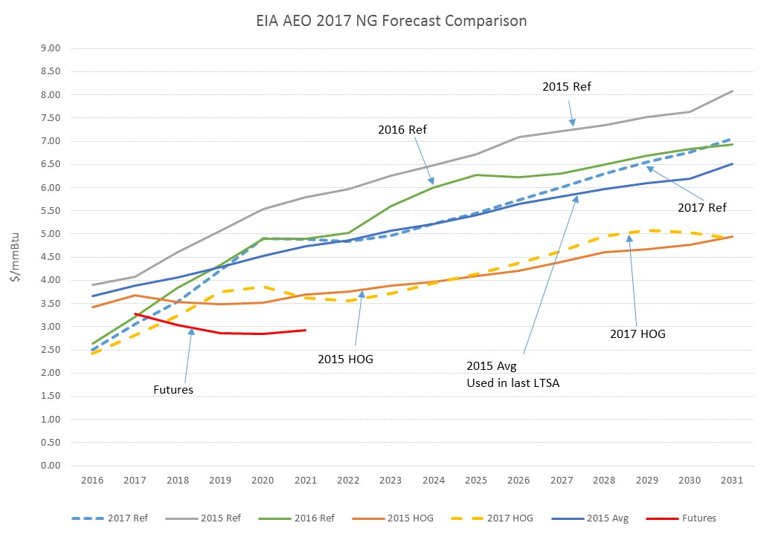
Natural Gas Price Assumptions

Slide 14
Energy Storage
Nemica Kadel

Slide 15
Agenda
Energy Storage Application in ERCOT
Operational Energy Storage Increase in United States (2000-2020)
Storage/EV Scenario Assumptions used in 2016 LTSA
Energy Storage Cost
Comments/Questions

Slide 16
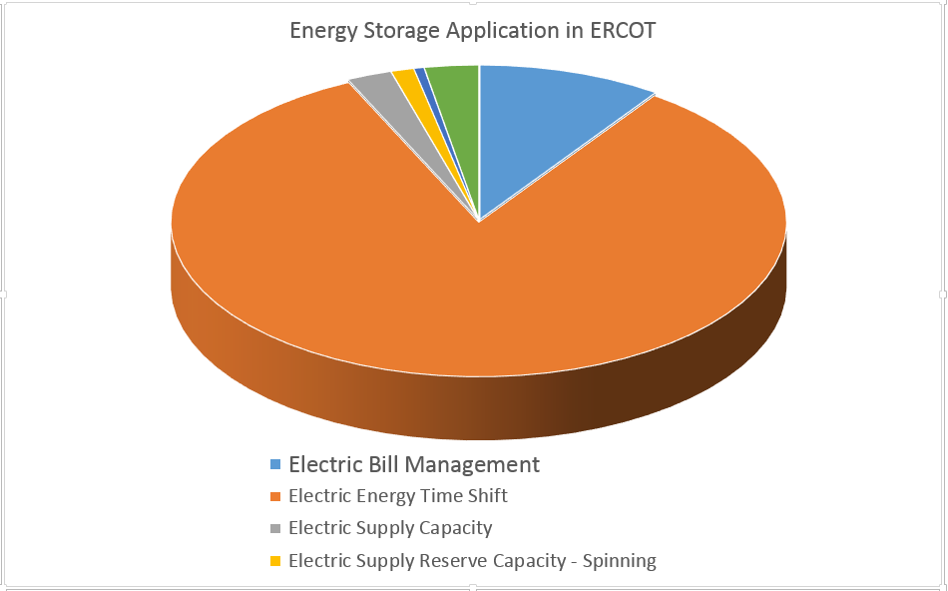
Energy Storage Application in ERCOT
A total of 169.21 MW of energy storage is operational in ERCOT with 83% of the capacity used for Energy Time Shift .¹
1.http://www.energystorageexchange.org

Slide 17
Operational Energy Storage Increase in United States (2000-2020)
The increment in the installed capacity of storage accounts for electro-chemical, electro-mechanical, hydrogen, liquid air energy, pumped hydro and thermal storage.²
2.http://www.energystorageexchange.org/projects/data_visualization

Slide 18
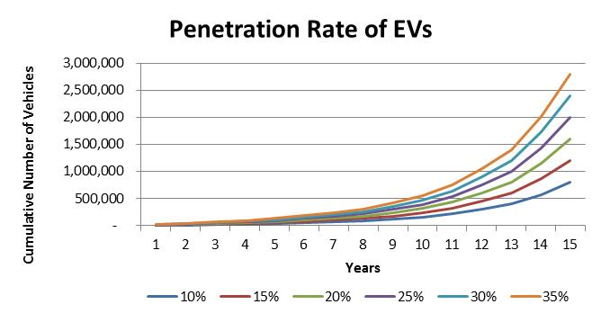
Storage/EV Scenario Assumptions used in 2016 LTSA
Scenario will include:
Increasing penetration on electric vehicles
Approximately 8 million passenger vehicles on Texas roads
Vehicle charging pattern will charge all day with most charging occurring off-pk hours
Average vehicle will require:
  8 hours of charging
  30 miles driven per day
  10.2 kWh needed per day
  1.275 average hourly charge rate
1,600,000 EVs by 2031 which will be 20% of total passenger vehicles in Texas today?

Slide 19
Energy Storage Cost
(Levelized Cost of Storage for Peaker Replacement)
The midpoint levelized cost for Li-Ion technologies has decreased by 12% for Peaker replacement purpose compared to 2015³.
Energy Storage Technology | Power Rating (MW) | Duration (Hours) | Levelized Cost of Storage ($/MWh)⁴
Zinc | 100 | 4 | $277-$456
Lithium | 100 | 4 | $285-$581
Flow Battery (Vanadium) | 100 | 4 | $441-$563
Flow Battery (Zinc-Bromide) | 100 | 4 | $448-$704
Flow Battery (Other) | 100 | 4 | $447-$563
Sodium | 100 | 4 | $320-$803
Flywheel | 100 | 4 | $342-$555
Thermal | 100 | 4 | $290-$348
3. https://www.lazard.com/media/438041/lazard-lcos-20-executive-summary.pdf
4. https://www.lazard.com/media/438042/lazard-levelized-cost-of-storage-v20.pdf

Slide 20
Distributed PV Projections
Tim McGinnis and Phung Nguyen

Slide 21
Agenda for Distributed Photovoltaic (PV) Projections
Headlines and Research
Effects of Distributed PV in the LTSA
Forecasted Distributed PV in ERCOT’s 2018 LTSA
Comments/Questions

Slide 22
Headlines
Amazon to Mount Solar Panels on 50 Facilities by 2020
Amazon is adding rooftop solar panels that will provide “up to 41 megawatts of power” starting with facilities “in California, New Jersey, Maryland, Nevada, and Delaware.”
--Commercial Property Executive (March 6, 2017)
El Paso Electric seeks 8.7% rate hike in Texas
“Residential homes with rooftop solar systems would see an average increase of almost 23 percent, or $14.09 more per month, as the utility is again asking that those customers be put into a separate class.”
--El Paso Times (February 13, 2017)

Slide 23
Headlines
China-Owned U.S. Solar Maker Seeks U.S. Tariffs on China Imports
“Suniva Inc., a bankrupt U.S. solar manufacturer with a Chinese majority owner, is seeking protection from cheap imports from China.”
“With surging global production and falling prices, U.S. companies ‘simply cannot survive’ according to the complaint.”
--Bloomberg (April 26, 2017)

Slide 24
Policy Decisions
Federal Investment Tax Credit (ITC)
  The Federal ITC has played an important role in the growth of solar PV for the United States
  ITC is currently 30% for residential and commercial solar
  Consolidated Appropriations Act, 2016: ITC to decrease annually
    2020: 26%
    2021: 22%
    2022: ITC goes away for residential; 10% for corporate owners
--U.S. Energy Information Administration (EIA) – Wind and Solar Data Projections from the U.S. EIA: Past Performance and Ongoing Enhancements

Slide 25
Summary of Headlines
Some news and information seems to indicate large amounts of Distributed PV will be installed in the future while other news indicates the rate of Distributed PV installation might decline
Due to conflicting forces effecting the amount of Distributed PV that will be installed by the year 2033, ERCOT’s 2018 Long-Term Study Assessment (2018 LTSA) scenarios should include a wide range of installed Distributed PV for the years 2028 and 2033

Slide 26
Effects of Distributed PV in the LTSA
    Higher amounts of Distributed PV will result in lower load values in the reliability and economic models
LTSA Generation expansion plans.
  Distributed PV may effect retirements and expansion of other generation types, including utility-scale solar.
LTSA Transmission expansion plans.
  Distributed PV may effect transmission congestion and reliability issues.

Slide 27
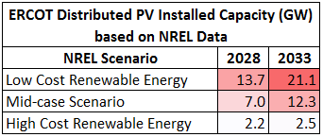
Forecasted Distributed PV in ERCOT’s 2018 LTSA
NREL developed a distributed generation forecasting tool called dGen
  dGen’s output data is included in the NREL’s “2016 Standard Scenarios Report: A U.S. Electricity Sector Outlook” report
  NREL’s dGen tool forecasted installed capacity (MW) of Distributed PV
  Assumed 90% of Texas’s Distributed PV would be in ERCOT

Slide 28
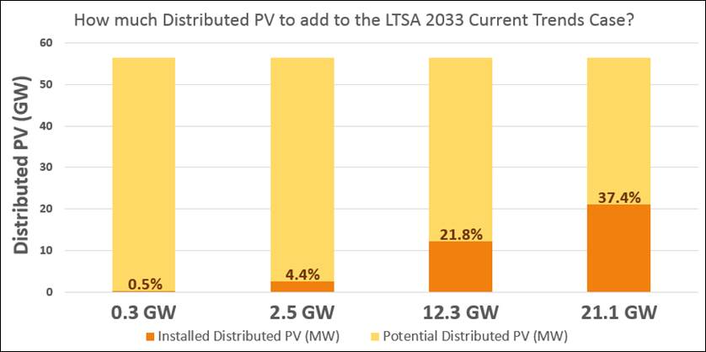
Distributed PV: Projections v/s Potential Capacity
Chart is based on NREL Projections of 56.4 GW of Potential Capacity

Slide 29
Forecasted Distributed PV in ERCOT’s 2018 LTSA
NREL’s Distributed PV Forecast can be applied to ERCOT’s 2018 LTSA by deciding how much Distributed PV should be included in the Current Trends scenario and other scenarios.
  There is around 0.2 GW of Distributed PV in 2017
  Will there be 2.5 GW, 12.3 GW, or 21.1 GW in 2033?

Slide 30
Load Forecast Scenarios
Calvin Opheim
Load Forecasting & Analysis

Slide 31
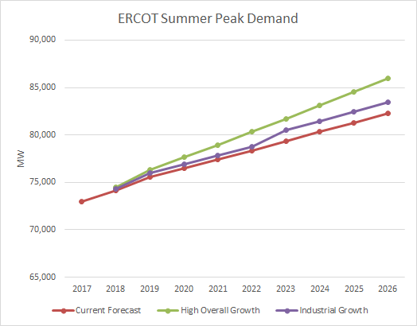
Load Forecast Options
ERCOT Load forecast using current methodology under different growth scenarios

Slide 32
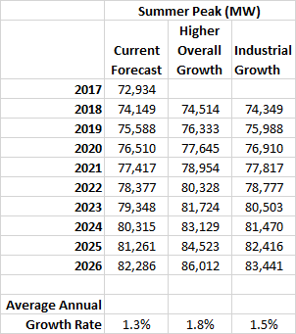
Load Forecast Options
Current forecast methodology includes:
200 MW of Load Management
150 MW of Energy Efficiency
200 MW of behind the meter DG
Higher Overall Growth – increases current forecast growth rate by 0.5% per year.
Industrial Growth – increases current forecast for large industrial loads:
1) 200 MW in the Permian Basin in 2018 on
2) 200 MW in the Gulf Coast in 2019 on
3) 755 MW for LNG in 2023 on (500 in South, 255 in Coast)

Slide 33
Energy Efficiency Projections
Naga Kota

Slide 34
Scenarios
Business as usual
  2017 Annual Energy Outlook prepared by Energy Information Administration (EIA). Load sales increase by 0.71% every year to 18% by the year 2040. Energy Efficiency (EE) is 0.25% per year.
Accelerated
  Significantly enhanced programs and policies to promote Energy Efficiency, Solar (PV), Electric Vehicles (EV), Hydropumps (HP) and Demand Response (DR). Load sales increase by 0.33% each year to 8% by year 2040. EE is taken as 1% per year.
Aggressive
  Significantly pushing the boundaries aggressively on programs and policies to promote EE, PV, EV, HP and DR that may be feasible. Load sales increase by 0.11% per year to 3% by year 2040. EE is 1.5%
Hybrid
  Combination of accelerated programs for EE, PV and DR with aggressive for EV and HP. Load increase is 14% increase by year 2040. EE is 1.0% in this scenario.
High energy demand
  Combination of increase in EV and HP but no keeping the load reductions EE, PV and DR to business as usual scenario. Load increase to 26% by year 2040. EE is 0.25%

Slide 35
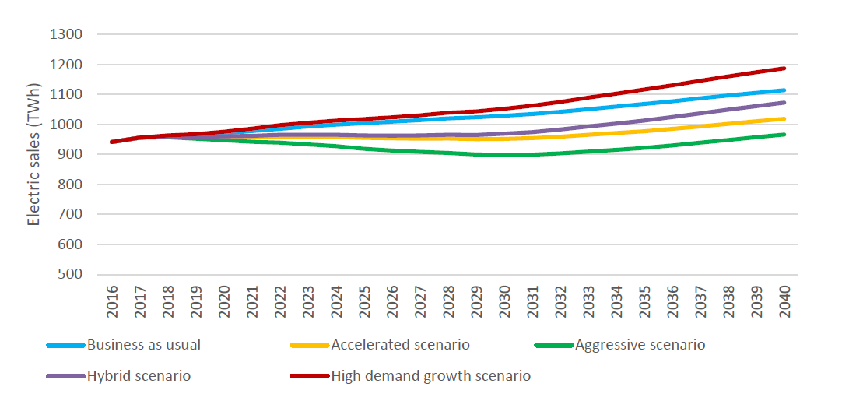
Electricity sales in five scenarios

Slide 36
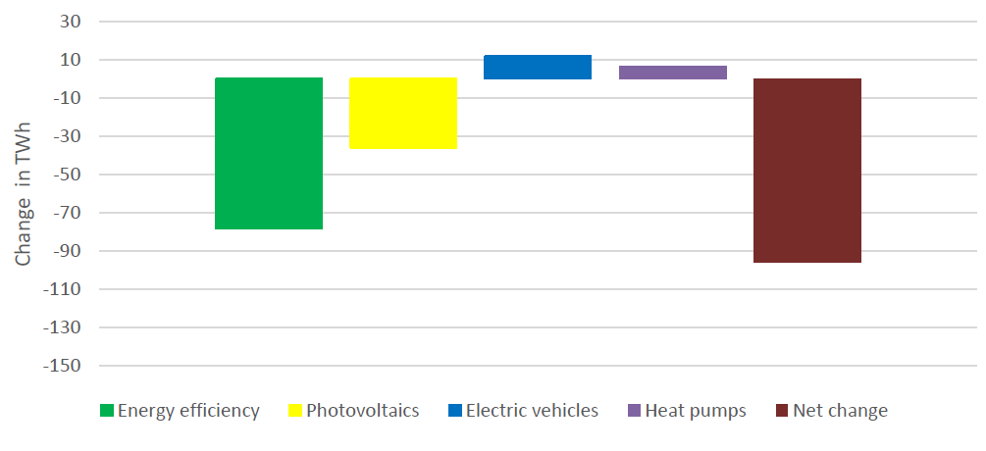
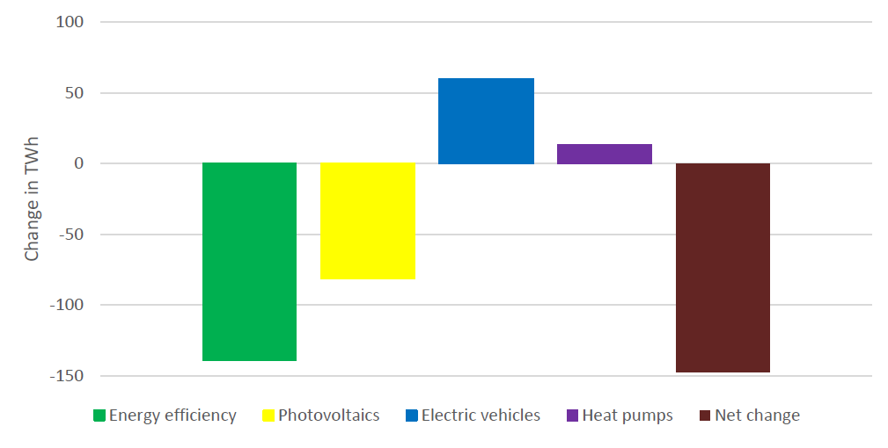
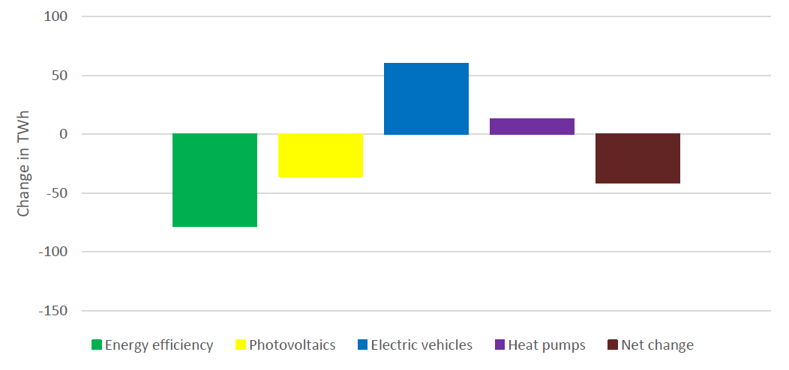
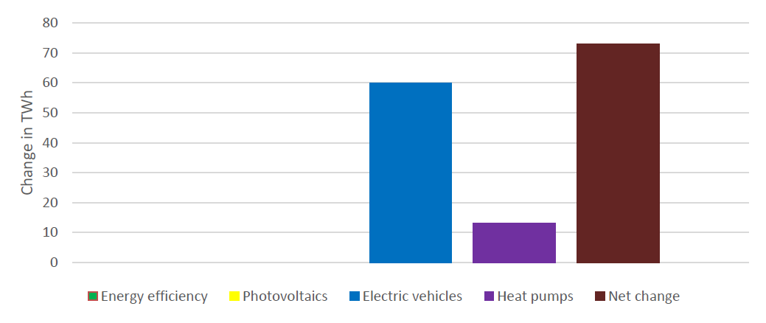
Changes in Electricity Sales
Changes in sales in accelerated scenario w.r.t. business as usual in 2040
Changes in sales in aggregated scenario w.r.t. business as usual in 2040
Changes in sales in hybrid scenario w.r.t. business as usual in 2040
Changes in sales in high energy demand scenario w.r.t. business as usual in 2040

Slide 37
Seasonal Peak Projections
Note: This data is not ERCOT load data. This is just a sample set of data from Southeastern US.

Slide 38
Seasonal Peak Projections (Contd.)
Note: This data is not ERCOT load data. This is a sample dataset for Southeastern US.

Slide 39
Scenario Assumptions
General | Scenario Name | Specify capital cost projections - baseline or aggressive or muted growth
 | Participants | Any limitations on renewable (Wind and Solar) development in ERCOT grid? Annual caps? Caps on growth rate?
 | Sensitivities | Identify any Sensitivities that should be considered when studying this scenario. Prioritize sensitivities.

Slide 40
Scenario Assumptions
Load Forecasting | System Load Growth (Peak and Total Energy) | What forecast of the one’s presented at the May RPG meeting would you recommend? Current forecast, High overall growth, Industrial Growth?
 | Geographic distribution of load growth | Indicate geographic distribution: along I35 corridor, Houston, West Texas, Rural v/s Urban
 | LNG export terminal additions | Any new LNG Terminals to be added? If so where and what size?
 | Weather assumptions | What weather year (90th percentile, 50th percentile etc) should be considered for this scenario?

Slide 41
Scenario Assumptions: cont.
Environmental Regulations/Energy Policy | Environmental Regs | What regulations to include: CSAPR, Regional Haze, CPP, MATS etc. SO2 non-attainment zones
 | Emission Cost | Carbon and SO2 price for the scenario
 | Renewable incentives | Whether to extend PTC/ITC beyond its current life? Any new or other subsidies to model?
 | Reserve margin mandates | Should reserve margins be mandated in this scenario? If so how much?
 | DC Tie additions | Should new DC ties be added to the scenario? If so then define location and capacity.

Slide 42
Scenario Assumptions: cont.
End Use/Demand Side Management | Distributed PV | How much of the load will be served by Distributed PV? What's the annual growth rate? Etc.
 | EE Growth | How much load reduction would be accounted to EE? Annual growth rate?
 | DR Growth | How much price responsive DR should be modeled?

Slide 43
Scenario Assumptions: cont.
Alternative Generation | Renewable and storage capital cost | Specify capital cost projections - baseline or aggressive or muted growth
 | Limitation on renewable development | Any limitations on renewable (Wind and Solar) development in ERCOT grid? Annual caps? Caps on growth rate?
Fuel price forecast | NG price forecast | NG Price projections in 10 and 15 years
 | Coal price forecast | Coal Price projections in 10 and 15 years

