Slide 1
Credit Exposure Update
Spoorthy Papudesi
ERCOT Credit
May 17, 2017

Slide 2
Agenda
Inputs and assumptions
Exposure and collateral distributions
Observations

Slide 3
Credit Exposure Update
Inputs and Assumptions:
Only Active Counter-Parties are included
Counter-Parties are classified by rating and market activity
TPE and collateral balances used are averages for March and April 2017
Counter-Parties that are subsidiaries of, or guaranteed by, rated entities are given the parent/guarantor’s rating, adjusted down one notch

Slide 4
Credit Exposure Update
Changes from Feb 2017 * to April 2017 *
Number of active Counter-Parties has decreased from 212 to 205.
Market-wide TPE has increased from 277 million to 320 million.
Average Excess Collateral has decreased from 1,646 million to 1,462 million.
TPE of Load and Gen category has decreased by 8.17% while the TPE of Trader category has increased by 10%.
The excess collateral decreased by 4% for Load and Gen Category.
*Numbers presented are averages of Jan-Feb 2017 and Mar-Apr 2017

Slide 5
Credit Exposure Update
Summary statistics by market category

Slide 6
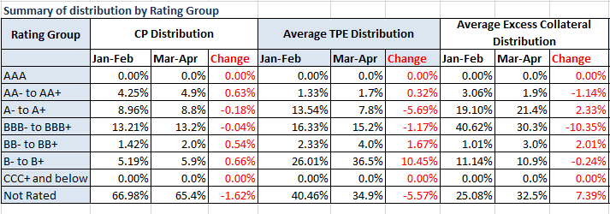
Credit Exposure Update
Summary statistics by rating group

Slide 7
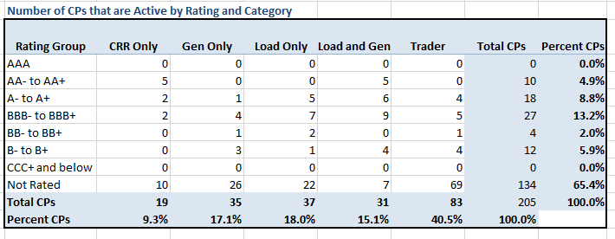
Credit Exposure Update
Active Counter-Parties distribution by rating and category

Slide 8
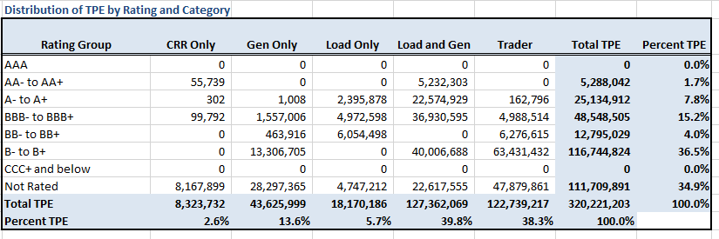
Credit Exposure Update
Average Total Potential Exposure distribution

Slide 9
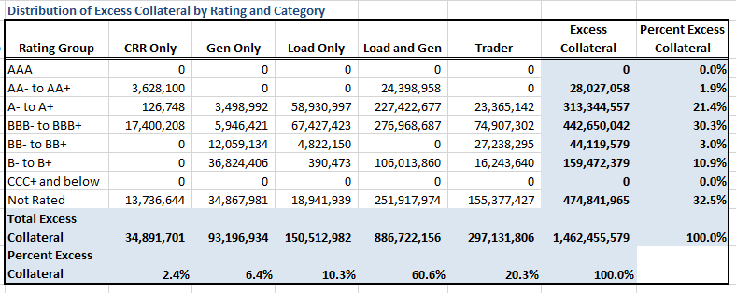
Credit Exposure Update
Average Excess Collateral distribution

Slide 10
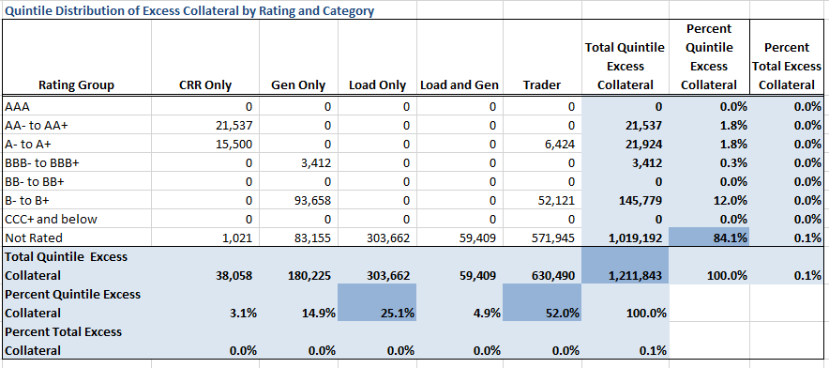
Credit Exposure Update
Average Excess Collateral distribution in the Bottom Quintile

Slide 11
Credit Exposure Update
Questions

