Slide 1
SMT Update To AMWG
MAY 2017

Slide 2
Monthly SMT Data Timelines AMWG CR 2014 002 End to End File Processing Completeness – MAY 2017
% Timely Market Delivery - % of files posted to market (FTPS) by 11:00pm out of # of files received by SMT by 11:00pm.
% Portal Data Availability - % of files loaded to the database for data availability on portal by 6:00am next day for the files received by 11:00pm
* A LSE file includes usage data for up to 50,000 ESIIDs.
2

Slide 3
SMT API and FTPS Services Availability – MAY 2017
The service availability is measured as a percentage of number of minutes the service was available out of the total number of minutes in a month, excluding planned outages.
Observed Anomalies:
Mar-Apr 2015: SMT outage and subsequent recovery/catch-up impacted API availability. FTPS was available for most of the part except on 03/21-03/22 for 36 hours.
26 Jul 2015: Services were unavailable for 12 hours due to Flash storage issue
25 Jan 2016: Services were unavailable for 19 hours due to storage configuration issue
07 Mar 2016: API Services were unavailable for 7hours due to Oracle archiver issue.
Notes:
3

Slide 4
SMT Number of Accounts by Type AMWG CR 2014 009 – MAY 2017
Registered Users | ONC | CNP | AEPN | AEPC | TNMP | TOTAL
Active Residential Accounts | 49104 | 27106 | 1871 | 5380 | 3233 | 86694
Active Residential English Accounts | 48903 | 26936 | 1865 | 5276 | 3224 | 86204
Active Residential Spanish Accounts | 201 | 170 | 6 | 104 | 9 | 490
Non Active Residential Accounts | 22229 | 14923 | 1753 | 3861 | 904 | 43251
Total Residential Accounts | 71333 | 42029 | 3624 | 9241 | 4137 | 129945
TDSP User | 336 | 31 | 12 | 18 | 1 | 398
TDSP Admin | 4 | 4 | 4 | 4 | 3 | 19
Small Business User | 96 | 48 | 1 | 1 | 2 | 148
Small Business Admin | 2937 | 1570 | 85 | 313 | 138 | 5194
Total Agreements (Includes Active and Pending) | 4471 | 2264 | 36 | 143 | 497 | 7411
Energy Data Agreements (Includes Active and Pending) | 4471 | 2019 | 36 | 143 | 497 | 7166
Han Device Agreements (Includes Active and Pending) | 0 | 244 | 0 | 0 | 0 | 244
Han Service Agreements (Includes Active and Pending) | 0 | 1 | 0 | 0 | 0 | 1
IN SMT
ESI IDs | 3536161 | 2460493 | 197788 | 867421 | 246830 | 7308693
Meters | 3475818 | 2460417 | 198591 | 867762 | 246367 | 7248955
HAN Devices | 3526 | 4532 | 141 | 284 | 29 | 8512
Acknowledgement | 0 | 0 | 0 | 0 | 0
Pending | 0 | 7 | 0 | 0 | 0
Meter Ready | 3 | 3 | 42 | 104 | 17
Provisioned | 3523 | 4522 | 99 | 180 | 12
HAN Messages (MTD) | 29 | 0 | 0 | 0 | 0 | 29
HAN Messages (YTD) | 45 | 0 | 0 | 0 | 0 | 45
HAN Messages (Cumulative) | 425 | 7405 | 0 | 0 | 0 | 7830
Simple Text Messages | 147 | 2930 | 0 | 0 | 0
Load Control Messages | 119 | 2658 | 0 | 0 | 0
Pricing Messages | 99 | 53 | 0 | 0 | 0
Cancellation Messages | 60 | 1764 | 0 | 0 | 0
Supplemental – (Friends)
Total Agreements | 1853 | 1445 | 81 | 94 | 64 | 3537
Accepted Agreements | 779 | 562 | 37 | 29 | 21 | 1428
Pending Agreements | 1 | 1 | 0 | 0 | 0 | 2
Revoked Agreements | 322 | 279 | 10 | 8 | 6 | 625
Expired Agreements | 713 | 572 | 32 | 57 | 37 | 1411
Terminated Agreements | 38 | 31 | 2 | 0 | 0 | 71
 | TDSPs | REP | Small Business | Regulatory | Third Party
Registered Entities | 5 | 115 | 5026 | 2 | 144
Registered Users | 398 | 838 | 148 | 8 | 26
Registered Admins | 19 | 175 | 5043 | 3 | 134
HAN Messages Sent By | 388 | 7418

Slide 5
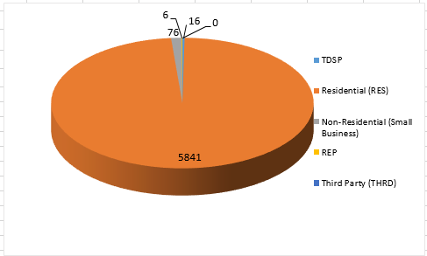
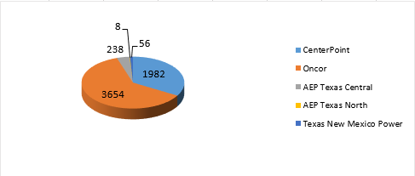
SMT ODR Details – MAY 2017
Total ODR Requests TDSP wise statistics:
Total ODR Requests User type statistics:

