Slide 1
RARF Dynamic Template Proposal
Dynamic Model Task Force
Jonathan Rose / Muhammad Khan
ERCOT Planning
June 7, 2017

Slide 2
Challenges
No standard model format
Models missing components / missing parameters
Very hard to maintain up-to-date cases. Models require manual translation to add to PSSE cases.
  Even when .dyr files submitted, require manual correction of bus numbers, equivalencing, etc.
No immediate feedback to developer if model is good

Slide 3
Benefits of Using Templates
Required information is clearly communicated to developer / manufacturer. No guesswork.
Expected to greatly reduce iterations
Format much easier to maintain over time
Reduce transcription errors
Less likely to have missing components

Slide 4
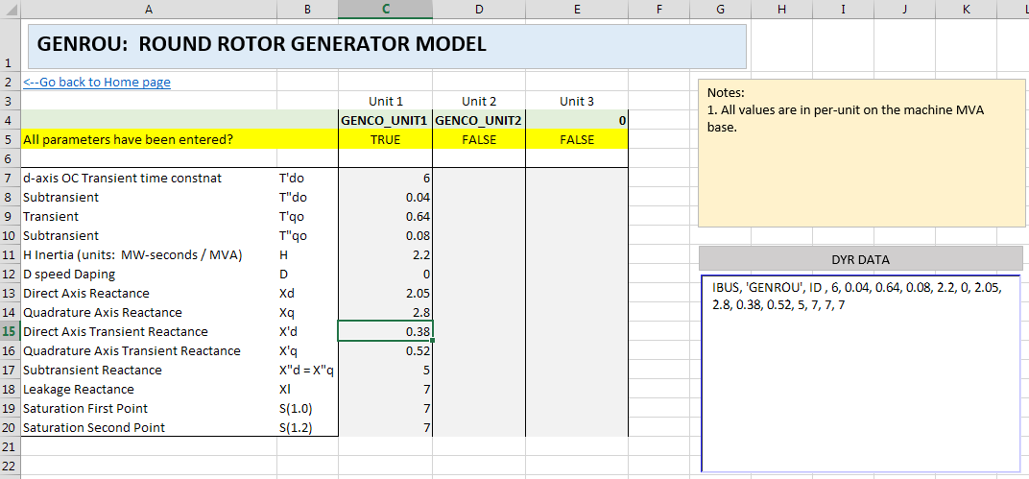
Example Fossil Template

Slide 5
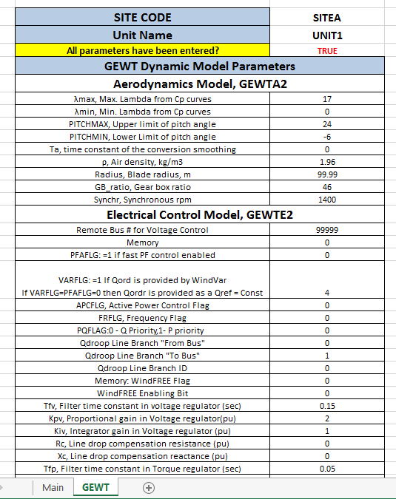
Example Wind Model Template

