Slide 1
PDCWG Report to ROS
Chair: Percy Galliguez, Brazos Electric Power Cooperative, Inc.
Vice Chair: Lei Ye, Austin Energy
ROS
June 8th, 2017

Slide 2
Report Overview & Notes
Report Overview
Meeting Minutes
BAL-001-TRE-1 FMEs & IMFR
0 FME in the month of April
Frequency Control Report
April Responsive Reserve Deployments

Slide 3
Meeting Minutes
PDCWG Meeting 5/10/17
GIC Model Workshop
GIC System Model Procedure Manual Walkthrough
Transformer Data Presentation
Substation Grounding Resistance Presentation
GIC System Model Supplemental Guidance
Regulation & Frequency Control Reports
GREDP Performance Analysis
NPRR 815 Discussion
MOD-026-1 & MOD-027-1 Discussion
NOGRR Proposal/Review Status

Slide 4
Frequency Measurable Events Performance
April 2017

Slide 5
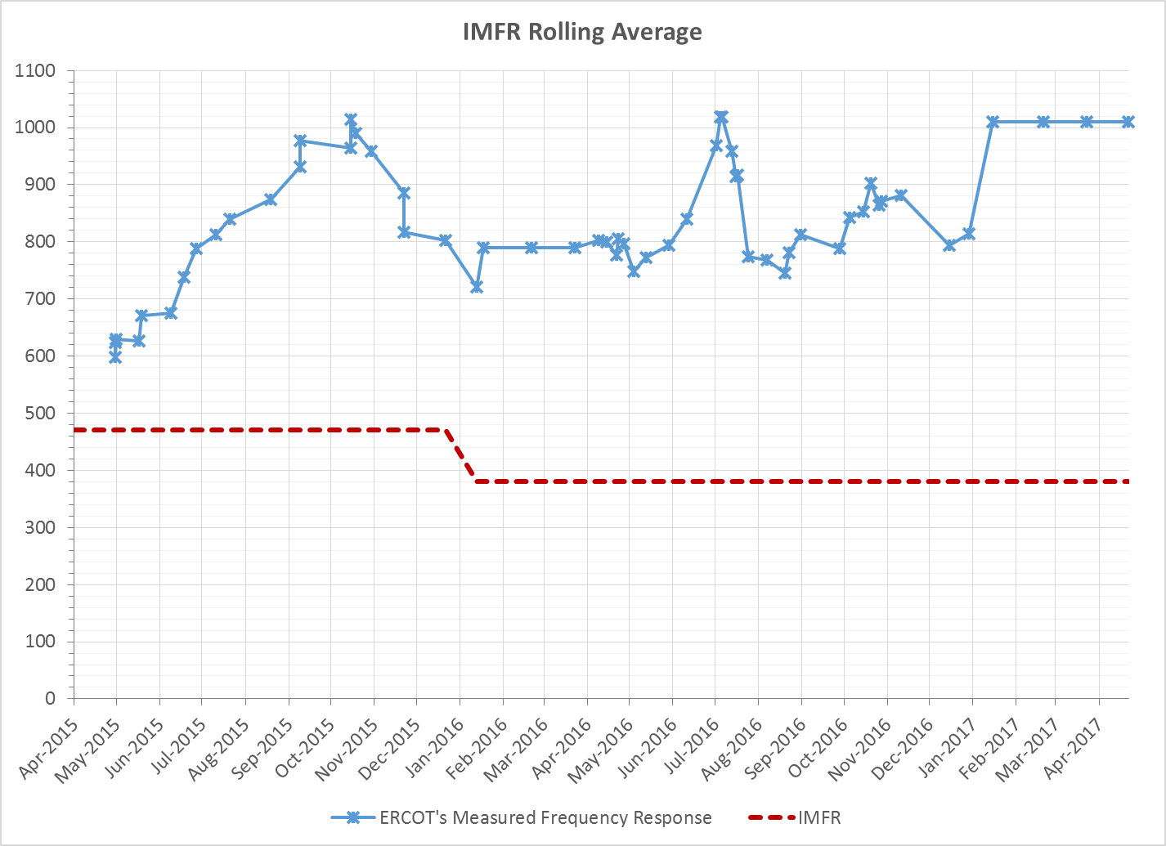
Interconnection Minimum Frequency Response (IMFR) Performance
IMFR Performance currently 1009.57 MW/0.1Hz

Slide 6
Frequency Control Report
April 2017

Slide 7
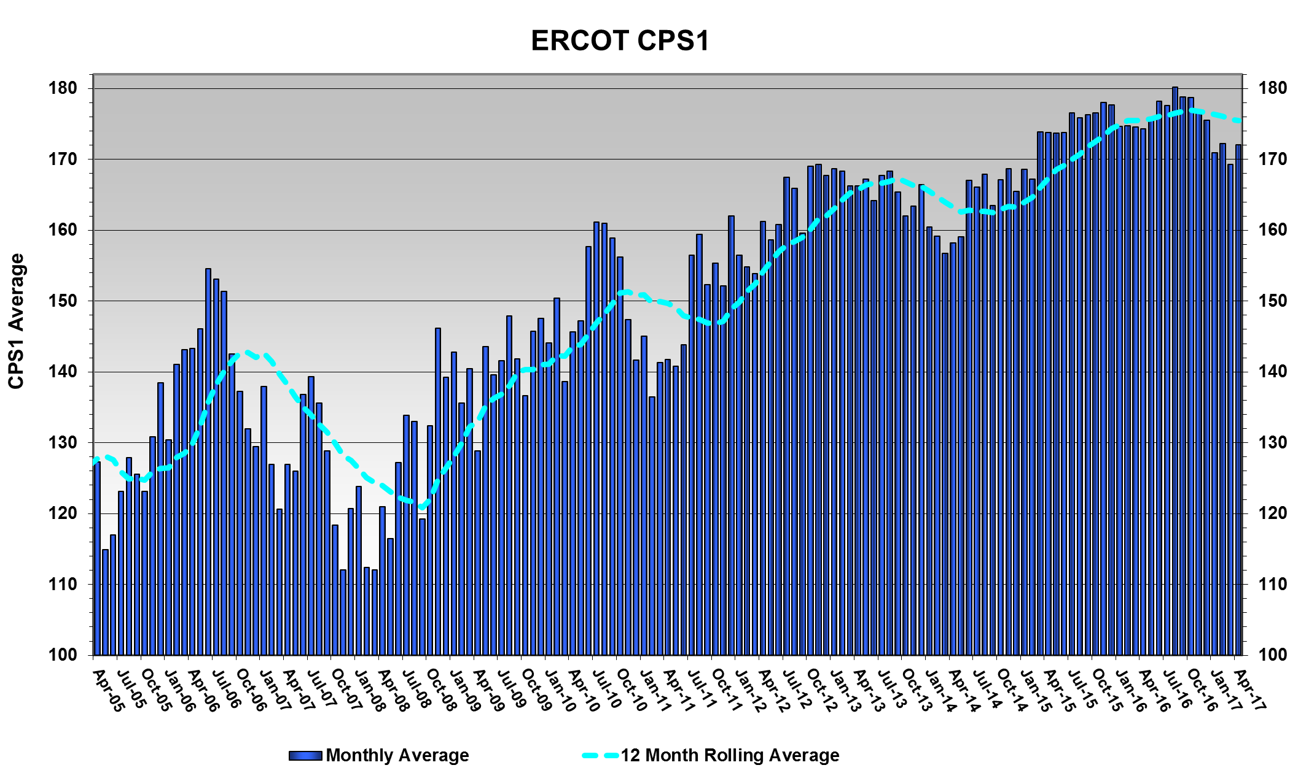
CPS1 Performance
CPS1 12 Month Rolling Average = 175.47%

Slide 8
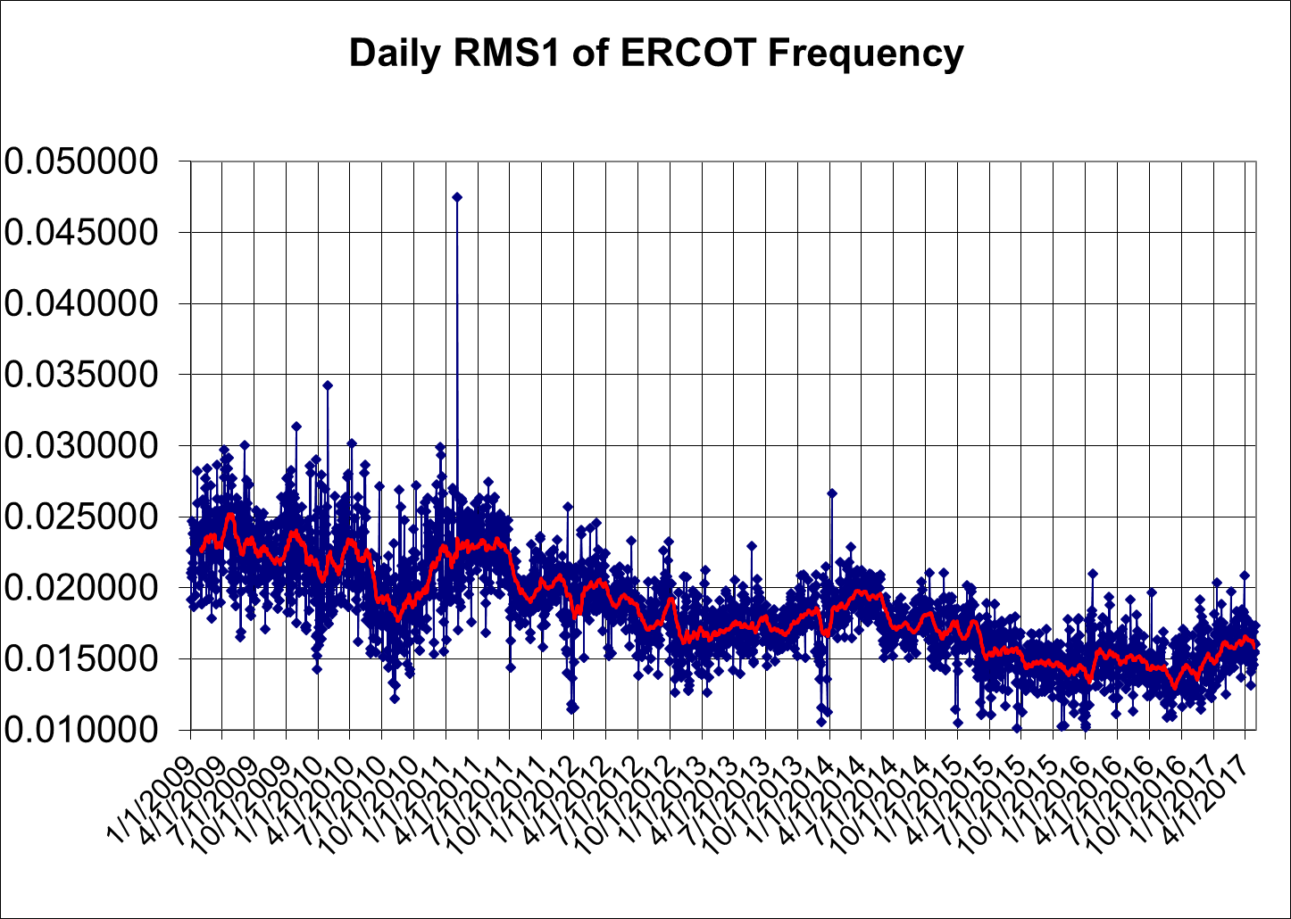
RMS1 Performance of ERCOT Frequency

Slide 9
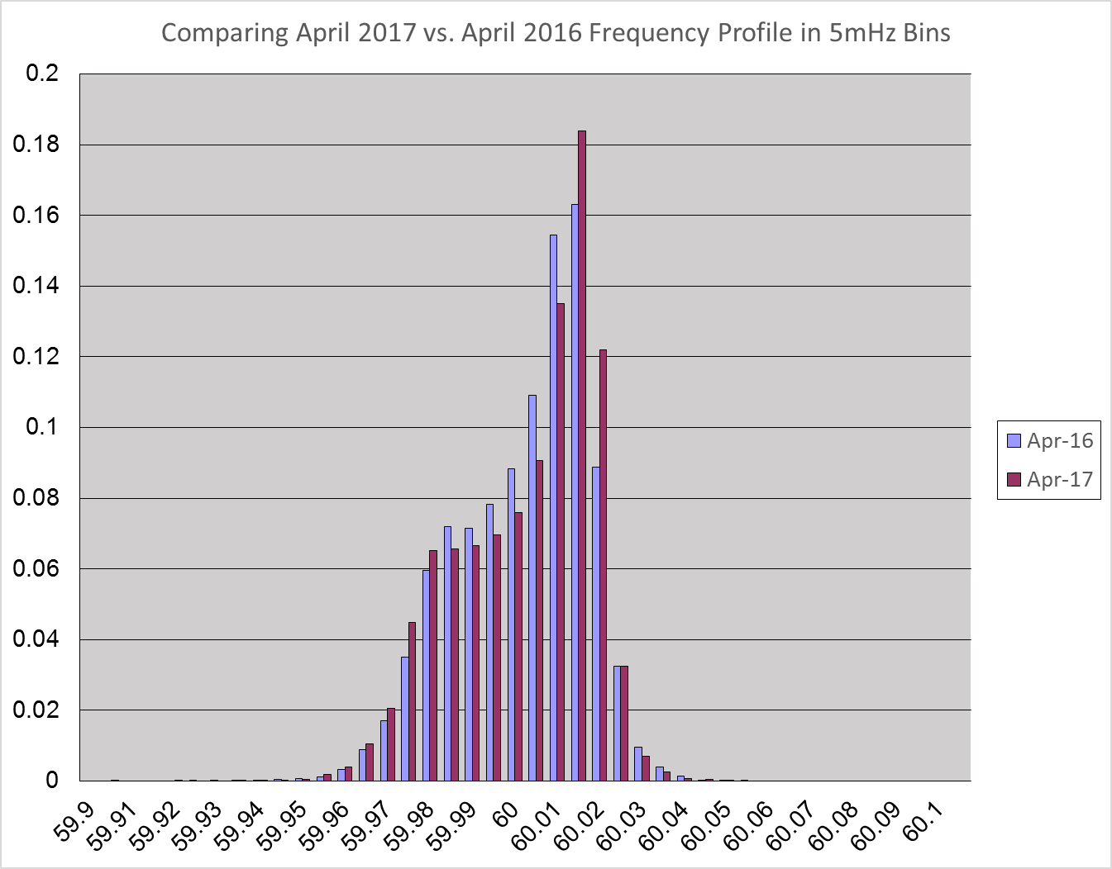
Frequency Profile Analysis
Year | Low Side (<60Hz) | High Side (>60Hz)
2016 | 170.87 | 177.12
2017 | 167.99 | 175.06
Year | Mean | Standard Deviation (from 60Hz)
2016 | 59.99979 | 0.015179
2017 | 59.99996 | 0.015838

Slide 10
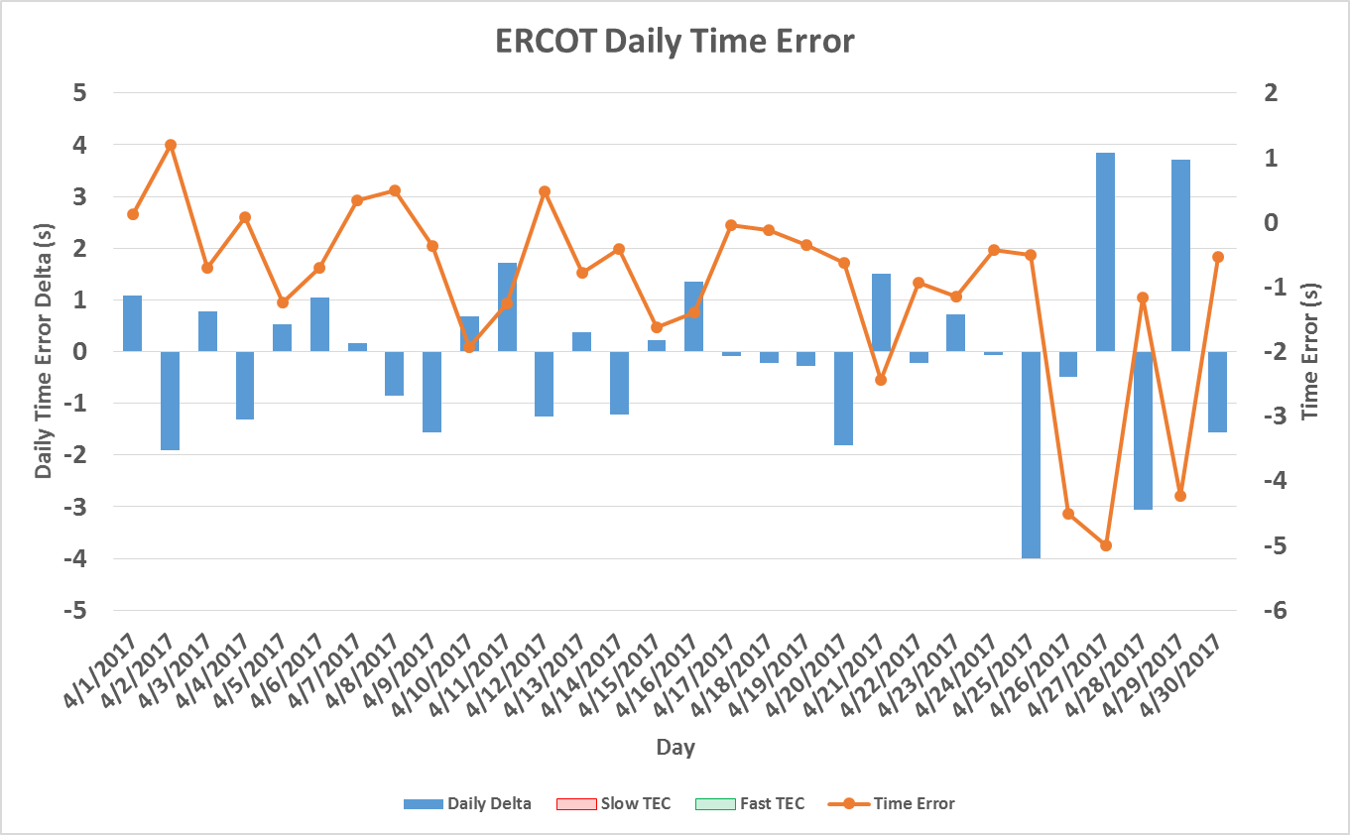
Time Error Corrections
There were no Time Error Corrections (TEC) in April
Notes:
TEC occurred on 12/03/2016 at 23:30. Time Error was 30.06

Slide 11
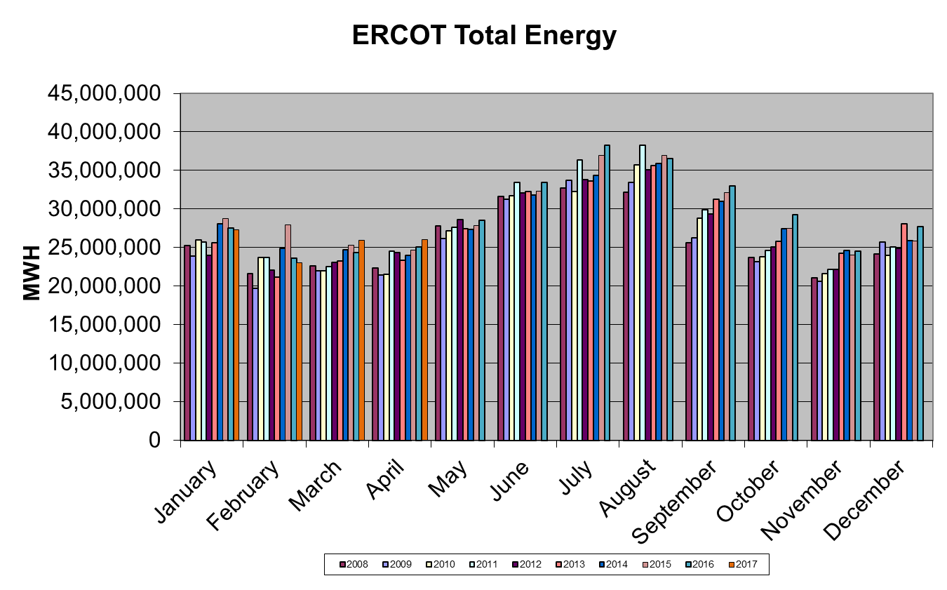
Wind Generation Performance

Slide 12
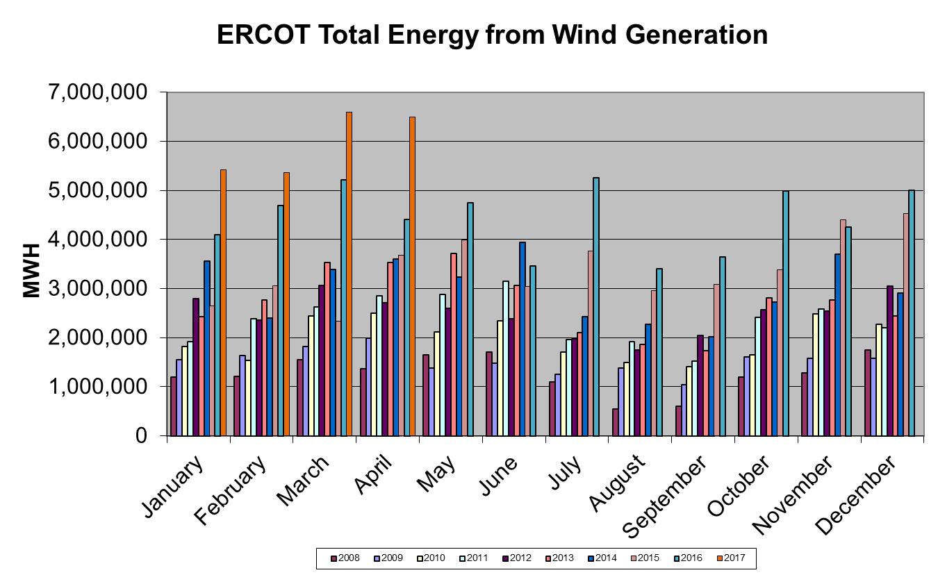
Wind Generation Performance

Slide 13
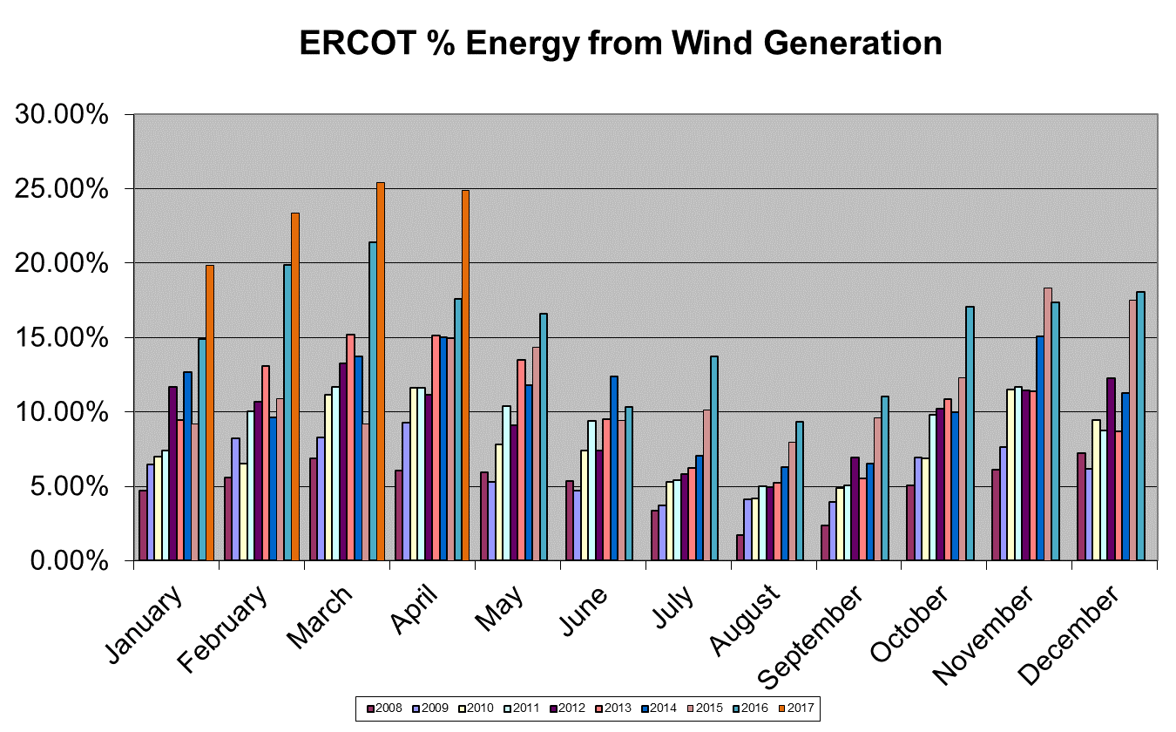
Wind Generation Performance

Slide 14
Responsive Reserve Deployments Deployed(3x) and Recalled(2x)
RRS Deployed(3x)-Usually from Regulation Up Exhaustion
1) Apr 26 2017 18:29:33 CST ERCOT Responsive Reserve Has Been Deployed Operational Information Active (No message of deployment recall cancelled)
2) Apr 14 2017 08:57:30 CST ERCOT Responsive Reserve Has Been Deployed Operational Information Active
-Apr 14 2017 08:59:30 CST ERCOT Responsive Reserve Has Been Recalled Operational Information Cancelled
3) Apr 10 2017 03:26:00 CST ERCOT Responsive Reserve Has Been Deployed Operational Information Active
-Apr 10 2017 03:28:16 CST ERCOT Responsive Reserve Has Been Recalled Operational Information Cancelled
RRS Recalled(2x)
1)Apr 16 2017 08:49:20 CST ERCOT Responsive Reserve Has Been Recalled Operational Information Cancelled
2)Apr 13 2017 09:18:04 CST ERCOT Responsive Reserve Has Been Recalled Operational Information Cancelled

Slide 15
Questions?

