Slide 1
Real-Time Co-optimization of Energy & Ancillary Services
SAWG
ERCOT
June 9th, 2017

Slide 2
RT Energy + Ancillary Service Co-Optimization
In order to implement Real-Time Energy and Ancillary Service Co-Optimization, there was consensus at May 8th SAWG meeting on the need to co-ordinate the values of:
  System Wide Offer Cap (SWOC)
  Value of Lost Load (VOLL)
  Maximum Value on the Power Balance Penalty Curve (PBPC)
  Maximum Value on the Ancillary Service Demand Curve (ASDC)

Slide 3
Examples of Values of VOLL, SWOC PBPC, and ASDC
 | Example 1 | Example 2 (Preferred) | Example 3
VOLL ($/MWh) | 18,000 | 9,000 | 9,000
SWOC ($/MWh) | 9,000 | 2,000 | 4,500
Max PBPC ($/MWh) | 18,001 | 9,001 | 9,001
Max ASDC ($/MW/h) | 9,000 | 7,000 | 4,500
Comments | Valid Observations of maximum submitted EOCs are $2,000 /MWh. Under these conditions, Energy prices at 18,000 will occur on rare occasions when PBPC is used More likely to achieve maximum shortage prices for energy in the range 9,000 to 11,000 rather than 18,000 | Valid More likely than other examples to achieve energy prices close to VOLL. SWOC of 2,000 $/MWh is within the range of observed submitted maximum offers | Valid Observations of maximum submitted EOCs are $2,000 /MWh. Under these conditions, Energy prices at VOLL will occur on rare occasions when PBPC is used More likely to achieve maximum shortage prices for energy in the range 4,500 to 6,500 rather than 9,000

Slide 4
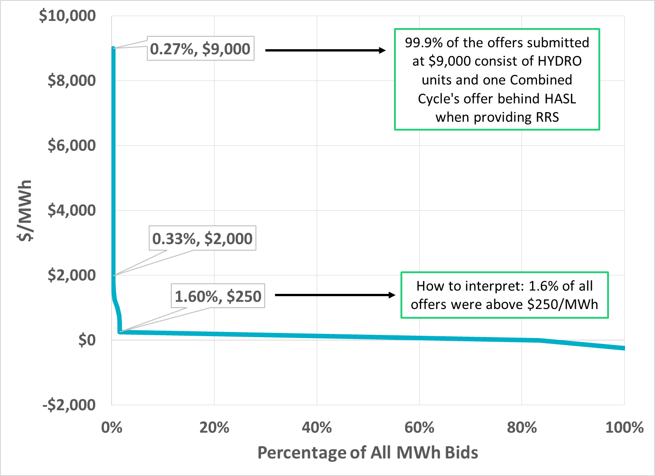
Duration Curve of Submitted EOCs
(June 2015-April 2017)

Slide 5
Submitted EOCs by Average MW (June 2015-April 2017)
Entire submitted energy offer curves were used except for RMR units and can include amounts over resources’ HSL
Total average MW totals over 120,000 MW due to counting multiple combined cycle configurations and wind units supplying offers up to total capacity
Resource Type | -250<=Price<250 | 250<=Price<2000 | 2000<=Price<4500 | 4500<=Price<7000 | 7000<=Price<9000 | 9000<=Price
CCGT90 | 56,949.2 | 45.7 | 0.4 | 0.6 | 7.8 | 0.1
CCLE90 | 6,150.6 | 2.6 | 2.9 | 2.0 | 3.2 | 95.9
CLLIG | 18,553.5 | 67.5 | 0.0 | 0.0 | 1.7 | -
DSL | 376.8 | - | - | - | 0.1 | -
GSNONR | 472.9 | 0.8 | - | - | 0.1 | -
GSREH | 7,715.6 | 7.7 | 1.8 | 2.6 | 10.5 | -
GSSUP | 1,650.5 | 13.4 | 0.0 | - | - | -
HYDRO | 0.6 | 22.6 | - | - | 27.0 | 229.5
NUC | 3,493.9 | - | - | - | - | -
PVGR | 118.2 | - | - | - | - | -
PWRSTR | - | - | - | - | 0.3 | -
RENEW | 321.2 | 19.0 | - | - | 14.5 | -
SCGT90 | 3,004.8 | 2.5 | 0.4 | 0.7 | 0.1 | -
SCLE90 | 2,601.3 | 1,351.2 | 1.8 | - | - | 0.0
WIND | 17,957.3 | 2.1 | - | 0.0 | - | -

Slide 6
DAM Ancillary Service Prices
(February 2,3 and August 3,4,5)

Slide 7
February 2, 2011 – DAM AS Prices

Slide 8
February 3, 2011 – DAM AS Insufficiency
Hour Ending | RRS Shortage
HE 7 | 154 MW
HE 18 | 22 MW
HE 19 | 10 MW
From the start of Nodal go-live, February 3rd is the only instance when DAM AS insufficiency occurred

Slide 9
February 3, 2011 – DAM AS Prices

Slide 10
August 3, 2011 – AS Prices

Slide 11
August 4, 2011 – DAM AS Prices

Slide 12
August 5, 2011 – DAM AS Prices

Slide 13
RT Co-Optimization: How does SASM process fit in?
With RT co-optimization, Ancillary Services procurements are reassigned every 5 minutes (nominally).
  Thus, if for whatever reason a QSE’s Day-Ahead AS responsibility cannot be provided, and, there is sufficient capacity available, then RT co-optimization will economically procure the required AS in a seamless fashion
Current thinking is that the SASM process will NOT be needed under RT-co-optimization
The RUC process that ensures sufficient capacity to meet load forecast and Ancillary Service requirements will be used to meet the scenario where a QSE reports to ERCOT that it cannot meet its Day-Ahead AS responsibility for future hours
RUC engine (DRUC,HRUC,WRUC) will be modified to include co-optimization.
  RUC process will commit sufficient capacity to meet load forecast and AS for the RUC study horizon
  Not protect HASL – allows for improved congestion management
  Discussion needed on which Resources can provide AS in the RUC study

