Slide 1
Discussion on Recent Market-Facing Report Questions
QSE Managers Working Group
June ’17

Slide 2
Introduction
Following the recent review of two market-facing reports, questions were raised which ERCOT staff wants to discuss with stakeholders
The two reports are:
Short-Term System Adequacy Report
48-Hour Highest Price AS Offer Selected
Both are posted on the MIS Public Area
This presentation will share those questions, propose some changes, and provide some insight on how those changes may impact the data in the report

Slide 3
The Short-Term System Adequacy Report
The question raised was which Resource statuses are included in the columns “TotalCapGenRes” and “OfflineAvailableMW”
For “TotalCapGenRes,” all Resource Statuses listed in Protocol 3.9.1(5)(b)(i) that can be used for the submittal of a Current Operating Plan (COP) are included in the calculation with the exceptions of “ONRR” and “OFFQS”
This is a function of the ambiguity of “available On-Line Resources” and the status definitions
For “OfflineAvailableMW,” the report logic is focused on the Resource Statuses listed in 3.9.1(5)(b)(ii) and includes “OFF” and “OFFNS”

Slide 4
The Short-Term System Adequacy Report
This poses some misalignments with what stakeholders may be expecting
To address this, ERCOT is proposing to:
Change the report logic to include Resources with a Resource Status of “ONRR” or “OFFQS” when determining the “TotalCapGenRes” value
Author an NPRR that provides more clarity as to the Resource Statuses including when the determining values for the two columns

Slide 5
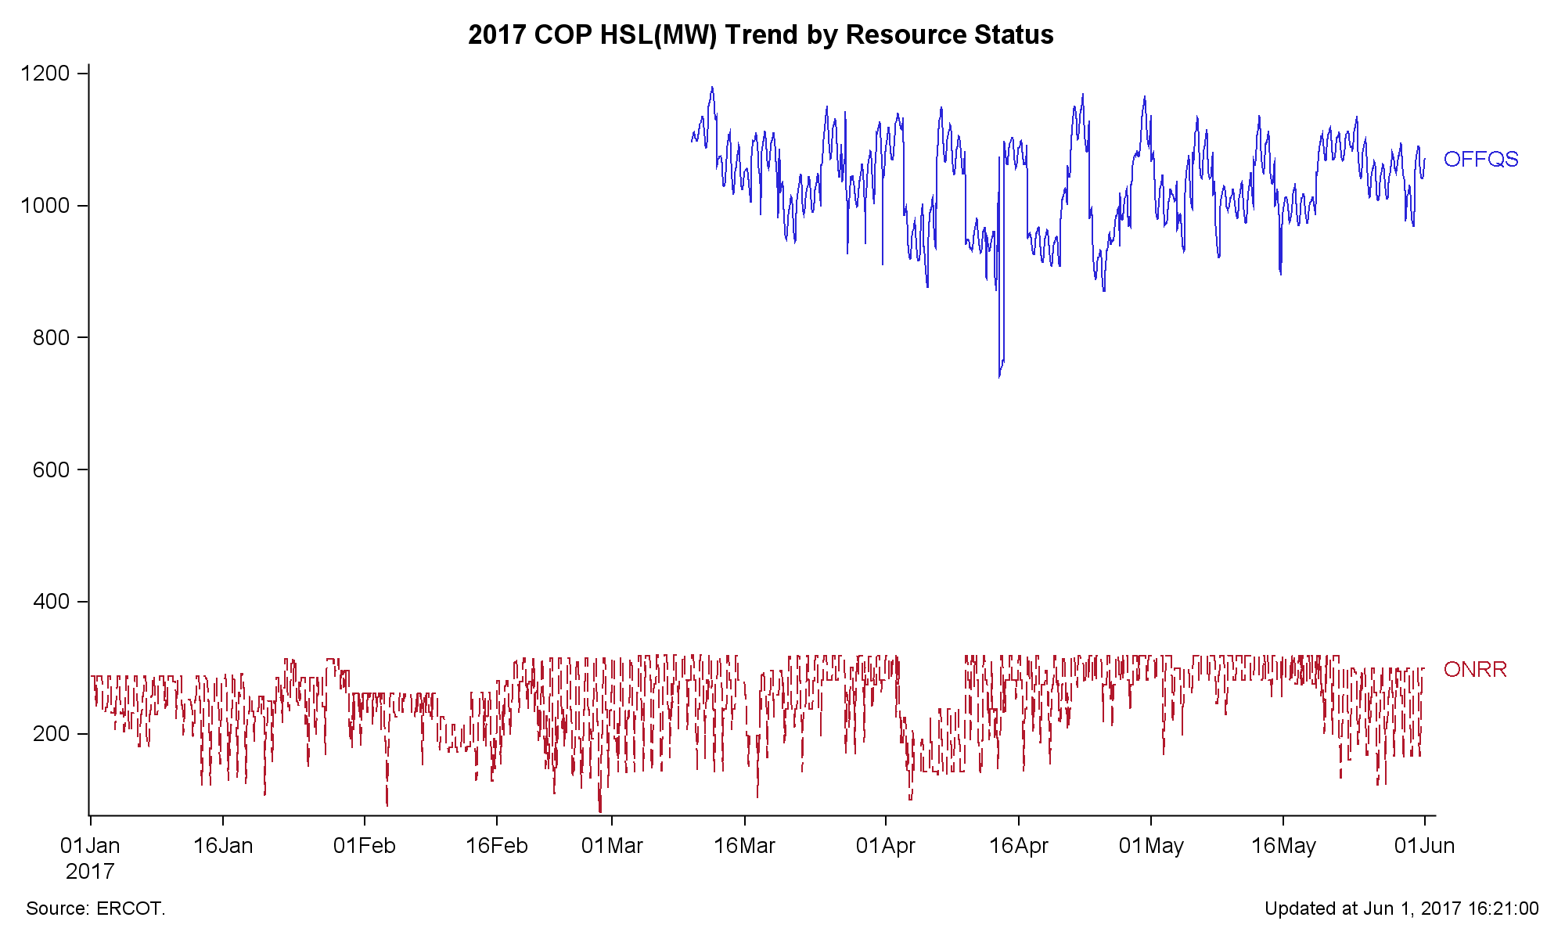
The Short-Term System Adequacy Report
The graph above provides some insight into how the proposed change may impact the report values, using data from the last submitted COPs as an example

Slide 6
48-Hour Highest Price Ancillary Service Offer Selected
The question raised for this report was whether or not this report was specific to the Day-Ahead Market (DAM)
Since its initial design, this report is specific to the DAM and does not consider the outcomes of any subsequent Supplemental Ancillary Service Market (SASM)
For this case, the language is again ambiguous

Slide 7
48-Hour Highest Price Ancillary Service Offer Selected
For this case, ERCOT is proposing to:
Change the report logic to consider both DAM and SASM outcomes when determining the highest-priced Ancillary Service (AS) Offer selected for a given Operating Hour and AS type
Author an NPRR that provides more clarity as to which markets are considered

Slide 8
48-Hour Highest Price Ancillary Service Offer Selected
Between 2016 and 2017, there have been 19 unique SASMs
The numbers indicate how frequently this change would have impacted the report and are relative to the 8,700+ hours in a year

