Slide 1
Emergency Response Service Analysis during 4CP/Near 4CP and Pricing Event Days
Mark Patterson
Manager, ERCOT Demand Integration

Slide 2
ERS Response During 4CP Days and near 4CP Days
Analysis performed by ERS resource type (ERS Load default baseline, ERS Load alternate baseline, ERS Gen)
August 11th was chosen for the 4CP day for analysis because it showed the largest MW reduction for the ERCOT system for any of the 4CP days during 2016.
September 8th was chosen as the near 4CP day for analysis because it showed the largest MW reduction for the ERCOT system for any of the 14 near 4CP days
Only ERS Loads reviewed for 4CP and near 4CP
Average SPP is the average of the four load zone prices

Slide 3
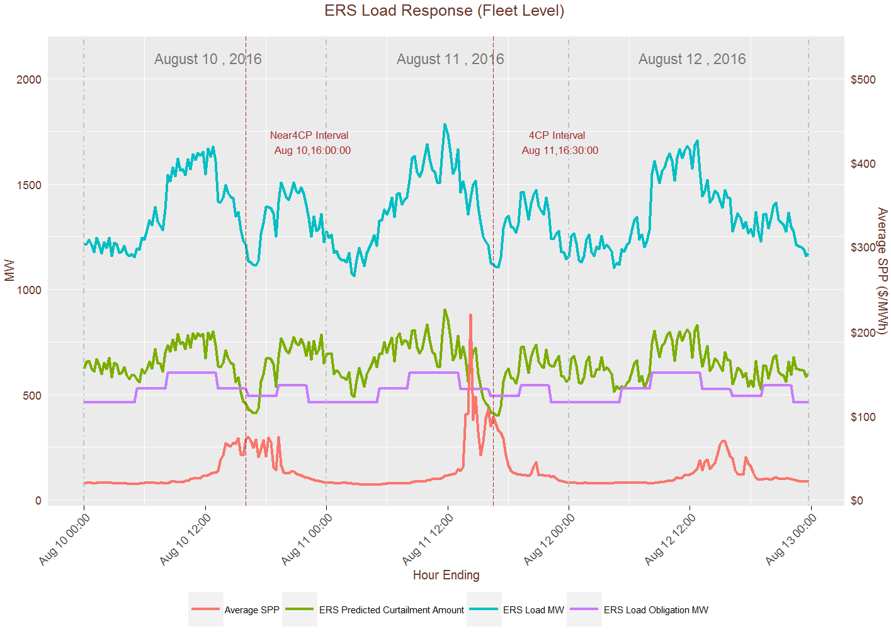

Slide 4
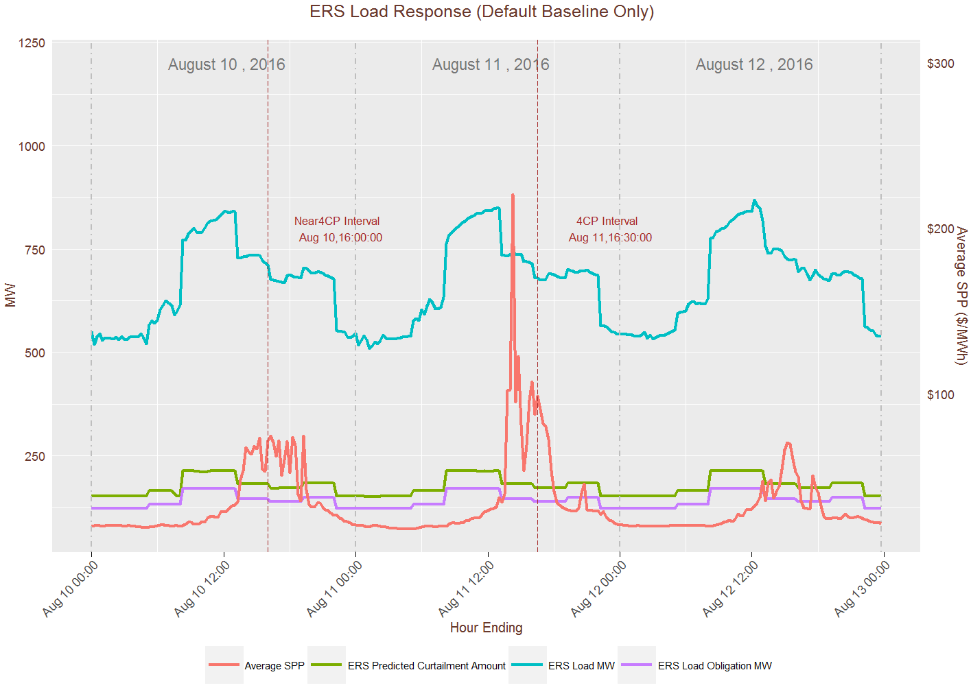

Slide 5
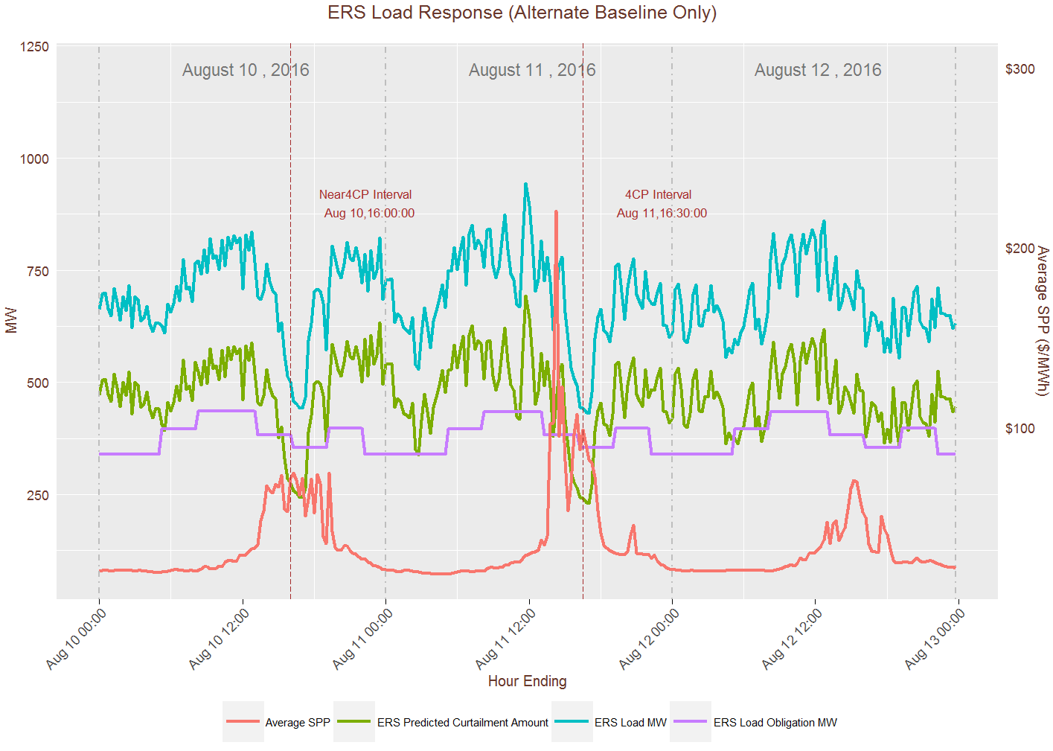

Slide 6
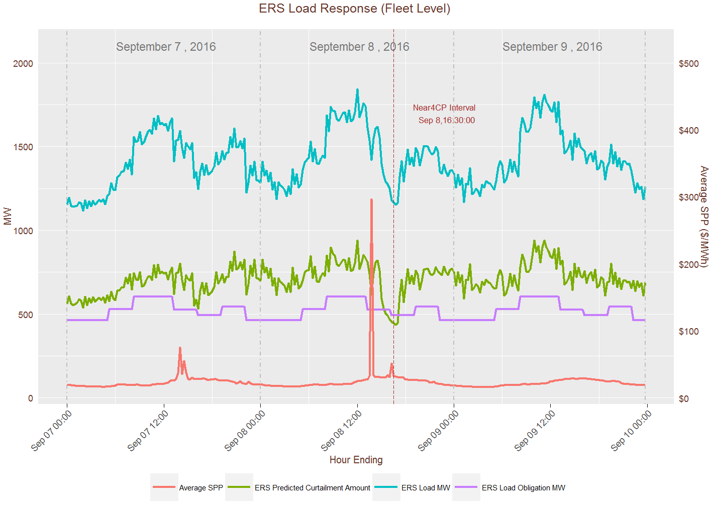

Slide 7
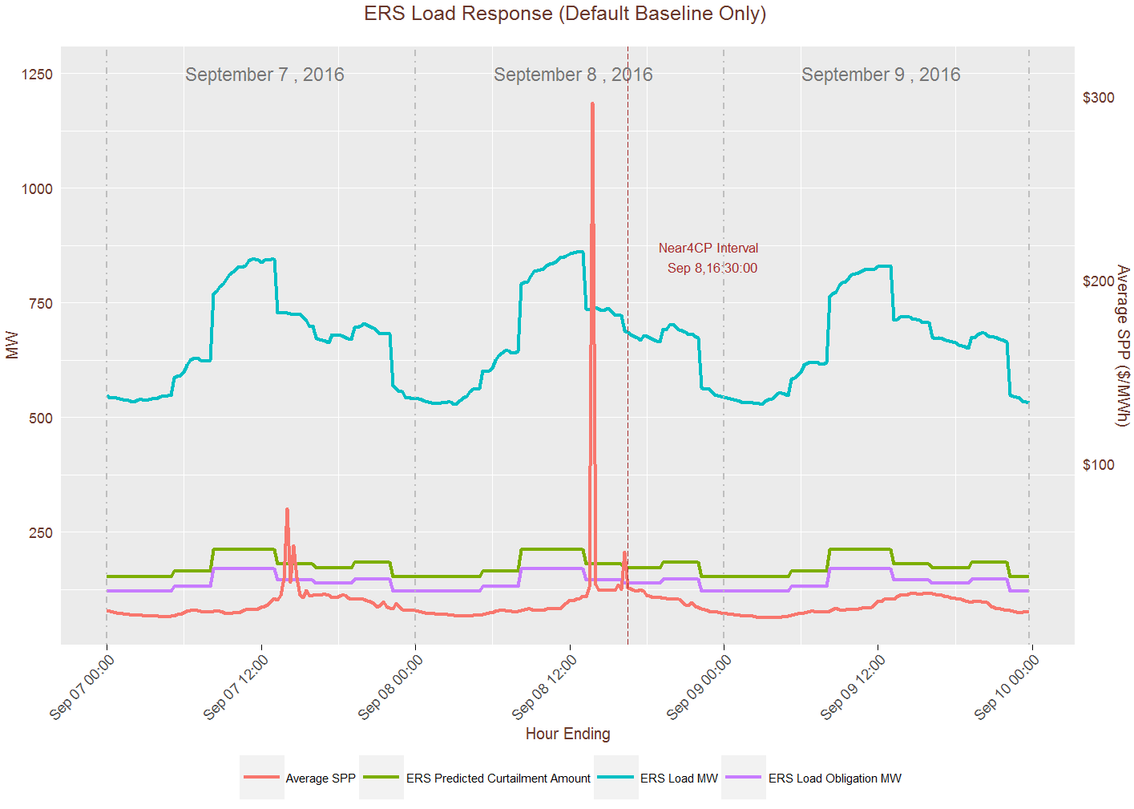

Slide 8
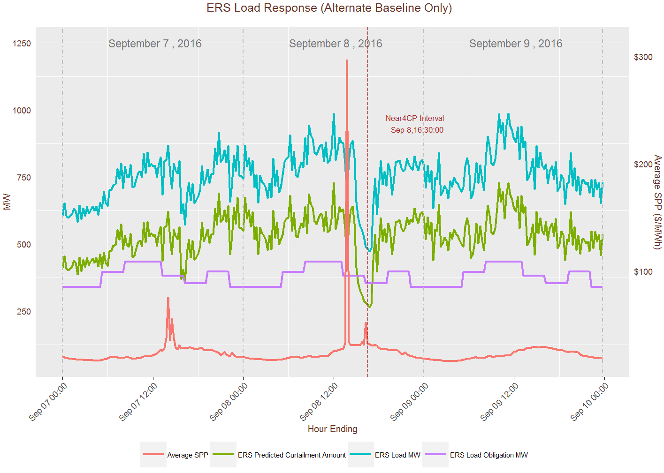

Slide 9
ERS Response during Pricing Event Days
Day when prices were over $200 for 4 consecutive intervals
November 29th was the largest price response by ESI-IDs on real-time pricing or block and index in 2016. This should provide a worst case scenario for the ERS fleet responding to prices.
August 2nd was chosen because it was both a pricing event and near 4CP day

Slide 10
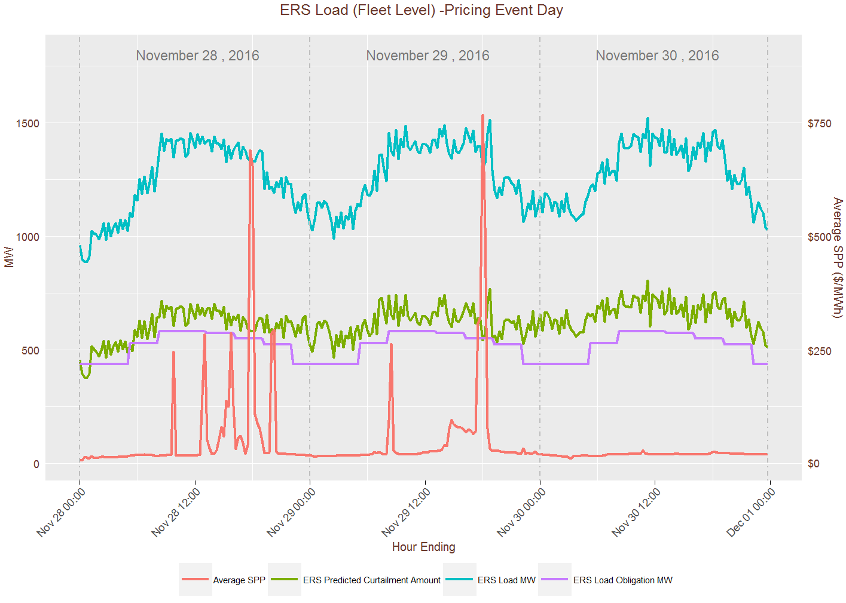

Slide 11
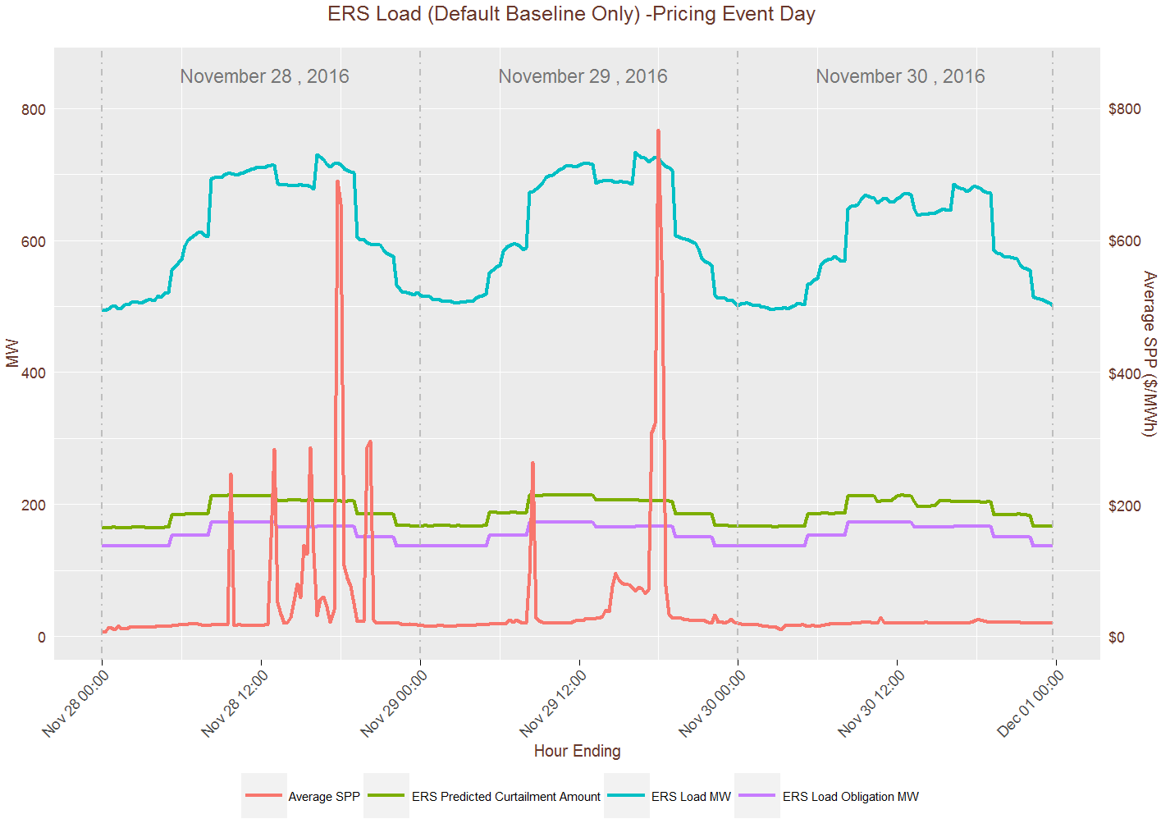

Slide 12
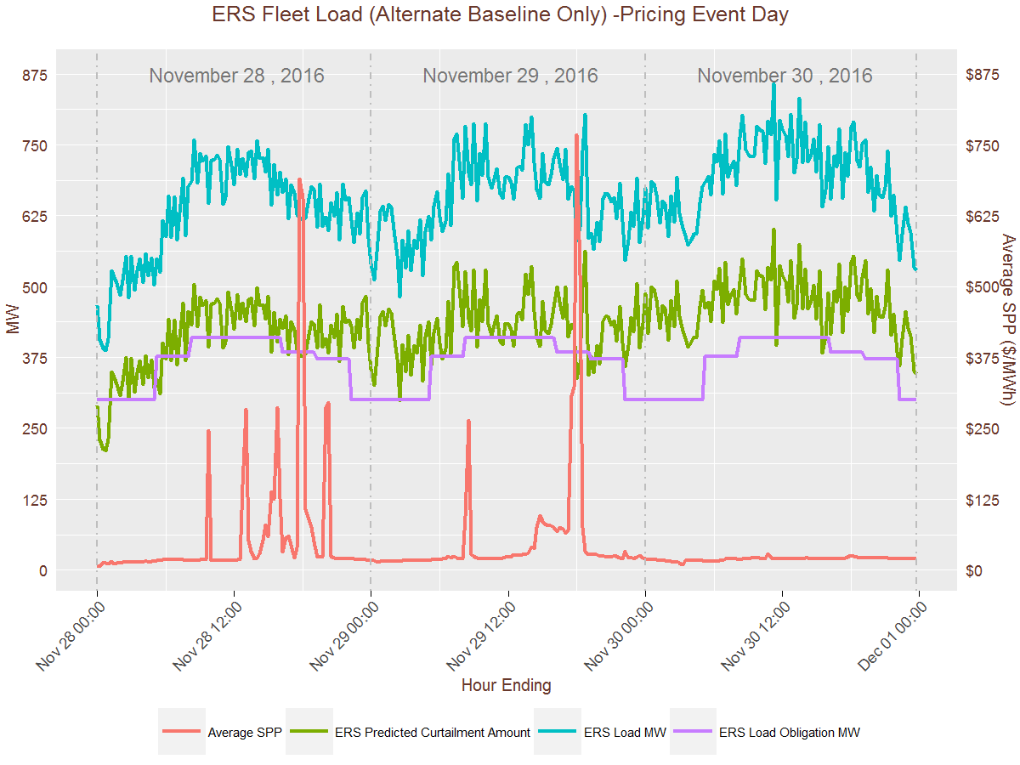

Slide 13
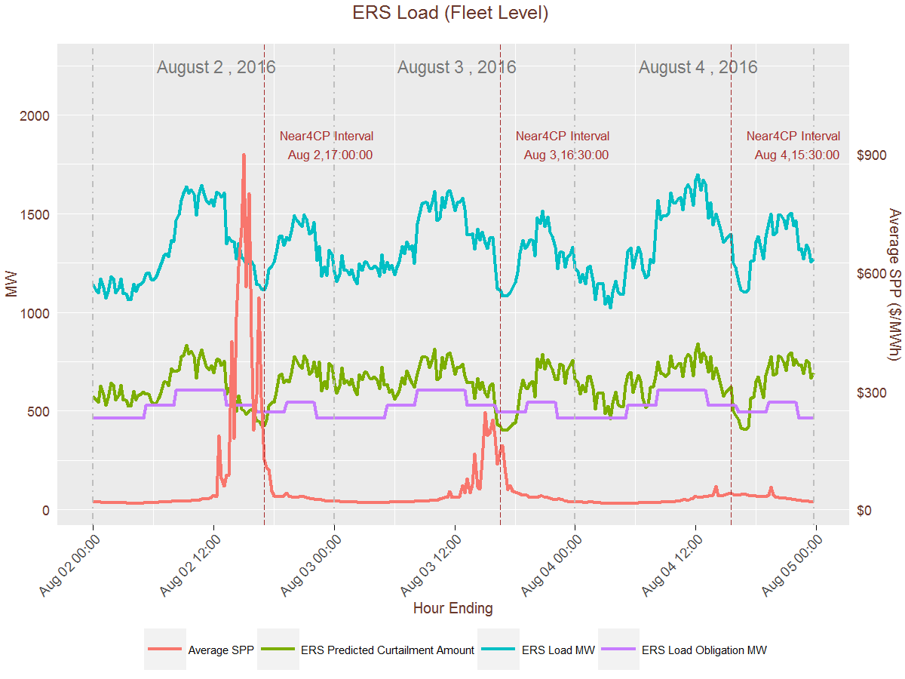

Slide 14
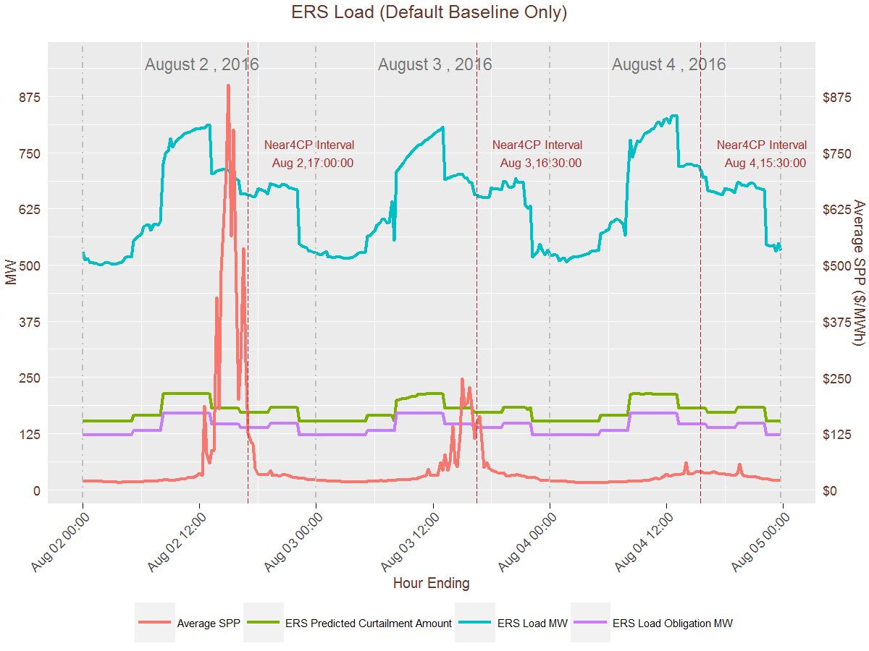

Slide 15
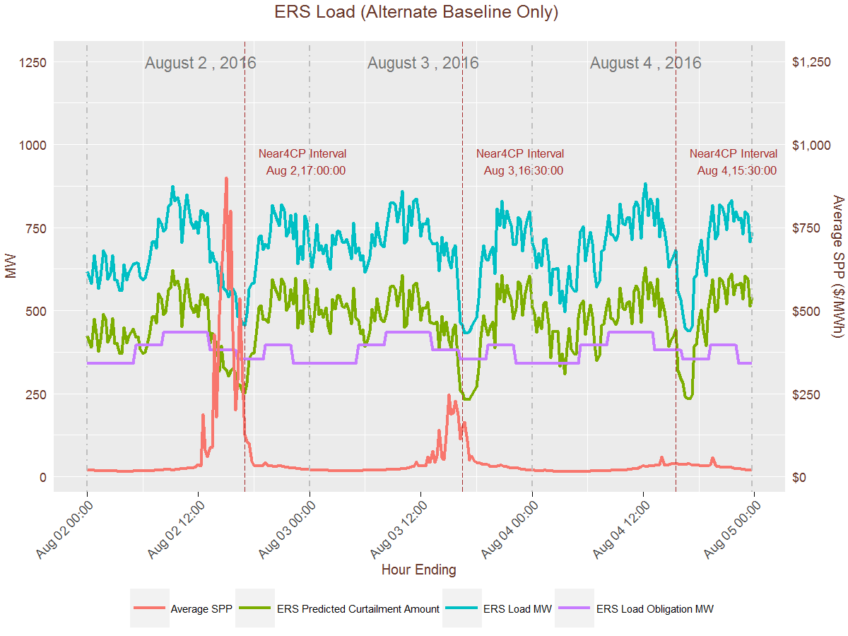

Slide 16
ERS Generator Response during Pricing Event and near 4CP Day
ERS Generator fleet obligation ≈ 310 MWs
ERS generators that deploy only for emergencies/ERCOT instruction have a total ERS Obligation ≈ 14 MWs (not included in this analysis).
ERS generators that also deploy outside of emergencies have a total ERS Obligation ≈ 296 MWs
November 29th was the largest price response by ESI-IDs on real-time pricing or block and index in 2016. This should provide a worst case scenario for the ERS fleet responding to prices.
August 2nd was chosen because it was both a pricing event and near 4CP day

Slide 17
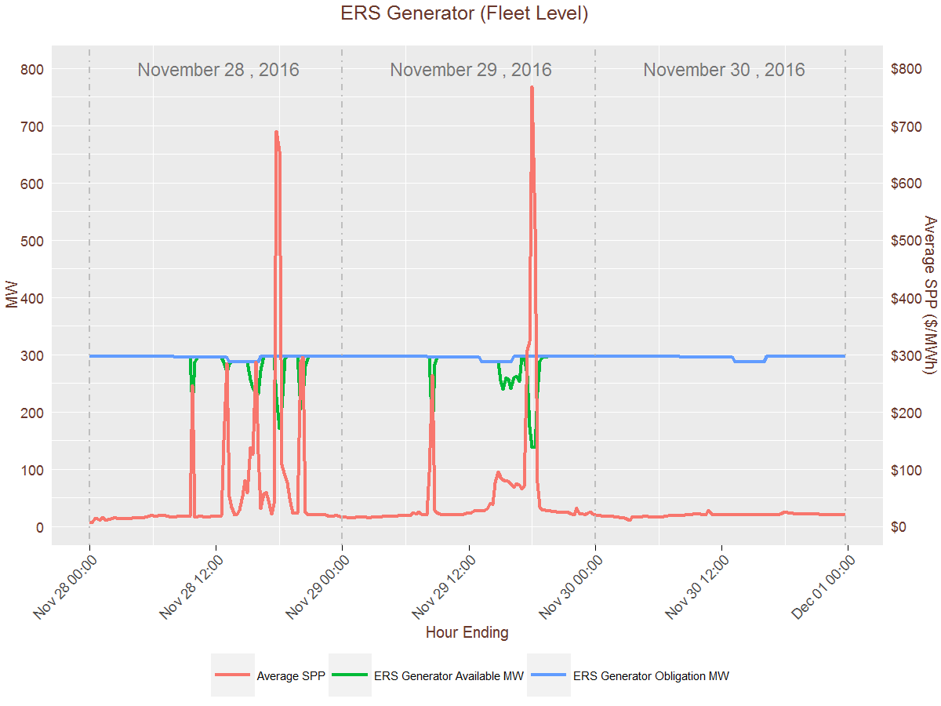

Slide 18
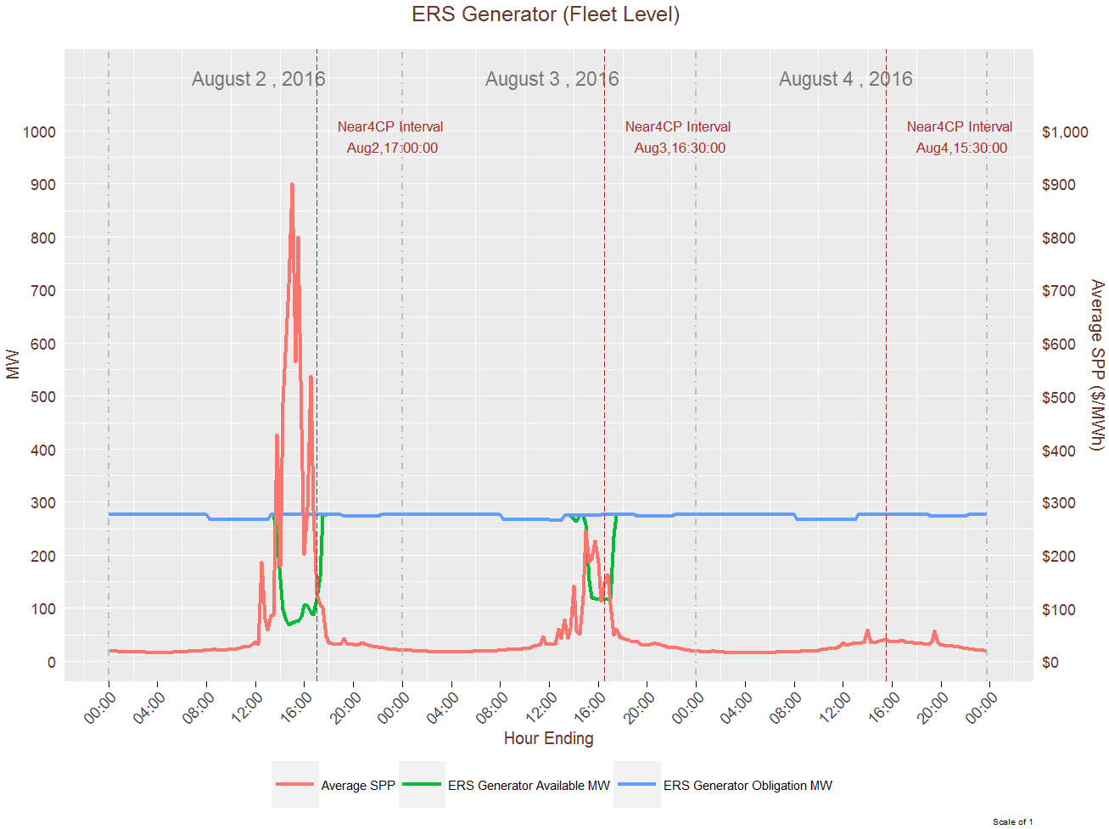

Slide 19
Summary of Analysis
ERS Load on default baseline did not show a discernible response to pricing or 4CP/near 4CP events.
ERS Load on alternate baseline did provide noticeable response during 4CP/near 4CP events but to a much lesser degree during pricing events.
ERS Gen responds regularly during pricing events.

