Slide 1
Wind Generation Operations
Challenges And Expectations
Operations Planning Staff
ERCOT

Slide 2
Objectives
List challenges in forecasting wind in Texas.
List actions a Wind facility experiencing icing issues should take.
Given an example of telemetry being received from a renewable resource, determine if it is an issue and whether the QSE representing this resource should be contacted to rectify the issue.

Slide 3
Wind Generation and Wind Forecasting in ERCOT

Slide 4
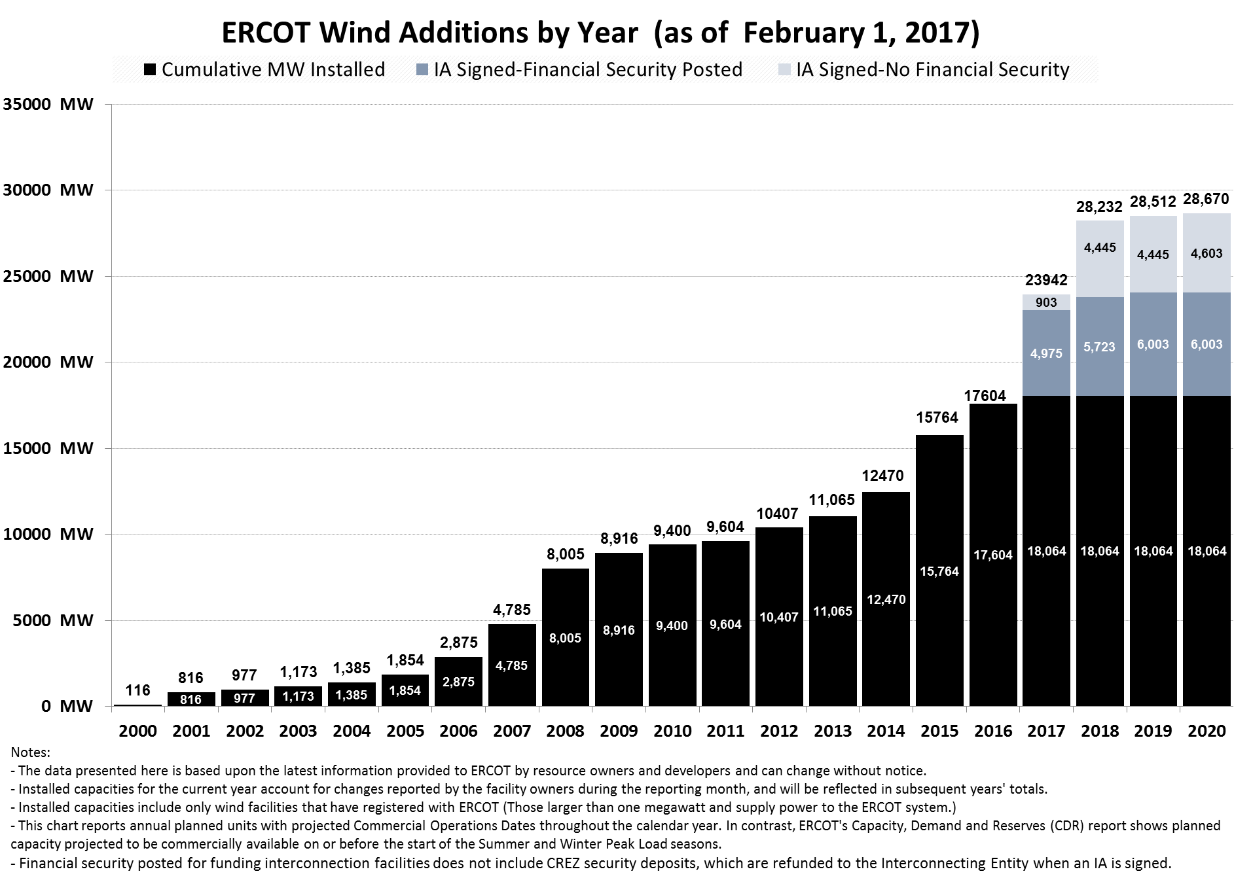
Wind Growth Potential

Slide 5
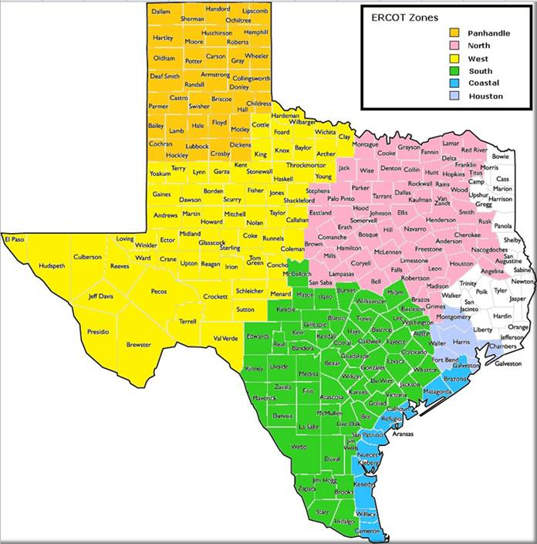
Wind Regions within ERCOT
Panhandle:
4,037 MW
North:
1,049 MW
West:
10,398 MW
Coast:
2,161 MW
South:
1639 MW
Notes:
1639 South
10398 West
4037 Panhandle
2161 Coast
1049 North

Slide 6
Wind Records
TIME | LOAD (MW) | WIND GENERATION (MW) | PENETRATION AT RECORD TIME
03/31/2017 20:56 | 40,863 | 16,141 | 39.50%
03/23/2017 03:50 | 28,780 | 14,391 | 50.00%

Slide 7
Wind Generation Forecast
AWS Truepower computes a Short Term Wind Power Forecast (STWPF) for all Wind-powered Generation Resources (WGR) in ERCOT for a rolling 168 hour timeframe.
This process uses information from multiple systems, including:
  RARF (Resource Asset Registration Form) (ex. site geo-location, met tower geo-location)
  EMS (Energy Management System) (ex. Resource Status, telemetered site specific meteorological data)
  Outage Scheduler (ex. WGR derate start/stop dates, derate values)
When submitting COPs, Wind QSEs must use this STWPF for the applicable 168 hours timeframe. (COP HSL must be <= STWPF.)
  Note that NPRR 785, upon approval will only require Wind QSEs to update a COP only when wind farm operating conditions dictate COP HSL to be lower STWPF.
*Note that for a WGR going through commissioning process, ERCOT will start providing STWPF to the QSE once WGR receives approval to Generate into the ERCOT Grid (Part II of the Commissioning check list)

Slide 8
WPF Process Inputs
Source | Data
Registration System | Resource Name Location of wind farm (latitude and longitude or equivalent for the center point of wind farm) Location of the meteorological tower (latitude and longitude or equivalent) Type (manufacturer/model) and number of turbines Turbine hub height(s) above ground level with associated number of turbines Manufacturer’s power curve (capability curve) Resource Commercial Operation Date
Energy Management System (EMS) | Most recent Resource (wind farm) status with date/time Most recent MW output of wind farm with date/time Most recent wind speed and direction at hub height from one meteorological tower with date/time Temperature and barometric pressure at 2 m above ground level on the meteorological tower
Telemetry Value (Sent every 5 minutes from EMS) | MW Average Wind Speed (mph) Wind Direction (degrees) Temperature (ºC) Barometric Pressure (mbar) HSL Average Num of Turbines ON Num of Turbines Off Num of Turbines Unknown Curtailment Flag
Outage Scheduler | Turbine Outage/Unit Derate Value (HSL) Turbine Outage/Unit Derate Start Turbine Outage/Unit Derate Stop

Slide 9
RRGRR-0003
A survey was conducted in 2015 to gather additional information to gauge the operational limits of the various WGRs in ERCOT.
    Maximum Operating Temperature (Fahrenheit (°F))
    Minimum Operating Temperature(Fahrenheit (°F))
    High Wind Speed Cut-Out (meters per seconds (m/s))
    High Wind Speed Cut-Out time (minutes)
    High Wind Speed Cut-Out Reset (meters per seconds (m/s))
    High Wind Speed Cut-Out Reset Time (minutes)
  This information is now part of the RARF and is fed into the wind forecast received from AWS.

Slide 10
NPRR 785
Synchronizes Short Term Wind Forecast (STWPF) with Current Operating Plan (COP) of Wind Generation Resources (WGRs) and Photovoltaic Generation Resources (PVGRs)
  ERCOT will automatically prepopulate every WGR and PVGR’s COP with most recent forecast for the next 168 hours.
  QSEs representing WGRs or PVGRs will be required to either submit a COP with the automatically prepopulated forecast or submit a lower number (when wind farm operating conditions dictate COP HSL to be lower STWPF).

Slide 11
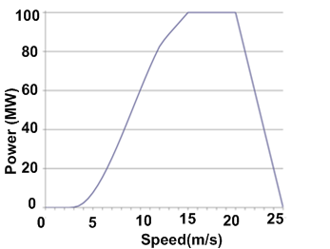
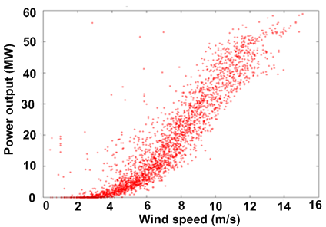
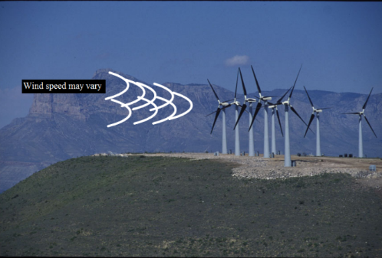
Challenges in Forecasting Wind
Relatively concentrated geographic region for wind installation (lack of spatial diversity)
Texas weather can change rapidly
Severe changes in wind generation output caused by different types of extreme weather (large wind ramps)
  Frontal system, trough, or dry line/Thunderstorms/Low-level jets/Weakening pressure gradients/Strengthening pressure gradients
There is an approximation of hypothetical wind speed-power curve to the real one
Hypothetical
Power Curve
Actual Wind Farm
Power
*The steep part of the power curve from 4-12 m/s is where power increases strongly with speed.

Slide 12
Wind Forecast Errors (Day-Ahead)
–
–

Slide 13
Wind Forecast Errors (Hour-Ahead)
–
–

Slide 14
Objectives
List challenges in forecasting wind in Texas.
List actions a Wind facility experiencing icing issues should take.
Given an example of telemetry being received from a renewable resource, determine if it is an issue and whether the QSE representing this resource should be contacted to rectify the issue.

Slide 15
Wind Generation Cold Weather Preparation

Slide 16

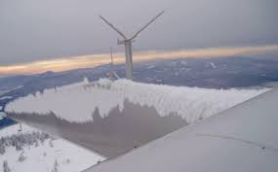
Icing Impacts
Source: Wind Turbines in Cold Climates: Icing Impacts and Mitigation Systems, http://www.springer.com/us/book/9783319051901

Slide 17
Wind Units Failure in Cold Winter
Frigid Temperatures Exceeds Turbine Limits
  Wind turbines are typically designed to operate within ambient air temperatures of -15°C/-20°C (5F/-4F)
  Wind turbines have an automatic shutdown feature to protect components if that range is exceeded.
Blade Icing
  Icing on wind turbines affects three different aspects simultaneously
    the design (aerodynamics, load, control system, and material)
    the safety (ice throw, unbalanced rotor spinning, over-power, and fatigue)
    performance (annual energy output, wind measurements, and design life duration)
  Other impacts
    wind sensors—rendering ineffective wind-measuring equipment
    increase noise levels and generally decrease a turbine’s cost-effectiveness.

Slide 18
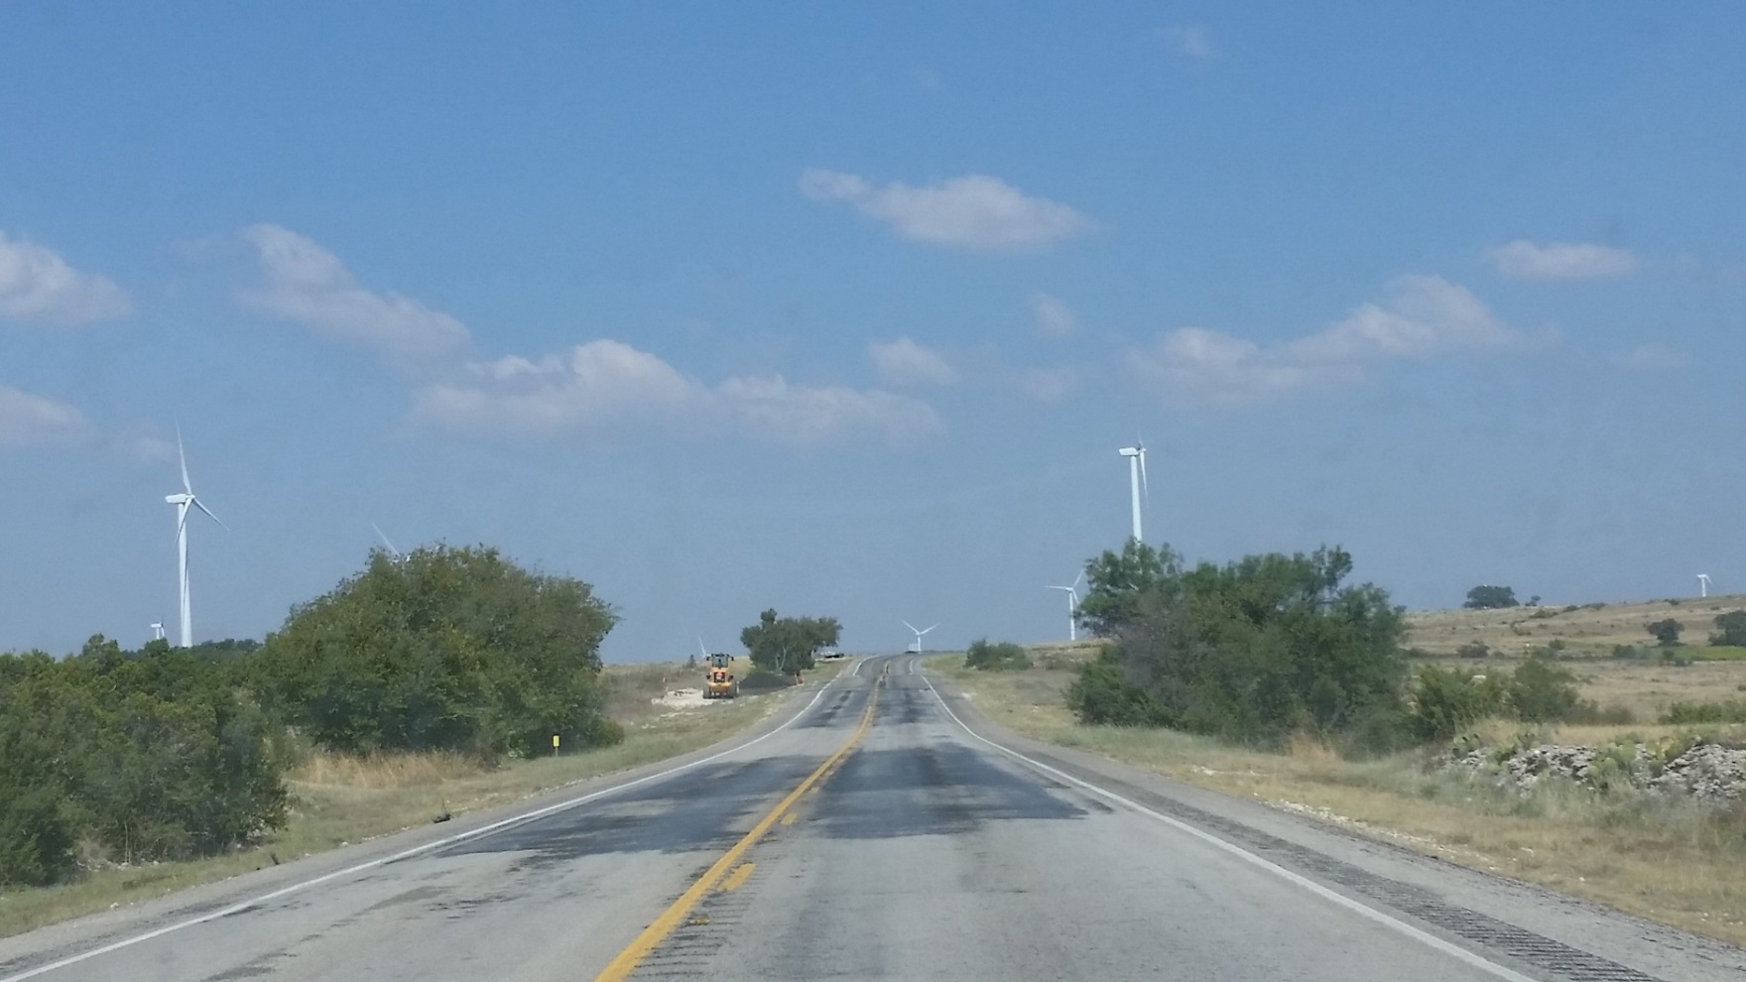
Safety

Slide 19
Cold Weather Extreme Package
This ensures that wind turbine operates in temperatures as low as -30C (-22F), and in survival mode without operation, at temperatures as low as -40C (-40F) (one example).
ERCOT is aware of at least one vendor that offers an extreme cold weather package. Resource Entities should check with their manufacturer.
 | Minimum temperature (standard) operational / survival
Standard weather package | -15°C/-20°C (5F/-4F)
Cold weather package | -30 °C/-40 °C (-22F/-40F)

Slide 20
Cold Weather Packages
“Cold Weather Packages” extend temperature ranges by heating components such as the nacelle space, yaw drive and pitch motors, and the gearbox, slip ring, controller and control cabinet, and battery.
Heating could also prevent another insidious cause of turbine failure.
  When a turbine is not running, oil that is stationary in radiator passages can quickly cool, and its viscosity can increase.
  Even if wind turbines are not being used, an important lesson worth learning is that the turbines should be cycled online to provide flow of cooling oil.
  All cooling equipment for radiators on wind turbines should also be disabled for cold weather events.

Slide 21
Icing Prevention Technologies
Passive icing prevention methods
  Rely on the physical properties of the blade surfaces to prevent ice accumulation.
  An example is application of an anti-adhesive coating on the blade such as teflon.
  Another approach takes advantage of the heat absorbing capacity of dark colored surfaces and consists in the use of black coated blades.
Active de-icing methods
  Consist of thermal, chemical and impulse de-icing
  In thermal de-icing, electrical elements, similar to the one found on the rear window of a car, can be used to warm and melt the ice accumulation off the blades.
In a comprehensive wind turbine icing prevention approach, sensors that could detect the build-up of ice on the rotor could be considered.

Slide 22
Cold Weather Preparation
Inclement Weather Plan
Preventative Maintenance Schedule
Emergency Plan
Communication

Slide 23
Wind Operations During Icing Conditions

Slide 24
Challenges Created by Icing
Icing creates a mismatch between the forecast and actual production.
This creates an error in the forecast which then was provided to WGRs.
This error may be used in the COP which feeds into RUC.
  Could lead to ERCOT counting on more wind than WGRs are able to generate.

Slide 25
Icing Event Dec 26-27, 2015
Freezing temperatures on December 26, 2015 in the panhandle region of Texas marked the beginning of icing conditions that lasted throughout the duration of December 27.
By 3:00 AM on December 27, the wind forecasting error had reached about 1700 MW. Icing was continually reported throughout the day and forecasting error reached nearly 4500 MW by the hour ending HE0800.
The outage scheduler reported new WGRs related derates and forced outages totaling around 6000 MW by the end of the day.

Slide 26
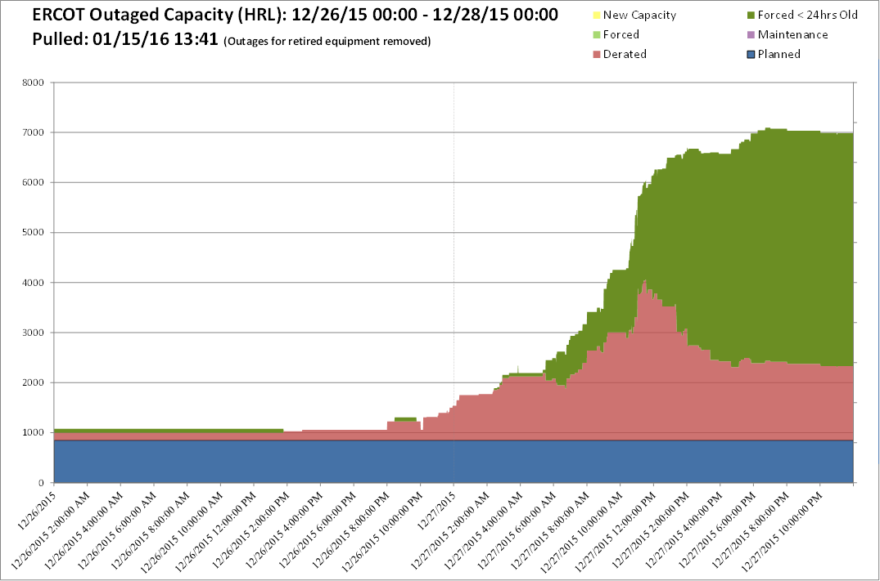
Wind Outages 12/26 – 12/27

Slide 27
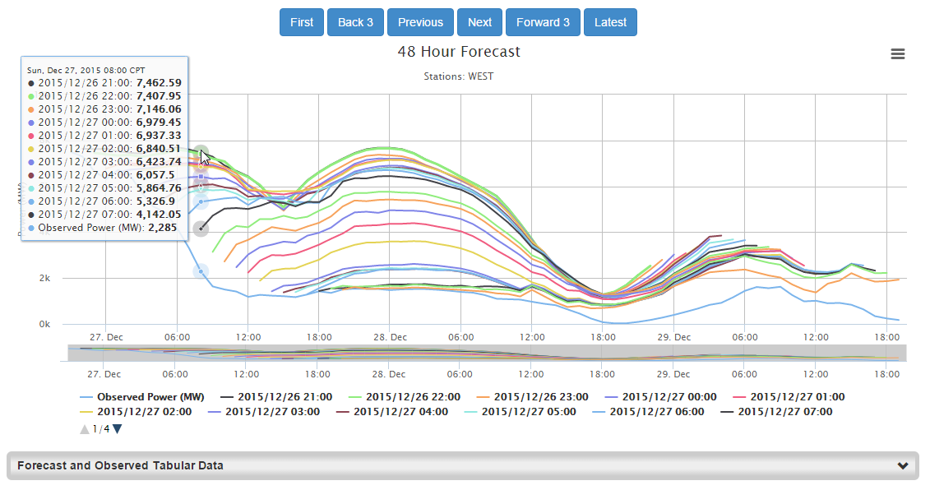
West Wind Forecasts Over Time – HE8
Observed: 2,285
Last COP: 5,864
6 hour: 6,937

Slide 28
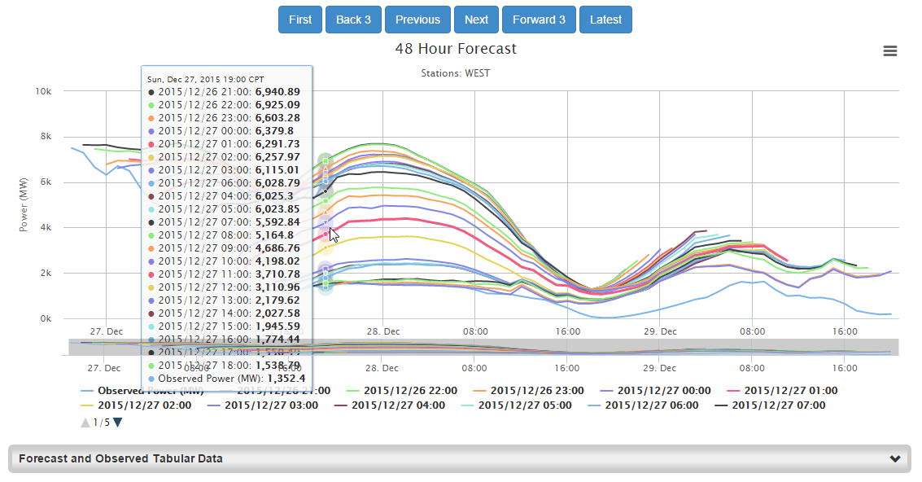
West Wind Forecasts Over Time – HE19
Observed: 1,352
Last COP: 1,774
6 hour: 3,110
12 hour: 5,592
00

Slide 29
West Wind Hour Ahead Summary

Slide 30
Panhandle Wind Hour Ahead Summary

Slide 31
Forecast vs. COP Comparison

Slide 32
Forecast Performance
Notice the disparity between the last forecast value before the adjustment period and the observed value in HE 8 and 12 versus in HE 19. Delayed outages caused these errors in earlier hours which were then minimized in HE 19. The faster these outages are entered, the faster they are incorporated to the forecast.
Panhandle Wind
West Wind

Slide 33
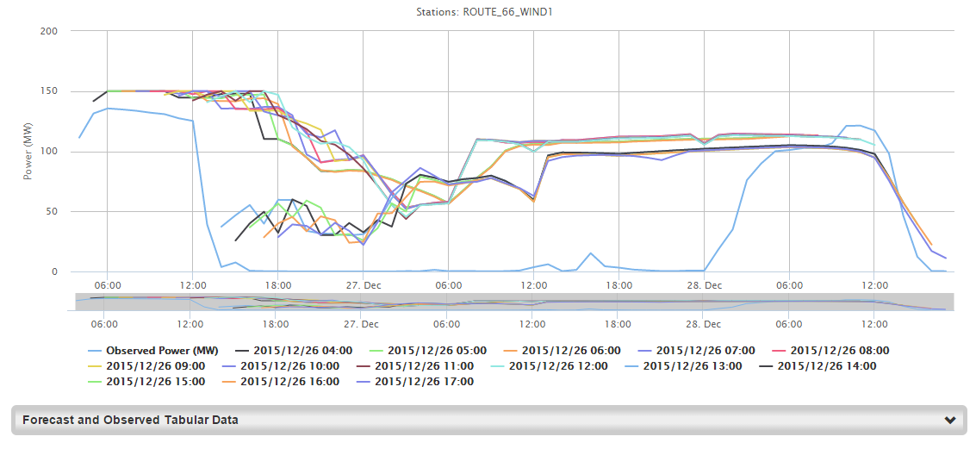
Unit’s STWF with no Outage Updates
WRONG
Forecast NEVER Converged to zero

Slide 34
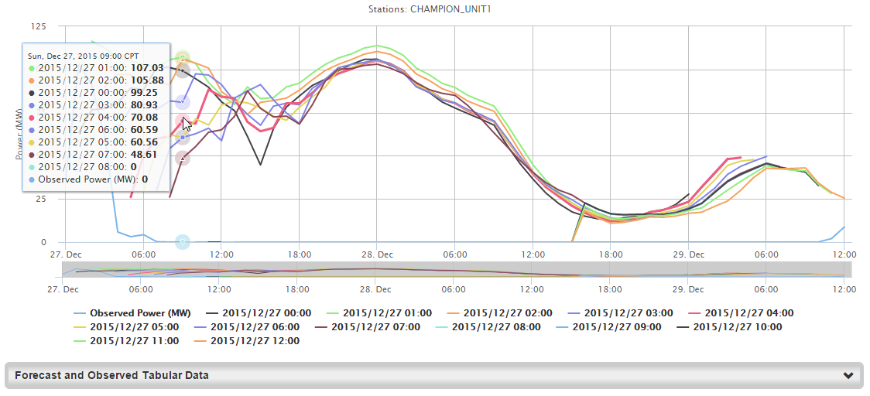
Unit’s STWF with Outage Updates
CORRECT
Forecast Converged to zero

Slide 35
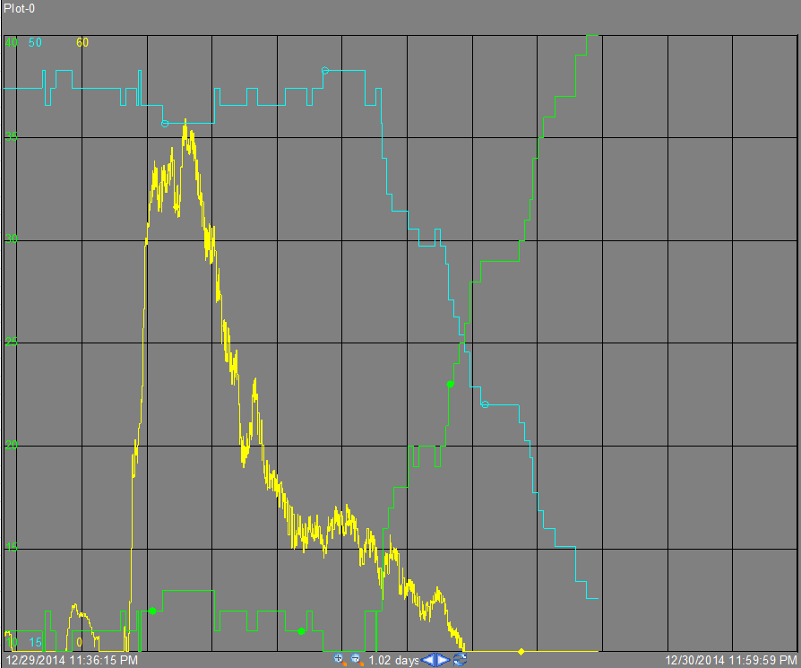
Telemetry During Icing Conditions
WRONG
Number of offline turbines
*Remember this is under icing conditions.
While the NTON line does decrease, it does not fall as the unit’s MW goes to zero, but is very delayed.
This is too slow.
Number of online turbines
MW output

Slide 36
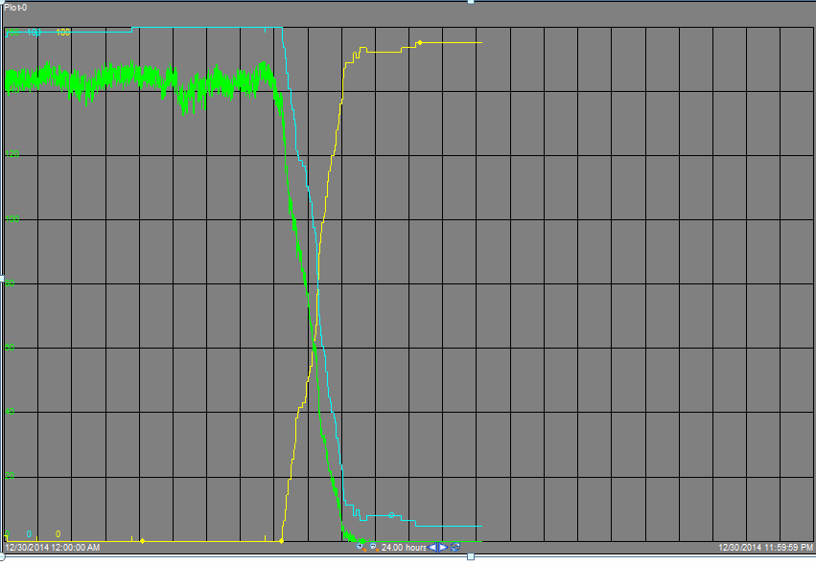
Telemetry During Icing Conditions
CORRECT
Number of offline turbines
*Remember this is under icing conditions.
The NTON line falls as the unit’s MW goes to zero.
This is very good.
Number of online turbines
MW output

Slide 37
Addressing the Wind Turbine Icing
Use the following when a WGR is experiencing an icing related event,
  Call the ERCOT Control Room and notify them.
    Ensure the Plant has a Communication Plan to inform QSE & ERCOT of the event.
  Continuously update the telemetry for number of turbines on and off (NTON and NTOFF) as conditions on the ground deteriorate.
  If the outage/derate is expected to last greater than 2 hours, submit this into ERCOT’s Outage Scheduler.
    In comparison to turbine telemetry, Outage submissions have a greater impact in correcting the forecast.
3.1.4.5 Notice of Forced Outage or Unavoidable Extension of Planned or Maintenance Outage Due to Unforeseen Events
(2) Any Forced Outage that occurs in Real-Time must be entered into the Outage Scheduler if it is to remain an Outage for longer than two hours.

Slide 38
Objectives
List challenges in forecasting wind in Texas.
List actions a Wind facility experiencing icing issues should take.
Given an example of telemetry being received from a renewable resource, determine if it is an issue and whether the QSE representing this resource should be contacted to rectify the issue.

Slide 39
Current and Ongoing Telemetry Concerns

Slide 40
Meteorological Telemetry Requirements
Meteorological telemetry must be telemetered with the specified data units at the refresh rates mentioned below.
References:
  ERCOT and QSE Operations Practices During The Operating Hour (Section 3.9.1)
  ERCOT Nodal ICCP Communications Handbook
Telemetry Name | Data Unit | Refresh Rate
Wind Speed (MPH) | MPH | 10s
Wind Direction (DEG) | Degrees (between 0 and 360) | 10s
Temperature (TEMP) | ºC | 10s
Barometric Pressure (PRES) | mbar | 10s
Num. Of Turbines Available (NTON) Num. Of Turbines Unavailable (NTOF) Num. Of Turbines Unknown (NTUN) | Integer (Count of turbines) | 10s

Slide 41
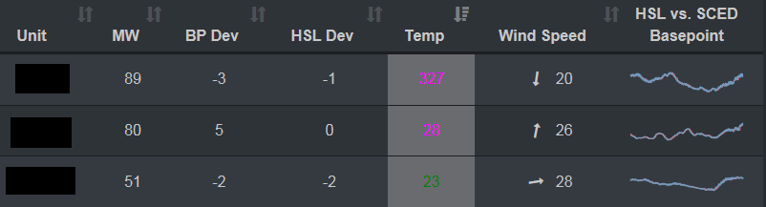
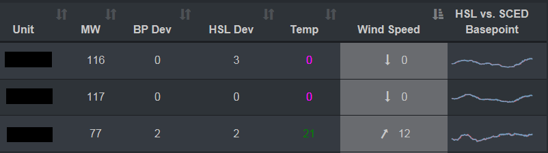
Telemetry Examples (from 9/6/2016)

Slide 42
Turbine Availability Telemetry Requirements
Num. Of Turbines Available (NTON)
  Should indicate count of turbines that will generate power if the operating conditions are met regardless of what current output from the wind generation resource may be.
  If a turbine is disconnected from the grid to reach curtailed Base Point, it should be communicated as Available.
Num. Of Turbines Unavailable (NTOF)
  Should indicate count of turbines that are offline & not available
  Turbines that are under maintenance, or experiencing forced outages (caused by meteorological phenomenon like icing, hurricane, etc.) or mechanical issues) should be communicated as unavailable
Num. Of Turbines Unknown (NTUN)
  should only be used in the few and temporary occasions when there is a failure with the wind plant’s communication system
Sum of the telemetered number of turbines Available, Unavailable and Unknown should equal the total number of turbines identified in unit’s RARF.
Reference:
  ERCOT and QSE Operations Practices During The Operating Hour (Section 3.9.2)
References:
  ERCOT and QSE Operations Practices During The Operating Hour (Section 3.9.2)

Slide 43
Number of Turbines Online (NTON)
WRONG
CORRECT
Wind farms interpret the NTON flag differently.
The NTON is meant to describe the number of turbines available for production, which has nothing to do with the actual output.
  The left image is taking the unit’s MW value into account - Wrong
  The right image is expected method for computing and telemetering this data.

Slide 44
NTON Example 1
WRONG

Slide 45
NTON Example 2
The NTON line stays constant despite the unit’s MW value going to zero.
CORRECT

Slide 46
MW exceeding HSL telemetry
MW telemetry must never exceed the HSL.
When a WGR is UNCURTAILED its MW and HSL values should be exactly the same.
WRONG

Slide 47
MW exceeding HSL telemetry
MW telemetry must never exceed the HSL.
When a WGR is UNCURTAILED its MW and HSL values should be exactly the same.
CORRECT

Slide 48
WGR Under Curtailment
ERCOT nodal protocols and Business Practices dictate that when under curtailment a WGR’s HSL must represent actual power generation potential.
HSL should never lower dramatically under curtailment scenarios.
WRONG

Slide 49
WGR Under Curtailment
ERCOT nodal protocols and Business Practices dictate that when under curtailment a WGR’s HSL must represent actual power generation potential.
HSL should never lower dramatically under curtailment scenarios.
CORRECT

Slide 50
WGR Under Curtailment
WGRs must follow ERCOT Base Point when under curtailment
CORRECT

Slide 51
Objectives
List challenges in forecasting wind in Texas.
List actions a Wind facility experiencing icing issues should take.
Given an example of telemetry being received from a renewable resource, determine if it is an issue and whether the QSE representing this resource should be contacted to rectify the issue.

Slide 52
Questions?

