Slide 1
2017 Summer Weather Outlook – Temperature, Precipitation,
Drought, and Hurricanes
Chris Coleman
Senior Meteorologist
OTS, Week One
March 28, 2017

Slide 2
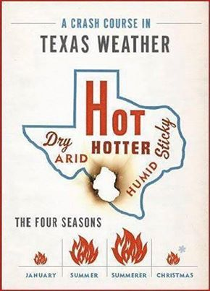
Introduction/Agenda
Today’s Weather Update & Outlook Presentation:
Weather Records
Review of Last Summer’s (2016) Weather
Summer 2017 Weather Forecast (Temperature and Rainfall)
Hurricane and Drought Review and Forecast for 2017

Slide 3
Recent Texas Weather Records
Wettest Consecutive Years
2015-16. 73.80”
1940-41. 71.08”
1991-92. 70.80”
1941-42. 69.43”
1919-20. 69.06”
(Austin: 98.85”)
Warmest Years (Mean)
2012. 67.8°
2011. 67.3°
2016. 67.2°
2006. 67.1°
1998. 67.0°
Warmest Years (Min)
2016. 55.2°
2012. 55.0°
1998. 54.8°
2015. 54.2°
2000 & 2006. 54.1°
(2016 was 11th hottest based on max temp)
Warmest Autumn Seasons
2016. 66.0°
1927. 64.7°
1931. 64.6°
1934. 64.5°
1973. 63.7°
Warmest Winter Seasons
2016-17 53.0°
1906-07. 52.6°
1999-00. 52.1°
1998-99. 51.7°
1951-52. 51.5°
Notes:
#1 is an outlier. 2.63” between 1 and 2. Average of 0.80” between each interval from #2 through #11

Slide 4
August 2016 & January 2017. Load versus Weather
August 2016
2nd coolest since 2006
4th coolest in the past 20 years
All-Time Peak
of 71.093 MW set on August 11, 2016
January 2017
January 2017 was the 9th warmest January on record (since 1895)
All-time Winter Peak of 59,650 MW* on January 6, 2017
* Preliminary
Load peaks can oftentimes be anomalous to long-term weather patterns
Notes:
January 2017 tied for 9th warmest

Slide 5
temperature REVIEW
Summer 2016

Slide 6
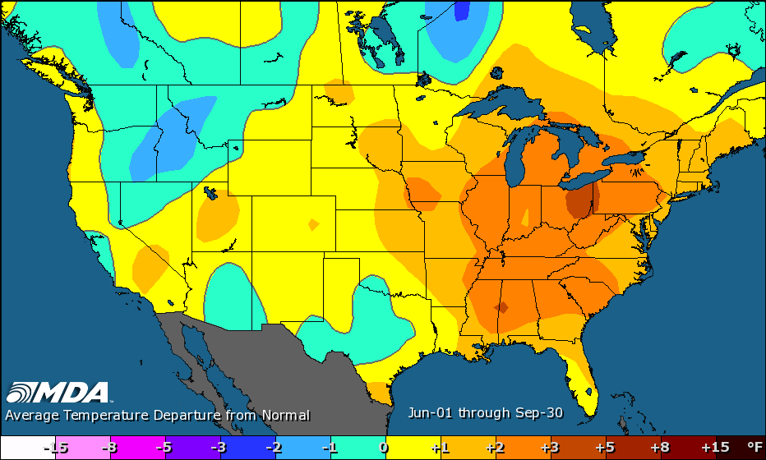
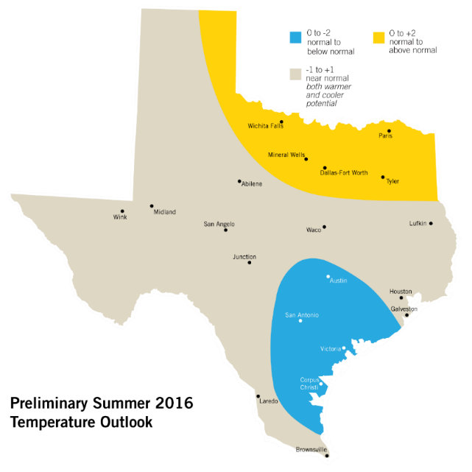
Summer 2016 Temperature Forecast Review
Summer
2016
Actual 2016 Temperatures
Forecast 2016 Temperatures

Slide 7
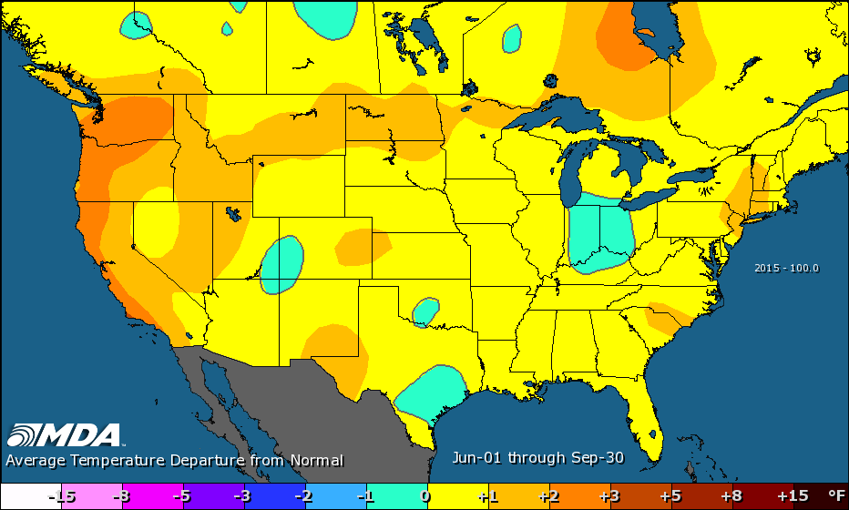
Summer 2016 compared to Summer 2015
The summer of 2016 was forecast to be no warmer than the summer of 2015, which ranked as the 17th hottest summer on record
The summer of 2016 was the 21st hottest summer on record
However, there was significant disparity between the max and min temperatures.
Summer
2016
Summer
2015

Slide 8
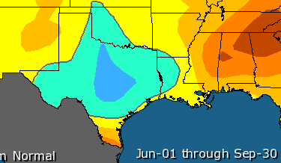
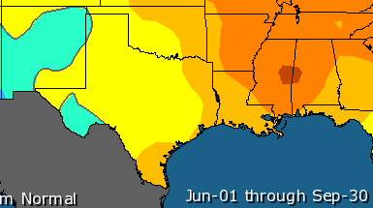
Summer 2016 Temperature Review
53rd hottest summer based on maximum temperatures, which was the 2nd coolest in the past 8 years
However, 5th hottest summer based on minimum temperatures.
Warmest overnight temperatures since 2011.
Max Temp
Min Temp

Slide 9
Summer 2016 Maximum Temperature Review
Summer 2016 was the 53rd hottest based on max temp (average high: 92.4°)
100° Days
Dallas: 18 days in 2016.
10yr normal = 29; 30yr normal = 21.
3rd consecutive year of <20 days.
-------------------------------------------------------------------------------------------------
Austin (Bergstrom): 10 days in 2016.
10yr normal = 29. 30yr normal = 15.
Lowest in consecutive years (10+9) since 2003-04.
-------------------------------------------------------------------------------------------------
San Antonio: 6 days in 2016.
10yr normal = 25. 30yr normal = 16. Lowest number since 2007.
--------------------------------------------------------------------------------------------------
Houston: 7 days in 2016.
10yr normal = N/A. 30yr normal = 5. Houston was above their long-term normal.
Max Temp

Slide 10
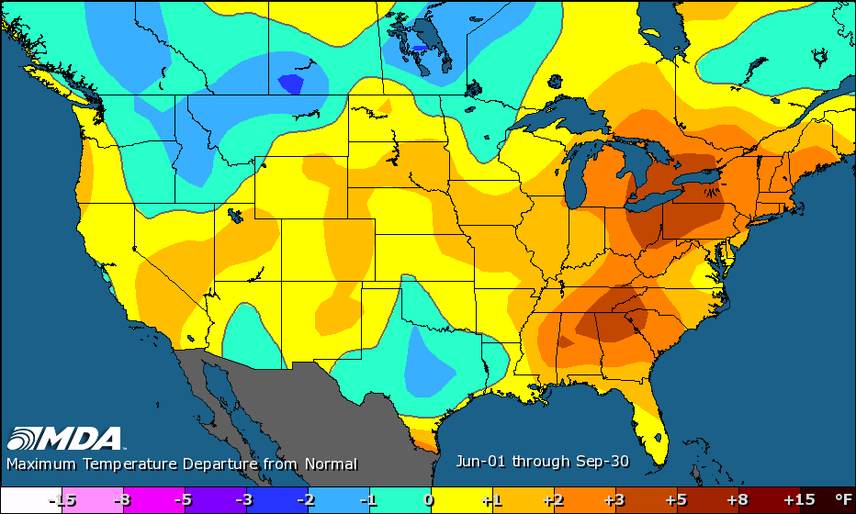
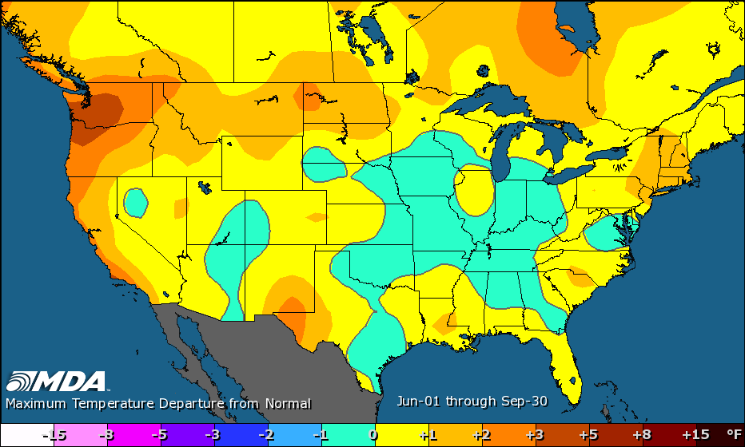
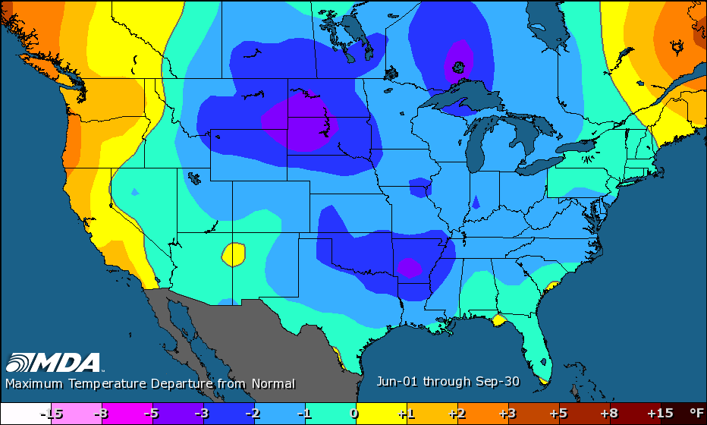
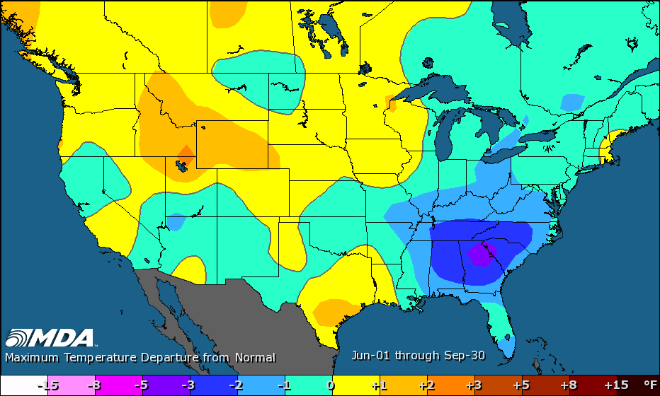
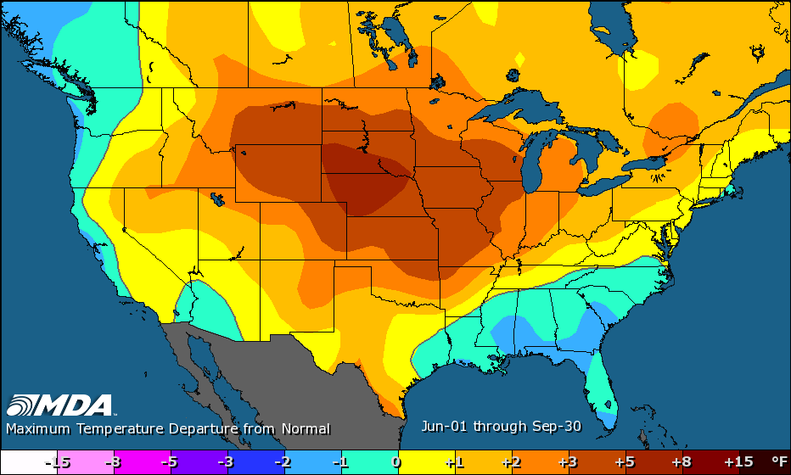
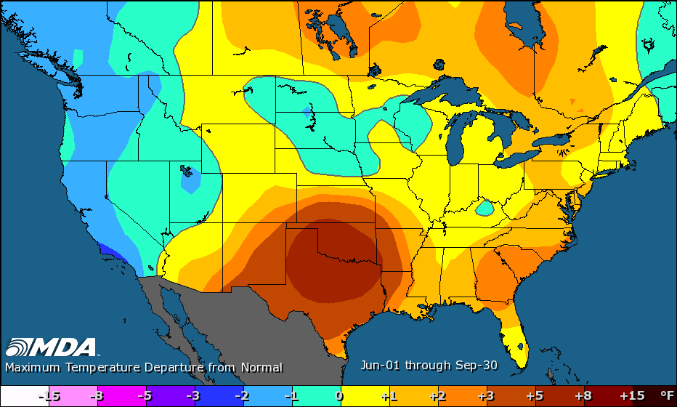
Past Six Summers, Max Temperature
2016: 53rd hottest, 92.4°
2013: 31st hottest, 93.2°
2015: 33rd hottest, 93.0° 2014: 77th hottest, 91.5°
2012: 13th hottest, 94.0° 2011: 1st hottest, 98.2°
(POR 1895-current, Jun-Sep; all of Texas)

Slide 11
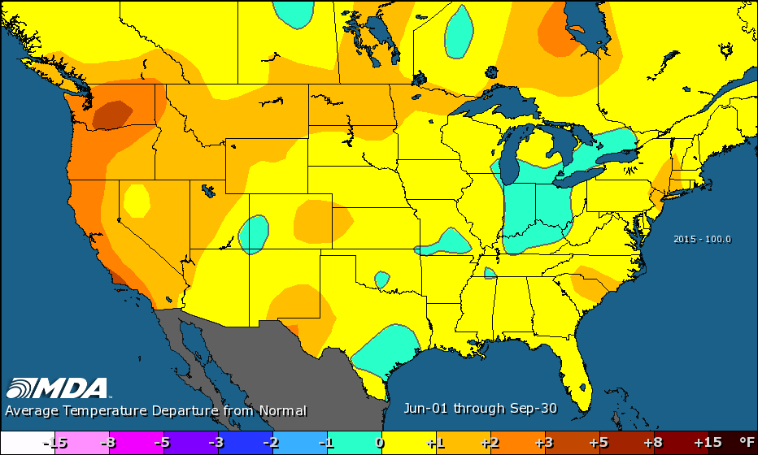
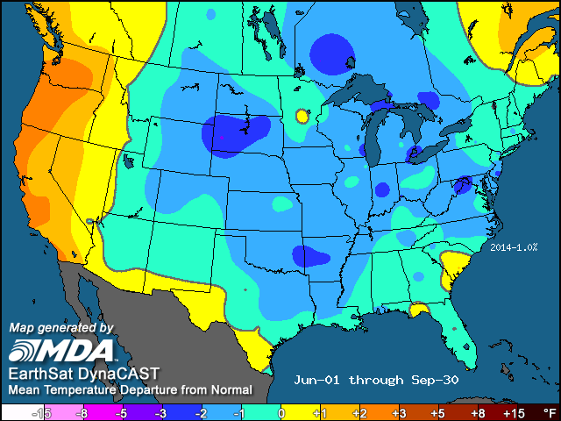
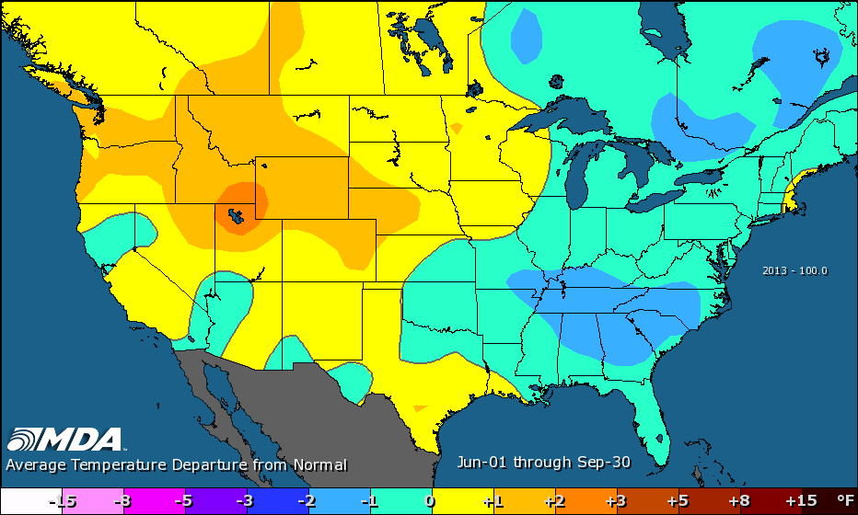
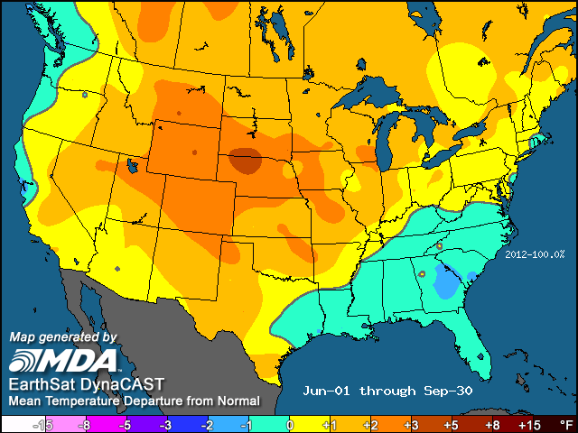
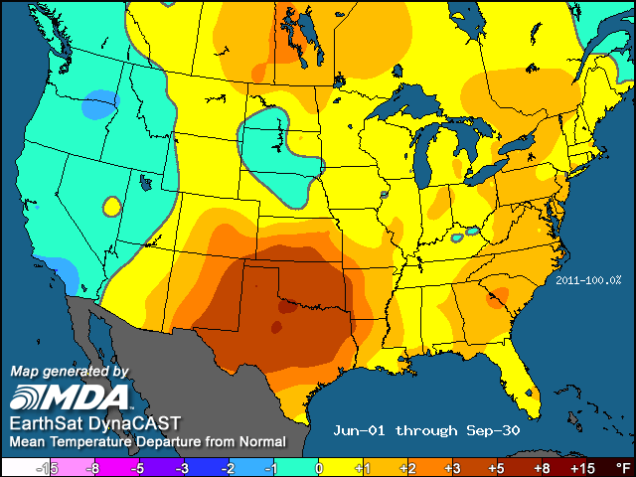
Past Six Summers, Mean Temperature
2016: 21st hottest, 81.2°
2013: 21st hottest, 81.2°
2015: 17th hottest, 81.3° 2014: 50th hottest, 80.4°
2012: 13th hottest, 81.5° 2011: 1st hottest, 84.6°
(POR 1895-current, Jun-Sep; all of Texas)

Slide 12
TEMPERATURE outlook
Summer 2017

Slide 13
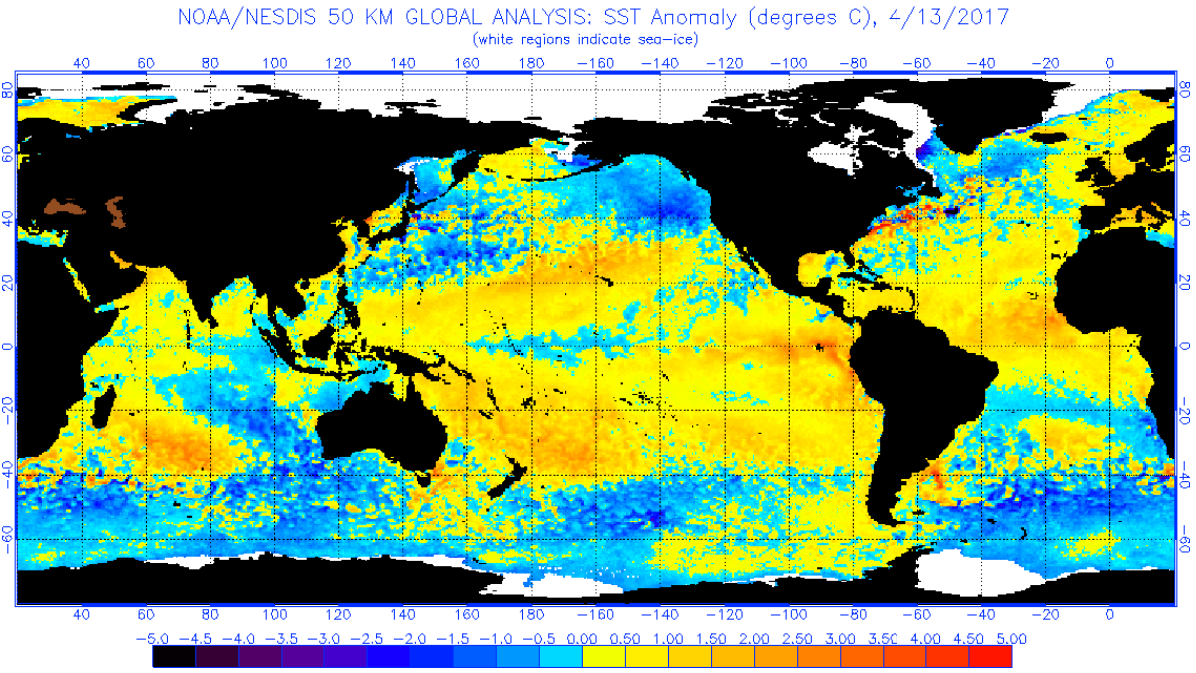
Ocean Temperatures
The oceans are the primary driver of weather patterns
No clear El Niño or La Niña (Neutral Phase)
Still see a predominantly warm pattern in the oceans (but some cooling in the Pacific)
The Gulf of Mexico did not drop below 73° this past winter

Slide 14
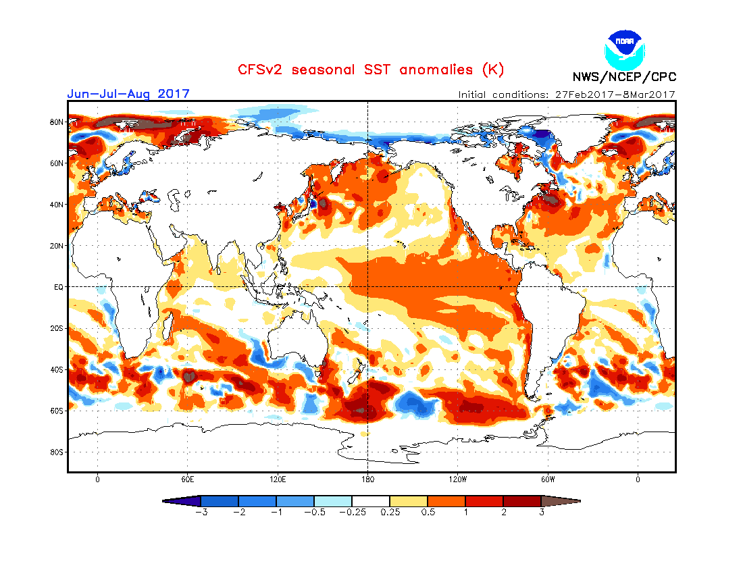
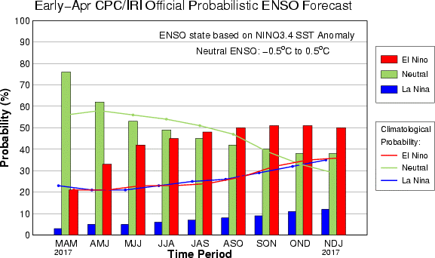
ENSO (El Niño Southern Oscillation)
2015-16 recorded the second strongest El Niño on record (1997-98)
2016 saw a transition to neutral by summer and a weak La Niña by fall
The winter of 2016-17 trended to a neutral phase
Either neutral or El Niño is projected for summer into fall (increasing El Niño potential)

Slide 15
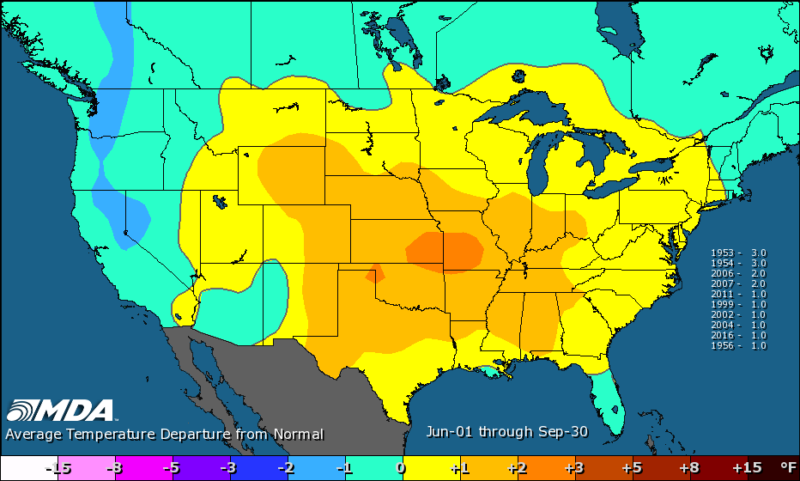
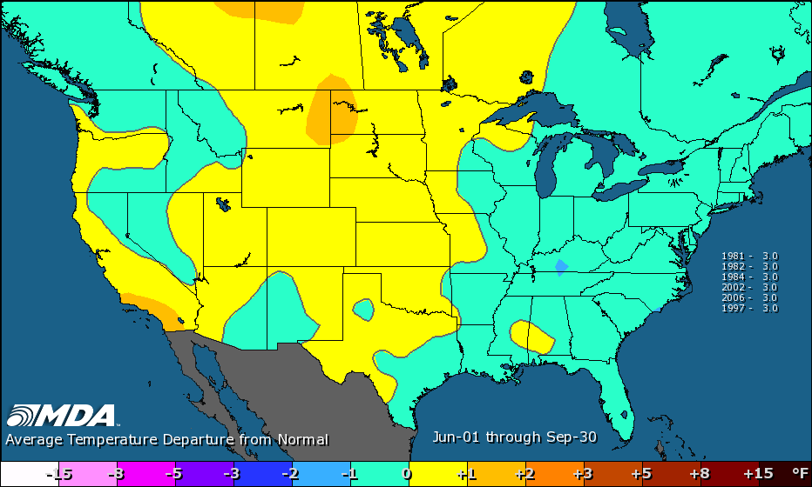
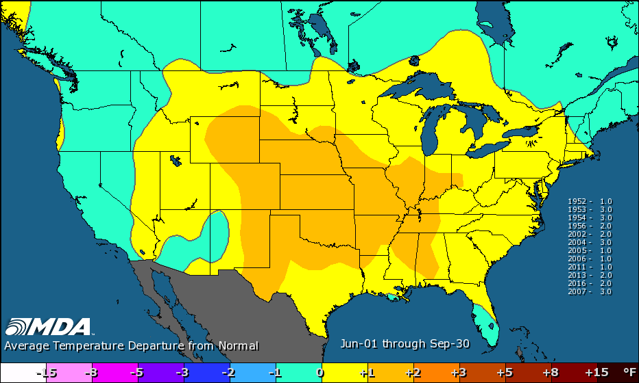
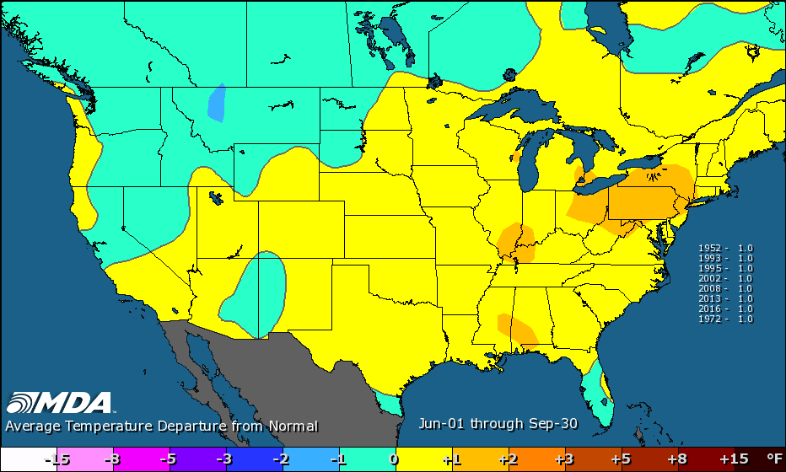
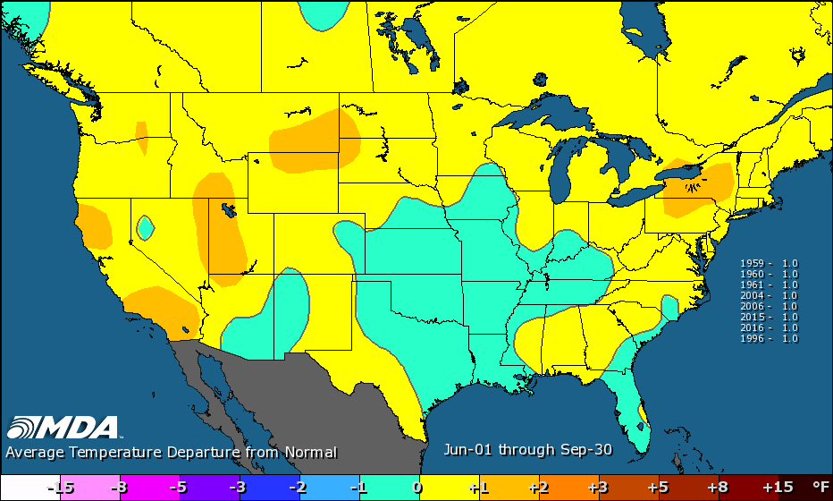
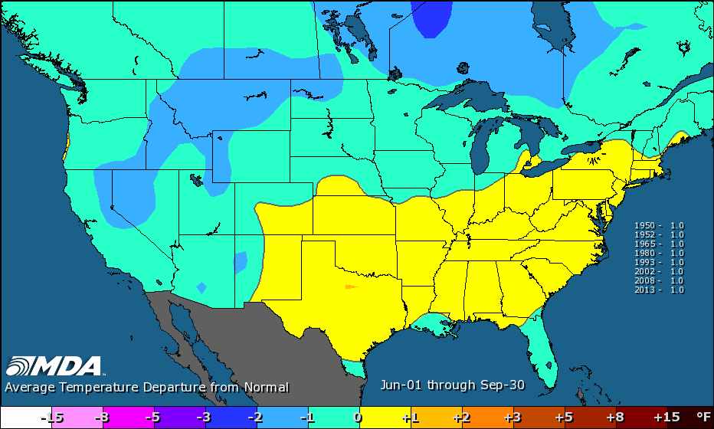
Building the Forecast
AMO
ENSO/MEI/SOI
PDO
Recent Temperature Patterns
SST
200mb/Jet Stream
AMO/PDO

Slide 16
Does a Warm Winter Foretell a Hot Summer?
121 total historical winters. Consider the top-third = 40 historical warm winters.
Continental United States:
Warm winter → Hot summer 20 times
Warm winter → Normal or Mild summer 20 times
Texas:
Warm winter → Hot summer 16 times
Warm winter → Normal or Mild summer 24 times
No apparent correlation

Slide 17
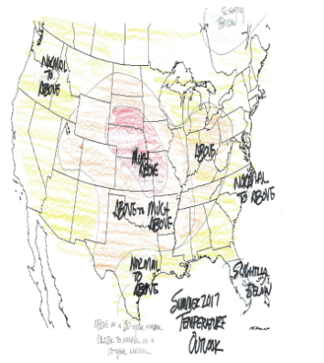
Summer 2017 Temperature Outlook
Historical Matches: 2002, 2006, 2016, 2013, 2004, 1960, 1952, 2007, 1953, 1954, 1956
Above on a 30-yr normal,
Normal to above on a 10-yr

Slide 18
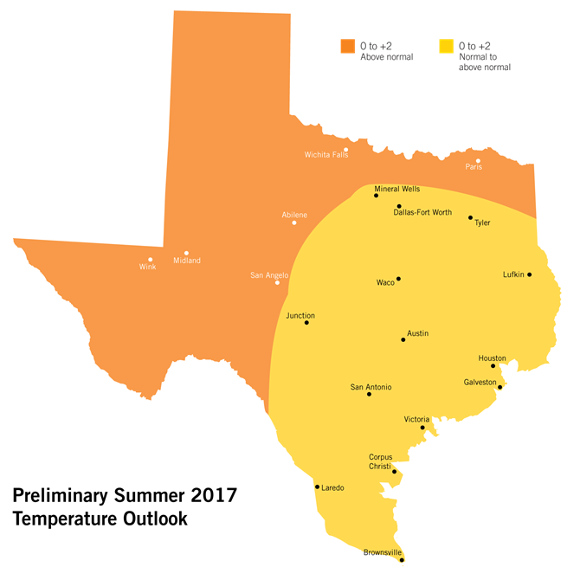
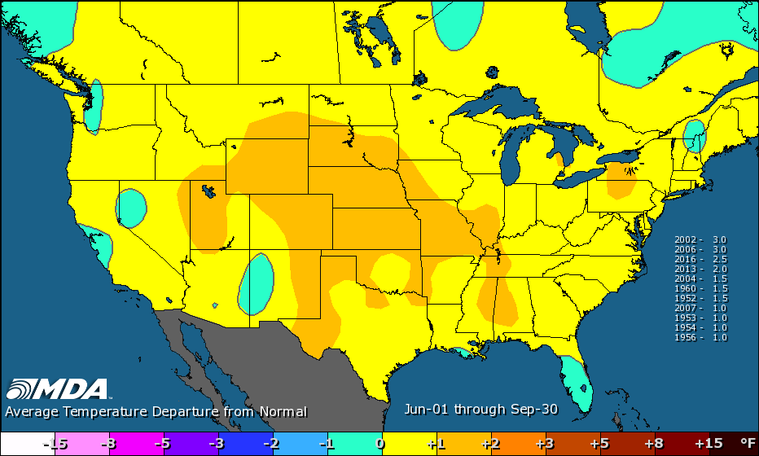
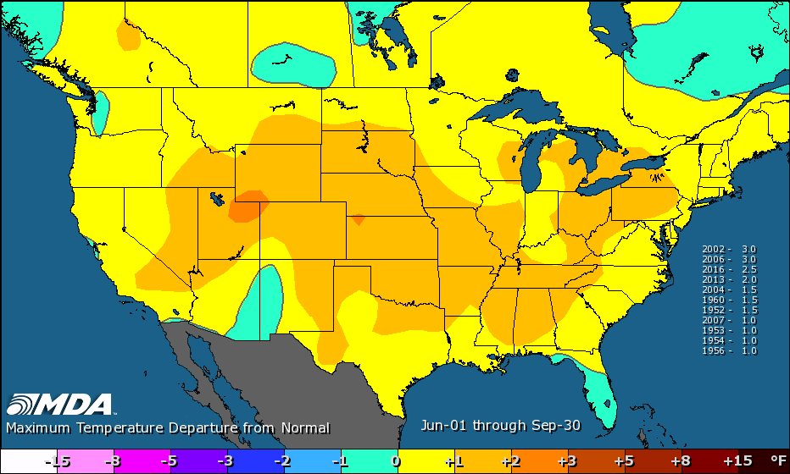
Summer 2017 Temperature Outlook
Historical Matches: 2002, 2006, 2016, 2013, 2004, 1960, 1952, 2007, 1953, 1954, 1956
Good potential to be as hot or hotter than last summer
Mean Temp
Max Temp

Slide 19
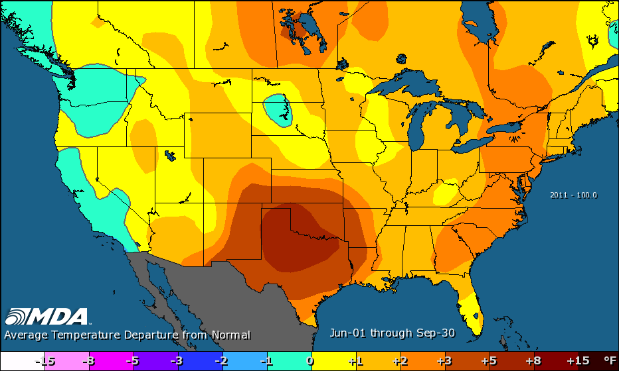
Repeat of 2011?
My forecast is hotter-than-normal this summer in ERCOT (hotter than the 30-year
normal, may be close to the 10-year normal)
This past fall and winter were the warmest ever respectively – could we keep that
trend into summer?
The Summer of 2011 was – by far – the hottest in Texas history (dating back
to 1895)
The difference between the summer of 2011 and the second hottest summer
(1998), is the same difference (2.3°) as the difference between 1998 and the
50th hottest summer – major outlier

Slide 20
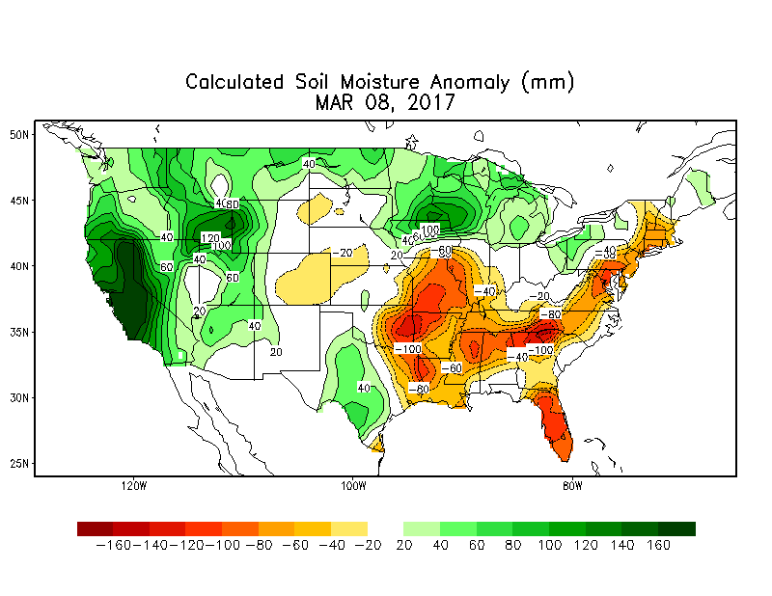
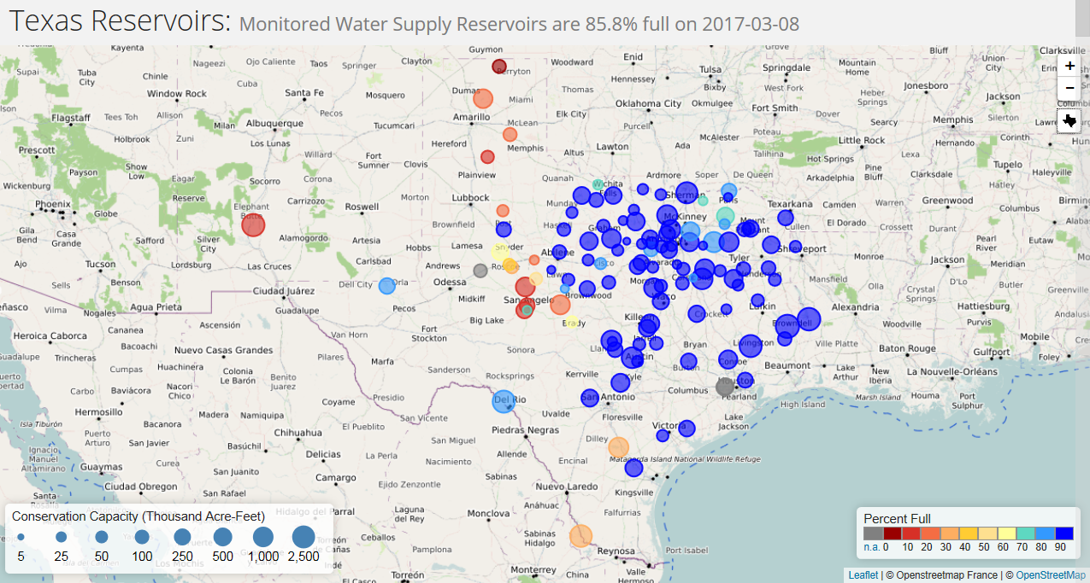
Repeat of 2011?
Soil moisture and reservoir levels will impact summer temperatures
Reservoirs are 85.8% full on 3/8/17. 80.5% full on 3/8/11
Reservoirs have averaged 78.1% full on March 8 over the past 20 years; 79.2% full for any date
Palmer Hydrological Drought Index (PHDI) currently ranks 104th since the start of the
current water year (far from a hydrological drought). In 2011, it ranked 3rd at this point
in the year
Soil moisture concerns over East Texas and the Rio Grande Valley but most of the state has
normal to wet soils for the early-spring time frame
Reservoirs were 88.3% full
heading into last summer

Slide 21
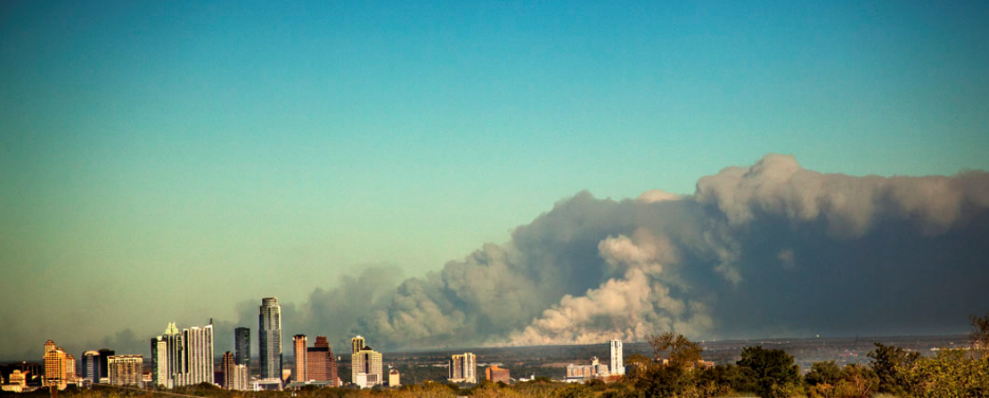
Repeat of 2011?
Very likely too wet in 2017 to repeat the extremes of 2011
But that doesn’t mean it can’t be hotter-than-normal

Slide 22
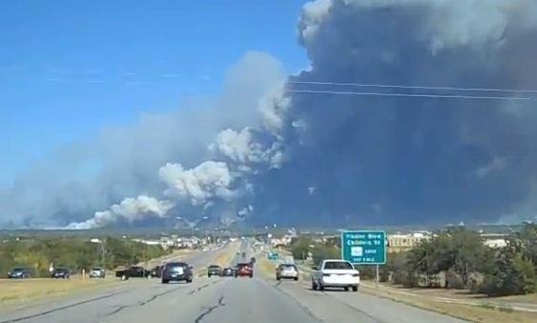
Repeat of 2011?
Note the Number of 100-degree days from 2011
Dallas: 71 days (average = 21); Also, 19 days of 105 or greater in 2011
Houston 46 days (average = 5)
Austin: 85 days (Camp Mabry) (average = 20, Mabry; 15, Bergstrom)
Wichita Falls: 100 days (average = 32)
Waco: 87 days (average = 24)
Abilene: 81 days (average = 16)
--------------------------------------------------------
Dallas (2015&2016): 15 & 18 days
Also, 2 days of 105 or greater in 2015,
1 day in 2016
Houston (2015&2016): 10 & 7 days
Austin (2015&2016): 9 & 10 days
McAllen (2016): 90 days – record
--------------------------------------------------------
Good chance we’ll see more
100° days in 2017 than we have for
At least the past two years – possibly
longer – but not to 2011 levels.
Of the large cities, Dallas is the most
likely to break the 100° totals of the past
two years. (Unlikely In McAllen.)

Slide 23
Summer 2017 Temperature Outlook
The summer of 2017 is forecast to be hotter-than-normal for ERCOT, on average
Most likely regions for above-normal temperatures 1. Far West 2. Panhandle 3. North Texas
Likely to top last summer’s maximum temperatures, which only ranked 53rd hottest all-time
Could top last summer’s mean temperatures, which ranked 21st hottest
Dallas/Fort Worth has the most heat potential this summer of the large cities
Good chance to top the number of 100° days from the past couple of years – especially true for Dallas

Slide 24
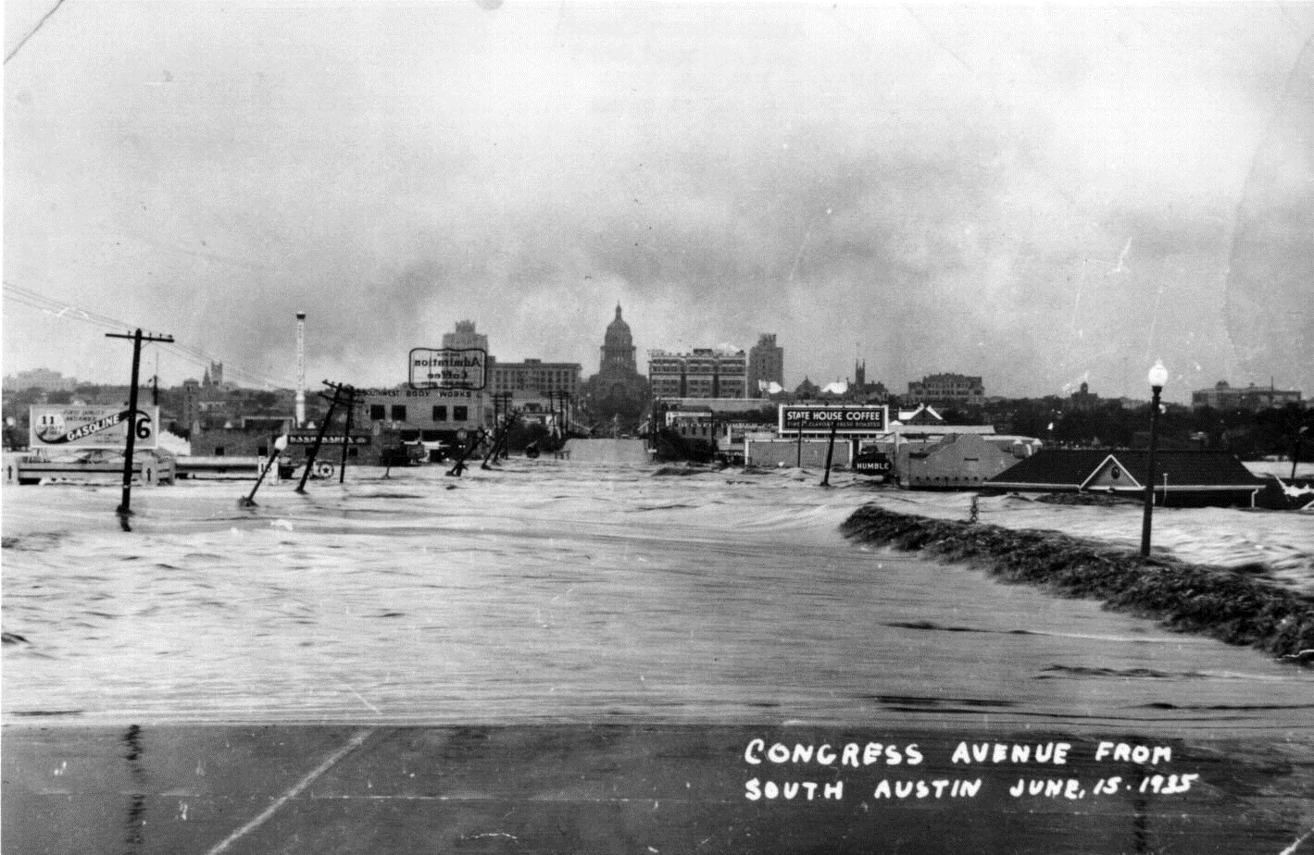
PRECIPITATION outlook AND DROUGHT REVIEW
Summer 2017

Slide 25
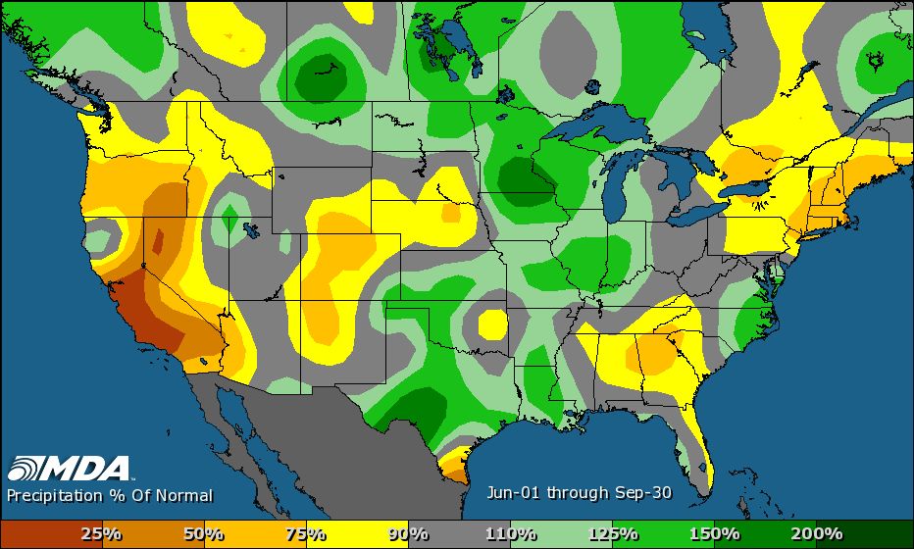
Summer 2016 Rainfall
17th wettest (106th driest) summer on record
Wettest summer since the drought of 2010-15
3rd wettest summer of the past 12 years; 4th wettest of the past 20 years
August was the 3rd wettest August all-time (1974, 1920)

Slide 26
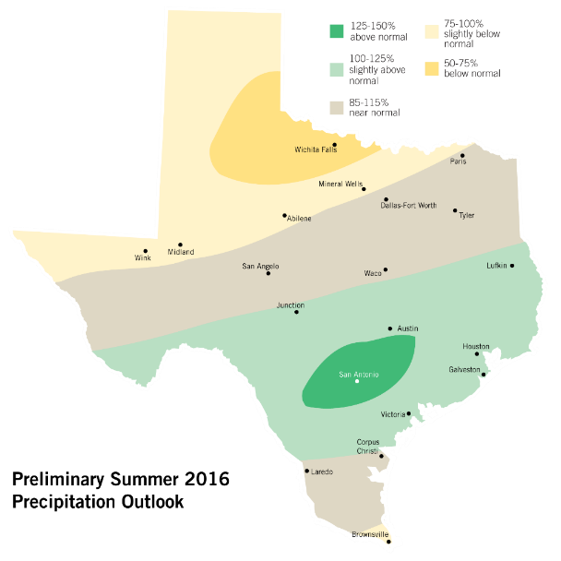
Summer 2016 Rainfall Forecast Review
Statements made with the 2016 Forecast:
1998 was a mostly dry summer – but dependent on a quick shift to La Niña and PDO-
There are opportunities for wetter summers over Central Texas with some of the higher ranked historical analogs
Several analogs suggest a dry summer in the RGV
In general, North has more dry potential, Central and Coast has more wet potential

Slide 27
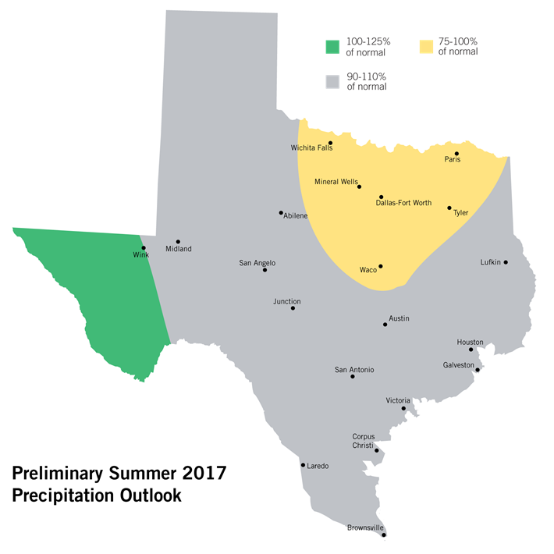
Summer 2017 Precipitation Outlook
Precipitation forecasts are much more challenging
than temperatures, due to the hit-and-miss nature
of rain
Latest information increases the drier-than-normal
potential across all of North Texas
Final forecast is more likely to be drier
than wetter

Slide 28
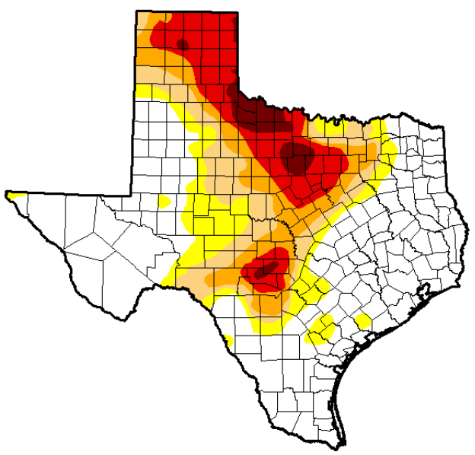
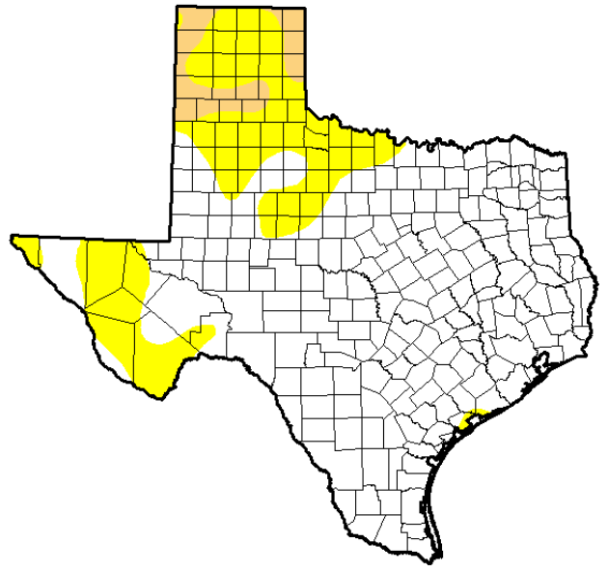
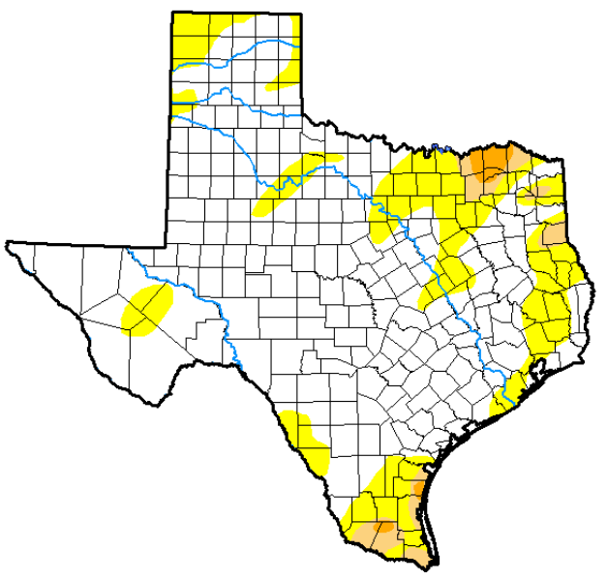
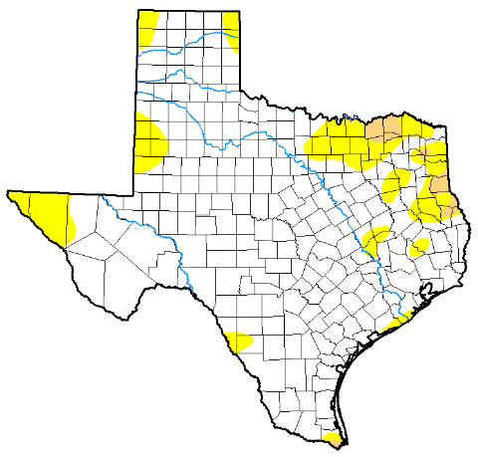
Drought Comparison over Time
35.3% Moderate or worse
4.1% Moderate or worse
April 14, 2015
April 12, 2016
1.7% Moderate or worse
3.9% Moderate or worse
Feb 28, 2017
April 11, 2017

Slide 29
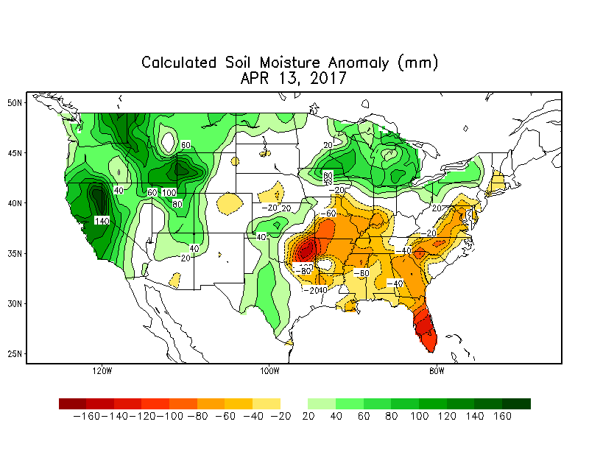
Drought Update and Outlook
The last widespread drought ended in early-2015
A strengthening El Niño under the influence of a PDO+ resulted in flooding rains in 2015 and 2016
2015 and 2016 were the wettest consecutive years in Texas weather history
None of the 10 most extreme Texas droughts occurred during a PDO+ (we are currently in a PDO+)
While a widespread, extreme hydrological drought is unlikely in 2017, some regions could see deteriorating conditions – especially portions of North Texas
Area to watch
February 28, 2017

Slide 30
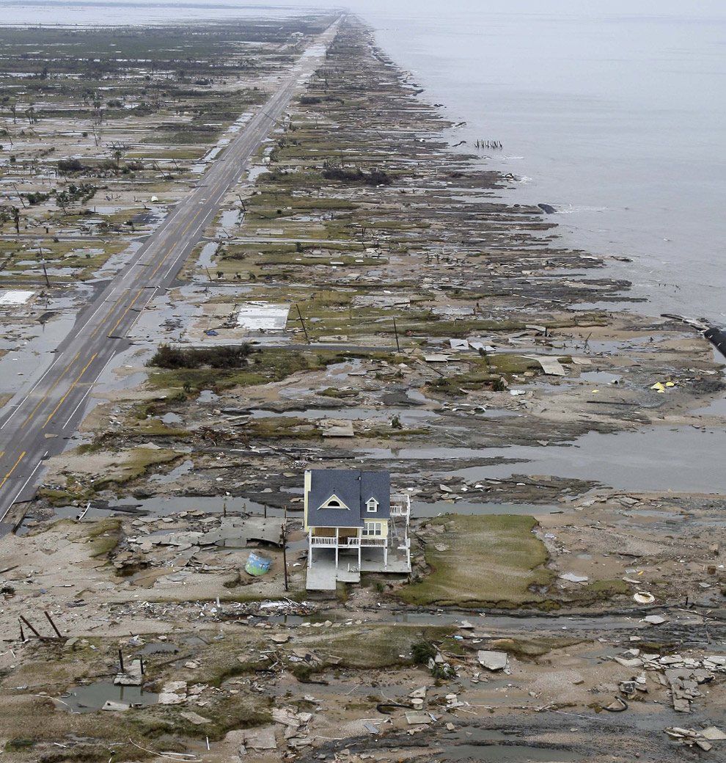
HURRICANE FORECAST
2017 Season

Slide 31
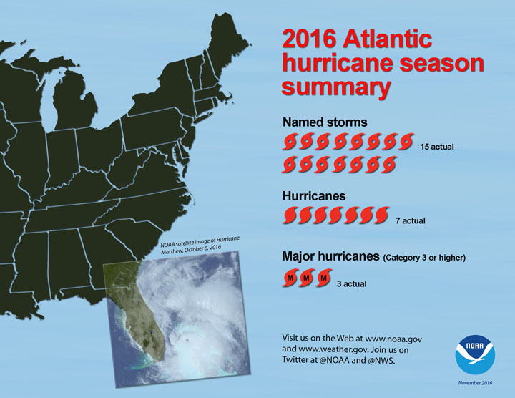
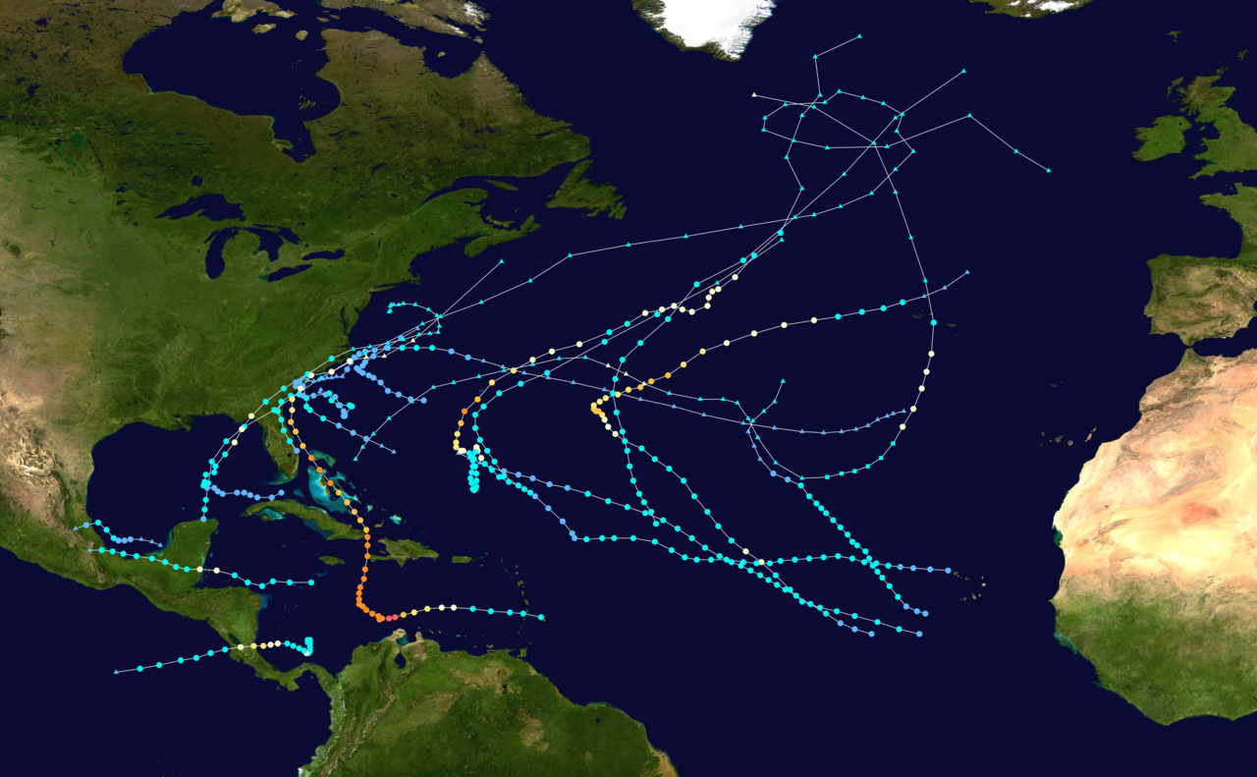
Review of the 2016 Hurricane Season
Most active Atlantic hurricane season since 2012
15/7/3 – 15 total named storms, 7 were hurricanes, 3 of those were major hurricanes
Two hurricanes and two tropical storms in Gulf (but no Texas landfall)
Gulf: T.S. Colin, Danielle. Hurricane Earl, Hermine
Hurricane Hermine was first hurricane to make landfall in Florida since 2005 – and the first hurricane to develop in the Gulf since 2013

Slide 32
2016 Hurricane Season Forecast Review
Forecast: 10/6/2 – 10 total named storms, 6 hurricanes, 2 major hurricanes
Actual: 15/7/3 – 15 total named storms, 7 were hurricanes, 3 of those were major hurricanes
Forecast: 3-4 named storms in Gulf. 1-2 hurricanes. 1 to 2 named storms with Texas landfall
Actual: 4 total named storms in Gulf. Two hurricanes and two tropical storms in Gulf. No Texas landfall

Slide 33
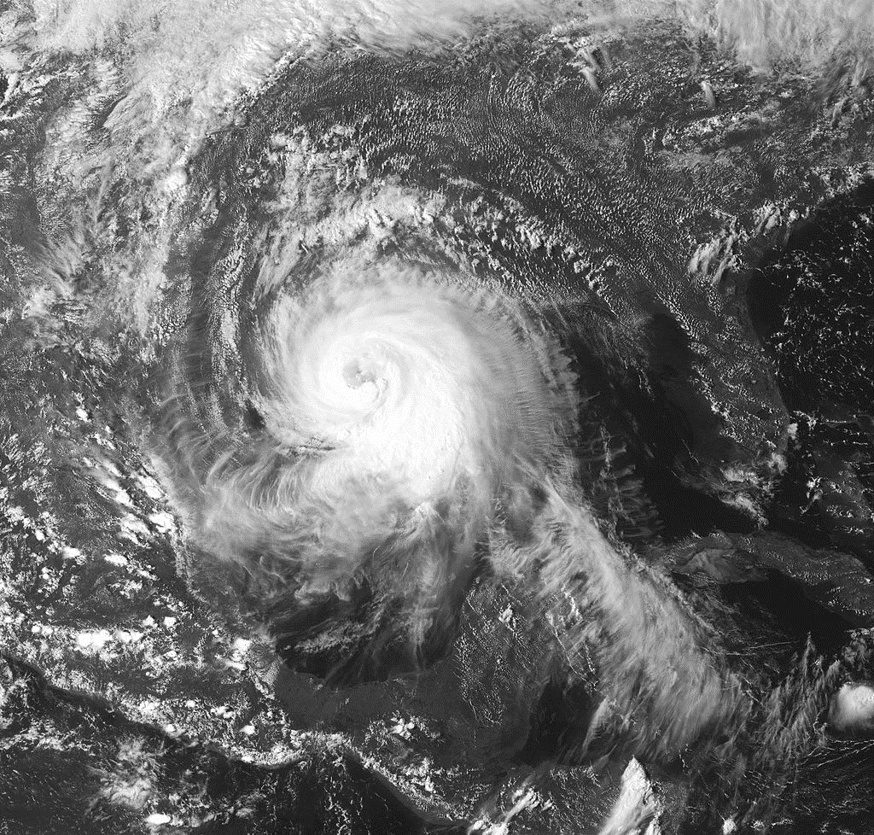
Review of the 2016 Hurricane Season
Actual: 4 total named storms in Gulf. Two hurricanes and two tropical storms in Gulf. No Texas landfall (tropical storms or hurricanes)
No hurricane landfalls in Texas since 2008
Since 1900, only one period minus a hurricane in Texas has been longer: 1990-98
On average, one hurricane makes landfall in Texas every 2.5 years

Slide 34
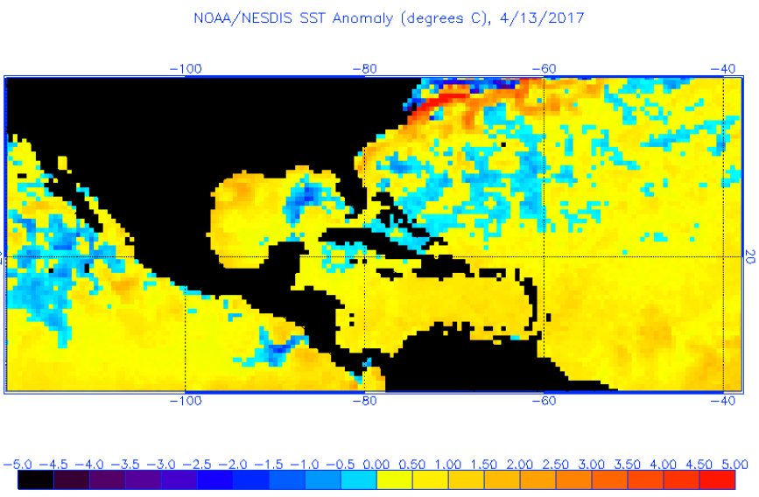
Early Thoughts on the 2017 Hurricane Season
La Niña has faded. Currently neutral. Will need to monitor a possible El Niño developing
An El Niño typically suppresses hurricanes, due to high wind shear
A positive in favor of hurricane development is the very warm, above-normal temperatures throughout the Atlantic Basin
The Gulf of Mexico never dropped below 73° this past winter – for the first time in recorded history

Slide 35
2017 Hurricane Season Forecast
The historical years being applied to the 2017 Atlantic hurricane season are: 2002, 2006, 2016, 2013, 2004, 1960, 1952
The average from those historical years is my forecast: 12/5/2. 12 named storms, 5 hurricanes, 2 major hurricanes.
12/5/2 would be at or just less than an average season (avg = 12/6/3)
Likely to be less than 2016 (15/7/3)
Forecast for Gulf is 3-4 named storms, which would be the same or less than last year
Although forecasting tracks months in advance has low skill, none of the historical years applied to the 2017 forecast featured a hurricane with a Texas landfall (which would keep the streak back to 2008 intact)

Slide 36
2017 Hurricane Season Forecast
Names:
Arlene
Bret
Cindy
Don
Emily
Franklin
Gert
Harvey
Irma
2011 list, with exception to Irene

Slide 37
Summary
The summer is showing increasing potential of being hotter-than-normal across Texas – especially portions of North and West Texas
Good chance for more 100° days in 2017 than the past two to three years in Dallas
A very wet 2015, 2016, and start to 2017 will limit drought potential this summer; however, could see regional drought concerns increase across portions of North Texas
Initial hurricane season forecast is for less activity than last year. That does not mean Texas won’t get hit but overall opportunity will be less
The finalized Summer
Outlook will be available
May 1 on the ERCOT website

