Slide 1
New Control Room Desk Overview
Mark Spinner
Manager, Operations Training
ERCOT Public
February 16, 2017

Slide 2
Objectives
List the four traditional risks that Operators encounter.
Identify how risk assessment is performed.
List the four stages of frequency response due to a generating unit loss.
Identify which type of generating units can provide system inertia.
Recall ERCOTs Critical Inertia level.
List the Reliability Risk Desk tasks.

Slide 3
Traditional Operational Risks
Operational
Monitoring
and Analysis
ERCOT operators deal with a variety of traditional risks in the Control Room:
  Transmission Outages
  Generation Resource Outages
  Load Forecast errors
  Base Point Deviations

Slide 4
Traditional Operational Risks
Operational
Monitoring
and Analysis
Control Room primarily assesses risk to operational reliability through:
  Contingency Analysis
  Operating reserves
  Informed, experienced operator judgment
Operating
Actions

Slide 5
Evolving Risks
With the changing resource mix on the system, the need to assess and manage certain risks has grown
Traditional Needs
Evolving Needs
Operational
Monitoring
and Analysis
Operating
Actions
Operating
Actions

Slide 6
Evolving Risks
Traditional Needs
Evolving Needs
Improved quantitative analysis and dynamic consideration of these risks and controls are needed
Operational
Monitoring
and Analysis
Operating
Actions
Operating
Actions

Slide 7
Evolving Risks
Traditional Needs
Evolving Needs
Perform existing activities with more in-depth monitoring and analysis
Operational
Monitoring
and Analysis
Operating
Actions
Operating
Actions

Slide 8
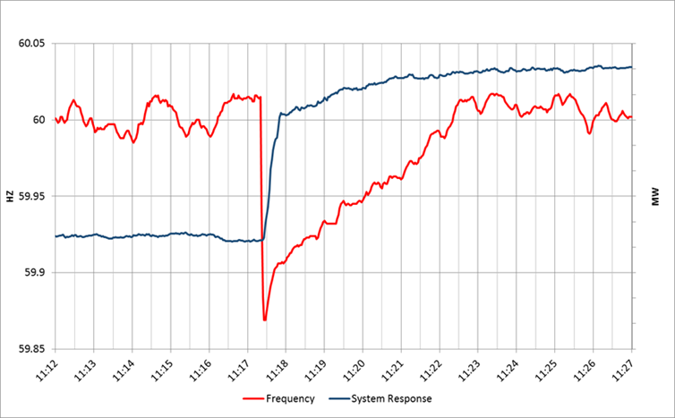
Frequency Response following a Unit Trip
Notes:
Inertia (Spinning Mass; specifically synchronous machines) and load response (1/3 sec to 5 seconds)
Newton’s first law of motion “things in motion stay in motion unless acted upon by a force; things at rest tend to stay at rest unless acted on by a force”
Governor Response ( 2 seconds to 20 seconds)
AGC (minutes following loss to 15 min)
Economic Re-dispatch (1 min-30 min)

Slide 9
Design Criteria
To consistently meet BAL-003 Interconnection Frequency Response Obligation, ERCOT must plan not to activate UFLS for the simultaneous trip of the two STP units.
Under frequency Load Shed (UFLS) relays will shed firm load if frequency drops to 59.3 Hz (5% of total ERCOT load)

Slide 10
Facts
Only synchronous machines provide inertia to the system
Everything else provides a response, but does not provide system inertia

Slide 11
Frequency Response
Initial rate of change of frequency (RoCoF) prior to any resource response is solely a function of inertia
Notes:
Talk about Australian Blackout

Slide 12
Frequency Response
Slope of the RoCoF line changes due to resources’ response
Re-dispatch to 60 Hz
AGC
Governor Response

Slide 13
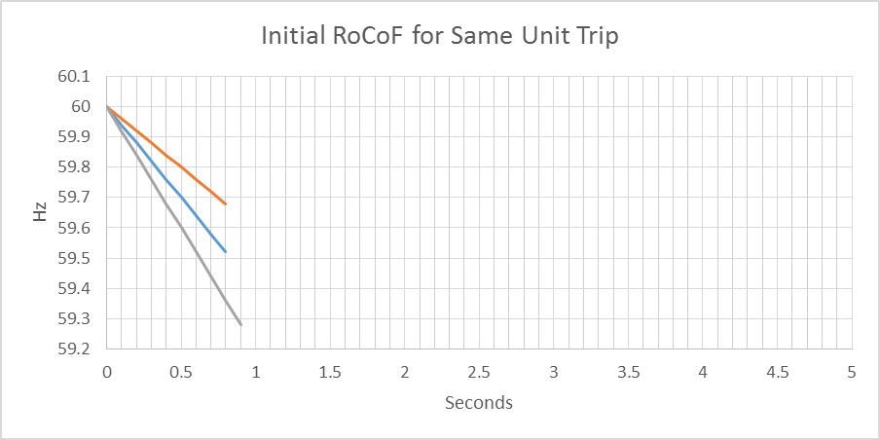
Rate of Change of Frequency
Higher Inertia
Lower Inertia

Slide 14
Response Time
Early – response is triggered earlier after the unit trip (e.g. a Resource that triggers at 59.8Hz would respond earlier than a Resource that triggers at 59.7Hz, all else equal)
Fast – response is delivered faster after the unit trip (e.g. a Resource that trips within 15 cycles is faster than one that trips within 30 cycles)

Slide 15
Response Times
Load Resources (LR) providing RRS have underfrequency relays that respond in about 0.5s after the frequency drops below the trigger level (currently 59.7Hz)
Governors of thermal generating units begin to respond “immediately” but will take a few seconds to provide significant response (requires more steam or more combustion)
Notes:
RRS – Responsive Reserve (Service)

Slide 16
Inertia Issues
Must maintain at least a Critical Inertia Level that is based on the current operation practices and characteristics of frequency responsive resources
As system inertia approaches critical level, RRS requirements increase exponentially

Slide 17
RRS Required as Critical Inertia is Approached
Studies have shown that the amount of RRS (if all provided by gen) required goes up asymptotically as inertia approaches the critical level

Slide 18
Critical Inertia
The level of inertia which causes the frequency to drop below the UFLS trigger before the “fastest” resources can provide sufficient frequency response (for the two STP trip) is the “Critical Inertia”
0.4 Hz
0.5 s

Slide 19
Critical Inertia
Currently, the Critical Inertia Level for ERCOT appears to be around 100 GW·s (based on current operations and response characteristics of current resources)
  Simulation results have shown that this is level at which RoCoF is high enough that frequency would drop below 59.3 HZ for the two STP trip
  Simulation results have also shown wide-area voltage oscillations at inertia below this level

Slide 20
Critical Inertia
Solutions
  Bring more synchronous units online
  Use resources that activate “earlier”
  Use resources that are “faster”

Slide 21
Impact of Resource Types
Load Resources help to lower the Critical Inertia Level and reduce the quantity of RRS needed as inertia approaches critical level (fast MW/s)
  Separating LRs so that some respond “earlier” (at 59.8Hz, e.g.) could provide additional improvement
  Moving some LRs to respond faster than 0.5s. Could also provide improvement

Slide 22
Impact of Resource Types

Slide 23
Critical Inertia Mitigation Solutions
Procure RRS from earlier and/or faster responding resources
Procure RRS from resources having relatively more inertia
Distribute RRS across a larger number of generators (results in faster aggregate response)

Slide 24
Number of Governors Supplying RRS
12 Governors

Slide 25
Reliability Risk Desk
To meet ERCOT’s strategic goal of adapting to the changing resource mix, staffing for a new desk in Control Room was approved in 2016-17 budget
Initial tools, procedures, staffing and training has been completed and new desk went live on 1/30/2017
  New Operations Procedures are posted – Power Operations Bulletin 770

Slide 26
Reliability Risk Desk
Facilitate improved accuracy of renewable forecasts
  Promote improved telemetry performance from wind/solar plants
  Perform forecast adjustments during icing and other extreme weather events
Maintain sufficient frequency responsive reserves
  Confirm critical level of inertia is online
  Ensure frequency responsive capacity is available to cover actual inertia conditions

Slide 27
Reliability Risk Desk Goals
Maintain sufficient temporally available capacity to cover remaining forecast errors and net load ramps

Slide 28
Reliability Risk Desk Tasks
Renewable Forecast and Extreme Weather Monitoring
Forecast Error Risk and NSRS Sufficiency
Intra-Hour Resource Monitoring
Inertia Monitoring and RRS Sufficiency

Slide 29
Renewable Forecast and Extreme Weather Monitoring
Reliability Risk Desk will:
  Monitor quality of data telemetered by intermittent resources and its accuracy in meeting the methodology outlined in ERCOT rules.
    Contact appropriate QSEs if needed to resolve the issues identified.

Slide 30
Renewable Forecast and Extreme Weather Monitoring
Reliability Risk Desk will:
  Monitor the current performance of renewable forecasts. Evaluate large forecast errors and correct the forecast if warranted.
  Monitor the probability of experiencing large wind output ramps and the sufficiency of the available ramping capability.

Slide 31
Inertia Monitoring and RRS Sufficiency
Reliability Risk Desk will:
  Monitor that the inertia on the system is above the Critical Level of Inertia
  Monitor adequacy of currently available RRS in comparison to the actual RRS requirement based on Real Time system inertia conditions.
AS Methodology Posted Minimums
Less synchronous unit commitment
More Frequency Responsive capacity needed
Less Inertia
RRS_{actual-req}
Less load and/or more wind

Slide 32
Inertia Monitoring and RRS Sufficiency
Reliability Risk Desk will:
  Evaluate the sufficiency of posted RRS requirement in the next 24 to 36 hour timeframe in comparison to the estimated RRS needed based on most recent COP submissions.
AS Methodology Posted Minimums
Less synchronous unit commitment
More Frequency Responsive capacity needed
Less Inertia
RRS_{actual-req}
Less load and/or more wind

Slide 33
Forecast Risk and NSRS Sufficiency Monitoring
Reliability Risk Desk will:
  Monitor the adequacy of scheduled resources (COPs) to cover the forecasted Load, ramp, and the uncertainty around the Load and renewable forecasts for the next 6 hours and identify hours with insufficiency
Net Load Forecast Error
Forecasted Load

Slide 34
Forecast Risk and NSRS Sufficiency Monitoring
Reliability Risk Desk will:
  Retain sufficient Non-spin in every hour to cover the higher of:
    Current level of net load ramp risk or
    Amount that will be needed, based on currently expected operating conditions, to restore frequency and recover contingency reserves
Net Load Forecast Error
Forecasted Load

Slide 35
Intra-hour Resource Monitoring
Reliability Risk Desk will:
  Monitor the short-term Load, wind and solar forecasts
    Intra-hour net load patterns due to load/wind/solar can be vastly different even with same hourly average values.
  Monitor the adequacy of available generation and reserves to cover the expected volatility in short-term net load over the next 60 minutes and identify sub-hourly intervals with insufficiency
  Tools for this functionality still under development

Slide 36
Operating Actions
Implementation of new desk should be almost imperceptible to stakeholders
  Additional analysis and monitoring to support current activities of existing desks
  Type and volume of resulting operating actions is not expected to change significantly
If additional resources are required to cover risk, will use existing tools and processes
  Order of actions are:
    Market responds
    Procure additional A/S as time permits
    RUC only as necessary maintain reliability

Slide 37
Objectives
List the four traditional risks that Operators encounter.
Identify how risk assessment is performed.
List the four stages of frequency response due to a generating unit loss.
Identify which type of generating units can provide system inertia.
Recall ERCOTs Critical Inertia level.
List the Reliability Risk Desk tasks.

Slide 38
Questions?

