Slide 1
NERC Event Compliance
Mark Henry
Director, Reliability Services, Texas RE
2017 Operator Training Seminar

Slide 2
Learning Objectives
Describe the process to complete a compliance review of a system event
Given a system event, identify requirement(s) of NERC Standards that may be applicable
Identify possible non-compliance with these standards
Notes:
What we really want is for you all to talk about how these NERC standards fit. Several are being revised and had an effective date of April 1, 2017. They really didn’t change too much, we’ve just tried to learn and adapt to ten years of formal compliance programs.

Slide 3
Texas RE Event Compliance Process
Receive notification of event occurrence
Request brief reports and data as necessary for the event
Compile a sequence of events (SOE) for the system event
For each step in the SOE, identify applicable NERC Standard requirements
For each step in the SOE, identify if the requirement is applicable to the entity involved based on their NERC registration
Identify possible non-compliance with each requirement utilizing the IRAC tool (Issue, Rule, Analysis, Conclusion)
* Through the NERC Events Analysis process

Slide 4
Compliance Self-Assessment
Entities are expected to perform a critical self-assessment of standards and to develop a compliance self-assessment report proportional to the significance of the event/risk to the bulk power system (BPS)
After identification of the applicable NERC Reliability Standard requirements, entities should identify possible non-compliance based on actions taken (or not taken)
If possible non-compliance is noted, entities should utilize the NERC self-report process

Slide 5
Translating ERCOT to NERC terms
Applicability of standards depends on this!
ERCOT ISO is the NERC Reliability Coordinator (RC)
ERCOT ISO is the NERC Balancing Authority (BA)
ERCOT ISO and the Transmission Service Providers share the role of Transmission Operator (TOP)
Resource Entities and Qualified Scheduling Entities address the NERC Generator Owner (GO) and Generator Operator (GOP) roles
Distribution Service Providers – at least the larger ones – fit the role of NERC Distribution Provider (DP)
Both NERC and ERCOT now call Special Protection Schemes (SPS) a Remedial Action Scheme (RAS)

Slide 6
NERC Standards Subset for this Exercise
COM-002-4 – Three-part communications
EOP-004-3 – Event reporting
EOP-011-1 – Implement emergency plans
PRC-001-1.1 – Protection schemes familiarity, status reporting and corrective actions
TOP-001-3 – Operating instructions, monitoring SPS and managing operations within System Operating Limits
TOP-002-4 – Next-day operations planning
VAR-001-4.1 – Transmission Operator voltage control
VAR-002-4 – Generator Operator voltage support

Slide 7
Compliance Review – IRAC tool example
Issue
Generator X tripped due to failed 46 relay @ 15:01.
Rule
PRC-001-1.1 R2 Each GOP and TOP shall notify reliability entities of relay or equipment failures as follows:
R2.1. If a protective relay or equipment failure reduces system reliability, the GOP shall notify its TOP and Host BA. The GOP shall take corrective action as soon as possible.
Analysis
The GOP properly analyzed the unit trip and determined that a failed relay was the cause. The GOP notified ERCOT and took corrective action to replace the relay.
Conclusion
No further review is suggested.
GOP notified ERCOT of the unit trip @ 15:04.
GOP notified ERCOT of relay misoperation @ 16:24.
Per the GOP, a replacement relay was installed and calibrated two days later.
Notes:
Animate the table so that text in each column’s second row drops in sequentially from the left

Slide 8
Group Exercise Instructions
Form a group with the table behind you. Write your names and company on the cover sheet for your “IRAC”.
Each group will be given one of the numbered scenario exercises from the pages that follow to prepare an “IRAC”. Write that scenario number next to the list of group members.
Fill in issues, applicable standards (number and requirement), brief analysis and conclusion. We will discuss after the break. Turn in the IRAC with names and scenario number on the way to lunch.
Notes:
Change to

Slide 9
Areas to Consider in Scenarios
  Communications:
    Were any Operating Instructions given or received?
    Was three-part communication used?
  Protection systems:
    Were operators familiar with the purpose/limitations of the relays?
    Were there any known equipment failures?
  Security:
    Was the TOP operating in a N-1 state?
    Was the status of all lines and resources being monitored?
    Was the BA operating with sufficient reserves for the contingency?
    Were studies performed?
  Status reporting:
    Were the TOP/BA aware of the unit’s status change?
    Is this a NERC-reportable event?

Slide 10
Scenario 1 – Bus Outage
Surge arrestor failed at a 700 MW generator’s substation bus, clearing the bus, tripping the generator and opening 4 transmission lines.
Another 600 MW generator located two buses away tripped, caused by a protection system misoperation.
Frequency recovers in 6 minutes since over 4300 MW of reserves are available; RC and TOP find no transmission security violations afterwards while the bus is out of service.
Later it is learned that the misoperation was the result of protection system communications equipment being out of service for repair. No one had filed notice of the work on the communication equipment.
Notes:
EOP-004 R2
TOP-001 R1, R10, R11
PRC-001 R2.1

Slide 11
Scenario 2 - EMS Outage
An EMS technician loaded an incorrect system model into the RC Energy Management System. The incorrect model load caused the complete shutdown of the EMS at the primary and backup sites for two hours.
The RC declared an Emergency and issued instructions for all TOPs to monitor their systems. These instructions were repeated, acknowledged and executed.
The BA issued emergency basepoint instructions for all generators and ordered one GOP to maintain constant frequency control. These instructions were repeated, acknowledged and executed.
Notes:
EOP-004 R2
COM-002 R5, R6, R7
EOP-011 R2(?)
TOP-001 R2, R5, R11(?)

Slide 12
Scenario 3 - Plant Trip
Two combined cycle plants, 1250 MW total generation, tripped due to protective relay misoperation in the interconnecting substation. The BA observed sufficient capacity and reserves to meet demand despite loss of this generator.
Loading on a nearby line exceeded a post-contingency rating as a result of the changes to transmission flow. A mitigation plan prepared for this contingency was initiated by the TOP, with instructions issued to a transmission company to perform switching, however the RC was not also notified. These instructions were repeated, acknowledged and executed.
Further review showed a failed protective relay component in the substation was discovered 3 days prior to the event but notification was not provided to the TOP or BA made about possible impacts. The GOP personnel involved did not appear to understand limitations of the protection system.
Replacement parts for the failed component were ordered, arrived the next day by FedEx and were installed, returning the protection system to service.
Notes:
EOP-004 R2
COM-002 R5, R6
TOP-001 R1, R8, R10, R11, R14, R15
PRC-002 R1, R2.1

Slide 13
Scenario 4 - Icing
Extreme cold weather predicted 3 days prior. Studies run to identify any capacity or deliverability issues found no issues for the next day, but load-generation balance was tight.
During extremely cold weather, seven wind plants in aggregate de-rated their planned output by 750 MW as ice formed on turbines; another four were forced to shut down, adding 425 MW, total 1175 MW. Transmission studies showed a secure area and reserves remained adequate.
A 138 kV transmission line developed galloping conductors. The owner called the RC to report that the line must be manually removed from service. Studies showed this would create a post-contingency overload on another line of 120% of emergency rating.
A mitigation plan developed by the TOP to address the overload required 15 MW of load shed. Instructions were issued to the DP to shed load, but there was no repeat back of the instruction. 50 MW of load was shed and the transmission line’s post-contingency rating returned to normal conditions.
Notes:
EOP-004 R2
COM-002 R5, R6
TOP-001 R1, R5, R7.2, R8, R10.1, R11, R14, R15
TOP-002 R1, R2, R4

Slide 14
Scenario 5 - Storm Damage
A pair of tornados swept through an area and blows over towers on three transmission lines and damaged a capacitor bank at a substation, all of which are reported as forced outages by the owner.
A nearby generator had a failure of its Automatic Voltage Regulator (AVR) and was not maintaining its voltage profile manually. Neither the generator or QSE (GOP) had contacted its transmission company or the RC.
Transmission studies by the TOP indicated post-contingency voltage in the emergency range after accounting for the outages. Instructions were issued to the generator to manually raise its voltage and to a local transmission owner to put a capacitor bank in service. Instructions were repeated, acknowledged and carried out as requested.
Notes:
EOP-004 R2
COM-002 R5, R5
TOP-001 R1, R3, R10, R14, R15
VAR-001 R2, R3
VAR-002 R1, R2

Slide 15
Scenario 6 - North-Houston
Sudden storms during record August heat resulted in the loss of several 345kV and 138kV transmission lines into Houston. The North-Houston voltage stability limit, an IROL, was exceeded.
The RC and TOP evaluated the condition and declared a Transmission Emergency Condition. Hotline calls were made and repeated by one of the receiving operators, with acknowledgement.
Due to extreme loading, an additional call to a TOP was made for load shed. The TOP instructed its DP to shed load in two 100 MW blocks. The instruction was repeated by the recipient, acknowledged and then executed.
A generator ordered to run had not complied with instructions but cited that they would exceed emissions limits. Its GOP had contacted the BA with the issue.
Notes:
EOP-004 R2
COM-002 R5, R6, R7
EOP-011 R1
TOP-001 R1, R3, R4, R5, R6, R10, R12, R14, R15

Slide 16
Scenario 7 - Hurricane
As landfall of a massive hurricane approached, the BA issued an Emergency through a hotline call to implement planned response to mitigate possible capacity and energy emergencies. The call was repeated by one receiving operator and acknowledged.
Firm load over 300 MW was lost for several hours due to distribution issues in the storm.
Analysis of transmission showed post-contingency voltage violations. The transmission company re-deployed its static reactive reserves to address the condition, then contacted the RC.
Additional reactive support was necessary, and the TOP requested nearby generation to lower voltage. The GOP indicated that it could not lower voltage the full amount requested due to excitation limiters. After discussion, a revised instruction was issued, repeated back by the GOP, and acknowledged.
Notes:
EOP-011 R2
EOP-004 R2
COM-002 R5, R6, R7
TOP-001 R1, R5, R6, R10, R14, R15
VAR-001 R3

Slide 17
Scenario 8 - SPS/RAS
A planned outage on a transmission circuit created abnormal line loading conditions observed in next day studies; however an SPS/RAS was available to address conditions.
During current day operations, the SPS/RAS activated and sent a runback signal to a generator to reduce output to manage line loading. However, the generator did not respond within the allowed time and the SPS/RAS sent a trip signal, which eliminated the line loading. The GOP operator on duty was not familiar with the SPS/RAS function.
The TOP did not notice that the SPS/RAS was activated. The RTU at the plant substation had been offline for maintenance for the last 2 days. The communication circuit between the substation and the SPS/RAS was also affected by the RTU outage, which was the cause for the generator failure to respond.
Notes:
TOP-002 R1, R2
TOP-001 R9, R10.1, R11
PRC-001 R1, R2.1, R6

Slide 18
Scenario 9 - Extreme Cold
Extreme cold weather predicted 3 days prior. Studies run to identify any capacity or deliverability issues found no issues for the next day, but load-generation balance was tight.
That morning, a “Watch” was issued via hot line call with instructions to cancel any planned transmission outages. One TSP operator echoed back the Watch and instruction.
An post-contingency SOL exceedance developed. A transmission line planned outage was expected to be cancelled, but was still out of service. A Temporary Outage Action Plan (TOAP) was identified and used to manage the security violation by performing switching on another line.
Instructions were repeated, acknowledged and executed. The RC was notified.
Notes:
TOP-002 R1, R2, R4
COM-002 R7
TOP-001 R1, R10, R14, R15

Slide 19
Review
What did you find in reviewing the fit between these NERC Standards and the scenarios?
In actual events, additional information is requested to confirm the facts and fill in any gaps, even when possible violations are self-reported.

Slide 20
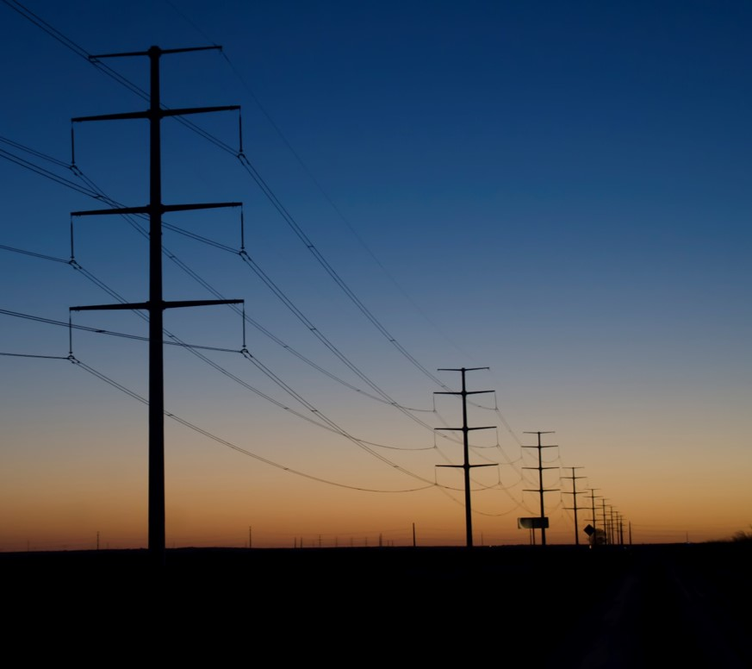
Questions

