Slide 1
Fossil Fuel Generation & Natural Gas Pipelines
Charlie Stone
Jeff Hardgrave

Slide 2
Objectives
Identify the Changing Resource Capacity Mix in ERCOT
Recognize the Changing Role of Natural Gas in the Future Capacity Mix
Identify Infrastructure Required to Support Natural Gas Generation
Identify Challenges for the Natural Gas Industry as it Relates to System Restoration from a Black Start Event
Notes:
Electric Generation Mix in ERCOT
Changing Role of Natural Gas Generation
Infrastructure Required to Support Natural Gas Generation Mix
Black Start Coordination

Slide 3
Generation Mix
Substantial changes to electric generation mix
Changes due to regulatory requirements
Environmental concerns
Industry innovation and efficiencies
Changes in global commodity prices
Demand growth
Notes:
Read from slide.

Slide 4
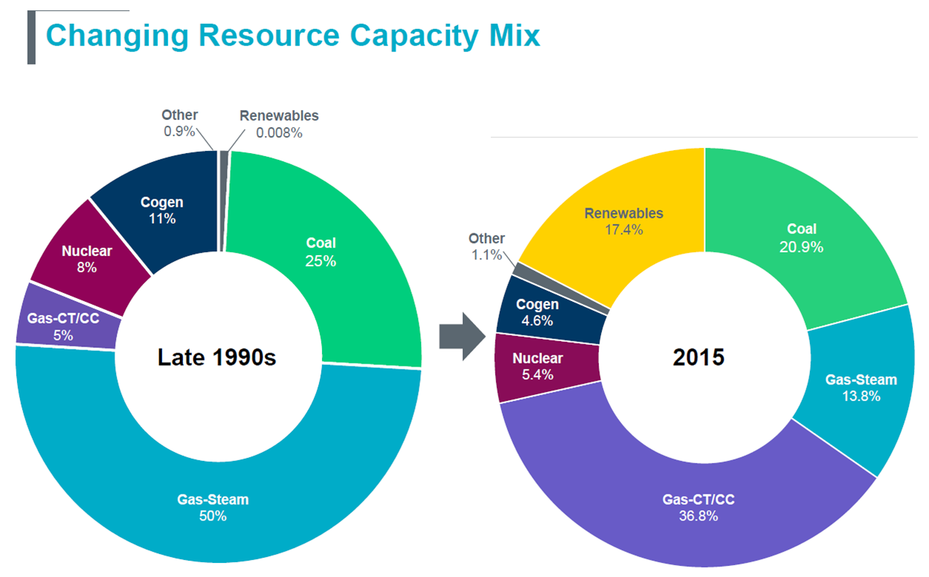
Notes:
The generation mix has been influenced by many outside factors including environmental regulations, government subsidies to renewable energy sources, EPA emissions regulations and national and global commodity prices.
Nuclear generation faces issues of waste rod disposal and public perception of safety (Chernobyl and Fukushima). Expansion projects at both Comanche Peak and South Texas Project have been placed on hold.
Coal Generation is becoming uneconomical due to costs for emissions compliance and low natural gas cost.
Cross State Air Pollution Rule (“CSAPR”)
Regional Haze requirements
Clean Power Plan
Could cause the retirement of up to 8,700 MW of coal capacity in near future
Government subsidies for wind and solar projects have greatly changed how power is priced and subsequently dispatched. Federal Production Tax Credit of $23/mwh continues through 2019. At 3.4 million Btu per megawatt-hour, that’s $6.76 per million Btu. (Compare to HSC Gas at $2.67 per MMBtu) Additionally, many wind projects also receive local and state subsidies.
Due to new technological breakthroughs in horizontal drilling and fracking the US is producing more low cost natural gas. In November 2016, the U.S. Geological Survey announced the largest continuous oil and gas deposit ever discovered in the U.S. The Wolfcamp shale contains 20 billion barrels of oil and 16 trillion cubic feet of natural gas.
Natural gas generators are becoming more efficient with Heat Rates dipping below 6,000.
Natural gas fleet moving toward more quick start units.

Slide 5
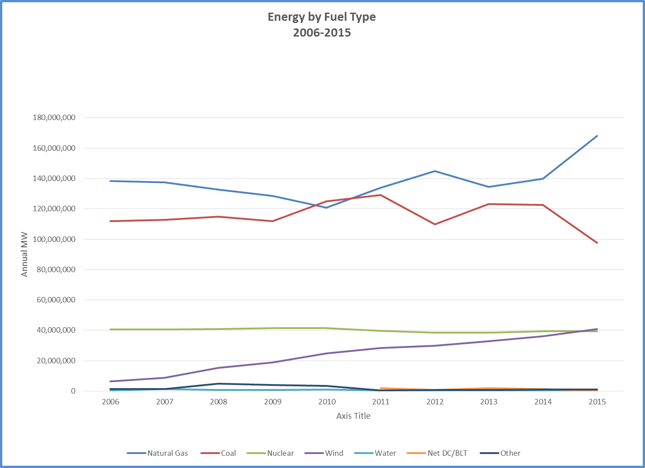
Notes:
Wind, solar and gas generation have been increasing since 2006.
Gas has received greatest increase in the past year. This increase is mainly due to spike in wind generation, but the decrease in coal is also a factor.

Slide 6
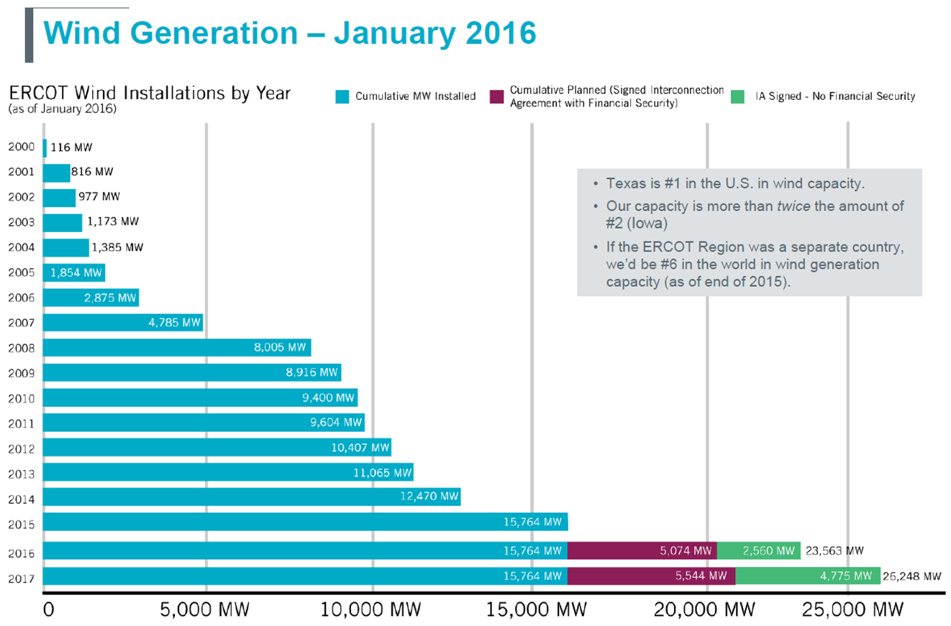

Slide 7
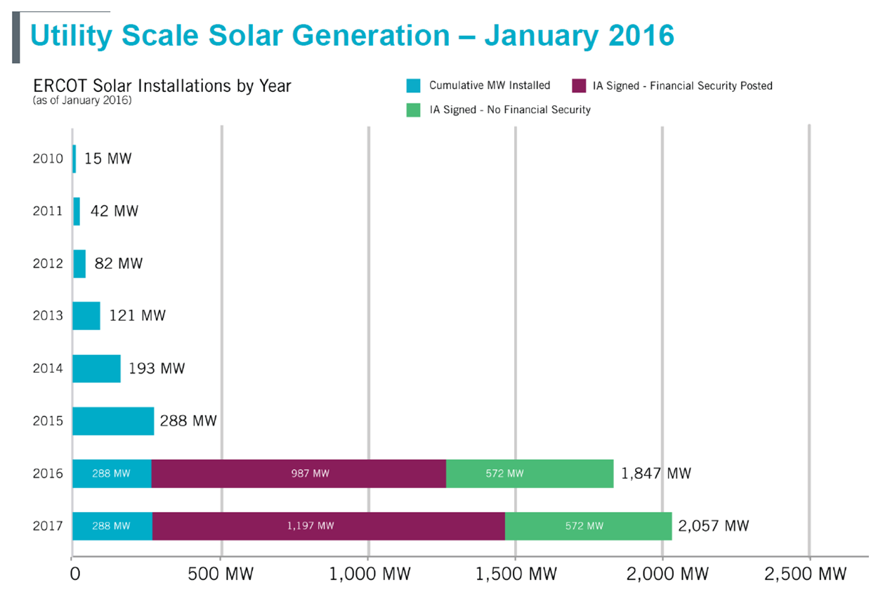

Slide 8
October 2016 Generation Interconnect Status Report
New Resources Approved for Synchronization/Commercial Operations
No. of Projects Fuel MW for Grid Earliest COD
6 Wind 1,293 10/13/2016
Generation Interconnect Agreements as of October 2016
No. of Projects Fuel MW for Grid Projected COD
1 Coal 240 12/2019
24 Gas 19,431* 12/2016 – 09/2019
21 Solar 2,179 07/2016 - 07/2020
1 Storage 324 12/2018
50 Wind 11,273 10/2016 – 12/2019
* 8,231 MW Simple Cycle such as Combustion Turbines
11,200 MW Combined Cycle
Notes:
Wind and Solar represent 73% of the current Interconnect Agreements.
Gas projects only represent 5,979 MW more than renewables. Many of the Gas projects will not make it to the construction phase. Developers have secured air permits, water rights and interconnect agreements, but are still waiting on market signals to make a final financial investment decision at which point they will have to obtain project financing.

Slide 9
Summary of Trends in Generation Mix
Expansion of existing or additional nuclear generation facilities on hold
Coal generation anticipated to continue to decrease
Continued growth in renewables
Wind generation
Solar generation
Changing role of natural gas in supply mix
Bridge fuel
Move from baseload to peaking
Notes:
As the market moves towards more renewable fueled generation, the role of gas generation will change.
Gas generation will migrate to more peaking services and less baseload generation. This causes the pipelines to operate less efficiently and will need to build additional infrastructure to accommodate the quick start CTs.
More gas storage, pipeline compression and excess pipeline capacity are required to facilitate the hourly swings in gas consumption.

Slide 10
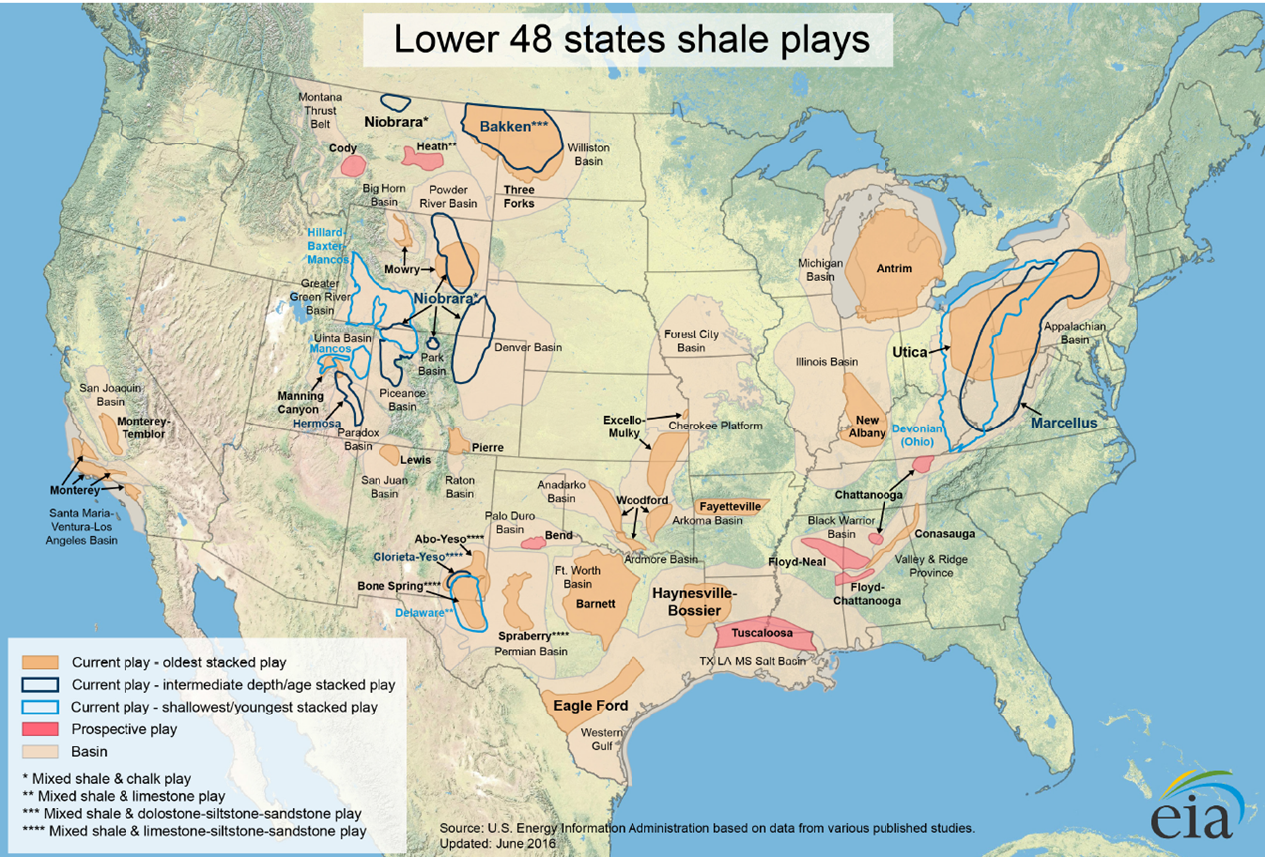
Notes:
US Natural Gas and Oil production continues to increase.
US is now an exporter of energy commodities.
Advances in the use of new technology and techniques in drilling and fracking have made production more predictable.
Map represents more than 2,552 Tcf of natural gas resources as of today and over 100 years of available resources
By 2020 projections are the available natural gas resources will just about double
Per the 2016 EIA Annual Energy Outlook Report for US Dry Natural Gas:
2015 Production – 28 Tcf 2040 Production - 42 Tcf
Imports – 3 Tcf Imports - 2 Tcf
Exports - 2 Tcf Exports - 9 Tcf
Consumption - 29 Tcf Consumption - 35 Tcf
2015 Elec. Cosumption – 9.1 Tcf 2020 Elec. Consumption – 12 Tcf
In Texas: Barnett and Eagle Ford plays are the 2 largest in production. Wolfcamp is the next big development prospect.
Per the RRC, as of 2012,
900 operating rigs (47% of US total)
97,000 producing natural gas wells (20% of US total)
Produced 7.5 Tcf of marketed natural gas (30% of US total)

Slide 11
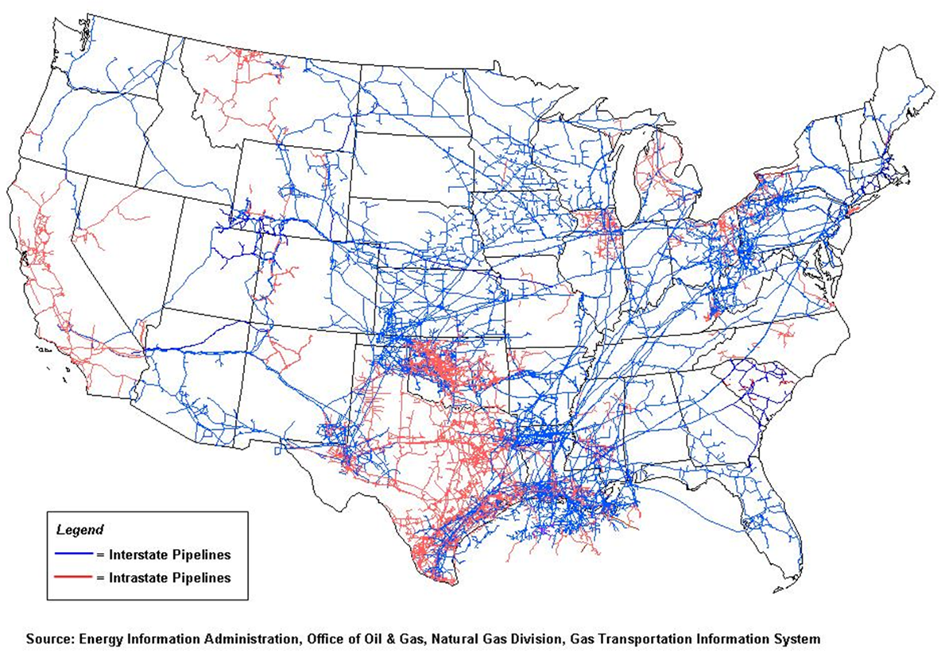
Notes:
Interstate Pipelines: a natural gas pipeline transportation system extending beyond state boundaries and subject to FERC jurisdiction
Intrastate Pipelines: a natural gas pipeline system that is within a state and not subject to FERC jurisdiction
Typically range in size from 16” to 48” in diameter with most Interstate Pipelines being 24” to 36” in diameter
There are over 240,000 miles of Interstate natural gas pipelines and over 98,000 miles of intrastate pipelines.
Texas has approximately 22,000 miles of Interstate pipelines.

Slide 12
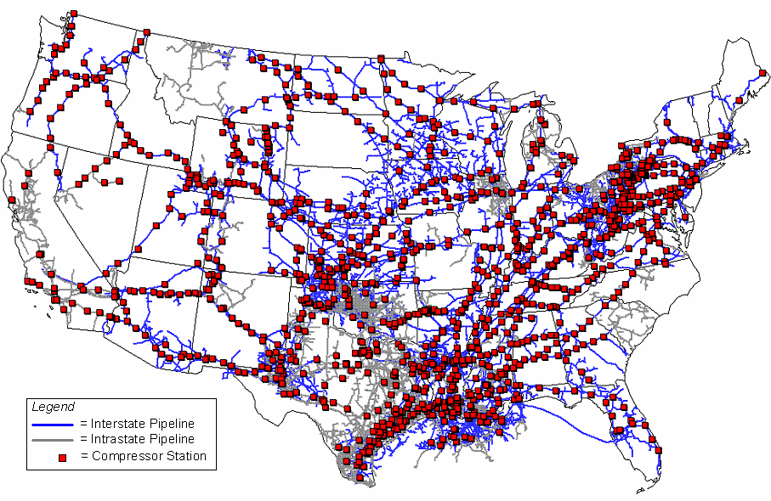
U.S. Natural Gas Pipeline Compressor Stations
Notes:
More than 1400 natural gas compressor stations
Comprised of reciprocating and combustion engines or electric motors
Typically 40 to 100 miles apart
40 million horsepower of compression with only 2.5% of that being electric
Most new stations are electric due to permitting and environmental reason, plus low maintenance and higher efficiencies
Electric compressions is used extensively in the rich gas plays for processing. A single processing facility may install up to 60 MW of electric compression or more.

Slide 13
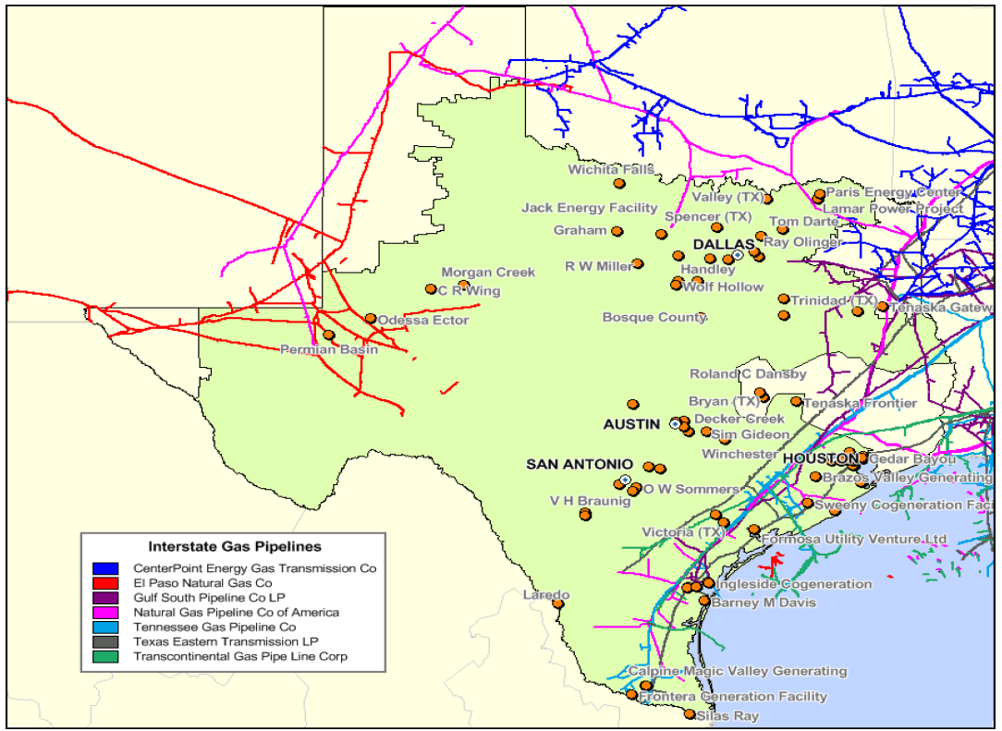
Interstate Pipelines Serving ERCOT Generators
Notes:
There are at least 7 interstate pipelines serving generators within ERCOT
These pipelines are subject to jurisdiction Federal Energy Regulatory Commission
Terms and conditions of operation are narrowly defined by Statement of Operating Conditions filed with FERC

Slide 14
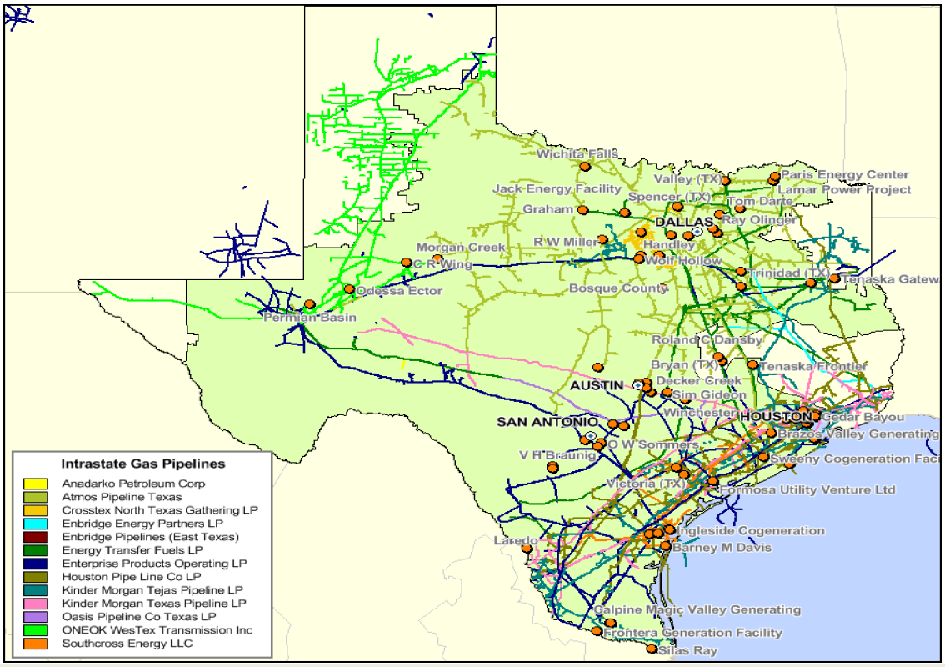
Intrastate Pipelines Serving ERCOT Generators
Notes:
There are at least 13 intrastate pipelines serving generators within ERCOT
These pipelines are subject to jurisdiction of the Texas Railroad Commission
No FERC jurisdiction
Terms and conditions are more broadly defined by Statement of Operating Conditions filed with the TRRC
Typically intrastate pipelines have more flexibility in how they are able contract and operate
Texas has more intrastate natural gas pipelines than any other State. California is second.
Based on Texas RRC data for 2013
Intrastate is approximately 138,000 miles with about 33,000 miles of this for transmission from gathering lines or storage facilities to LDC and the remaining 105,000 miles for local distribution.

Slide 15
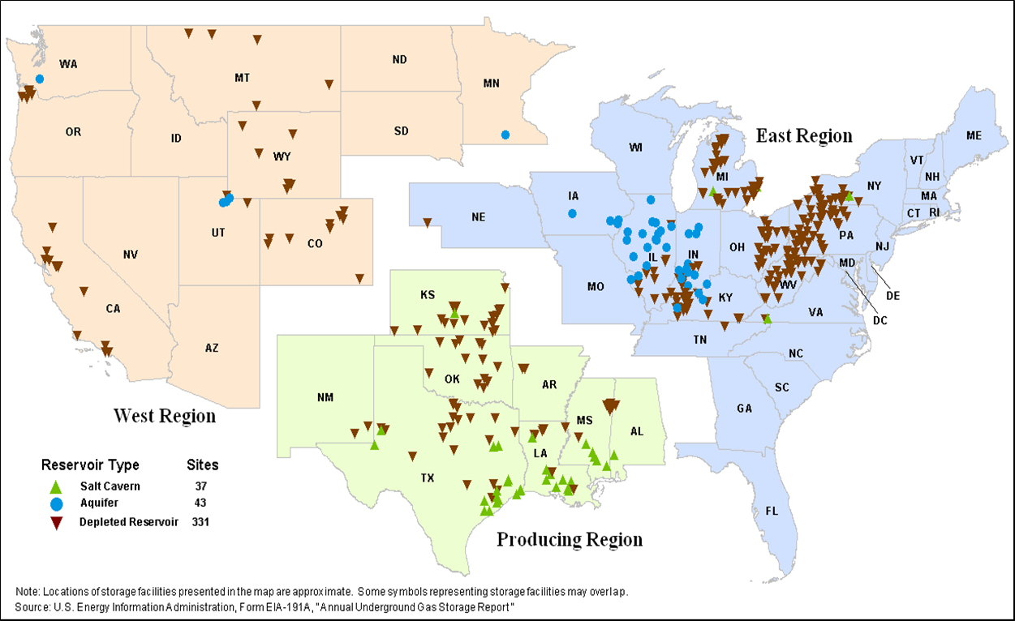
U.S. Underground Natural Gas Storage Facilities
Notes:
3 regions that report to the EIA on Natural Gas Storage on a weekly basis; East, West and Producing
3 types of storage; Salt Caverns (Domes), Aquifers and Depleted Reservoirs
US Total Storage Capacity, which is volume of natural gas that can be stored underground, is around 9,031 Bcf
Working Gas Capacity, which represents the total Storage Capacity minus Base Gas, is around 4,681 Bcf
Base Gas is permanent gas in storage to maintain adequate pressure
In Texas, there is a Total Storage Capacity of around 850 BCF and a working Gas Capacity of 532 Bcf

Slide 16
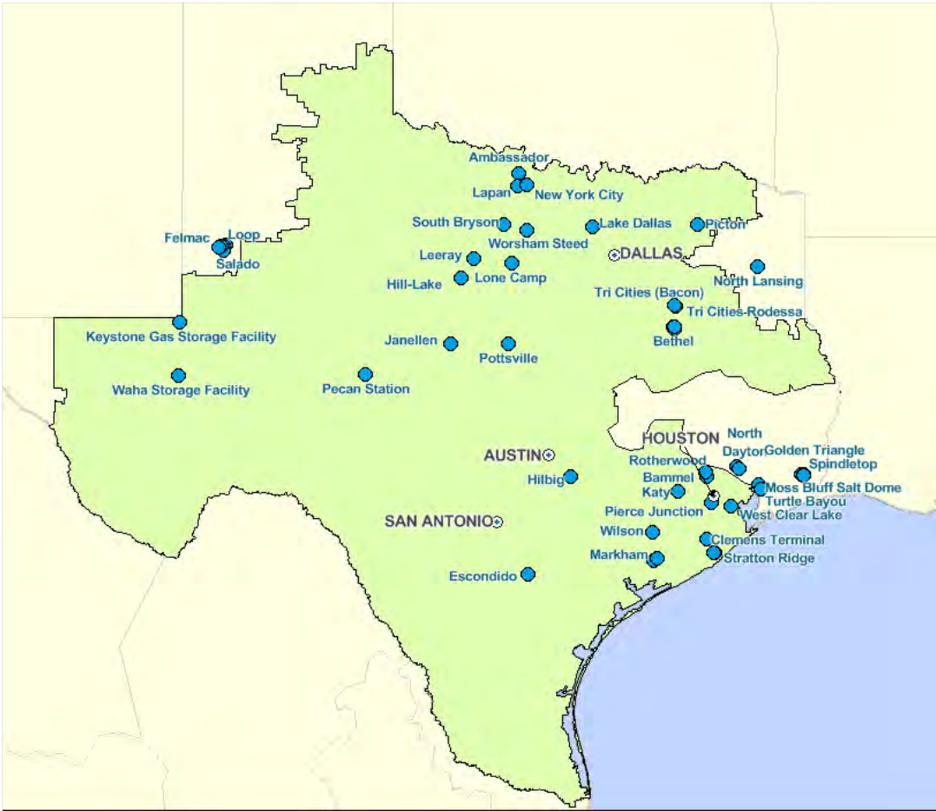
Gas Storage Facilities Serving ERCOT Generators
Notes:
These are depleted natural gas or oil fields that are converted from production to storage
Takes advantage of existing wells, gathering systems and pipeline connections.
Most commonly used because of their wide availability

Slide 17
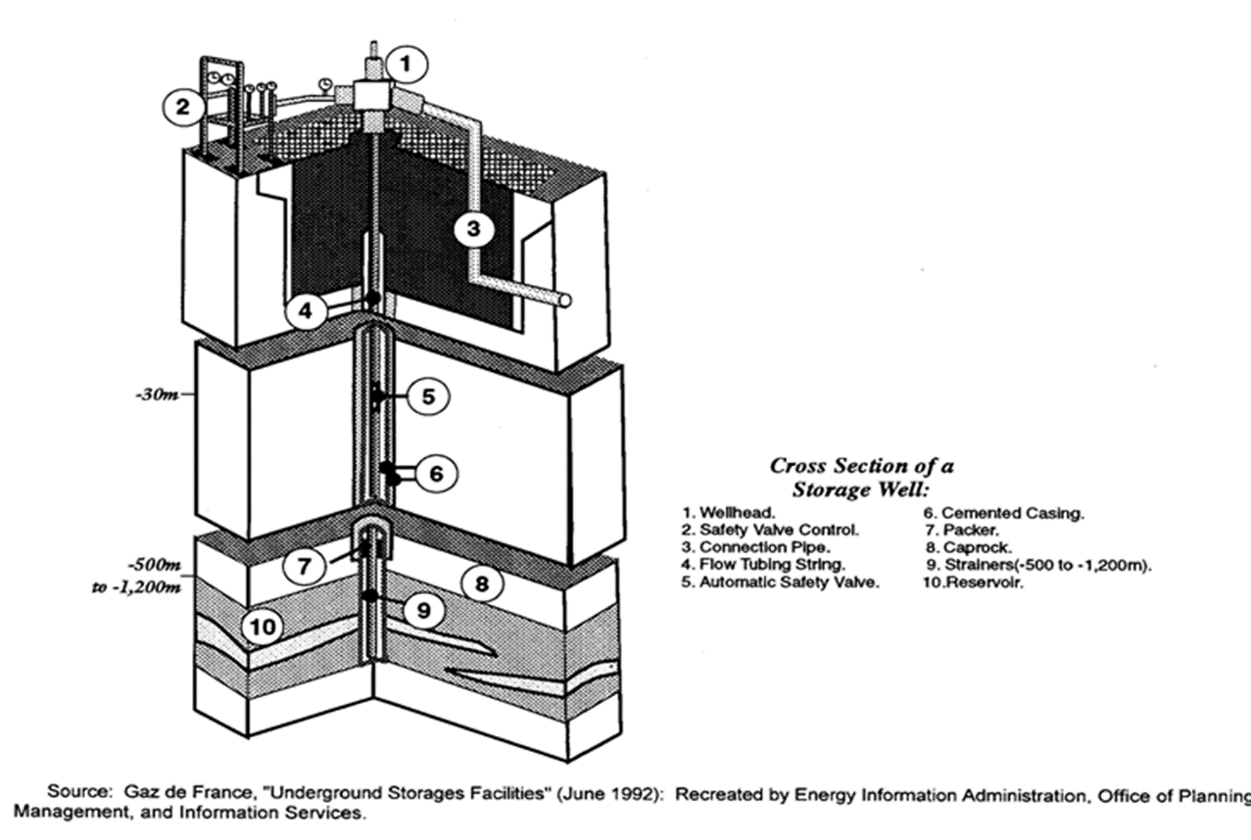
Depleted Reservoir Storage Well
Notes:
Majority of these are located on Gulf Coast
Base Gas requirements are relatively low
They are more costly but ability to have several injection and withdrawal cycles each year reduces the per unit cost
Large as 5,200 ft. in diameter and from 1,500 to 5,900 ft. below the surface

Slide 18
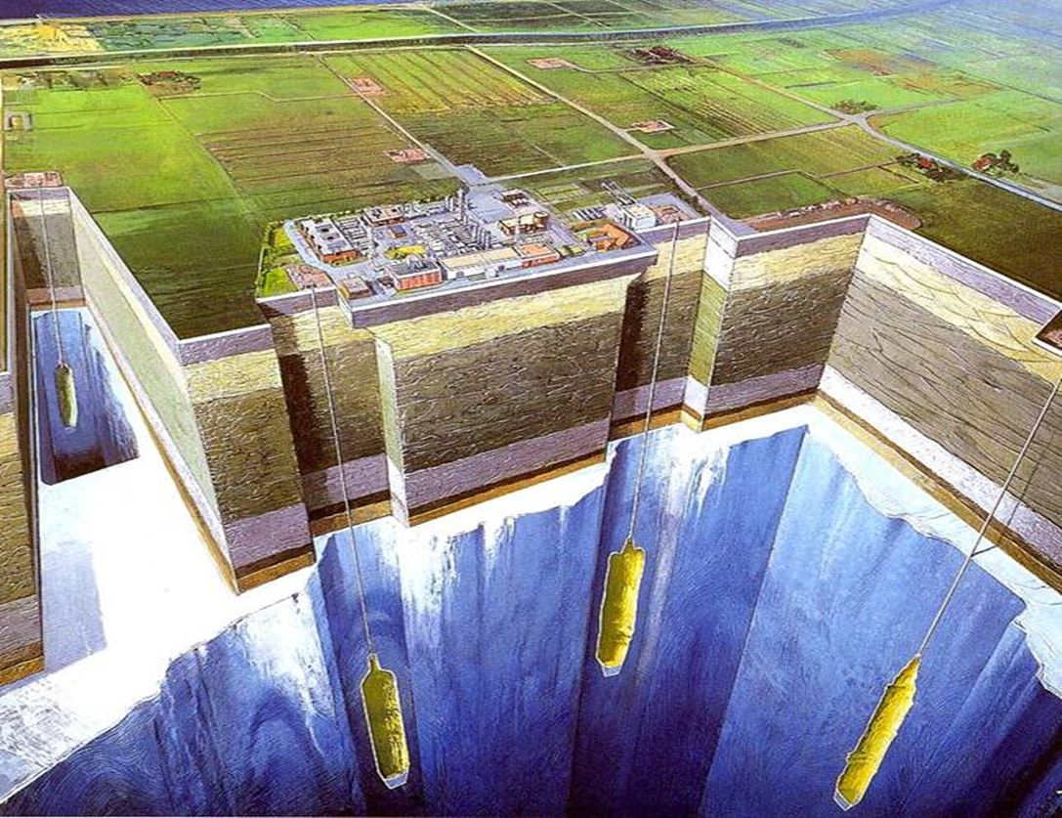
Salt Cavern Underground Storage
Notes:
Use pointer and go through the various steps

Slide 19
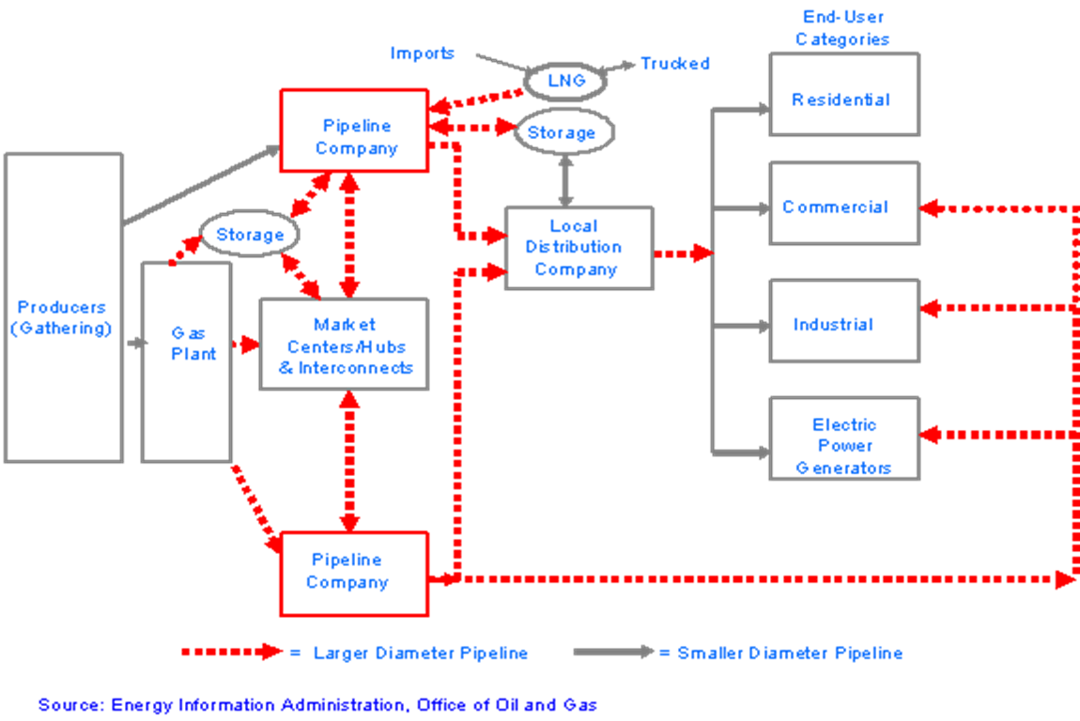
Natural Gas Transmission Path

Slide 20
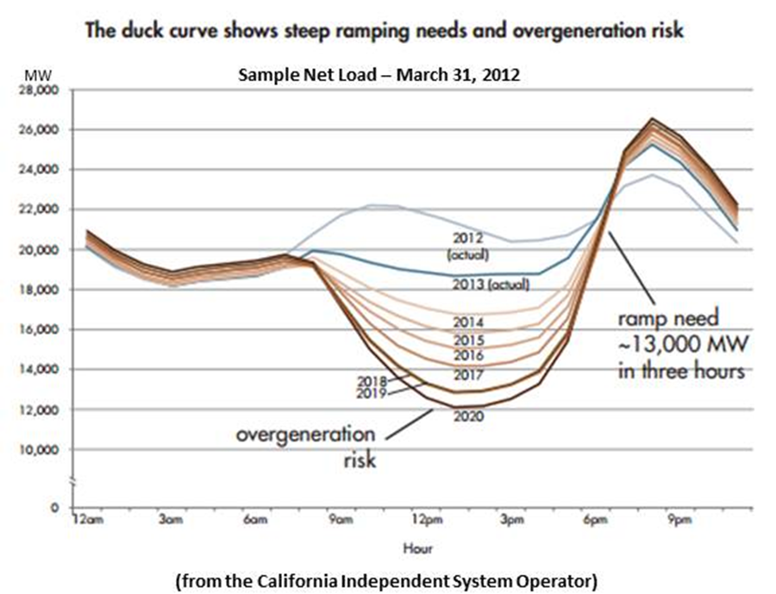
A Case for Storage - Duck and Armadillo

Slide 21
A Case for Storage - Duck and Armadillo (cont.)

Slide 22
Winter Event
Preparation
Gas Control
Volume Management
Operations
Alert Levels
Level 1 – Normal Conditions
Level 2 – Artic Front 2 days from Region
Level 3 – Severe Winter Weather caused by Artic conditions
Notes:
Preparation (Fall/Winter, between December 1 and March 31)
Gas Control - Gas Control determines the Winter Storm Alert Levels
Proactively address artic conditions as they are forecast
Automate Imbalance reports
Train night time Controllers to manage interconnect points
Review interconnection contact lists
Categorize meter sites per Texas RRC curtailment priority
Notify Texas RRC and operations of any curtailments.
Volume Management
Monitor deliveries to match approved nominations and available supplies
Monitor shippers to prevent over-pull or under supply situations
Responsible for cutting non-preforming receipt points and reallocation of deliveries
Operations
Check delivery/receipt points for winterization, such as
heat tracing and catalytic heaters
On pipelines check methanol inventory and injection pumps,
system wide, inspect heaters at stations,
install heat tracing at appropriate compressor stations
At storage locations install heat tracing on all cavern heads and water lines.
Maximize operational inventory in all caverns.
Alert Levels
Level 1: Normal Conditions
Level 2: Artic front 2 days from region
Cancel all maintenance work on equipment
Start and run critical engines to insure reliability
Personnel are put on standby
Prepare to Staff critical stations
Level 3: Severe Winter Weather caused by Artic Conditions
Pre-fill storage, if possible
Pressurize/Pack the lines, and

Slide 23
Winter Event
During Event
After Event
Cold Weather Related Issues
Electrical Outages
Transmission Related
Distribution Related
Gas Supply
Ice Freeze-Offs
Rotating Load Shedding
Notes:
During Event: (as pipeline conditions dictate, Level 3 situation)
Suspend loans, deferred deliveries and advances
Police interconnect points, shippers and joint owners
Maintain at least a minimum cavern pressure
Remind firm customers of uniform hourly rate provisions
Short deliveries on interstate and intra state pipelines
Curtail end use customers - Notify Texas RRC
After Event: (back to Level 1 – Normal Conditions)
Require payback from under-preforming shippers
Require payback from under preforming interconnect points and joint shippers
Restore line pressure/pack and storage inventory

Slide 24
Curtailment Program
Priorities
A – use in residences, hospitals, schools, churches, public safety buildings, agriculture and other human needs
B – (1) small commercial/industrial customers (2) plant protection to prevent danger to personnel and facilities
(3) for human needs at commercial and industrial sites
(4) power generation for start up, safety and flame stabilization
C – medium size commercial customers
D – medium size industrial customers
E – (1) industrial customers for feed stocks
(2) small public utility electric generating systems

Slide 25
Curtailment Program
Priorities
F – power generating plants for electricity to serve customers in A above and small commercial/industrial costumers
G – (1) medium size commercial customers
(2) small industrial not qualifying in B, C, D or E above
H – power generating plants for electricity not included in F
and B (4) above
I – (1) large users with no alternative fuels
(2) Feedstock as defined in E above with greater
consumption
J – boiler fuel and other indirect flame applications not
qualifying under a preceding priority
Notes:
Priorities – based on Firm Contract Loads
E – (2) defined as a generating station that uses less than 3,000 Mcf on an average day
F – defined as small commercial and industrial customers using 20,000kWh or less on an average day

Slide 26
Curtailment Program
Priorities
K – Interruptible sales – Railroad Commission requires
interruptible sales interrupted prior to curtailment of
A through J above.
L – Interstate sales – these are to be interrupted prior to beginning curtailment of A through K above and as
required by law.

Slide 27
Black Start Gas Coordination Group
Formed in Late 2013 and comprised of
ERCOT
Transmission Service Providers (TSPs)
Qualified Scheduling Entities (QSEs)
Resource Entities (Res)
Gas Transmission Operators (GTOs)
Gas Suppliers (GS)
Address coordination of gas supply during Black Start
Development of Gas Black Start Restoration Plans
Identify critical gas facilities and infrastructure
Identify transmission/distribution suppliers
Notes:
Formed in late 2013 and comprised of:
ERCOT
Transmission Service Providers (TSPs)
Qualified Scheduling Entities (QSEs)
Resource Entities (REs)
Gas Transmission Operators (GTOs)
Gas Suppliers (GSs)
Address coordination of natural gas supplies during Black Start
Development of Gas Black Start Restoration Plans
Identify critical gas facilities/infrastructure
Identify transmission/distribution suppliers

Slide 28
Black Start
Normal Conditions
Power Plant
Power Plant
Power Plant
Gas Processing Plant
Gas Processing Plant
Compressor Station
Compressor Station
Underground Storage
Gathering Field
Compressor Station
Gas Processing Plant

Slide 29
Black Start
1st Hour
Black Start Unit-1
Black Start
Unit-3
Black Start Unit-2
Gas Processing Plant
Gas Processing Plant
Compressor Station
Compressor Station
Underground Storage
Gathering Field
Compressor Station
Gas Processing Plant

Slide 30
Black Start
Beginning of Hour 1
Black Start Unit-1
Island #1 – TO #1
Island #3 – TO #3
Underground Storage on back-up Generator
Island #2 – TO #2
Gas Processing Plant
Compressors on back-up Generator

Slide 31
Black Start
By End of Hour 1
Black Start Unit-1
Island #1 – TO #1
Gas Processing Plant
Energized
Island #3 – TO #3
Underground Storage
Energized
Island #2 – TO #2
Gas Processing Plant Energized
Notes:
Hour 1 of Black Start scenario

Slide 32
Black Start
Hour 2
Black Start Unit-3
Black Start Unit-1
Black Start Unit-2
Gas Processing Plant
Island #1 – TO #1
Island #3 – TO #3
Compressor Station Energized
Compressor Station Energized
Gas Processing Plant Energized
Underground
Storage
Island #2 – TO #2
Gathering Field
Compressor Station Energized
Gas Processing Plant
Notes:
Hour 2

Slide 33
Black Start
Hour 3 and later
Black Start
Unit-3
Black Start Unit-1
Black Start
Unit-2
Black Start
Unit-4
Gas Processing Plant
Gas Processing Plant
Compressor Station
Compressor Station
Underground Storage
Gathering Field
Compressor Station
Gas Processing Plant
Notes:
Hour 3 and forward

Slide 34
Regulatory Agencies
Federal Energy Regulatory Commission (FERC)
Natural Gas Section
U.S. Department of Transportation
Pipeline and Hazardous Materials Safety Administration (PHMSA)
Office of Pipeline Safety (OPS)
Texas Railroad Commission (RRC)
Texas Attorney General
Texas General Land Office
Texas Comptroller’s Office
Texas Commission on Environmental Quality (TCEQ)
Texas Pubic Utility Commission (TxPUC)
Notes:
FERC – Natural Gas Section (Commission's Responsibilities)
Regulation of pipeline, storage, and liquefied natural gas facility construction
Regulation of natural gas transportation in interstate commerce
Issuance of certificates of public convenience and necessity to prospective companies providing energy services or constructing and operating interstate pipelines and storage facilities.
Regulation of facility abandonment.
Establishment of rates for services.
Regulation of the transportation of natural gas as authorized by the NGPA (Natural Gas Policy Act) and the OCSLA (Outer Continental Shelf Lands Act).
Oversight of the construction and operation of pipeline facilities at U.S. points of entry for the import or export of natural gas.
U.S Department of Transportation
Pipeline and Hazardous Material safety Administration (PHMSA)
Office of Pipeline Safety
Carries out a national program to ensure the safe, reliable and environmentally sound operation of the Nation's pipeline transportation system.
Supports the operation of, and coordinates with, the United States Coast Guard on the National Response Center. Also serves as a DOT liaison with the Department of Homeland Security and the Federal Emergency Management Agency on matters involving pipeline safety.
Develops and maintains partnerships with other Federal, state, and local agencies, public interest groups, tribal governments, and the regulated industry and other underground utilities to address threats to pipeline integrity, service, and reliability and to share responsibility for the safety of communities.
Administers Pipeline Safety regulatory programs and establishes the regulatory agenda. Develops regulatory policy options and initiatives, and researches, analyzes, and documents social, economic, technological, environmental, safety, and security impacts upon existing/proposed regulatory, legislative, or program activities involving pipeline safety.
Oversees pipeline operator implementation of risk management and risk-based programs. Administers a national pipeline inspection and enforcement program.
Provides technical and resource assistance for state pipeline safety programs to ensure oversight of intrastate pipeline systems and educational programs at the local level.
Supports the development and conduct of pipeline safety training programs for Federal and state regulatory and compliance staff and the pipeline industry.
Serves as focal point for pipeline safety studies and reports by the National Transportation Safety Board, DOT Inspector General, and Government Accountability Office and other oversight and/or stakeholder entities.
The Southwest Region is comprised of Arkansas, Louisiana, New Mexico, Oklahoma and Texas with the regional office being located in Houston.
Texas Railroad Commission (RRC)
The Railroad Commission of Texas is comprised of five divisions with regulatory authority. The divisions with brief descriptions of authority are as follows:
SAFETY - has safety jurisdiction over intrastate pipeline that transports natural gas, crude oil and refined products; has safety regulatory authority of propane, compressed natural gas and liquefied natural gas.
GAS SERVICES - holds hearings when a city and gas utility cannot agree on a proposed rate change; collects the gas utility tax and assures compliance with other statutory and regulatory requirements for intrastate gas utilities.
OIL AND GAS - regulates the exploration and production of oil and gas, issues permits for various activities associated with exploration and production of oil and gas, regulates the disposal of oil and gas waste to prevent pollution, plugs wells and cleans up oil and gas sites abandoned by the operators to prevent pollution, and oversees the activities of the RRC's nine district offices located across the state.
ALTERNATIVE FUELS RESEARCH AND EDUCATION - charged with researching and educating the public about propane and other environmentally beneficial fuels that can help reduce air pollution and developing marketing, technical training, advertising, and informational programs to increase public awareness about the fuel.
SURFACE MINING AND RECLAMATION - regulates surface mining for coal and uranium, conducts a program for reclaiming lands that were mined and abandoned before 1975, issues permits to companies for each mining site operated within the state, studies proposed mining sites to determine environmental impact.
Texas Attorney General
Works with Enforcement Section of the Office of General Counsel of the Texas RRC on legal issues/matters and all lawsuits in which they are a party.
Receives complaints billing complaints on the natural gas industry through the Consumer Protection Division
Texas General Land Office
Oil and Natural Gas
One of the primary responsibilities is to lease the vast land and mineral holdings for energy and mineral development, with the proceeds going to the Permanent School Fund to help pay for public education.
Managing leases for oil and gas development both onshore and offshore is one of its core functions.
Texas Comptroller’s Office
Collect the Natural Gas Production Tax and Regulatory Fees
A tax imposed on the market value of gas produced and saved in the state by a producer.
Texas Commission on Environmental Quality (TCEQ)
Environmental Agency of the State and for Oil and Gas Activities regulates in conjunction with MOU with Texas RRC the following;
Air Emissions
Nuisance Odor Complaints, during drilling and exploration activities
After Drilling and at facilities such as tank batteries and compressor stations
Lead agency in responding to releases of
Hazardous substances
Refined petroleum products
Abandoned containers of unknown substances that are not leaking
Jurisdiction over
Waste associated with transportation of crude oil and natural gas by railcar, truck, barge or oil tanker and refined products by pipeline
Waste generated at oil field service facilities that provide equipment, material, or service to the Oil and Gas industry
Texas Public Utility Commission (TxPUC)
Indirectly, on matters related to new electrical infrastructure, such a CCN for transmission line that exceed the 1 mile distance.

Slide 35
Objectives
Identify the Changing Resource Capacity Mix in ERCOT
Recognize the Changing Role of Natural Gas in the Future Capacity Mix
Identify Infrastructure Required to Support Natural Gas Generation
Identify Challenges for the Natural Gas Industry as it Relates to System Restoration from a Black Start Event
Notes:
Electric Generation Mix in ERCOT
Changing Role of Natural Gas Generation
Infrastructure Required to Support Natural Gas Generation Mix
Black Start Coordination

Slide 36
Questions?

