Slide 1
CEO Perspectives
Bill Magness
President & CEO
ERCOT
2017 ERCOT Operations Training Seminar
March, April & May 2017

Slide 2
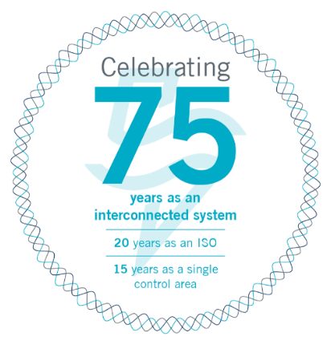
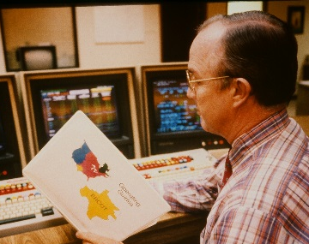
ERCOT History: 1941-2016
2001
Ten control centers merge into one.
2016
ERCOT surpasses previous system demand and wind generation records.
System demand tops 71,000 MW.
1996
ERCOT becomes first ISO in the United States.
1941
Utilities create Texas Interconnected System to support war effort.

Slide 3
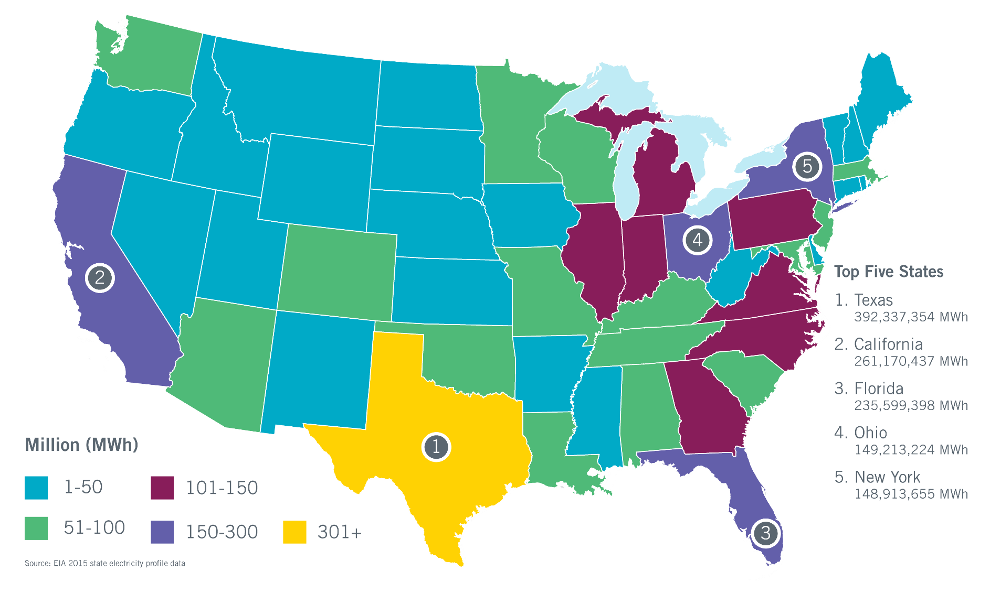
Texas Leads Nation in Electricity Sales
In 2015, retail sales to industrial customers in Texas (110.2 million MWh) were more than twice as high as in #2 California (52.6 million MWh).
Industrial load represents 28% of total Texas sales.

Slide 4
2017 ERCOT Strategic Goals
In support of its mission to serve the public by ensuring a reliable grid, efficient electricity markets, open access and retail choice, ERCOT’s goals are to:
Anticipate and adapt to changing resource mix:
Generation Resources
Demand Response
Distribution Level Resources
Provide thought leadership in support of continued improvements to operational reliability and markets.
Deliver channels and tools to stakeholders for enhanced communication and increased transparency and access.
Continually enhance our cyber and physical security posture.
Develop ERCOT resources – people and technology.

Slide 5
2017 ERCOT Strategic Goals
In support of its mission to serve the public by ensuring a reliable grid, efficient electricity markets, open access and retail choice, ERCOT’s goals are to:
Anticipate and adapt to changing resource mix:
Generation Resources
Demand Response
Distribution Level Resources
Provide thought leadership in support of continued improvements to operational reliability and markets.
Deliver channels and tools to stakeholders for enhanced communication and increased transparency and access.
Continually enhance our cyber and physical security posture.
Develop ERCOT resources – people and technology.

Slide 6
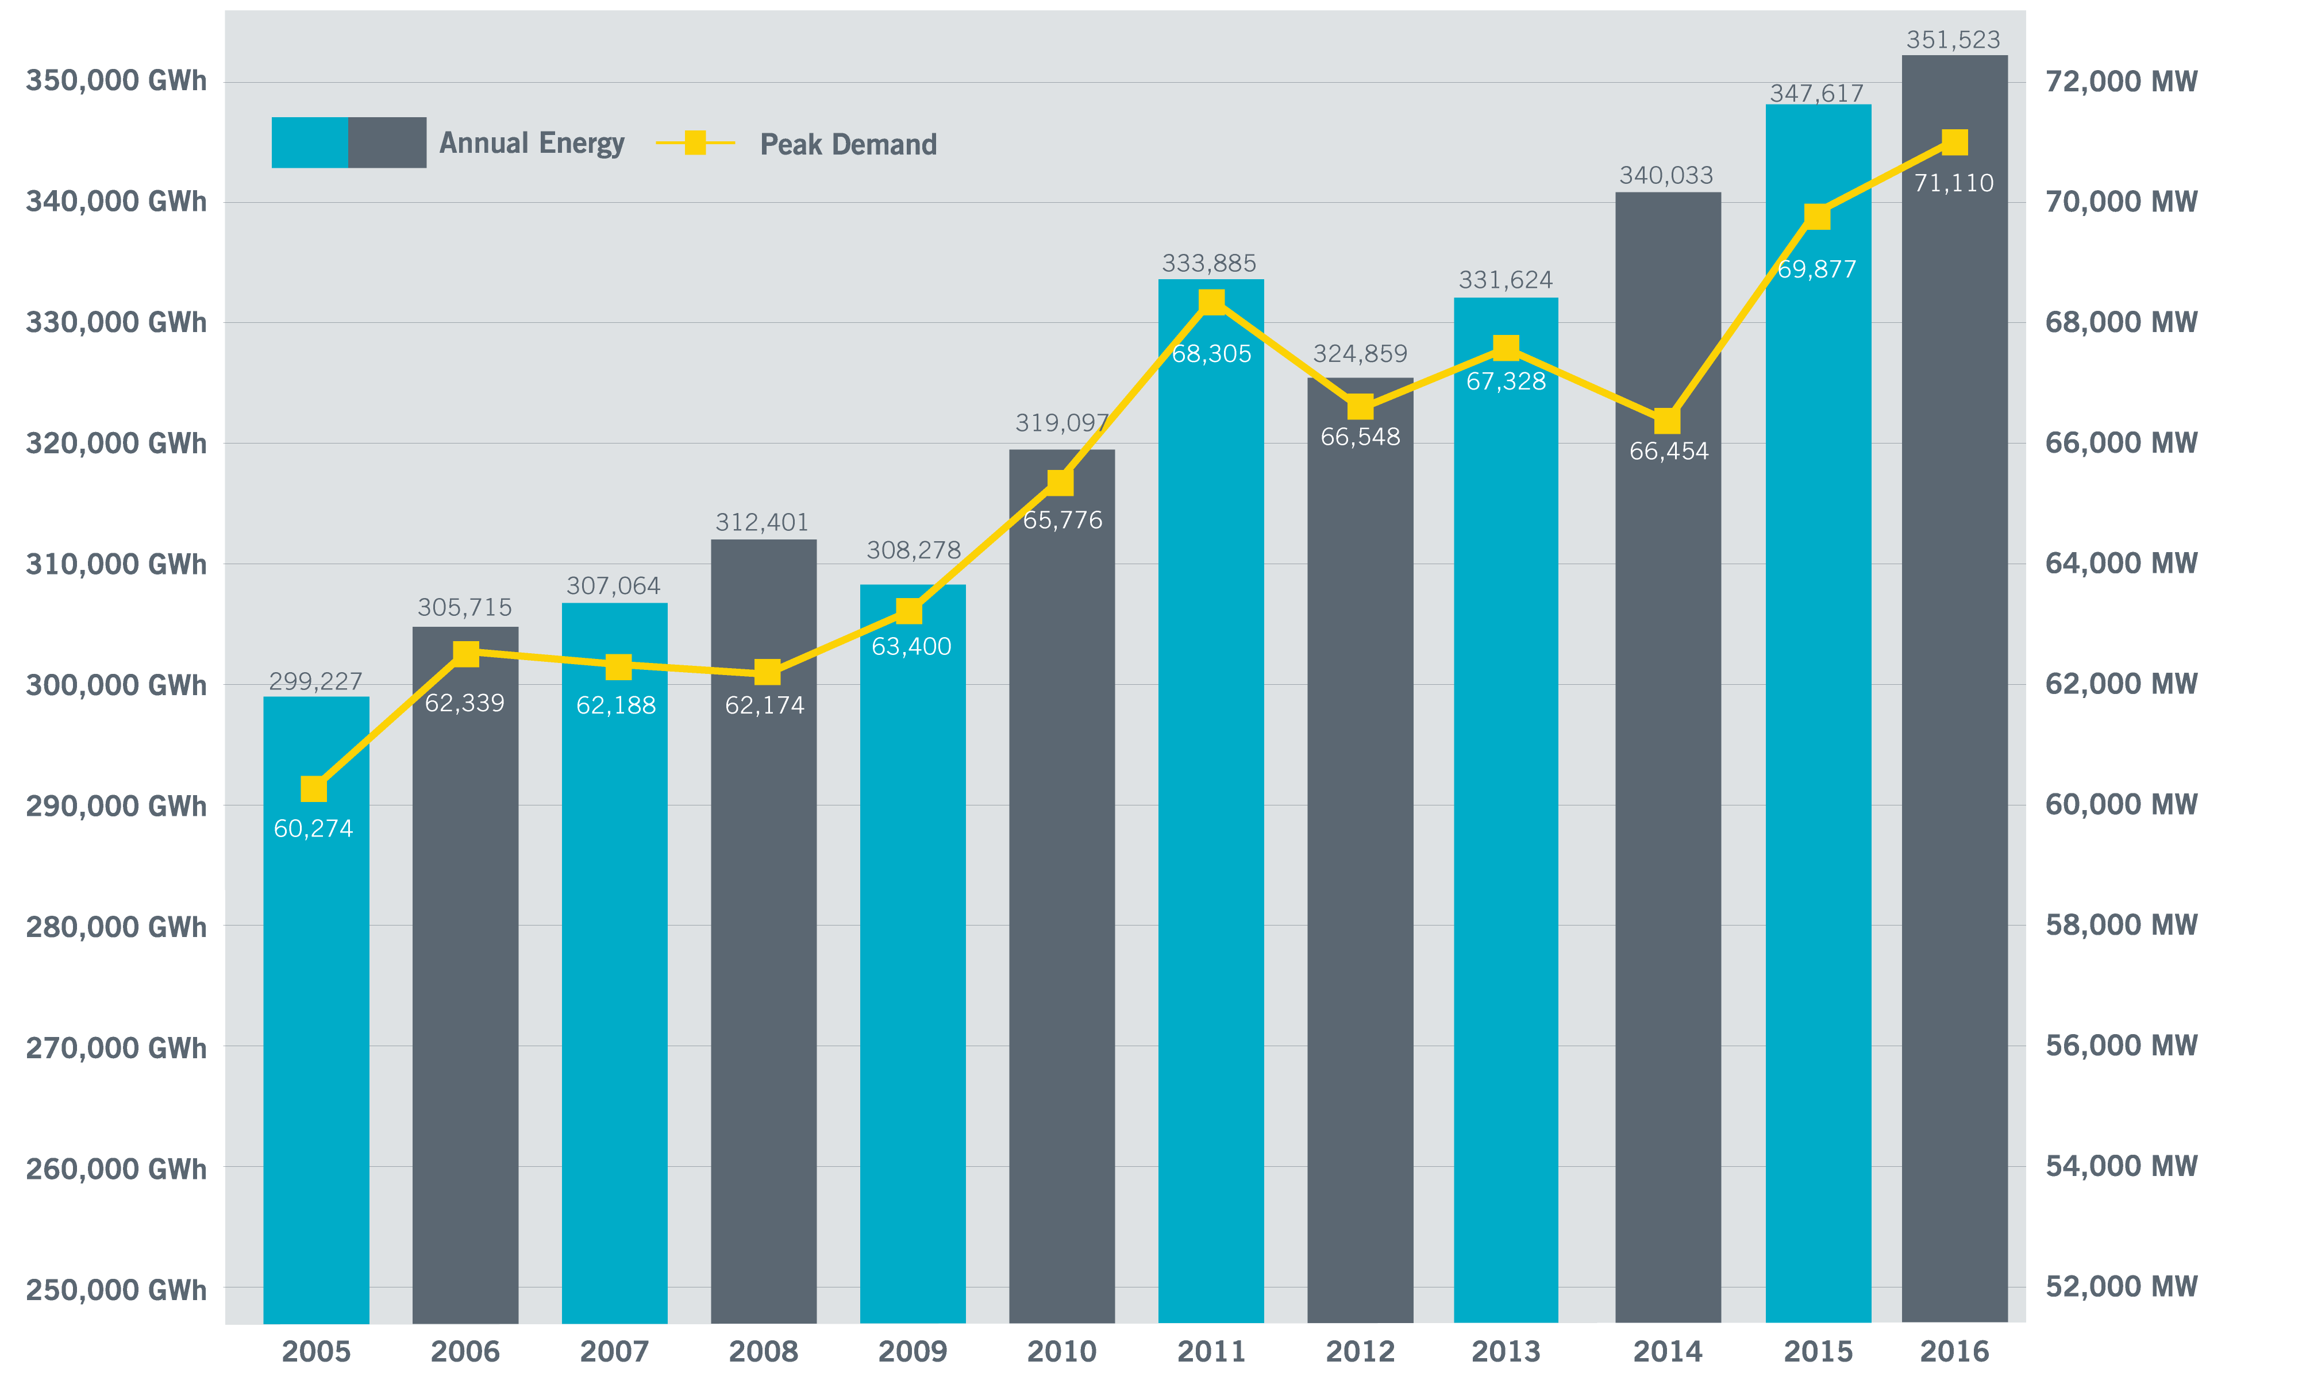
Annual Energy and Peak Demand (2005-2016)

Slide 7
Load Forecast Shows Growth in Peak Demand
Previous Forecast
Current Forecast
The long-term summer peak forecast used in the December 2016 CDR shows annual growth 2-4% higher than the previous long-term peak demand forecast.
Where possible, growth forecasts are based on premise counts in each customer class.
Strong economic forecast drove increased demand, especially in South Central region.

Slide 8
Current Records
Peak Demand Record: 71,110 megawatts (MW)
Aug. 11, 2016, 4-5 p.m.
Weekend Record: 66,921 MW
Sunday, Aug. 7, 2016, 5-6 p.m.
Winter Peak Record: 59,636 MW
Jan. 6, 2017, 6-7 p.m.
Wind Generation Records (instantaneous)
Output: 16,141 MW
March 31, 2017, 8:56 p.m.
Penetration (load served): 50%
March 23, 2017, 3:50 a.m.
Total Load = 28,780 MW
Recent Monthly Peak Demand Records
2017
January: 59,650 MW (Jan. 6, 6-7 p.m.)
2016
August: 71,110 MW (All-time record)
September: 66,949 MW (Sept. 19, 4-5 p.m.)
October: 59,864 MW (Oct. 5, 4-5 p.m.)
December: 57,932 MW (Dec. 19, 7-8 a.m.)
2015
July: 67,650 MW (July 30, 4-5 p.m.)
Notes:
Old:
Winter Peak Record: 57,265 MW
57,265 MW, Feb. 10, 2011
Wind Generation Records (instantaneous)
15,195 MW, Dec. 17, 2016, 6:20 p.m.
Non-Coastal Wind Output = 12,473 MW
Coastal Wind Output = 2,722 MW
Supplying 36% of the load
Active Wind Capacity = 18,811 MW
15,033 MW, Nov. 27, 2016, 12:36 p.m.
Non-Coastal Wind Output = 11,100 MW
Coastal Wind Output = 3,800 MW
Supplying 45% of the load
Active Wind Capacity = 17,150 MW

Slide 9
Capacity, Demand & Reserves Report – December 2016
Reserve margins 16.9% - 20.2% in next five years
Forecasting higher demand than recent reports
Uncertainty about generation unit retirements; changing resource mix

Slide 10
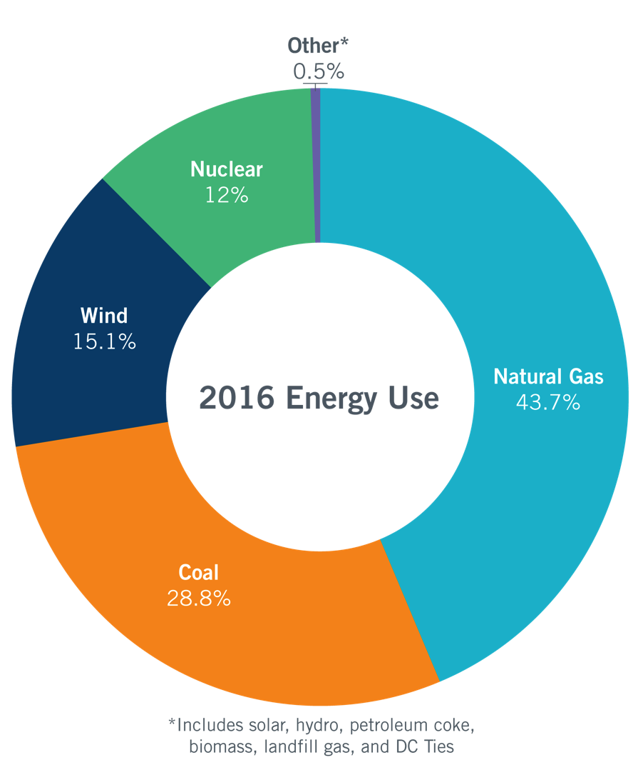
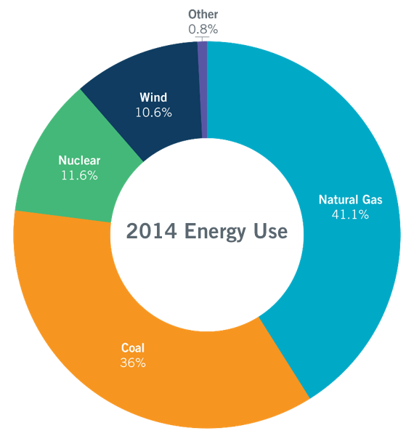
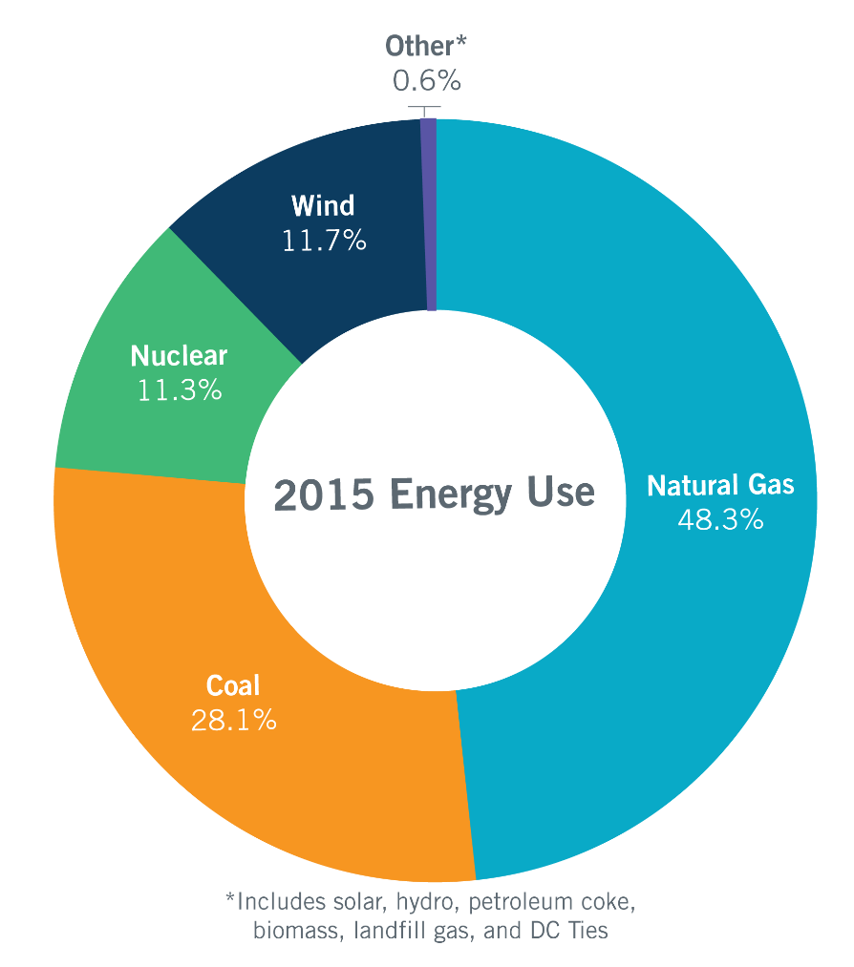
Energy Use Comparison
Total energy consumed:
351,523,351 MWh
Total energy consumed:
340,033,353 MWh
Total energy consumed:
347,466,232 MWh

Slide 11
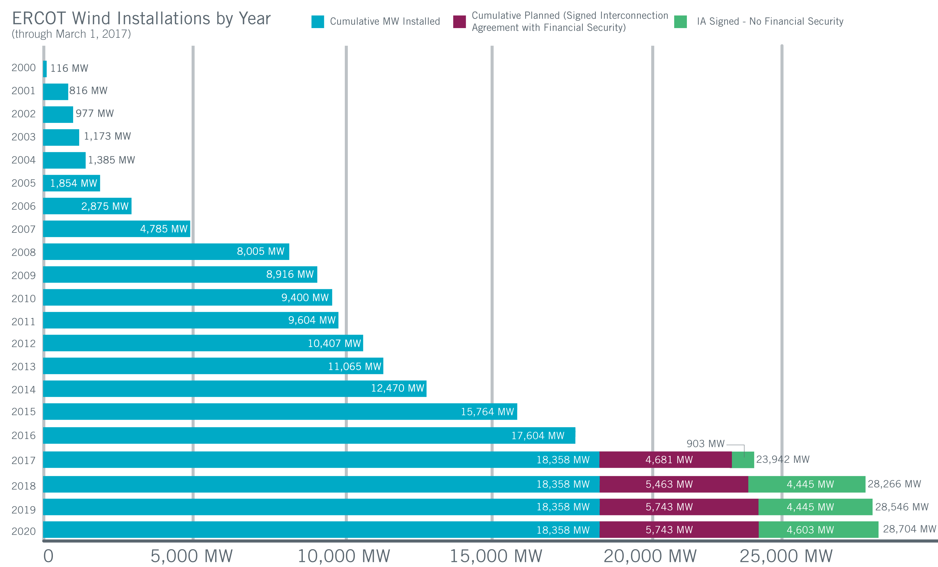
Wind Generation Capacity – February 2017
Steady growth continues, with some spikes.
Largest annual increase: 3,294 MW in 2015 (A close second: 3,220 MW in 2008)
Incentives, uncertainty and other factors affect construction decisions and schedules.
Historically, not all planned projects are completed.
Texas continues to lead U.S. in wind capacity.
Future outcomes uncertain

Slide 12
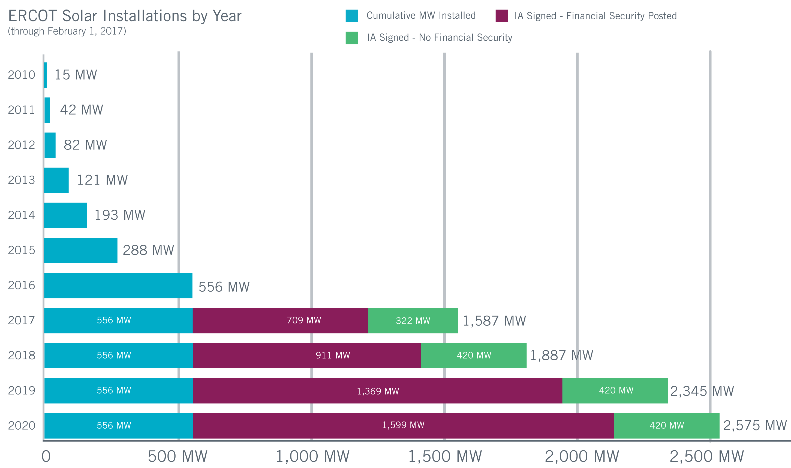
Utility Scale Solar Generation Capacity – February 2017
Utility-scale solar still in early stages in ERCOT
Nearly doubled in 2016; largest increase so far
Potentially fastest-growing resource in future
Incentives, uncertainty and other factors affect construction decisions and schedules.
Historically, not all planned projects are completed.
Future outcomes uncertain
The data presented here is based upon the latest registration data provided to ERCOT by the resource owners and can change without notice. Any capacity changes will be reflected in current and subsequent years' totals. Scheduling delays will also be reflected in the planned projects as that information is received. This chart reflects planned units in the calendar year of submission rather than installations by peak of year shown.

Slide 13
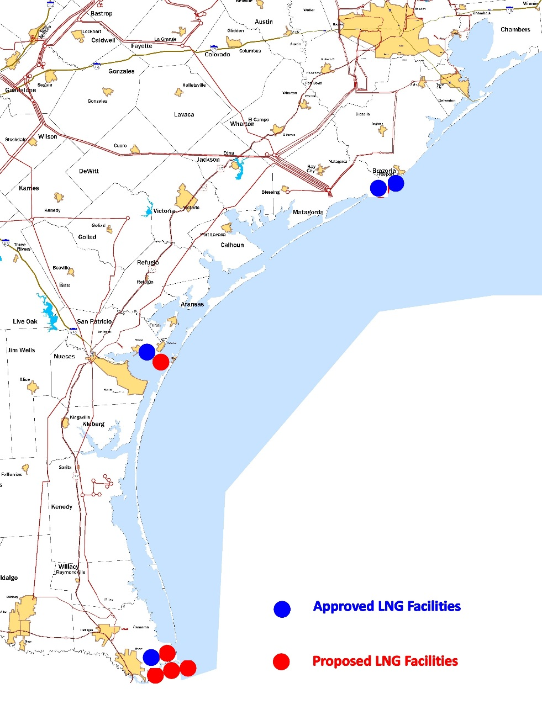
Liquefied Natural Gas (LNG) Facilities
Freeport LNG: Project will use electricity-driven compressors, adding about 700 MW of load starting in 2017. Has received all necessary FERC and DOE permits, including necessary permits for expansion project.
Corpus Christi Liquefaction: Project will use gas-driven compressors, adding about 100 MW of load starting in 2018. Has received all necessary FERC and DOE permits and applied for expansion project.
Brownsville Area: Annova LNG project has received all necessary FERC permits; four other proposed LNG facilities in that area are in permitting process.

Slide 14
2017 ERCOT Strategic Goals
In support of its mission to serve the public by ensuring a reliable grid, efficient electricity markets, open access and retail choice, ERCOT’s goals are to:
Anticipate and adapt to changing resource mix:
Generation Resources
Demand Response
Distribution Level Resources
Provide thought leadership in support of continued improvements to operational reliability and markets.
Deliver channels and tools to stakeholders for enhanced communication and increased transparency and access.
Continually enhance our cyber and physical security posture.
Develop ERCOT resources – people and technology.

Slide 15
Integrating and Managing Renewables
New Desk: Added Reliability Risk Desk in the Control Room this year
Inertia: Tracking system inertia against Critical Inertia levels and monitoring sufficiency of Responsive Reserves in Real-Time & Day-Ahead markets
Net Load: Assessing available generation capacity and Non-Spin reserves to serve expected variability in net load
Ancillary Services: Continue 2016 methodology to procure enough Non-Spin to operate reliably during hours with high risk of net load ramp; 2017 procurement will include solar.
Peak Average Wind and Solar Capacity Percentages
Season | Coastal Wind | Non-Coastal Wind | Solar
Winter | 35% | 20% | 5%
Spring | 68% | 29% | 47%
Summer | 58% | 14% | 77%
Fall | 44% | 35% | 63%

Slide 16
Integrating and Managing Renewables
Improving wind forecast and preparation for extreme weather events
Implementing software changes to pre-populate Current Operating Plans with forecast output from renewables
Evaluating five-minute forecast to help pre-position other resources when large ramps expected in renewable resources

Slide 17
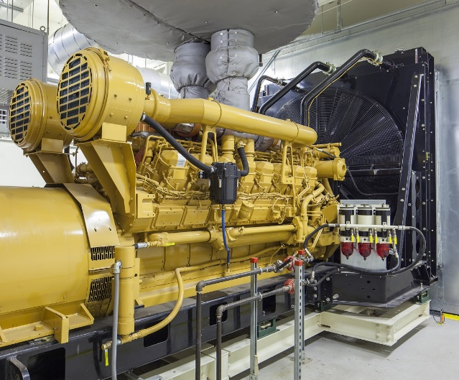
Distributed Energy Resources (DERs)
Includes rooftop solar panels, diesel engines, storage devices and demand response resources
Capable of providing backup (emergency) power, demand charge reduction (e.g., 4CP), response to wholesale market prices, ERCOT Emergency Response Service, offset to energy consumption, Ancillary Services
Increase Visibility: Identify potential future impacts of DERs on ERCOT’s functions ― including but not limited to load forecasting, network modeling, real-time grid operations, metering and settlement.

Slide 18
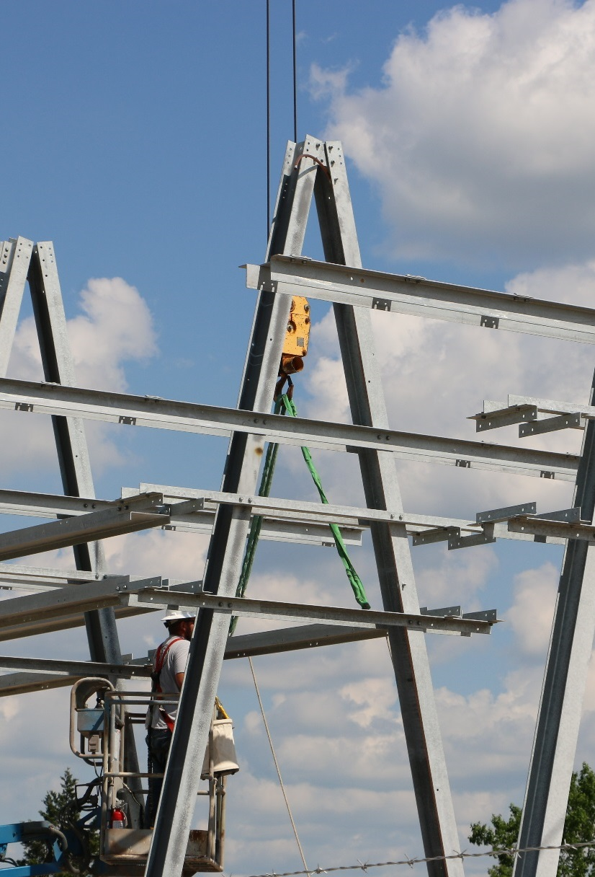
Transmission Planning Summary – January 2017
As of Dec. 31, 2016:
Tracking 247 active generation interconnection requests totaling 59,896 MW (includes 26,732 MW of wind)
Reviewing proposed transmission improvements with a total cost of $872.3 million
Endorsed transmission projects totaling $489.1 million in 2016 (up from $477.6 million in 2015)
As of Dec. 31, 2016:
Projects in engineering, routing, licensing and construction total about $6.91 billion.
Projects energized in 2016 total about $2 billion.

Slide 19
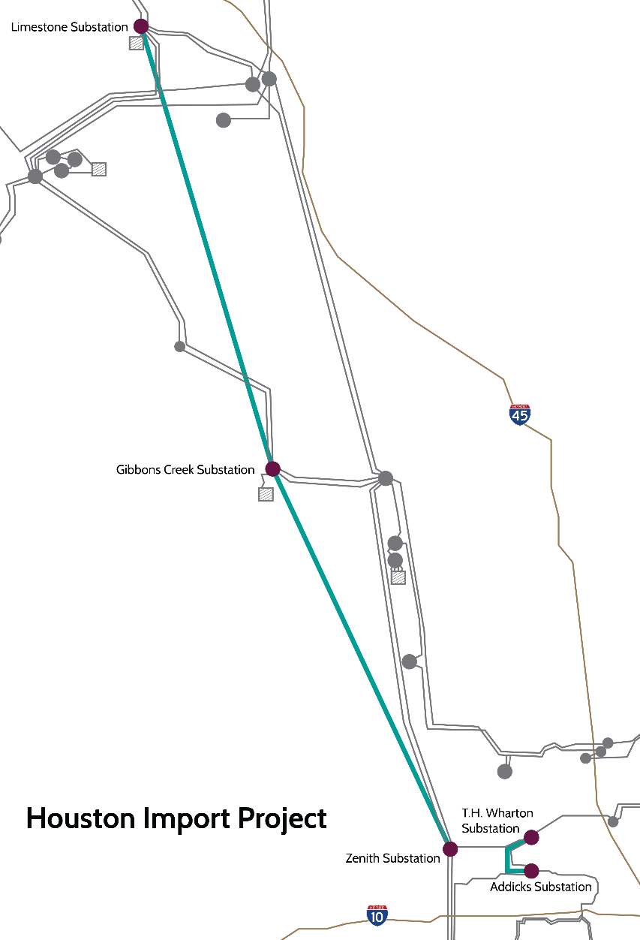
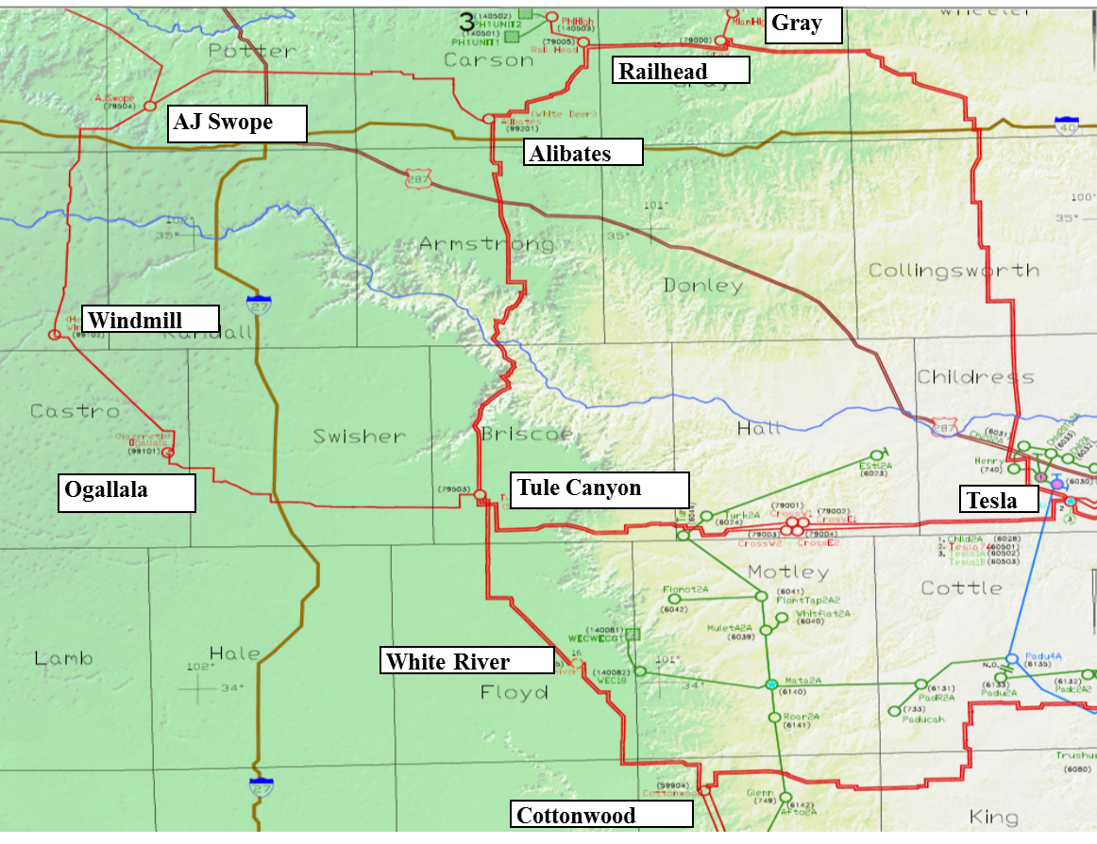
Major Transmission System Improvements
Houston Import Project: Scheduled for completion in summer 2018; addresses constraint north of Houston
Houston Import Project
Panhandle Projects: Scheduled for completion in 2018; address export capacity for growing wind resources, weak grid conditions
West Texas Improvements: Additional projects under review by stakeholders

Slide 20
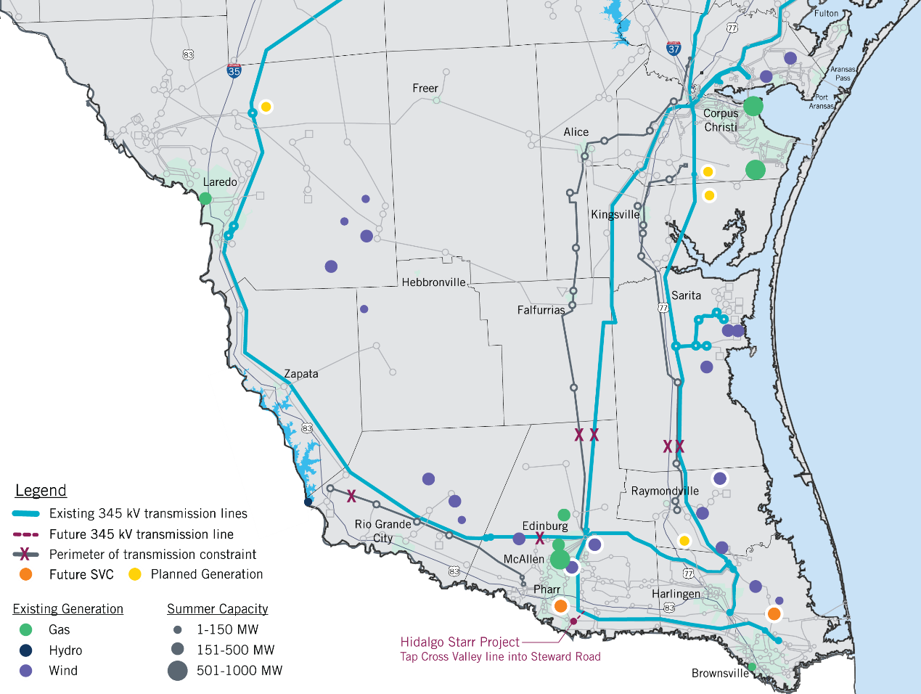
Lower Rio Grande Valley Projects
345 kV projects energized in 2016
Valley Import Project (Lobo – North Edinburg line and upgrade of existing Valley import lines)
Cross Valley Project (North Edinburg – Loma Alta line)
New projects endorsed by ERCOT Board in 2016
Hidalgo-Starr Project: New 345 kV to connect Stewart Road substation to North Edinburg – Loma Alta 345 kV line. Projected in service 2019
LRGV Project: Two new 300-MVAR SVC at La Palma 138 kV and AEP Pharr 138 kV substations. Projected in service December 2018

Slide 21
Other Steps for Reliability in Lower Rio Grande Valley
Investigation of options to improve Valley Import Limits
Reorganization of generation resources in the area relative to the import interface based on existing conditions and planned changes to interconnection points
Options for operator action identified for use during low import margins for the Valley:
Use real-time tools to identify and switch shunt reactive devices that have high impact on the import limit.
Possibly deploy series compensation on the Lobo–Del Sol–N. Edinburg 345kV line.
Study Results
400 MW – 550 MW increase in load serving capability for the Valley
Incremental benefit in particular scenarios depends on:
Load level
Wind Output
The critical pre-existing outage causing low import margins
Which of the identified options are available for deployment

Slide 22
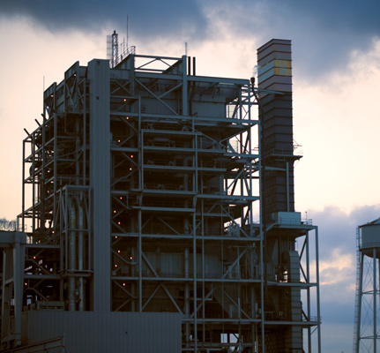
Reliability Must-Run Agreements
Entered agreement for Greens Bayou Unit 5
Study determined that, under existing rules, unit was needed to support transmission system reliability in Houston area until new 345 kV transmission is energized in 2018.
ERCOT entered agreement with NRG Texas Power in June 2016 to keep unit available during summer months through June 2018.
NPRR 788, approved in October 2016, modified criteria for RMR studies.
Unit was still needed under new rules.
New generation in region would offer alternative exit strategy.
As of March 1, moving to end agreement
New 1,100 MW generation resource, expected on-line prior to summer peak, will support reliability need in region.
NRG Texas Power Photo

Slide 23
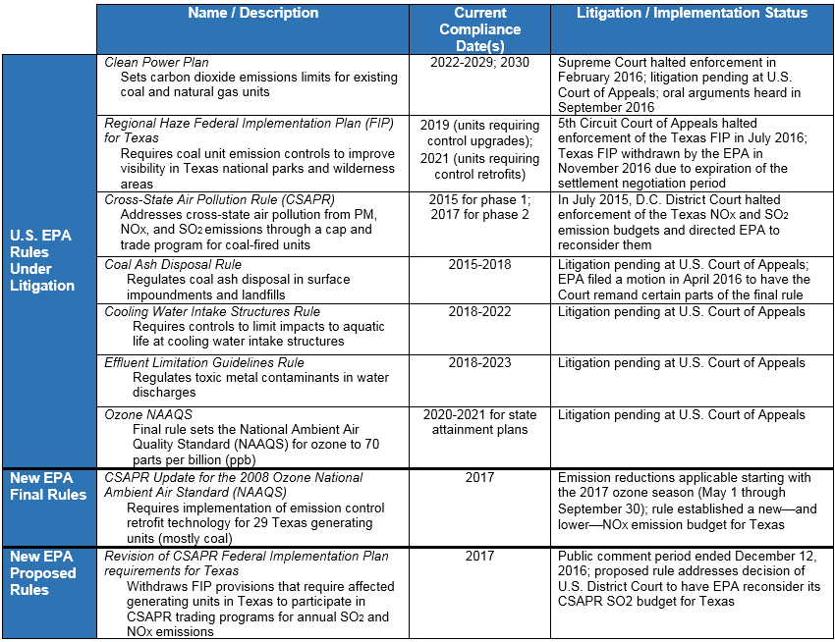
Environmental Regulatory Uncertainty Continues

Slide 24
2017 ERCOT Strategic Goals
In support of its mission to serve the public by ensuring a reliable grid, efficient electricity markets, open access and retail choice, ERCOT’s goals are to:
Anticipate and adapt to changing resource mix:
Generation Resources
Demand Response
Distribution Level Resources
Provide thought leadership in support of continued improvements to operational reliability and markets.
Deliver channels and tools to stakeholders for enhanced communication and increased transparency and access.
Continually enhance our cyber and physical security posture.
Develop ERCOT resources – people and technology.

Slide 25
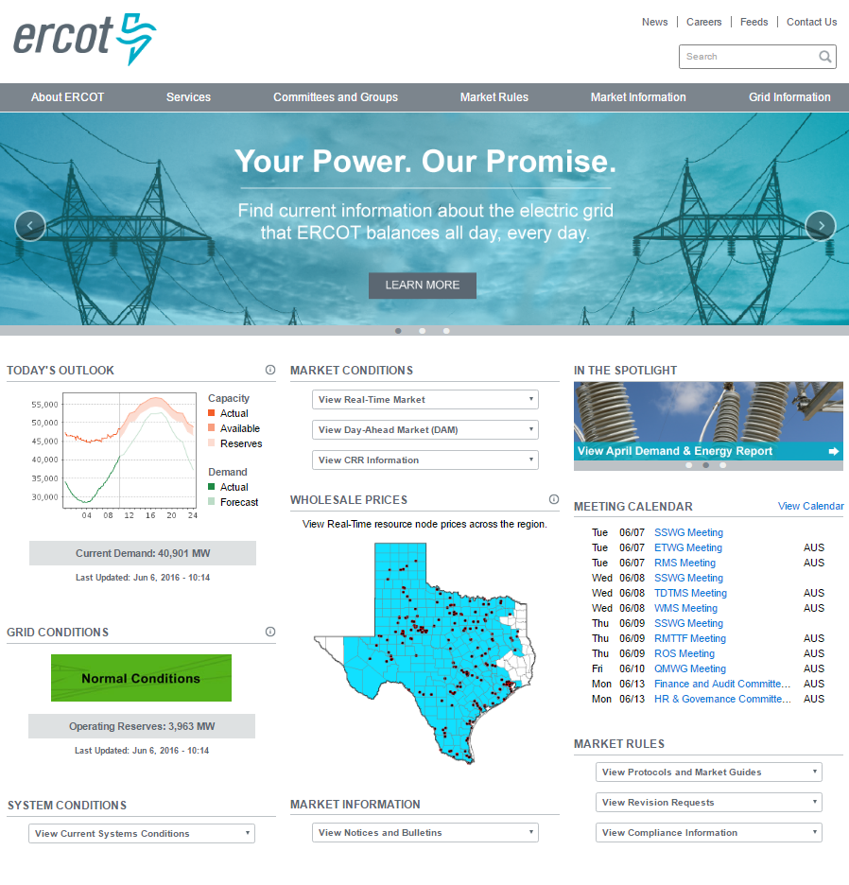
ERCOT Communication Channels
ERCOT website – www.ercot.com
Today’s Outlook and grid conditions
Daily and seasonal weather
Market information, prices and more
Social media
Twitter: @ERCOT_ISO
Facebook: Electric Reliability Council of Texas
LinkedIn: ERCOT
ERCOT mobile app
Real-time updates
Wholesale pricing
Information sharing

Slide 26
Data & Information Channels
ERCOT makes data and information products available through several distribution channels.
The two primary channels are ERCOT.com and the Market Information System (MIS).
ERCOT.com provides data and information available to all stakeholders, including the general public
MIS and associated web services provides a secure channel for consuming market sensitive data
ERCOT creates and posts more than 100,000 data products per day, and those are consumed at an average rate of more than 27 million downloads monthly.
ERCOT Data Product Postings Q4 - 2016
ERCOT Data Product Downloads Q4 - 2016
3,644,858
3,561,908
3,697,130
26,831,295
26,853,073
27,567,249

Slide 27
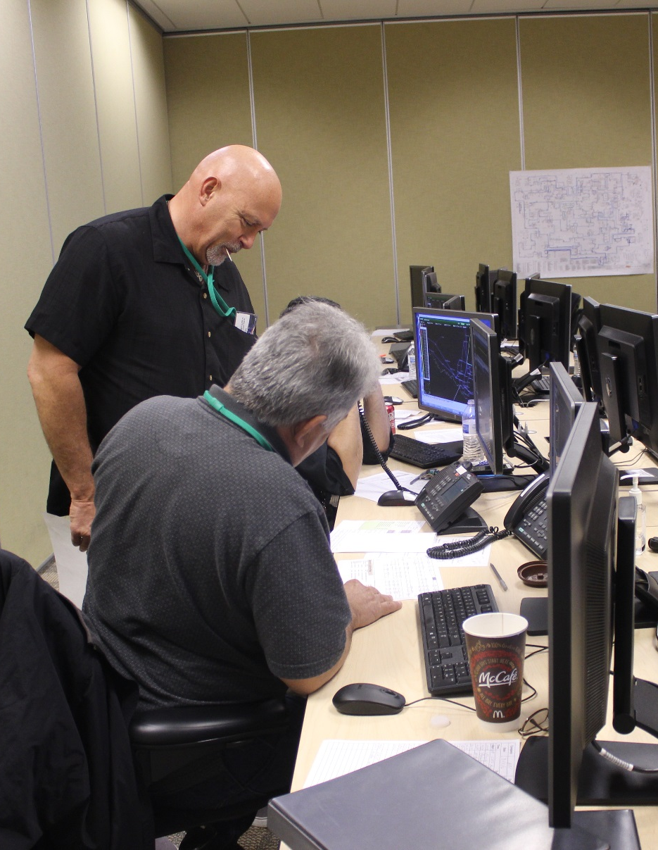
Expanding Simulation Training for Operators
Operators complete regular training to prepare for a variety of possible scenarios.
ERCOT training is evolving and expanding to adapt to new challenges, changing systems.
Goal is to include market participant operations teams in training as much as possible and provide simulation tools, staff expertise and facilities that support shared success in system operations.

Slide 28
2017 ERCOT Strategic Goals
In support of its mission to serve the public by ensuring a reliable grid, efficient electricity markets, open access and retail choice, ERCOT’s goals are to:
Anticipate and adapt to changing resource mix:
Generation Resources
Demand Response
Distribution Level Resources
Provide thought leadership in support of continued improvements to operational reliability and markets.
Deliver channels and tools to stakeholders for enhanced communication and increased transparency and access.
Continually enhance our cyber and physical security posture.
Develop ERCOT resources – people and technology.

Slide 29
ERCOT Cyber & Physical Security Program
ERCOT has a dedicated and integrated cyber/physical security organization and established strategy.
ERCOT uses layered cyber and physical security architectures, known as a defense-in-depth strategy, along with careful monitoring.
ERCOT is committed to external collaboration with relevant government agencies, law enforcement, industry and national labs to enhance its and the industry’s security posture.

Slide 30
Grid Security Collaboration
Federal/National
State
Industry
National Labs
Critical Infrastructure Protection Working Group (CIPWG)
Grid Resilience Working Group (GRWG)

Slide 31
2017 ERCOT Strategic Goals
In support of its mission to serve the public by ensuring a reliable grid, efficient electricity markets, open access and retail choice, ERCOT’s goals are to:
Anticipate and adapt to changing resource mix:
Generation Resources
Demand Response
Distribution Level Resources
Provide thought leadership in support of continued improvements to operational reliability and markets.
Deliver channels and tools to stakeholders for enhanced communication and increased transparency and access.
Continually enhance our cyber and physical security posture.
Develop ERCOT resources – people and technology.

Slide 32
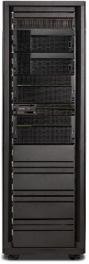
DC4 Technology Refresh Update
Reliability initiative to replace ERCOT’s aging computer technology
Project initiated in 2015 with 4 years and $48 million forecast.
Scope, schedule and budget remain on track for success.
Contracts committed: 60% locked
$48 million budget: 40% spend forecast through 2016
Hardware deployed: 21% as planned
Key Challenges
Migrating applications to the new computers
Ensuring no disruption during transition
Financials
Forecast to meet or be slightly below budget

Slide 33
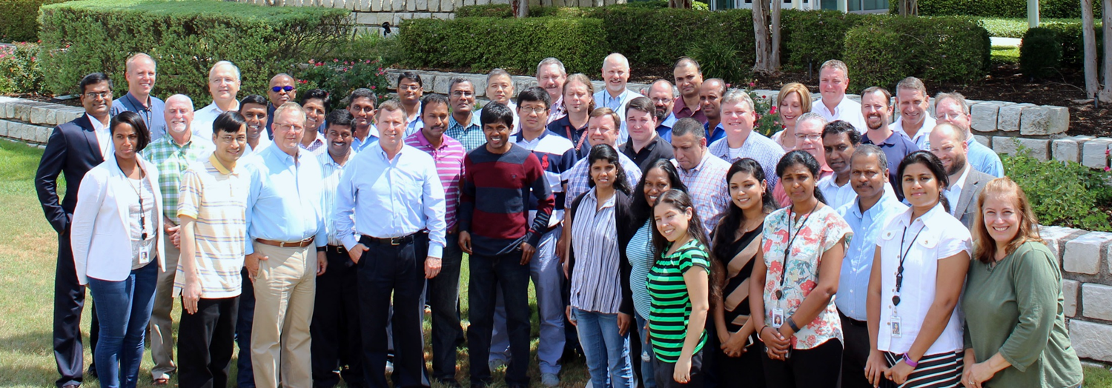
The Best Strategy is Great People
EMS Upgrade Project — 2016
Four-year project completed successful cutover June 16, 2016.
170+ employees contributed; 84,000+ hours over four years.
ERCOT staff and GE (Alstom) together delivered successful upgrade.

