Slide 1
SMT Update To AMWG
APR 2017

Slide 2
Monthly SMT Data Timelines AMWG CR 2014 002 End to End File Processing Completeness – APR 2017
% Timely Market Delivery - % of files posted to market (FTPS) by 11:00pm out of # of files received by SMT by 11:00pm.
% Portal Data Availability - % of files loaded to the database for data availability on portal by 6:00am next day for the files received by 11:00pm
* A LSE file includes usage data for up to 50,000 ESIIDs.
2

Slide 3
SMT API and FTPS Services Availability – APR 2017
The service availability is measured as a percentage of number of minutes the service was available out of the total number of minutes in a month, excluding planned outages.
Observed Anomalies:
Mar-Apr 2015: SMT outage and subsequent recovery/catch-up impacted API availability. FTPS was available for most of the part except on 03/21-03/22 for 36 hours.
26 Jul 2015: Services were unavailable for 12 hours due to Flash storage issue
25 Jan 2016: Services were unavailable for 19 hours due to storage configuration issue
07 Mar 2016: API Services were unavailable for 7hours due to Oracle archiver issue.
Notes:
3

Slide 4
SMT Number of Accounts by Type AMWG CR 2014 009 – APRIL 2017
Registered Users | ONC | CNP | AEPN | AEPC | TNMP | TOTAL
Active Residential Accounts | 45360 | 26767 | 1868 | 5341 | 2956 | 82292
Active Residential English Accounts | 45160 | 26594 | 1862 | 5235 | 2948 | 81799
Active Residential Spanish Accounts | 200 | 167 | 6 | 106 | 8 | 487
Non Active Residential Accounts | 21877 | 14764 | 1742 | 3827 | 882 | 42683
Total Residential Accounts | 67237 | 41531 | 3610 | 9168 | 3838 | 124975
TDSP User | 335 | 31 | 12 | 18 | 1 | 397
TDSP Admin | 4 | 4 | 4 | 4 | 3 | 19
Small Business User | 96 | 46 | 1 | 1 | 2 | 146
Small Business Admin | 2906 | 1555 | 85 | 310 | 136 | 5141
Total Agreements (Includes Active and Pending) | 899 | 2056 | 20 | 118 | 101 | 3194
Energy Data Agreements (Includes Active and Pending) | 899 | 1811 | 20 | 118 | 101 | 2949
Han Device Agreements (Includes Active and Pending) | 0 | 244 | 0 | 0 | 0 | 244
Han Service Agreements (Includes Active and Pending) | 0 | 1 | 0 | 0 | 0 | 1
IN SMT
ESI IDs | 3531126 | 2455941 | 197915 | 866088 | 246188 | 7297258
Meters | 3470218 | 2455863 | 198723 | 866387 | 245737 | 7236928
HAN Devices | 3555 | 4568 | 141 | 287 | 29 | 8580
Acknowledgement | 0 | 0 | 0 | 0 | 0
Pending | 0 | 7 | 0 | 0 | 0
Meter Ready | 3 | 3 | 42 | 105 | 17
Provisioned | 3552 | 4558 | 99 | 182 | 12
HAN Messages (MTD) | 0 | 0 | 0 | 0 | 0 | 0
HAN Messages (YTD) | 16 | 0 | 0 | 0 | 0 | 16
HAN Messages (Cumulative) | 396 | 7405 | 0 | 0 | 0 | 7801
Simple Text Messages | 147 | 2930 | 0 | 0 | 0
Load Control Messages | 104 | 2658 | 0 | 0 | 0
Pricing Messages | 97 | 53 | 0 | 0 | 0
Cancellation Messages | 48 | 1764 | 0 | 0 | 0
Supplemental – (Friends)
Total Agreements | 1843 | 1438 | 80 | 94 | 64 | 3519
Accepted Agreements | 773 | 556 | 37 | 29 | 21 | 1416
Pending Agreements | 2 | 3 | 0 | 0 | 2 | 7
Revoked Agreements | 321 | 279 | 10 | 8 | 6 | 624
Expired Agreements | 709 | 569 | 31 | 57 | 35 | 1401
Terminated Agreements | 38 | 31 | 2 | 0 | 0 | 71
 | TDSPs | REP | Small Business | Regulatory | Third Party
Registered Entities | 5 | 114 | 4977 | 2 | 140
Registered Users | 397 | 836 | 146 | 8 | 24
Registered Admins | 19 | 173 | 4992 | 3 | 131
HAN Messages Sent By | 359 | 7418

Slide 5
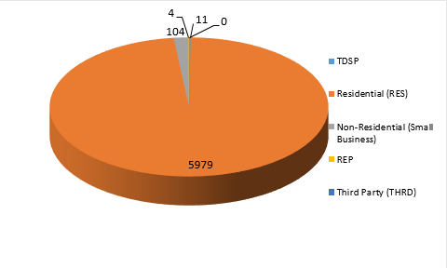
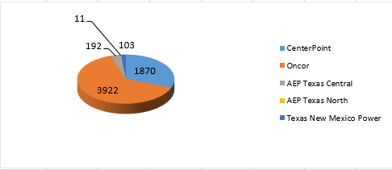
SMT ODR Details – APR 2017
Total ODR Requests TDSP wise statistics:
Total ODR Requests User type statistics:

