Slide 1
AEP’s Ground Grid Resistance Measurement Procedure

Slide 2
Overview
Ground grid resistance (GGR) and GIC flow
Available approaches for obtaining GGR value
Calculating Effective GGR
A recommended procedure for obtaining GGR value

Slide 3
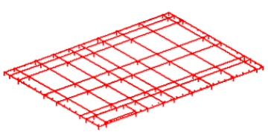
Ground Grid Resistance and GIC Flow
1. Typical Substation ground grid
4/0 cu buried at 18”
10-20’ grid welded
Ground Rods every 20’ typical
Low R
Meets the requirement of IEEE80 standard

Slide 4
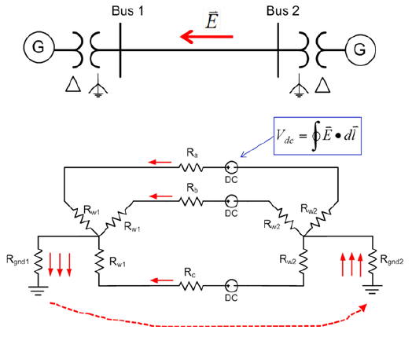
2. Basic GIC flow

Slide 5
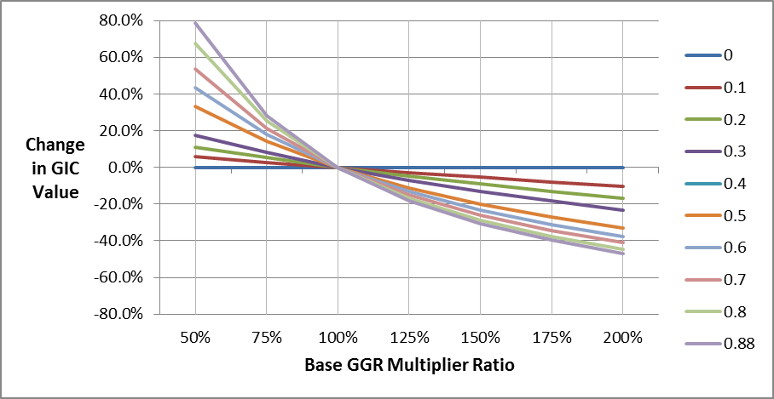
3. The significance of GGR value on GIC calculation
$$GIC Thevenin Ratio=\frac{GGR}{GGR+Station′s Thevenin impedance}$$
Change in GIC values vs Substation GGR under different Thevenin ratio

Slide 6
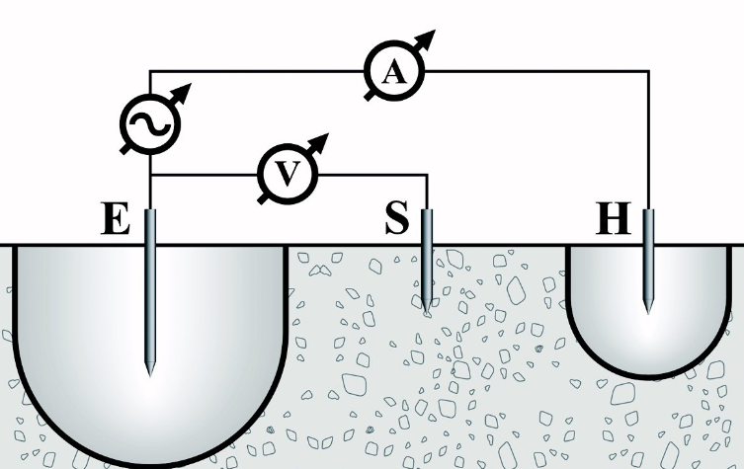
Obtaining GGR Value
1. Direct approach
Fall of potential (FOP)
R
Resistance
Distance

Slide 7
Most popular method for measuring sub station ground grid impedance
Fixed test frequency range from 20 hertz to 418 hertz (50Hz and 60 Hz are omitted)
To achieve 95% accuracy, it requires 6.5 times the grids maximum diagonal distance.
Due to the impact of other interconnected ground sources, FOP should be performed only with new installation or the substation should be de-energized

Slide 8
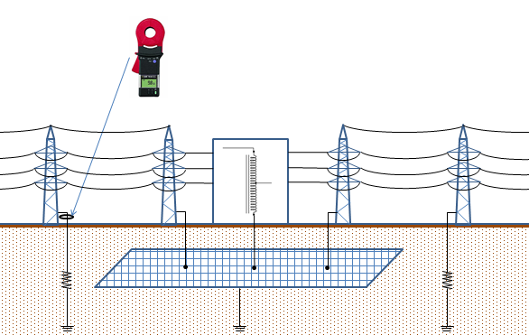
Clamp on meter

Slide 9
Theoretically it is able to measure the combination of substation ground grid and shield wire resistance
The signal of clamp on meter is too weak to obtain an accurate measurement

Slide 10
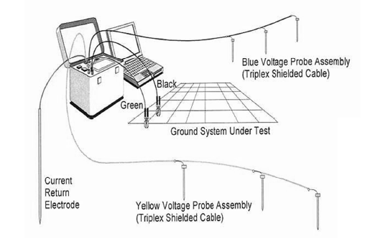
Computer based grounding multi-meter

Slide 11
Follows fundamental principles of the FOP method
There are 1 current injection probe and 6 voltage probes
Require less space for probe placement and does not need de-energize the substation.
AEP’s field test has experienced inaccurate results. The vendor claimed they have improved the technique but requested additional funding. So AEP has stopped pursuing this approach

Slide 12
Value form experience
Last resort
Based on experience, the value GGR range can be between 0.1 and 2 ohm.
Our experience showed these default values can differ from actual values by up to 600%

Slide 13
2. Indirect approach
Step 1: Soil Resistivity
Step 2: Calculate GGR
Wenner Method
IEEE 80
USGS Survey
CDEGS Simulation

Slide 14
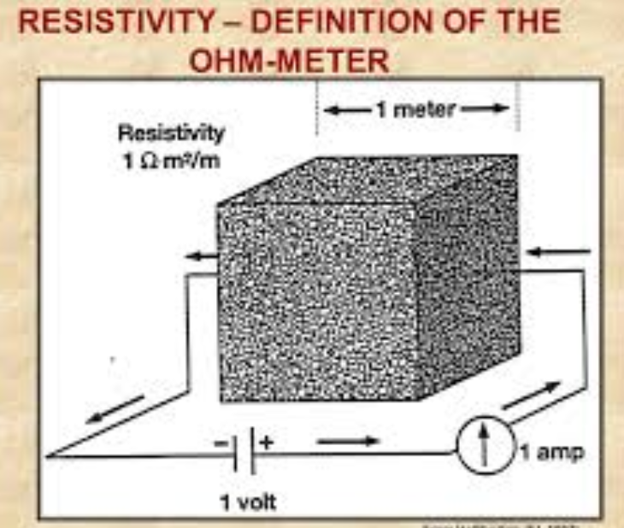
Soil Resistivity $ρ$
$$ρ= \frac{RA}{L}$$
$ρ$ = the resistivity of 1 cubic meter or 1 cubic centimeter soil. The unit of $ρ$is ohm-m or ohm-cm

Slide 15
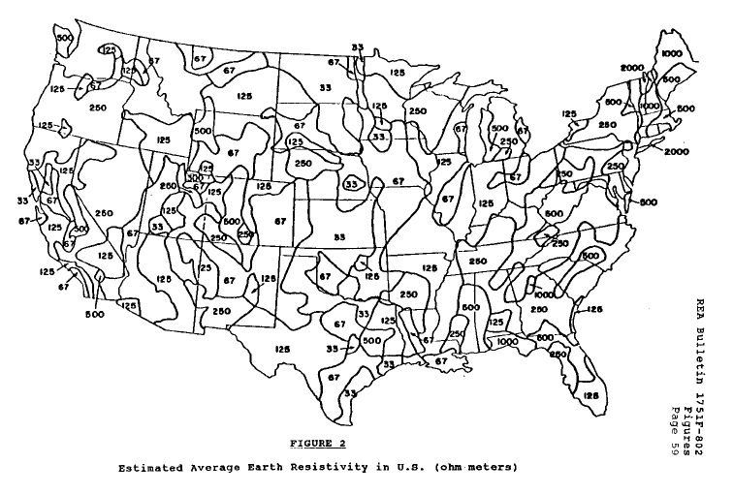
Geological Survey
UNITED STATES DEPARTMENT OF AGRICULTURE Rural Electrification Administration REA BULLETIN 1751F-802

Slide 16
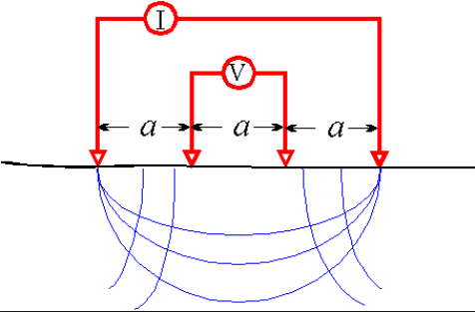
Step 1: Soil Resistivity
Wenner Method
a = Distance between the electrodes
b = electrode depth
R = Reading in instrument
If a >20b the soil resistivity is calculated as:
$$ρ= \frac{4πaR}{1+\frac{2a}{\sqrt{a^{2}+4b^{2}}}−\frac{a}{\sqrt{a^{2}+b^{2}}}}$$
$$ρ=2πAR$$

Slide 17
Measurement can be taken outside of the energized station yard
Can obtain site-specific, multi-layer values
For reliable results, the test line must be longer than the diagonal length of the station yard.

Slide 18
Step 2: Calculating GGR
IEEE 80 (IEEE Guide for Safety in AC Substation Grounding)
A minimum value of the substation grounding system resistance in uniform soil can be estimated by means of the formula of a circular metal plate at zero depth
Where:
$R_{g}$ Substation ground grid resistance
$ρ$ Soil Resistivity in ohm-meter
A Area occupied by the ground grid in $m^{2}$
$$R_{g}=\frac{ρ}{4}\sqrt{\frac{π}{A}}$$
(1)

Slide 19
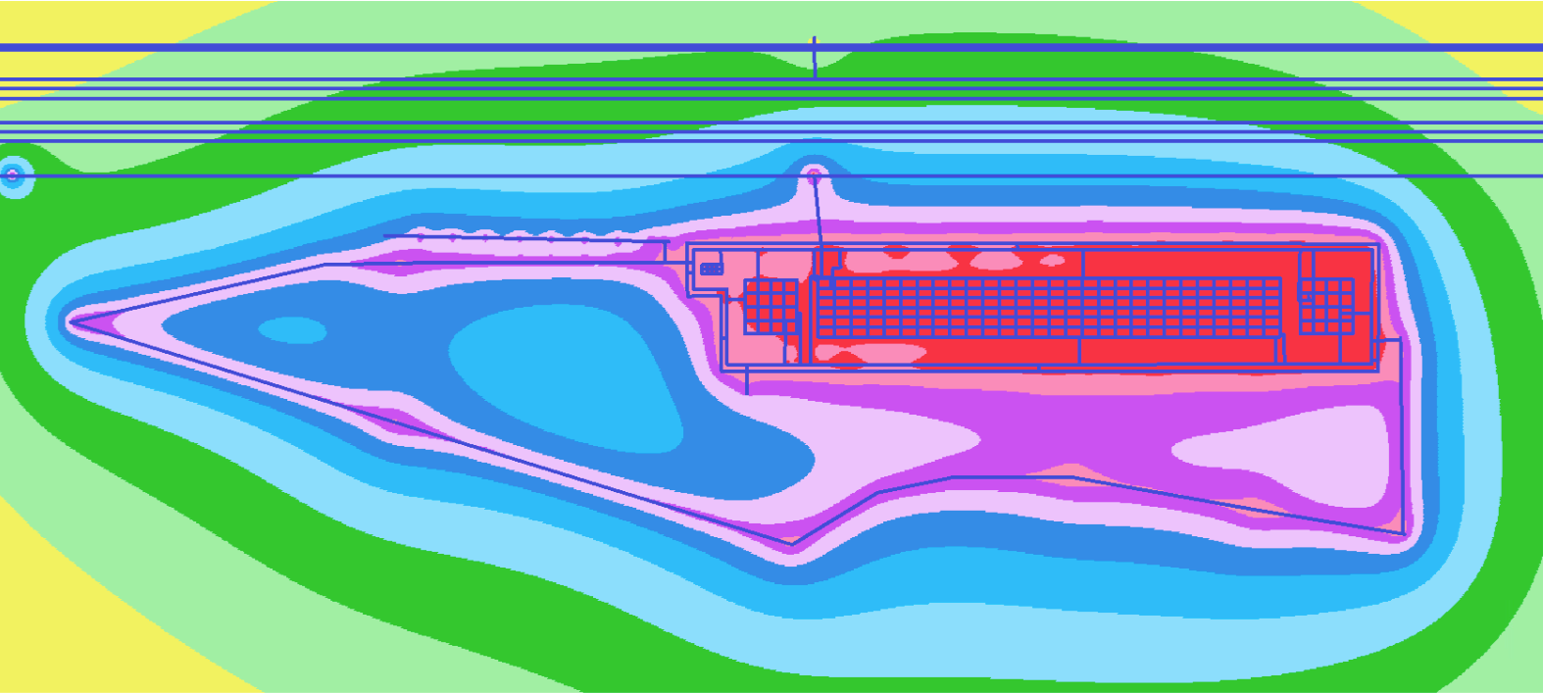
Current Distribution, Electromagnetic Fields, Grounding and Soil Structure Analysis (CDEGS) Software
Soil resistivity analysis and soil structure interpretation
Arbitrary soil structures; any frequency & transients

Slide 20
Comparison of USGS survey data and CDGES simulation results
Station Name | Uniform Soil Layer Resistivity From USGS Survey (ohm*m) | CDGES - Wenner Method (ohm*m) | GGR Calculated by IEEE 80 method (ohms) | GGR From CDGES (ohms)
1 | 250 | 266.3481 | 1.812989 | 0.8
2 | 500 | 207.9795 | 2.145076 | 2.1438
3 | 500 | 41.43066 | 0.367745 | 724.17
4 | 500 | 74.35284 | 0.320555 | 0.59
5 | 250 | 202.9892 | 1.805878 | 4.11
6 | 250 | 934.514 | 5.662666 | 9.2347
7 | 66.67 | 84.61926 | 0.082047 | 0.3114
8 | 250 | 15.34106 | 0.10846 | 0.70856
9 | 500 | 1004.323 | 5.921809 | 4.0409
10 | 250 | 56.98275 | 0.142078 | 0.14
11 | 125 | 49.92627 | 0.056835 | 0.1086207

Slide 21
Comparison of different methods with per station cost
Method | Soil Resistivity Measurement Needed? | Station Ground Grid Model Required? | Requires De-Energized Station? | Cost ($/Station) |  | Accuracy
Effective GGR Direct measurement (Direct Approach)
Fall of Potential | No | No | Yes | $5,000 |  | High
Clamp On | No | No | No | $1,600 |  | Low
Computer based grounding multi-meter | No | Yes | No | $17,000 |  | Unconfirmed
GGR Measurement for Effective GGR Calculation (Indirect Approach)
Wenner method | Yes | No | No | $4000 | High
Survey | No | No | No | $0 | Low
IEEE 80 | No | Yes | No | $0 | Low
CDEGS | Yes | No | No | $1600 | High

Slide 22
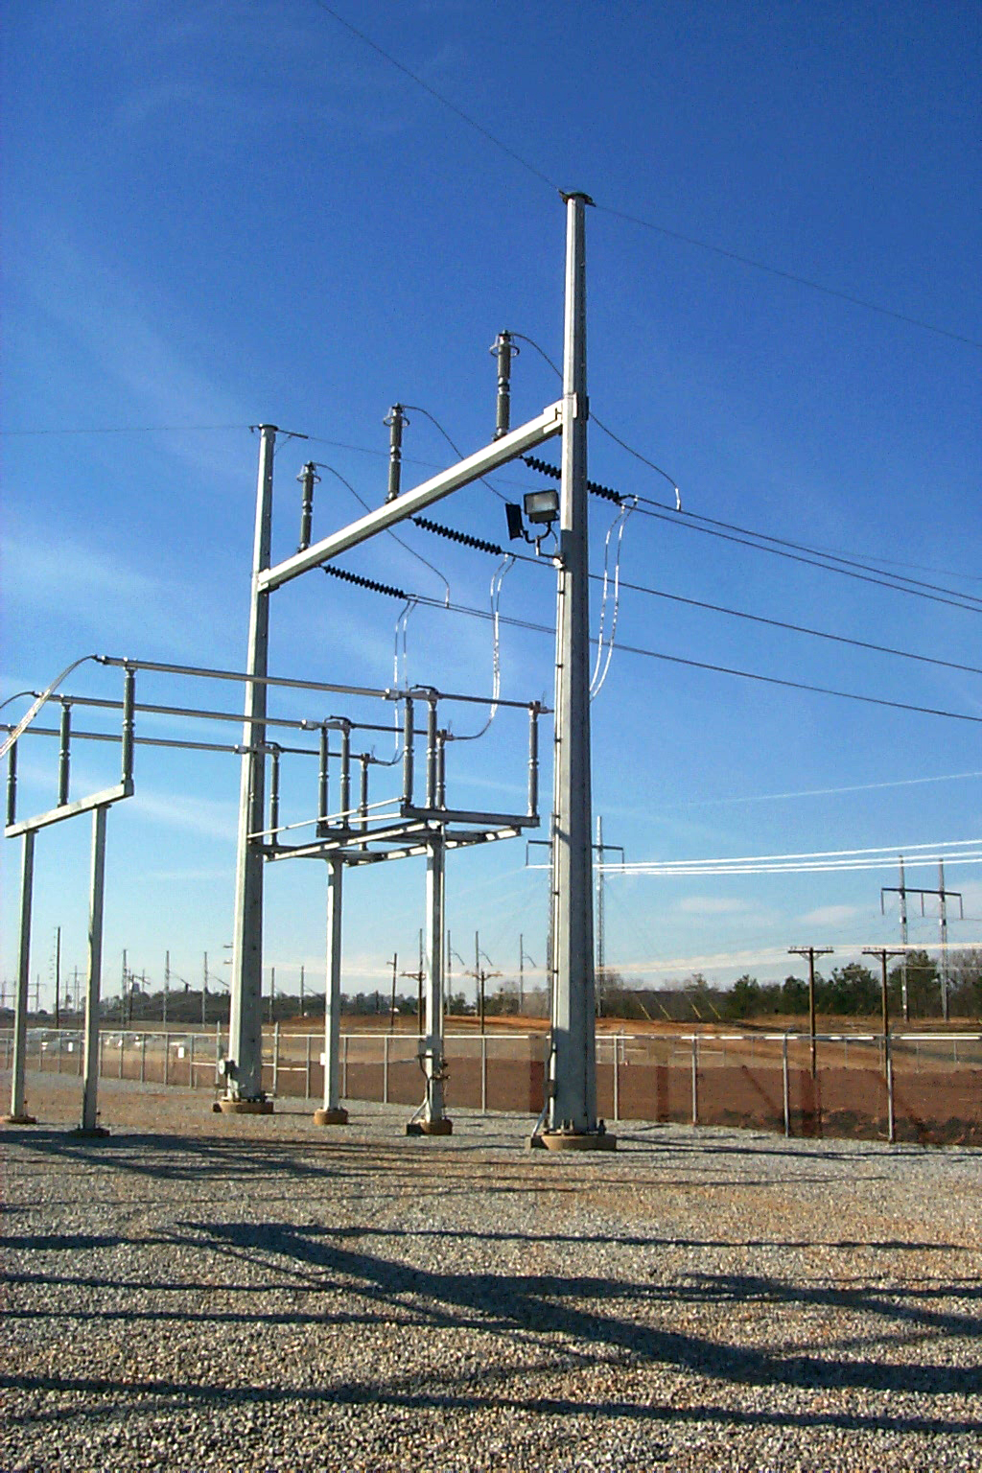
Calculating Effective GGR
1. GIC flow with shield wire
It is standard AEP practice to connect station ground grids, either directly (with dedicated copper wires) or indirectly (through supporting steel structures) to the shield wires for lightning protection on high voltage transmission lines, which themselves are grounded at every transmission structure.
The shield wire grounding has provided an additional path for GIC propagation

Slide 23
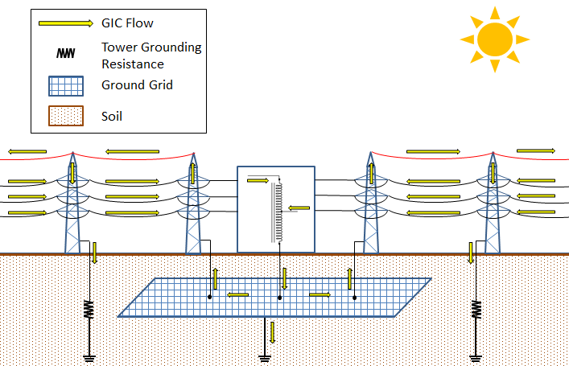
Shield wire

Slide 24
2. Calculating Effective GGR
Effective GGR is the parallel of substation GGR and resistance of all overhead shield wires connecting to the substation ground grid.
Where:
${GGR}_{S}$ Substation ground grid resistance
$R_{sw−X}$ Equivalent grounding resistance of Xth shield wire
$${GGR}_{E}=\frac{1}{\frac{1}{R_{GGR}}+\frac{1}{R_{sw−1}}+\frac{1}{R_{sw−2}}+…\frac{1}{R_{sw−X}}}$$
(2)

Slide 25
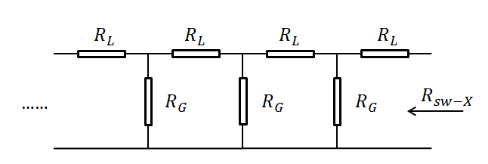
Shield wire is grounded through a conductor installed at each tower. It can be assumed as a series of Γ equivalent models shown below:
Where:
$R_{L}$ n^{th} segment shield wire resistance
$R_{G}$ n^{th} segment shield wire grounding resistance

Slide 26
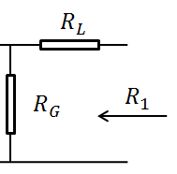
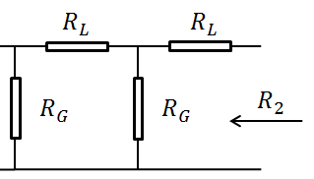
When there is only one Γ segment
When there are two Γ segments
$$R_{1}= R_{L}+R_{G}$$
$R_{2}= R_{L}+R_{G}∥\left(R_{L}+R_{G}\right)=R_{L}+\frac{R_{G}\left(R_{L}+R_{G}\right)}{R_{G}+\left(R_{L}+R_{G}\right)} = R_{L}+\frac{R_{G}\left(R_{1}\right)}{R_{G}+\left(R_{1}\right)}$

Slide 27
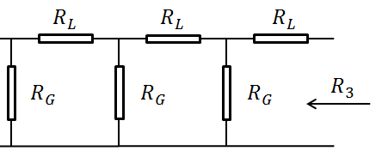
When there are three Γ segments:
$R_{3}= R_{L}+R_{G}∥\left[R_{L}+R_{G}∥\left(R_{L}+R_{G}\right)\right]=R_{L}+\frac{R_{G}\left(R_{L}+\frac{R_{G}\left(R_{L}+R_{G}\right)}{R_{G}+\left(R_{L}+R_{G}\right)}\right)}{R_{G}+\left(R_{L}+\frac{R_{G}\left(R_{L}+R_{G}\right)}{R_{G}+\left(R_{L}+R_{G}\right)}\right)} =R_{L}+\frac{R_{G}\left(R_{2}\right)}{R_{G}+\left(R_{2}\right)}$

Slide 28
When there are n Γ segments:
$R_{n}= R_{L}+R_{G}∥\left[R_{n−1}\right]=R_{L}+\frac{R_{G}\left(R_{n−1}\right)}{R_{G}+\left(R_{n−1}\right)}$
$\lim_{n→∞}{(R_{n})}=\lim_{n→∞}{(R_{L}+\frac{R_{G}\left(R_{n−1}\right)}{R_{G}+\left(R_{n−1}\right)})}=R_{L}+\frac{R_{G}\left(R_{n}\right)}{R_{G}+\left(R_{n}\right)}$ =$R_{n}$
(3)
Solving above equation gives:
$R_{n1}=\frac{R_{L}+\sqrt{R_{L}^{2}+4R_{g}R_{L}} }{2}$
$R_{n2}=\frac{R_{L}−\sqrt{R_{L}^{2}+4R_{g}R_{L}}}{2}$
$R_{n2}$ is less than 0 which can be excluded. Therefore the Xth shield wire equivalent grounding resistance is calculated by $R_{n1}$. After calculating all shield wire equivalent ground resistance $R_{sw−X}$, the effective GGR is calculated by (2)

Slide 29
Procedure for Obtaining GGR and Effective GGR values
AEP’s recommendation
Identify Substation List
NO
GGR exist
YES
Soil Resistivity
Wenner method
Calculate
Effective GGR
Estimate GGR CDEGS
GIC Calculation

Slide 30
Questions?

