Slide 1
GIC Data Gathering Transformer and Shunt Reactor Direct Current Resistance Data Needed For GIC System Model
Kaleb Luce
GIC Data Workshop
5/10/2017

Slide 2
Two Winding Transformer Examples

Slide 3
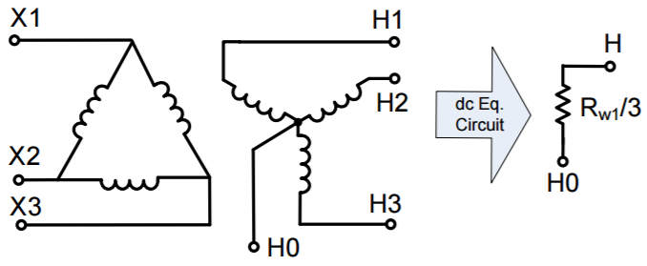
GSU Example

Slide 4
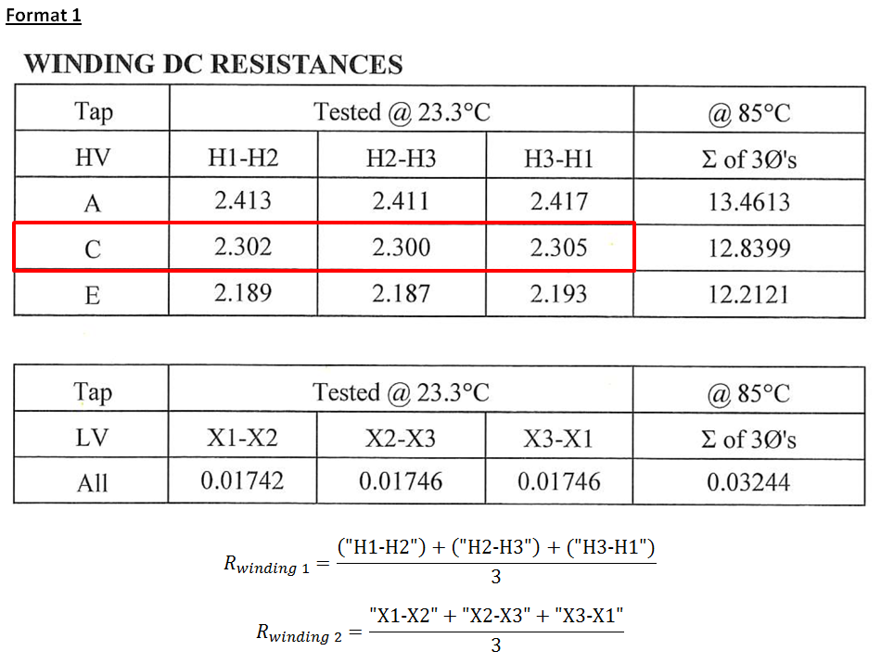
GSU Example Test Reports and Extracting Data
$$R_{winding1}=\frac{\frac{"H1−H2"}{2}+\frac{"H2−H3"}{2}+\frac{"H3−H1"}{2}}{3}$$

Slide 5
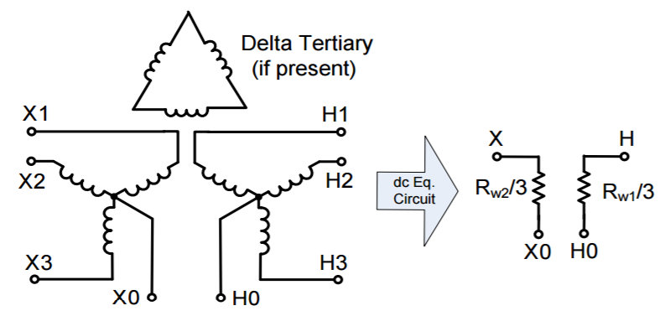
Standard Two/Three Winding Transformer Example

Slide 6
2/3 Winding Example Test Reports and Extracting Data
**
H1-H0
H2-H0
H3-H0
X1-X0
X2-X0
X3-X0
**
(“H1-H0”)+(“H2-H0”)+(“H3-H0”)
**
(“X1-X0”)+(“X2-X0”)+(“X3-X0”)
**NOTE: This report has winding resistances referenced to neutral, therefore, no need to divided by 2.

Slide 7
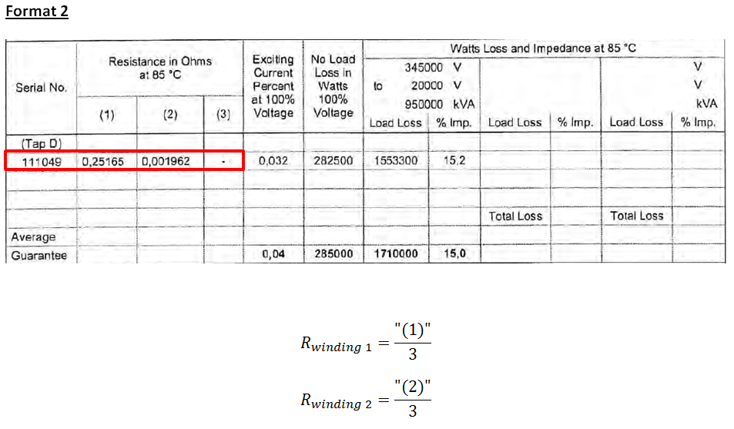
Example Test Reports and Extracting Data

Slide 8
Autotransformer Examples

Slide 9
Autotransformer Winding Resistance
Note: In this equivalence model, values are in direct current Ohms/Phase. This is the format required for the GIC system model.

Slide 10
Example Test Reports and Extracting Data

Slide 11
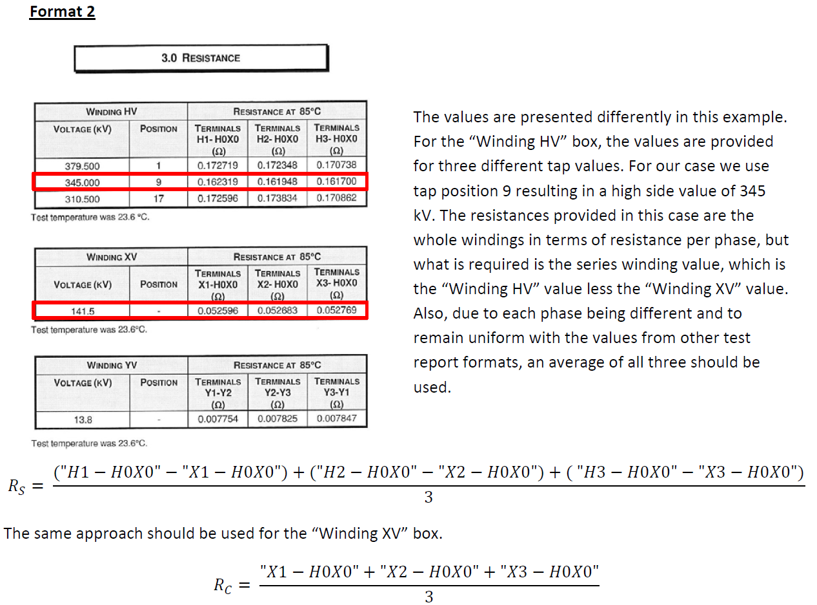
Example Test Reports and Extracting Data

Slide 12
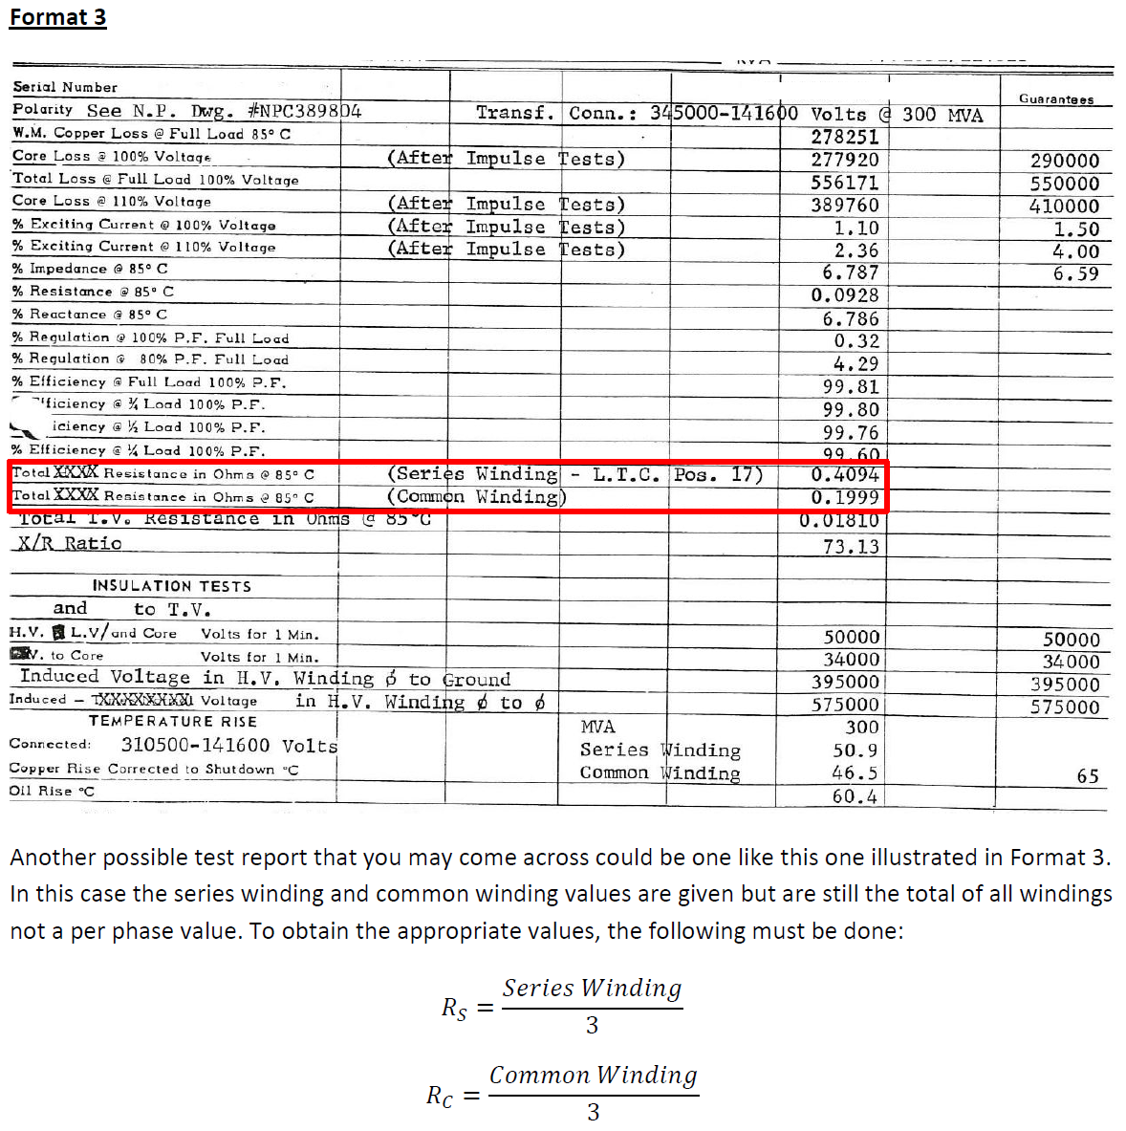
Example Test Reports and Extracting Data

Slide 13
Transmission Shunt Reactor Example

Slide 14
Example Test Report and Extracting Data
$$R_{S}=\frac{\left(\text{"}\text{H}\text{1}\text{−}\text{N}\text{1"}\right)+\left(\text{"}\text{H}\text{2}\text{−}\text{N}\text{2"}\right)+("\text{H}\text{3}\text{−}\text{N}\text{2")}}{3}$$

Slide 15
Temperature Conversion

Slide 16
Example Temperature Conversion To 75⁰C
Formula
Example
Assuming that there is a measurement of 0.001962 Ohms at 85°C, it would need to be converted to 75°C. Assuming that you are converting the temperature of something made of copper, the equation would be worked as follows.
$$R_{S}=0.001962\left(\frac{75+234.5}{85+234.5}\right)$$
$$R_{S} @{ 75}^{o}C=0.001900 Ohms$$

Slide 17
Vector Group

Slide 18
How To Determine Vector Group
Steps To Determine Vector Group:
First Symbol: for High Voltage: Always capital letters. D=Delta, Y=Wye, YN=Wye-Nuetral, Z=Interconnected star, N=Neutral
Second Symbol: for Low voltage: Always Small letters. d=Delta, y=wye, yn=wye-nuetral, z=Interconnected star, n=Neutral.
Third Symbol: Phase displacement expressed as the clock hour number (1,6,11)
0 =0° that the LV phasor is in phase with the HV phasor
1 =30° lagging (LV lags HV with 30°) because rotation is anti-clockwise.
11 = 330° lagging or 30° leading (LV leads HV with 30°)
5 = 150° lagging (LV lags HV with 150°)
6 = 180° lagging (LV lags HV with 180°)

Slide 19
Vector Group Example
Vector Group: YNd0

Slide 20
Questions?

