Slide 1
WebEx Training for NPRR744, RUC Trigger for the Reliability Deployment Price Adder and Alignment with RUC Settlement
Hailong Hui
Aaron Townsend
Pamela Shaw
ERCOT Market Design & Operations
2PM-5PM
May 16, 2017

Slide 2
Outline
NPRR744 Schedule Update
Current (pre-NPRR744) Implementation and Issues
Overview of NPRR744
Implementation of NPRR744
NPRR744 Buyback Scenarios
  NPRR744 Examples

Slide 3
NPRR744 Schedule Update
NPRR744 was approved by Board on April 19, 2016
NPRR744 code is currently under testing.
WebEx Training for NPRR744 2-5 PM on May 16, 2017 (today).
Implementation in production scheduled for June 1, 2017.
Market notices will be sent ahead of implementation.

Slide 4
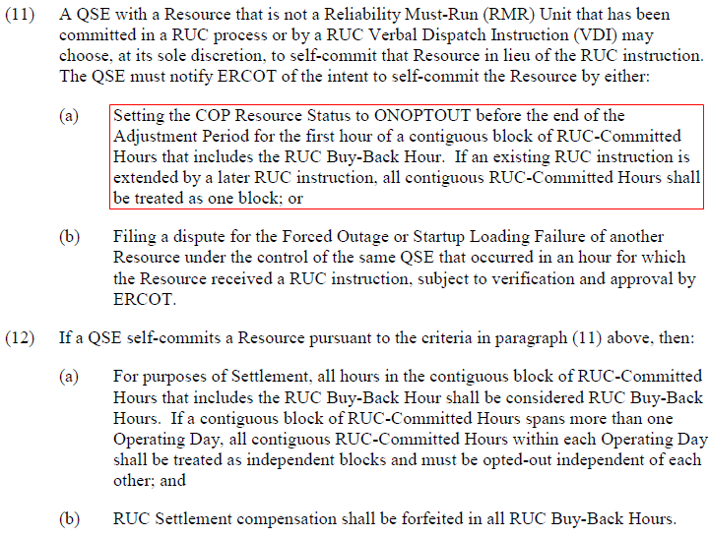
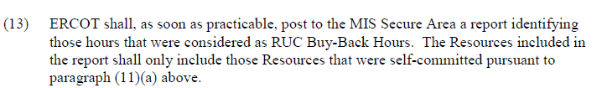
Current (pre-NPRR744) Protocol Language

Slide 5
Current (pre-NPRR744) Implementation
QSE needs to buyback the RUC-committed Resource by submitting ONOPTOUT status in COP before the end of adjustment period of the first hour of the RUC block
Currently SCED performs a validation against the telemetered ONRUC status
  SCED reads the RUC commitment information for current hour
  If the ONRUC Resource is not in the RUC commitment list, SCED will override the ONRUC status to ON
    Will not apply $1,500/MWh RUC price floor when create proxy Energy Offer Curve
    Will not trigger Real-Time On-Line Reliability Deployment Price Adder (RTORDPA) calculation

Slide 6
Issues with Current (pre-NPRR744) Implementation
  A QSE cannot buy back an HRUC commitment for the next hour or VDI commitment for current hour or next hour
  Because COP submission windows close at end of adjustment period
  Resource telemetry status not consistent with Resource RUC commitment status or buyback status
  Buy back in COP but telemeter ONRUC in Real-Time
  Not buy back in COP but telemeter ONOPTOUT or ON in Real-Time
  Causes issues for the RTORDPA pricing run

Slide 7
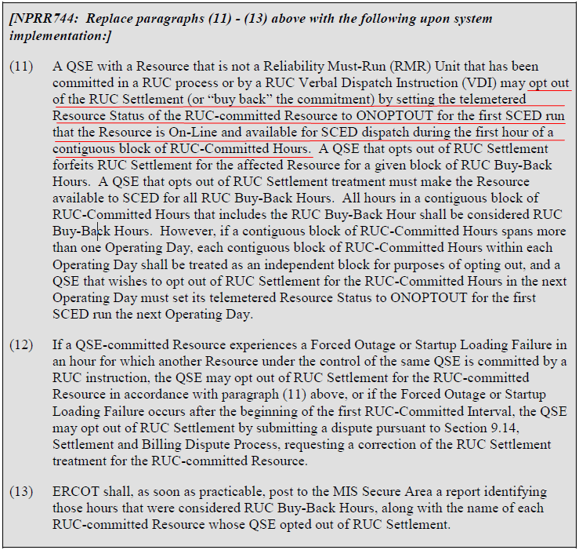
NPRR744 Protocol Language

Slide 8
Overview of NPRR744 Buyback Process
Regardless of when the RUC is communicated, SCED will take a Resource status telemetry snapshot when the following are ALL TRUE:
  Resource has a confirmed RUC commitment block
  The first hour of the RUC commitment block
  First SCED run when Resource is On-Line and available for SCED dispatch
      Statuses treated as NOT available for SCED dispatch are: EMR, OFF, OFFNS, OFFQS, OUT, STARTUP, SHUTDOWN, ONTEST, ONRR

Slide 9
Overview of NPRR744 Buyback Process
This Resource status telemetry snapshot will be used to determine the buyback flag for the entire RUC block and any extensions of the RUC commitment block, unless the RUC goes into the next operating day.
This determined buyback flag will be used in the QSE’s settlement for the entire RUC commitment block as well as the RUC trigger for the RTORDPA pricing run.
  If snapshot is ONOPTOUT then Resource is opted-out of RUC settlement and RTORDPA pricing run will not be initiated. The buyback flag will be set to YES.
  If any other online status , since unit is RUC-committed, then Resource will be settled as per RUC settlement and the RTORDPA pricing runs will be initiated for the entire block. The buyback flag will be set to NO.

Slide 10
Benefits of NPRR744
Addresses current implementation issues
  Can buy back a RUC commitment for next Operating Hour and possible current hour
  Use one single buyback flag for the entire RUC block
    Override the telemetry status if it is different from the determined buyback flag
  Fix the RUC and buyback inconsistency between SCED and Settlement by using one single Buyback flag set by SCED

Slide 11
NPRR744 Implementation-Combined Cycle Resources
MMS determines the buyback flag for Combined Cycle Resources at Combined Cycle Train level
  All Combined Cycle Configurations within the same Combined Cycle Train are treated as the same Resource for NPRR744 purpose, and MMS uses the Combined Cycle Train name as Resource Name
  For a contiguous RUC block that includes different Combined Cycle configurations within the same train, MMS will treat the entire bock as a single RUC block with the same Resource Name
  QSEs telemeter a single Combined Cycle Configuration in Real-Time. SCED will treat all the configurations within the same train as the same Resource and apply the buyback rule and telemetry status override rule to any configuration within that train.

Slide 12
NPRR744 Implementation-RUC Commitments Spanning Two Days
If a contiguous block of RUC-Committed Hours spans more than one Operating Day, each contiguous block of RUC-Committed Hours within each Operating Day is treated as an independent block
Each independent block has a separate buyback flag and QSE needs to buy back each independent block separately

Slide 13
NPRR744 Implementation-RUC Block
RUC Block
  A contiguous block of RUC-Committed Hours for a specific Operating Day
  RUC_START_HOUR is the first hour of the block in Hour Ending Format
  RUC_END_HOUR is the last hour of the block in Hour Ending Format
  BUYBACK_FLAG default is initially NULL and is set by SCED
  Examples
DELIVERY_DATE | RESOURCE_NAME | RUC_START_HOUR | RUC_END_HOUR | BUYBACK_FLAG
04/30/2017 | UNIT1 | 12 | 24 | YES
04/30/2017 | UNIT2 | 10 | 20 | NO
05/01/2017 | UNIT3 | 11 | 12 | YES
05/01/2017 | UNIT3 | 18 | 21
05/01/2017 | UNIT4 | 17 | 24
05/01/2017 | UNIT5 | 21 | 24
05/01/2017 | XYZ_CC1 | 17 | 20
05/02/2017 | UNIT5 | 1 | 7

Slide 14
NPRR744 Implementation-COP Submissions
NPRR744 does not change any COP submission requirements
The QSE is still required to update the COP with expected operational status for all hours before the end of the Adjustment Period, including the RUC hours
  Submit ONOPTOUT if QSE intends to buy back a future RUC block
  Submit ONRUC if QSE does not intend to buy back a future RUC block
  Submit ONOPTOUT for future hours in a current RUC block if QSE successfully bought back the RUC block
  Submit ONRUC for future hours in a current RUC block if QSE did not successfully buy back the RUC block

Slide 15
NPRR744 Implementation-SCED Changes
SCED will take a snapshot of the telemetered Resource status of the RUC-committed Resource for the first SCED run that the Resource is On-Line and available for SCED dispatch during the first hour of the RUC block
SCED will determine the buyback flag for the entire RUC block based on the telemetered status snapshot
  If the snapshot status is ONOPTOUT, SCED will set the buyback flag to YES indicating that the Resource successfully bought back the RUC block
  Otherwise SCED will set the buyback flag to NO indicating that the Resource did not successfully buy back the RUC block
SCED will use the RUC block and determined buyback flag to validate telemetered Resource status and override the telemetered status if it is inconsistent with the determined buyback flag
SCED will use the determined buyback flag and the validated Resource status to trigger RTORDPA calculation for the RUC block

Slide 16
NPRR744 Implementation-SCED Telemetry Status Override
SCED will override Resource telemetry status if it is not consistent with the determined buyback flag and RUC commitment status
  Statuses treated as NOT available for SCED dispatch are: EMR, OFF, OFFNS, OFFQS, OUT, STARTUP, SHUTDOWN, ONTEST, ONRR
  The other statuses other than the above statuses are treated as available for SCED dispatch, including ON, ONRUC, ONOPTOUT, ONOS etc.
Status Override Scenarios
RUC_Commitment | BUYBACK_FLAG | TELEMETRY_STATUS | STATUS_OVERRIDE | COMMENT
YES | YES | ONOPTOUT |  | No override
 |  | Status available for SCED dispatch other than ONOPTOUT | ONOPTOUT | Override
 |  | Status not available for SCED dispatch |  | No override
 | NO | ONRUC |  | No override
 |  | Status available for SCED dispatch other than ONRUC | ONRUC | Override
 |  | Status not available for SCED dispatch |  | No override
No | N/A | ONRUC | ON | Override
 |  | Any status other than ONRUC |  | No override

Slide 17
NPRR744 Implementation-SCED Workflow

Slide 18
NPRR744 Implementation-CDR Report Change
As required by NPRR744, ERCOT will publish a CDR report to the MIS Secure Area for the RUC buyback information
  Changes to the existing report NP5-513-CD RUC Buy-Back Hours (Report Type ID 13102), same report name and same location with different content
  Report is running every hour for current Operating Day
  Post all the RUC buyback blocks in current Operating Day if any at the time of the report execution
  No report if no buyback for current Operating Day

Slide 19
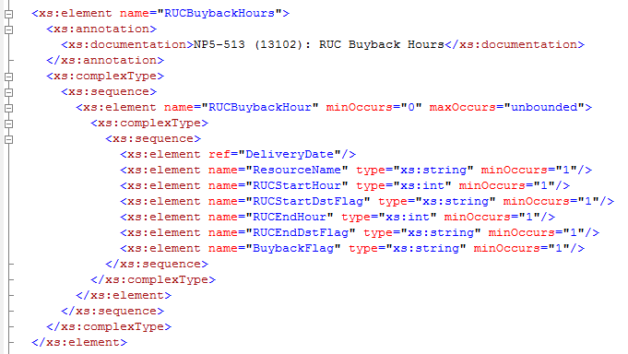
NPRR744 Implementation-CDR Report XSD Change
New XSD for NPRR 744 buyback report is available at Current Day Reports XSD v6.25
Report Example

Slide 20
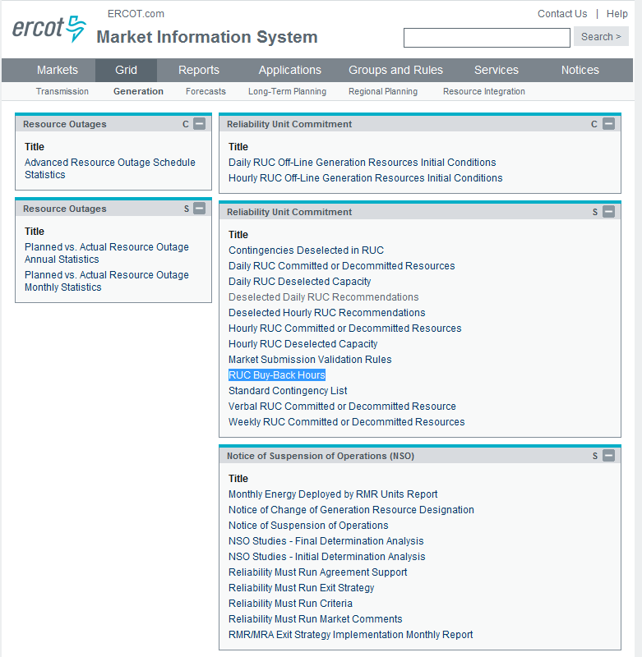
NPRR744 Implementation-CDR Report Location

Slide 21
NPRR744 Implementation-New MMS Notifications
MMS will send XML notification messages to the affected QSE and the notification messages are also available at MIS MARKET MANAGER under the Notifications tab
  When the buyback flag is set by SCED, MMS will send the following message to QSE (only once for a RUC block)
    CM-SCED-NOTIF <resource_name> buyback status: Y, set by SCED <YYYY-MM-DD HH24:MI:SS>
  When there is a Resource status override by SCED, send the following message to QSE
    CM-SCED-NOTIF <resource_name> status <original_status> overridden to <new_status>, SCED at <YYYY-MM-DD HH24:MI:SS>
    QSE shall update telemetry and validate COP status in the future hours of the RUC block

Slide 22
NPRR744 Implementation-Settlement Changes
Settlements will consume a new data element that identifies when a QSE has successfully opted out of RUC settlement. This new bill determinant, BUYBACK, will equal
  1 if the opt-out attempt is successful,
  2 if the opt-out attempt is un-successful or no attempt is made,
  0 for hours that are not RUC-committed.
RUC Buy-Back hours will still be communicated to the Market via the current RUC Bill Determinant with an hourly value of 5 for each RUC-committed hour found eligible for the RUC Resource Buyback provision.
RUC hourly values of 5 will still be considered not RUC-Committed for Settlement purposes.
Bill Determinant | Short Description | Extract | Extract Table
BUYBACK | RUC Buyback Flag | RTM CODE | MKTINPUTHEADER MKTINPUTINTERVAL

Slide 23
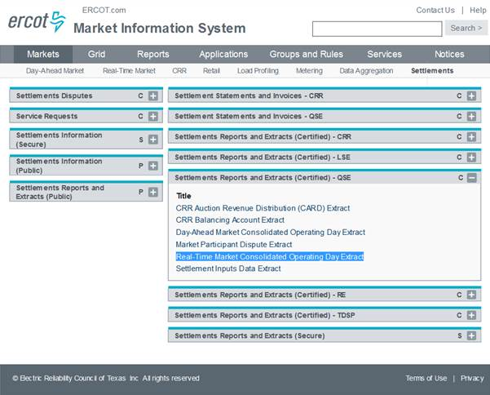
NPRR744 Implementation-Settlement Extract for BUYBACK Bill Determinant
BUYBACK bill determinant reside within the RTM CODE Extract

Slide 24
NPRR744 Buyback Scenarios-General Scenarios
Off-line Scenario (STARTUP->ONOPTOUT):
  If the Resource is starting up from Off-Line status to the first hour of the RUC block, it shall telemeter STARTUP and then ONOPTOUT right after it is started up
    Already started up before the beginning of the first hour
    Not yet started up at the beginning of the first hour
    On-Line Scenarios (ON->ONOPTOUT):
      If the Resource is RUC committed for a block immediately following a QSE-commitment block, it shall telemeter ONOPTOUT before the beginning of the first hour of the RUC block

Slide 25
NPRR744 Buyback Scenarios-VDI Commitment for Current Hour for Off-Line Fast Start Resource
If ERCOT Operators decide to commit an Off-Line fast start Resource immediately through a VDI
  First the Operator will check the Resource startup time
    If the Resource can start up by the end of the current hour, the Operator will commit the current hour as first hour of the RUC block
    If the Resource cannot start up by the end of the current hour, the Operator will commit the next hour as first hour of the RUC block
  Either way the QSE can buy back the RUC block by telemetering ONOPTOUT immediately after the Resource starts up (STARTUP->ONOPTOUT)

Slide 26
NPRR744 Buyback Scenarios-VDI Commitment for Current Hour for a Shutting Down Resource
If ERCOT Operators decide to extend a QSE commitment including current hour for a Resource in or close to the shutting down process
  If the Resource is already in the shutting down process and is telemetering SHUTDOWN status
    The QSE can buy back the RUC block by telemetering ONOPTOUT right after the Resource receives the RUC commitment and becomes available for SCED dispatch again
  If the Resource is very close to the shutting down process but is still telemetering ON status
    Need coordination between ERCOT Operator and QSE Operator
      The ERCOT Operator will call the QSE about the VDI commitment before entering it in the MMS system. Once the VDI is entered in the MMS, the next SCED run will read the RUC block information and will set the buyback flag based on the snapshot of the Resource telemetry at next SCED run.
      The QSE needs to telemeter ONOPTOUT before the next SCED run after VDI entry in MMS, normally less than 5 minutes once VDI is entered

Slide 27
NPRR744 Examples
Off-Line Buyback with snapshot at start of first hour
Off-Line Buyback with snapshot during first hour
On-Line Buyback with snapshot at start of first hour
Off-Line ONRUC with snapshot at start of first hour
On-line ONRUC with snapshot at start of first hour
Buyback for current day and next day
Buyback for current day and ONRUC for next day
Telemetry Resource status override
Buyback for Combined Cycle Resources
ONRUC for Combined Cycle Resources
Unsuccessful Buyback due to missed first SCED interval
Unsuccessful Buyback due to missed first SCED interval
VDI Commitment for current hour for Off-Line Fast Start Resource
VDI Commitment for current hour for a Resource during Shutdown
VDI Commitment for current hour for a Resource planning Shutdown
VDI Commitment for current hour for a Resource planning Shutdown (peaker)

Slide 28
NPRR744 Example 1: Off-Line Buyback with Snapshot at Start of First Hour
Scenario
  08:20:00 HRUC commits an Off-Line Resource for HE11-HE12
  08:25:00 QSE updates COP status for the Resource to ONOPTOUT for HE11-HE12
  09:37:00 QSE telemeters status of STARTUP for this resource
  09:53:00 QSE telemeters status of ONOPTOUT for this resource
  10:00:00 SCED reads the ONOPTOUT status and sets the BUYBACK_FLAG=YES for the block
  SCED
SCED_EXECUTION_TIME | TELEMETRY_STATUS | RUC_COMMITMENT | BUYBACK_FLAG | STATUS_OVERRIDE | COMMENT
09:35:00 | OFF | NO |  |  | Off-Line
09:40:00 | STARTUP | NO |  |  | Startup
09:45:00 | STARTUP | NO |  |  | Startup
09:50:00 | STARTUP | NO |  |  | Startup
09:55:00 | ONOPTOUT | NO |  |  | Startup complete
10:00:00 | ONOPTOUT | YES | YES |  | Buyback flag is set
10:05:00 | ONOPTOUT | YES | YES |  | Use set buyback flag
10:10:00 | ONOPTOUT | YES | YES |  | Use set buyback flag
10:15:00 | ONOPTOUT | YES | YES |  | Use set buyback flag

Slide 29
NPRR744 Example 2: Off-Line Buyback with Snapshot during First Hour
Scenario
  08:20:00 HRUC commits an Off-Line Resource for HE11-HE12
  08:25:00 QSE updates COP status for the Resource to ONOPTOUT for HE11-HE12
  09:37:00 QSE telemeters status of STARTUP for this resource
  10:03:00 QSE telemeters status of ONOPTOUT for this resource
  10:05:00 SCED reads the ONOPTOUT status and sets the BUYBACK_FLAG=YES for the block
  SCED
SCED_EXECUTION_TIME | TELEMETRY_STATUS | RUC_COMMITMENT | BUYBACK_FLAG | STATUS_OVERRIDE | COMMENT
09:35:00 | OFF | NO |  |  | Off-Line
09:40:00 | STARTUP | NO |  |  | Startup
09:45:00 | STARTUP | NO |  |  | Startup
09:50:00 | STARTUP | NO |  |  | Startup
09:55:00 | STARTUP | NO |  |  | Startup
10:00:00 | STARTUP | YES |  |  | Startup, no status override
10:05:00 | ONOPTOUT | YES | YES |  | Buyback flag is set
10:10:00 | ONOPTOUT | YES | YES |  | Use set buyback flag
10:15:00 | ONOPTOUT | YES | YES |  | Use set buyback flag

Slide 30
NPRR744 Example 3: On-Line Buyback with Snapshot at Start of First Hour
Scenario
  08:20:00 HRUC commits an On-Line Resource for HE11-HE12 and the Resource is QSE-committed for HE09-HE10
  08:25:00 QSE updates COP status for the Resource to ONOPTOUT for HE11-HE12
  09:00:00 QSE telemeters status of ON for this resource
  09:58:00 QSE telemeters status of ONOPTOUT for this resource
  10:00:00 SCED reads the ONOPTOUT status and sets the BUYBACK_FLAG=YES for the block
  SCED
SCED_EXECUTION_TIME | TELEMETRY_STATUS | RUC_COMMITMENT | BUYBACK_FLAG | STATUS_OVERRIDE | COMMENT
09:35:00 | ON | NO |  |  | QSE-committed On-Line
09:40:00 | ON | NO |  |  | QSE-committed On-Line
09:45:00 | ON | NO |  |  | QSE-committed On-Line
09:50:00 | ON | NO |  |  | QSE-committed On-Line
09:55:00 | ON | NO |  |  | QSE-committed On-Line
10:00:00 | ONOPTOUT | YES | YES |  | Buyback flag is set
10:05:00 | ONOPTOUT | YES | YES |  | Use set buyback flag
10:10:00 | ONOPTOUT | YES | YES |  | Use set buyback flag
10:15:00 | ONOPTOUT | YES | YES |  | Use set buyback flag

Slide 31
NPRR744 Example 4: Off-Line ONRUC with Snapshot at Start of First Hour
Scenario
  08:20:00 HRUC commits an Off-Line Resource for HE11-HE12
  08:25:00 QSE updates COP status for the Resource to ONRUC for HE11-HE12
  09:37:00 QSE telemeters status of STARTUP for this resource
  09:53:00 QSE telemeters status of ONRUC for this resource
  10:00:00 SCED reads the ONRUC status and sets the BUYBACK_FLAG=NO for the block
  SCED
SCED_EXECUTION_TIME | TELEMETRY_STATUS | RUC_COMMITMENT | BUYBACK_FLAG | STATUS_OVERRIDE | COMMENT
09:35:00 | OFF | NO |  |  | Off-Line
09:40:00 | STARTUP | NO |  |  | Startup
09:45:00 | STARTUP | NO |  |  | Startup
09:50:00 | STARTUP | NO |  |  | Startup
09:55:00 | ONRUC | NO |  | ON | Status override
10:00:00 | ONRUC | YES | NO |  | Buyback flag is set
10:05:00 | ONRUC | YES | NO |  | Use set buyback flag
10:10:00 | ONRUC | YES | NO |  | Use set buyback flag
10:15:00 | ONRUC | YES | NO |  | Use set buyback flag

Slide 32
NPRR744 Example 5: On-Line ONRUC with Snapshot at Start of First Hour
Scenario
  08:20:00 HRUC commits an On-Line Resource for HE11-HE12 and the Resource is QSE-committed for HE09-HE10
  08:25:00 QSE updates the COP status for the Resource to ONRUC for HE11-HE12
  09:00:00 QSE telemeters status of ON for this resource
  09:58:00 QSE telemeters status of ONRUC for this resource
  10:00:00 SCED reads the ONRUC status and sets the BUYBACK_FLAG=NO for the block
  SCED
SCED_EXECUTION_TIME | TELEMETRY_STATUS | RUC_COMMITMENT | BUYBACK_FLAG | STATUS_OVERRIDE | COMMENT
09:35:00 | ON | NO |  |  | QSE-committed On-Line
09:40:00 | ON | NO |  |  | QSE-committed On-Line
09:45:00 | ON | NO |  |  | QSE-committed On-Line
09:50:00 | ON | NO |  |  | QSE-committed On-Line
09:55:00 | ON | NO |  |  | QSE-committed On-Line
10:00:00 | ONRUC | YES | NO |  | Buyback flag is set
10:05:00 | ONRUC | YES | NO |  | Use set buyback flag
10:10:00 | ONRUC | YES | NO |  | Use set buyback flag
10:15:00 | ONRUC | YES | NO |  | Use set buyback flag

Slide 33
NPRR744 Example 6: Buyback for Current Day and Next Day
Scenario
  18:20:00 HRUC commits an Off-Line Resource from HE21 to next Operating Day HE07
  18:25:00 QSE updates the COP status for the Resource to ONOPTOUT for HE21 to OD+1 HE07
  19:37:00 QSE telemeters status of STARTUP for this resource
  19:53:00 QSE telemeters status of ONOPTOUT for this resource
  20:00:00 SCED reads the ONOPTOUT status and sets the BUYBACK_FLAG=YES for the block of current OD
  00:00:00 OD+1 SCED reads the ONOPTOUT status and sets the BUYBACK_FLAG=YES for the block of OD+1
  SCED
SCED_EXECUTION_TIME | TELEMETRY_STATUS | RUC_COMMITMENT | BUYBACK_FLAG | STATUS_OVERRIDE | COMMENT
19:50:00 | STARTUP | NO |  |  | Startup
19:55:00 | ONOPTOUT | NO |  |  | Startup complete
20:00:00 | ONOPTOUT | YES | YES |  | Buyback flag is set
20:05:00 | ONOPTOUT | YES | YES |  | Use set buyback flag
… | … | … | … |  | …
23:55:00 | ONOPTOUT | YES | YES |  | Use set buyback flag
00:00:00 | ONOPTOUT | YES | YES |  | Buyback flag is set for the new block
00:00:05 | ONOPTOUT | YES | YES |  | Use set buyback flag

Slide 34
NPRR744 Example 7: Buyback for Current Day and ONRUC for Next Day
Scenario
  18:20:00 HRUC commits an Off-Line Resource from HE21 to next Operating Day HE07
  18:25:00 QSE updates the COP status for the Resource to ONOPTOUT for HE21-HE24 and ONRUC for OD+1 HE01-HE07
  19:37:00 QSE telemeters status of STARTUP for this resource
  19:53:00 QSE telemeters status of ONOPTOUT for this resource
  20:00:00 SCED reads the ONOPTOUT status and sets the BUYBACK_FLAG=YES for the block of current OD
  23:58:00 QSE telemeters status of ONRUC for this resource
  OD+1 00:00:00 SCED reads the ONRUC status and sets the BUYBACK_FLAG=NO for the block of OD+1
  SCED
SCED_EXECUTION_TIME | TELEMETRY_STATUS | RUC_COMMITMENT | BUYBACK_FLAG | STATUS_OVERRIDE | COMMENT
19:50:00 | STARTUP | NO |  |  | Startup
19:55:00 | ONOPTOUT | NO |  |  | Startup complete
20:00:00 | ONOPTOUT | YES | YES |  | Buyback flag is set
20:05:00 | ONOPTOUT | YES | YES |  | Use set buyback flag
… | … | … | … |  | …
23:55:00 | ONOPTOUT | YES | YES |  | Use set buyback flag
00:00:00 | ONRUC | YES | NO |  | Buyback flag is set for the new block
00:00:05 | ONRUC | YES | NO |  | Use set buyback flag

Slide 35
NPRR744 Example 8: Telemetry Resource Status Override
Scenario
  08:20:00 HRUC commits an Off-Line Resource for HE11-HE12
  08:25:00 QSE updates the COP status for the Resource to ONOPTOUT for HE11-HE12
  09:37:00 QSE telemeters status of STARTUP for this resource
  09:53:00 QSE telemeters status of ONOPTOUT for this resource
  10:00:00 SCED reads the ONOPTOUT status and sets the BUYBACK_FLAG=YES for the block
  10:10:00 and 10:15:00 QSE telemeters status of ON and ONRUC for this resource. SCED overrides status to ONOPTOUT.
  10:20:00 QSE telemeters status of ONOPTOUT.
  12:00:00 QSE telemeters status of ONRUC for this resource. SCED overrides status to ON because the RUC block has ended.
  SCED
SCED_EXECUTION_TIME | TELEMETRY_STATUS | RUC_COMMITMENT | BUYBACK_FLAG | STATUS_OVERRIDE | COMMENT
09:50:00 | STARTUP | NO |  |  | Startup
09:55:00 | ONOPTOUT | NO |  |  | Startup complete
10:00:00 | ONOPTOUT | YES | YES |  | Buyback flag is set
10:05:00 | ONOPTOUT | YES | YES |  | Use set buyback flag
10:10:00 | ON | YES | YES | ONOPTOUT | Override status
10:15:00 | ONRUC | YES | YES | ONOPTOUT | Override status
10:20:00 | ONOPTOUT | YES | YES |  | Use set buyback flag
… | … | … | … | … | …
12:00:00 | ONRUC | NO |  | ON | Override status

Slide 36
NPRR744 Example 9: Buyback for Combined Cycle Resources
Scenario
  08:20:00 HRUC commits an Off-Line CCGR XYZ_CC1_1 for HE11-HE12
  08:25:00 QSE updates COP status for the Resource to ONOPTOUT for HE11-HE12
  09:37:00 QSE telemeters status of STARTUP for CCGR XYZ_CC1_2
  09:53:00 QSE telemeters status of ONOPTOUT for XYZ_CC1_2
  10:00:00 SCED reads the ONOPTOUT status and sets the BUYBACK_FLAG=YES for the block
  10:05:00 QSE telemeters status of ON for XYZ_CC1_2. SCED overrides status to ONOPTOUT.
  10:10:00 QSE telemeters status of ONRUC for XYZ_CC1_3. SCED overrides status to ONOPTOUT.
  12:00:00 QSE telemeters status of ONRUC for this Resource. SCED overrides status to ON.
  SCED
SCED_EXECUTION _TIME | RESOURCE _NAME | CCGR_NAME | TELEMETRY _STATUS | RUC_ COMMITMENT | BUYBACK _FLAG | STATUS_ OVERRIDE | COMMENT
09:35:00 | XYZ_CC1 | XYZ_CC1_1 | OFF | NO |  |  | Off-Line
… | … | … | … | … | … | … | …
09:50:00 | XYZ_CC1 | XYZ_CC1_2 | STARTUP | NO |  |  | Startup
09:55:00 | XYZ_CC1 | XYZ_CC1_2 | ONOPTOUT | NO |  |  | Startup complete
10:00:00 | XYZ_CC1 | XYZ_CC1_2 | ONOPTOUT | YES | YES |  | Buyback flag is set
10:05:00 | XYZ_CC1 | XYZ_CC1_2 | ON | YES | YES | ONOPTOUT | Override status
10:10:00 | XYZ_CC1 | XYZ_CC1_3 | ONRUC | YES | YES | ONOPTOUT | Override status
… | … | … | … | … | … | … | …
11:55:00 | XYZ_CC1 | XYZ_CC1_3 | ONRUC | YES | YES | ONOPTOUT | Override status
12:00:00 | XYZ_CC1 | XYZ_CC1_3 | ONRUC | NO |  | ON | Override status

Slide 37
NPRR744 Example 10: ONRUC for Combined Cycle Resources
Scenario
  08:20:00 HRUC commits an Off-Line CCGR XYZ_CC1_1 for HE11-HE12
  08:25:00 QSE updates COP status for the Resource to ONRUC for HE11-HE12
  09:37:00 QSE telemeters status of STARTUP for CCGR XYZ_CC1_2
  09:53:00 QSE telemeters status of ONRUC for XYZ_CC1_2
  10:00:00 SCED reads the ONRUC status and sets the BUYBACK_FLAG=NO for the block
  10:05:00 QSE telemeters status of ON for XYZ_CC1_2. SCED overrides status to ONRUC.
  10:10:00 QSE telemeters status of ONOPTOUT for XYZ_CC1_3. SCED overrides status to ONRUC.
  12:00:00 QSE telemeters status of ONRUC for this Resource. SCED overrides status to ON.
  SCED
SCED_EXECUTION _TIME | RESOURCE _NAME | CCGR_NAME | TELEMETRY _STATUS | RUC_ COMMITMENT | BUYBACK _FLAG | STATUS_ OVERRIDE | COMMENT
09:35:00 | XYZ_CC1 | XYZ_CC1_1 | OFF | NO |  |  | Off-Line
… | … | … | … | … | … | … | …
09:50:00 | XYZ_CC1 | XYZ_CC1_2 | STARTUP | NO |  |  | Startup
09:55:00 | XYZ_CC1 | XYZ_CC1_2 | ONRUC | NO |  | ON | Startup complete
10:00:00 | XYZ_CC1 | XYZ_CC1_2 | ONRUC | YES | NO |  | Buyback flag is set
10:05:00 | XYZ_CC1 | XYZ_CC1_2 | ON | YES | NO | ONRUC | Override status
10:10:00 | XYZ_CC1 | XYZ_CC1_3 | ONOPTOUT | YES | NO | ONRUC | Override status
… | … | … | … | … | … | … | …
11:55:00 | XYZ_CC1 | XYZ_CC1_3 | ONRUC | YES | NO |  | Correct status
12:00:00 | XYZ_CC1 | XYZ_CC1_3 | ONRUC | NO |  | ON | Override status

Slide 38
NPRR744 Example 11: Unsuccessful Buyback due to Missed First SCED Interval
Scenario
  08:20:00 HRUC commits an Off-Line Resource for HE11-HE12
  08:25:00 QSE updates COP status for the Resource to ONOPTOUT for HE11-HE12
  09:37:00 QSE telemeters status of STARTUP for this resource
  09:53:00 QSE telemeters status of ON for this resource
  10:00:00 SCED reads the ON status and sets the BUYBACK_FLAG=NO for the block
  10:03:00 QSE telemeters status of ONOPTOUT for this resource
  10:05:00+ SCED overrides status to ONRUC
  SCED
SCED_EXECUTION_TIME | TELEMETRY_STATUS | RUC_COMMITMENT | BUYBACK_FLAG | STATUS_OVERRIDE | COMMENT
09:35:00 | OFF | NO |  |  | Off-Line
… | … | … | … | … | …
09:50:00 | STARTUP | NO |  |  | Startup
09:55:00 | ON | NO |  |  | Startup complete
10:00:00 | ON | YES | NO | ONRUC | Buyback flag is set
10:05:00 | ONOPTOUT | YES | NO | ONRUC | Use set buyback flag
10:10:00 | ONOPTOUT | YES | NO | ONRUC | Use set buyback flag

Slide 39
NPRR744 Example 12: Unsuccessful Buyback due to Missed First SCED Interval
Scenario
  08:20:00 HRUC commits an Off-Line Resource for HE11-HE12
  08:25:00 QSE updates COP status for the Resource to ONOPTOUT for HE11-HE12
  09:37:00 QSE telemeters status of STARTUP for this resource
  09:53:00 QSE telemeters status of ONOPTOUT for this resource
  09:57:00 QSE telemeters status of ON for this resource
  10:00:00 SCED reads the ON status and sets the BUYBACK_FLAG=NO for the block
  10:00:00+ SCED overrides status to ONRUC
  SCED
SCED_EXECUTION_TIME | TELEMETRY_STATUS | RUC_COMMITMENT | BUYBACK_FLAG | STATUS_OVERRIDE | COMMENT
09:35:00 | OFF | NO |  |  | Off-Line
… | … | … | … | … | …
09:50:00 | STARTUP | NO |  |  | Startup
09:55:00 | ONOPTOUT | NO |  |  | Startup complete
10:00:00 | ON | YES | NO | ONRUC | Buyback flag is set
10:05:00 | ON | YES | NO | ONRUC | Use set buyback flag
10:10:00 | ON | YES | NO | ONRUC | Use set buyback flag

Slide 40
NPRR744 Example 13: VDI Commitment for Current Hour for Off-Line Fast Start Resource
Scenario
  10:21:00 VDI commit an Off-Line fast start Resource with startup time 20 minutes for HE11-HE12
  10:23:00 QSE telemeters Resource status of STARTUP for this resource
  10:43:00+ QSE telemeters Resource status of ONOPTOUT for this resource
  10:45:00 SCED reads the ONOPTOUT status and sets the BUYBACK_FLAG=YES for the block
  SCED
SCED_EXECUTION_TIME | TELEMETRY_STATUS | RUC_COMMITMENT | BUYBACK_FLAG | STATUS_OVERRIDE | COMMENT
10:20:00 | OFF | NO |  |  | Off-Line
10:25:00 | STARTUP | YES |  |  | RUC block created
10:30:00 | STARTUP | YES |  |  | Startup
10:35:00 | STARTUP | YES |  |  | Startup
10:40:00 | STARTUP | YES |  |  | Startup
10:45:00 | ONOPTOUT | YES | YES |  | Buyback flag is set
10:50:00 | ONOPTOUT | YES | YES |  | Use set buyback flag
10:55:00 | ONOPTOUT | YES | YES |  | Use set buyback flag
11:00:00 | ONOPTOUT | YES | YES |  | Use set buyback flag
11:05:00 | ONOPTOUT | YES | YES |  | Use set buyback flag

Slide 41
NPRR744 Example 14: VDI Commitment for Current Hour for a Resource during Shutdown
Scenario
  COP status for the Resource is ON for HE10 and OFF for HE11
  09:57:00 QSE telemeters Resource status of ON for this resource
  10:07:00 QSE telemeters Resource status of SHUTDOWN for this resource
  10:13:00 VDI commit the Resource for HE11-HE12
  10:18:00 QSE telemeters Resource status of ONOPTOUT for this resource
  10:20:00 SCED reads the ONOPTOUT status and sets the BUYBACK_FLAG=YES for the block
  SCED
SCED_EXECUTION_TIME | TELEMETRY_STATUS | RUC_COMMITMENT | BUYBACK_FLAG | STATUS_OVERRIDE | COMMENT
10:00:00 | ON | NO |  |  | No RUC block yet
10:05:00 | ON | NO |  |  | No RUC block yet
10:10:00 | SHUTDOWN | NO |  |  | Shutdown
10:15:00 | SHUTDOWN | YES |  |  | RUC block created
10:20:00 | ONOPTOUT | YES | YES |  | Buyback flag is set
10:25:00 | ONOPTOUT | YES | YES |  | Use set buyback flag
10:30:00 | ONOPTOUT | YES | YES |  | Use set buyback flag

Slide 42
NPRR744 Example 15: VDI Commitment for Current Hour for a Resource Planning Shutdown
Scenario
  COP status for a Resource is ON for HE08-HE10 and OFF for HE11-HE12
  HE08-HE10 Resource is QSE-committed On-Line and telemetering ON status
  10:15:00 QSE calls ERCOT Operator indicating it is going to shut down at 10:25:00
  10:16:00 VDI commit the Resource for HE11 and HE12
  10:18:00 QSE telemeters Resource status of ONOPTOUT for this Resource
  10:20:00 SCED reads the ONOPTOUT status and sets the BUYBACK_FLAG=YES for the block
  SCED
SCED_EXECUTION_TIME | TELEMETRY_STATUS | RUC_COMMITMENT | BUYBACK_FLAG | STATUS_OVERRIDE | COMMENT
10:10:00 | ON | NO |  |  | On-Line
10:15:00 | ON | NO |  |  | On-Line
10:20:00 | ONOPTOUT | YES | YES |  | Buyback flag is set
10:25:00 | ONOPTOUT | YES | YES |  | Use set buyback flag
10:30:00 | ONOPTOUT | YES | YES |  | Use set buyback flag

Slide 43
NPRR744 Example 16: VDI Commitment for Current Hour for a Resource Planning Shutdown (Peaker)
Scenario
  COP status for a Resource (peaker unit) is OFF for HE10-HE12
  09:10:00 Resource self-commits, comes On-Line, and telemeters ON status
  10:15:00 QSE calls ERCOT Operator indicating it is going to shut down at 10:25:00
  10:16:00 VDI commit the Resource for HE11 and HE12
  10:18:00 QSE telemeters Resource status of ONOPTOUT for this Resource
  10:20:00 SCED reads the ONOPTOUT status and sets the BUYBACK_FLAG=YES for the block
  SCED
SCED_EXECUTION_TIME | TELEMETRY_STATUS | RUC_COMMITMENT | BUYBACK_FLAG | STATUS_OVERRIDE | COMMENT
10:10:00 | ON | NO |  |  | On-Line
10:15:00 | ON | NO |  |  | On-Line
10:20:00 | ONOPTOUT | YES | YES |  | Buyback flag is set
10:25:00 | ONOPTOUT | YES | YES |  | Use set buyback flag
10:30:00 | ONOPTOUT | YES | YES |  | Use set buyback flag

Slide 44
Questions/Comments?
Market Design & Operations
Hailong Hui
Hailong.Hui@ercot.com
Aaron Townsend
Aaron.Townsend@ercot.com
Pamela Shaw
Pamela.Shaw@ercot.com
ERCOT Client Services
512-248-3900
ClientServices@ercot.com

