Slide 1

Economically Optimum Reserve Margin (EORM) Workshop
April 14, 2017
ERCOT, Astrapé Consulting LLC, The Brattle Group

Slide 2
1. Introduction

Slide 3
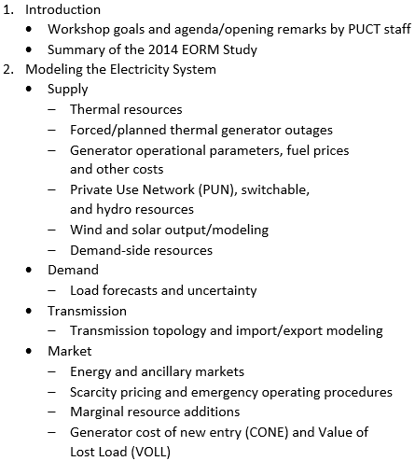
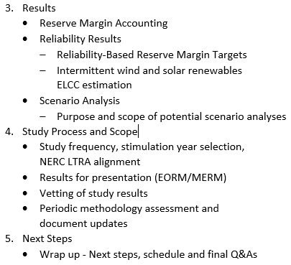
Workshop Agenda

Slide 4
Workshop Goals
Provide stakeholders with a solid understanding of the EORM/MERM modeling approaches
Consensus decision-making on methods for EORM/MERM studies
Stay focused on methodological approaches and issues; we will not discuss opportunities for supplementary studies
Discuss each method used for 2014 Brattle/Astrapé study and NERC Loss of Load studies
Collaboratively modify the method
Identify unsatisfied concerns
Assess the degree of support
Finalize the method, or table for further discussion at follow-up conference call

Slide 5
Summary of 2014 Optimal Reserve Margin Study
In 2014 the PUCT asked Brattle and Astrapé to estimate the economically-optimal reserve margin in ERCOT to inform their ongoing review of market design for resource adequacy (full study linked here)
Under base case assumptions, we estimated reserve margins* of:
  10.2% economic optimum
  11.5% in energy-only equilibrium (also minimizes customer cost)
  14.1% required to meet 1-in-10
Enforcing a 1-in-10 reserve margin requirement at 14.1% (with or without a capacity market) would increase long-run average customer costs by approximately $400 million/year or 1% of retail rates relative to the current energy-only market in equilibrium (considering energy and capacity price impacts, not considering other costs and benefits)
A 14.1% reserve margin requirement would also reach equilibrium price levels sooner than an energy-only market, meaning near-term impacts would be greater
*2014 reported reserve margins used ELCC and other reserve margin accounting conventions at the time. Updated conventions would increase all reported numbers by 1.8%.

Slide 6
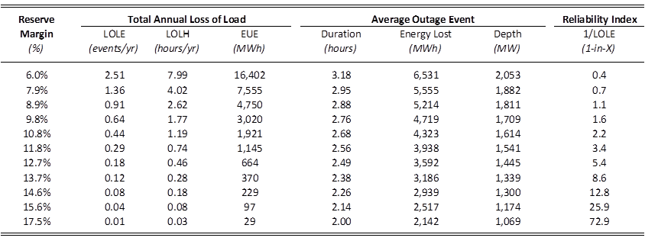
Summary of 2014 Optimal Reserve Margin Study
We estimated a 14.1% reserve margin required to meet the traditional 1-in-10 loss of load event (LOLE) standard, results sensitive to:
  Forward period at which supply decisions are locked in, and consequential load forecast error (LFE) that needs to be considered in analysis (removing LFE drops the reserve margin to 12.6%)
  Likelihood of 2011 weather recurring, with this extreme year treated at 1% chance in base case (increasing to 1/15 or equal chance would increase the reserve margin to 16.1%)
Estimated other reliability metrics as well
Reliability Metrics Across Reserve Margins*
9.6% for 0.001% Normalized EUE
14.1% for 1-in-10
*2014 reported reserve margins used ELCC and other reserve margin accounting conventions at the time.

Slide 7
2. Modeling the Electricity System

Slide 8
SERVM Modeling Framework
Hourly chronological unit commitment and dispatch
Stochastic (Monte Carlo) simulation involving thousands of model iterations
Simulate distributions for load/weather, load growth uncertainty, outages, fuel prices, intermittent renewable output, demand response, etc.
Simulate Emergency Operating Procedures
Simulate scarcity pricing during shortage events
Example based on recent Loss of Load studies conducted for ERCOT:
  Weather (13 years of weather history)
  Economic load forecast error (distribution of 5 points)
  Multi-state unit outage modeling, capturing frequency and duration (50 iterations)
  Probabilistic modeling of external assistance/DC ties, Private Use Network generating units
  Total load scenario breakdown: 13 weather years x 5 LFE points = 65 scenarios; Total iteration breakdown: 65 scenarios * 50 unit outage iterations = 3,250 yearly simulations or until convergence is met
  Model run-time: A single 50 iteration scenario takes ~ 30 minutes. These scenarios are simulated in parallel across multiple cores

Slide 9
Supply

Slide 10
Thermal Resources
Modeled based on CDR and ERCOT internal production cost model data
  Seasonal Capacity (Vary by hourly temperature)
  Heat Rate Curves
  VOM
  Startup Costs
  Fuel Prices
  Startup Times
  Emissions
  Min-up/Min-down Times
  Ramp Rates
  Ancillary Service Capability
    AGC Capable
    Quick Start

Slide 11
Forced/Planned Thermal Generator Outages
Full Outages
  Time to Repair
  Time to Failure
Partial Outages
  Time to Repair
  Time to Failure
  Derate Percentage
Startup Failures
Maintenance Outages
Planned Outages
Created based on Outage Scheduler data for December 2010 – July 2016
Unit Name | Capacity Weighted Equivalent Forced Outage Rate (%)
Nuclear | 4.04%
Coal | 6.32%
Gas Combined Cycle | 4.27%
Gas Combustion Turbine | 19.42%
Gas Steam Turbine | 20.03%
Fleet Capacity Weighted Average EFOR 8.50% *Values based on ERCOT’s latest Loss of Load study for NERC (http://www.nerc.com/pa/RAPA/ra/Reliability%20Assessments%20DL/2016ProbA_Report_Final_March.pdf)

Slide 12
Forced/Planned Thermal Generator Outages

Slide 13
Private Use Network Resources
Net Output modeled stochastically
Most Recent NERC Study: Output based on load level as shown below
Previous EORM study: Output based on market price
Draw Probability | 10% | 10% | 10% | 10% | 10% | 10% | 10% | 10% | 10% | 10%
Load Level | Net Output (MW)
Above 100% of Peak Forecast | 3,631 | 3,800 | 3,822 | 3,875 | 3,885 | 3,885 | 3,916 | 3,927 | 3,991 | 4,090
95% - 100% of Peak Forecast | 3,042 | 3,222 | 3,403 | 3,583 | 3,764 | 3,809 | 4,026 | 4,243 | 4,459 | 4,676
90% - 95% of Peak Forecast | 3,042 | 3,201 | 3,360 | 3,519 | 3,677 | 3,723 | 3,938 | 4,154 | 4,370 | 4,585
85% - 90% of Peak Forecast | 2,633 | 2,860 | 3,087 | 3,314 | 3,541 | 3,587 | 3,825 | 4,063 | 4,302 | 4,540
70% - 85% of Peak Forecast | 2,270 | 2,531 | 2,792 | 3,053 | 3,314 | 3,360 | 3,655 | 3,950 | 4,245 | 4,540
Below 70% of Peak Forecast | 999 | 1,044 | 1,067 | 1,441 | 2,497 | 2,542 | 2,985 | 3,428 | 3,870 | 4,313

Slide 14
Hydro Resources
13 years of historical hydro energy modeled
Peak shaving capacity based on regression above

Slide 15
Hydro Resources
521 MW nameplate
Characterized resources based on:
  4 years of hourly data from ERCOT
  15 years of monthly data from FERC 923
Hydro resources modeled with different parameters each month:
  Monthly total energy output
  Daily peak shaving capability (from historical hourly data, recreated for other years based on regression analysis)
Energy output is partly peak shaving (scheduled during daily load peaks) and partly run-of-river (output in off-peak hours)
Remaining hydro capacity (nameplate minus output) counts toward RRS and ORDC x-axis (approximately the same as 240 MW of hydro-synchronous resource that ERCOT assumes in PRC calculation)
Peak Shaving Capability
Maximum Output during August
Annual Energy

Slide 16
Switchable, Mothballed, Retired Units
  Past studies based on CDR forecast/accounting rules
    Switchable Units: Included as internal resources with capacity deductions based on Notices of “Unavailable Capacity” submitted by SGR owners
    Propose adopting a price response method similar to how PUN units are modeled
    Retirements: Exclude starting in the CDR-specified year based on Notices of “Suspension of Operations of a Generation Resource
    Seasonal Mothballs: included 1,876 MW of seasonal mothballs that are available for dispatch only in summer months, nearly all of them from May-September
    Permanent Mothballs: Exclude from model
    Planned New Units: Excluded from model to achieve low starting reserve margin in simulations; then increase with marginal unit

Slide 17
Wind Modeling
Hourly shape by weather year
  Developed by third party consultant by site
  Aggregated to CDR values for study year

Slide 18
Solar Modeling
Hourly shape by weather year
  Developed by third party consultant by site
  Aggregated to CDR values for study year

Slide 19
Demand-Side Resources
Dispatched based on price subject to the following
  Hours per season
  Time of day
  Weekday/Weekend

Slide 20
Demand-Side Resources
 | Summer Capacity | Call Limits | Call Priority
TDSP Standard Load Management Programs | 208 | 16 hours per year, during hours 14-20 | 1
Load Resources Serving as Responsive Reserve | 1,153 | Unlimited | 2
10 Min ERS | 609 | 8 hours per season and per hourly intervals; Seasons: Winter, Spring, Summer, Fall; Hourly intervals: week day hours 1-8 and 21-24 and weekends, week day hours 9-13, week day hours 14-16, week day hours 17-20 | 3
30 Min ERS | 898 | 8 hours per season and per hourly intervals; Seasons: Winter, Spring, Summer, Fall; Hourly intervals: week day hours 1-8 and 21-24 and weekends, week day hours 9-13, week day hours 14-16, week day hours 17-20 | 4

Slide 21
Demand

Slide 22
Weather Uncertainty on Loads
Peak Load by Weather Year
(Before and After DR Gross-Up)
Load Duration Curves
(Peak Hours, Before DR Gross-Up)

Slide 23
Economic Growth Uncertainty
Non-Weather Forecast Error
With Increasing Forward Period
  Non-weather load forecast error (LFE) increases with forward period
    Assume normally distributed forecast error with standard deviation of 0.8% on a 1-year forward basis, increasing by 0.6% with each additional forward year
    Scale of error is a standard assumption developed in lieu of an ERCOT-specific analysis
    We assume no bias or asymmetry in the non-weather LFE (unlike weather-driven LFE which has greater upside than downside uncertainty)
  Modeling approach:
    Assume resource decisions and reserve margin must be “locked in” 3 years forward, so realized forecast error is larger than if more shorter-term supply options were available
    Sensitivity analysis examining impact of forward periods ranging from 0 to 4 years forward
3-Year Forward LFE
Discrete LFE Error Points Modeled

Slide 24
Transmission

Slide 25
Transmission Topology and Import/Export Modeling
External Regions
  Hourly Loads
  Resources
  DC Ties (probabilistic for EORM study; based on historic flows during highest peak load hours for NERC Loss of Load study)
  Share resources based on economics
SPP
810 MW
5,180 MW
ERCOT
Entergy
(MISO)
280 MW
Mexico
(Coahuila, Nuevo Leon, & Tamaulipas)

Slide 26
Generation Resource Mix
Values based on previous EORM study

Slide 27
Diversity with External Regions
Values based on previous EORM study

Slide 28
The Market

Slide 29
Representation of Energy and Ancillary Service Markets
Economic reserve margin analyses need to simulate market dispatch and prices
Most important elements to model are those that characterize scarcity event:
  System cost (drives the optimal reserve margin)
  Energy/ancillary prices (drives the market equilibrium reserve margin)
Recommend using a similar approach in future studies, but reviewing the need for significant market design updates
Unit Commitment
Week-ahead unit commitment
4-hour ahead unit commitment
Hourly dispatch of 10 & 30-min quickstart
Energy Market
Hourly production cost model representing real-time energy market
Prices at marginal cost, considering generation and demand response
Detailed representation of scarcity event costs and pricing (see next slides)
Scarcity prices affected by ancillary service shortage pricing
Ancillary Services
Regulation, spinning, and non-spinning reserves
Operating Reserve Demand Curve (ORDC)
Power Balance Penalty Curve (PBPC)

Slide 30
Scarcity Pricing and Emergency Procedures
Recommend reviewing 2014 study assumptions for material updates.
Emergency Level | Marginal Resource | Trigger | Price | Marginal System Cost
n/a | Generation | Price | Approximately $20-$250 | Same
n/a | Imports | Price | Approximately $20-$250 Up to $1,000 during load shed | Same
n/a | Non-Spin Shortage | Price | Marginal Energy + Non-Spin ORDC w/ X = 2,000 | Marginal Energy + Non-Spin ORDC w/ X = 1,150
n/a | Emergency Generation | Price | $500 | Same
n/a | Price-Responsive Demand | Price | $250-$9000 | Same
n/a | Spin Shortage | Price | Marginal Energy + Non-Spin + Spin ORDC w/ X = 2,000 | Marginal Energy + Non-Spin + Spin ORDC w/ X = 1,150
n/a | Regulation Shortage | Price | Power Balance Penalty Curve | Same
EEA 1 | 30-Minute ERS | Spin ORDC x-axis = 2,300 MW | $3,239 at Summer Peak (from ORDC) | $1,405
EEA 1 | TDSP Load Curtailments | Spin ORDC x-axis = 1,750 MW | $9,000 (from ORDC) | $2,450
EEA 2 | Load Resources in RRS | Spin ORDC x-axis = 1,700 MW | $9,000 (from ORDC) | $2,569
EEA 2 | 10-Minute ERS | Spin ORDC x-axis = 1,300 MW | $9,000 (from ORDC) | $3,681
EEA 3 | Load Shed | Spin ORDC x-axis = 1,150 MW | VOLL = $9,000 | Same

Slide 31
Operating Reserve Demand Curve
ORDC is one of the most important drivers of economic reserve margin
Important to distinguish the distinction between:
  Marginal system cost (blue curve) based on ERCOT’s analysis of the likelihood of lost load when running short of reserves
  Price-setting ORDC (red curve) at X = 2,000 used to set market prices
Recommend implementing updated ORDC curves in the model (4 seasons, 6 times of day, 2 reserve types) and updating for design enhancements as needed
Operating Reserve Demand Curves
Example: Summer Hours 15-18
Sources and Notes:
Page 35, Figure 17, Brattle EORM report.

Slide 32
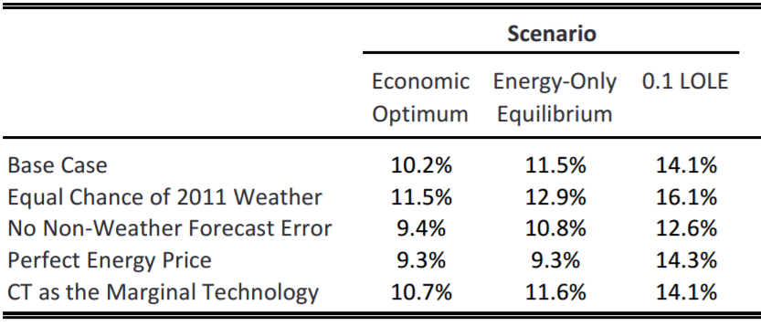
Selection of the Marginal Resource
Basic study approach is to add (or subtract) supply from the model until we find the cost-minimizing quantity (optimal reserve margin) or the maximum quantity that the market will attract (market equilibrium), see later slides
Outcome depends partly on what type of resource is added
If the market is near equilibrium among resource types, results will be similar regardless of this choice (e.g., 2014 study found similar results whether using gas CC or CT as the marginal resource)
Recommend future studies:
  Use gas CC as the default type, given the greater quantity and uniformity of CC technologies
  Maintain flexibility to examine CTs as a test, or examining other types if system conditions change
2014 Reserve Margin Study Results
Gas CC Marginal
Gas CT Marginal

Slide 33
Cost of New Entry Estimate
CONE is a significant driver of results, with higher CONE driving lower economic reserve margin
Subject to significant uncertainties, e.g., ATWACC
2014 study adapted PJM’s bottom-up engineering CONE estimate, applying adjustments for ATWACC, location, and interconnection costs
Recommend developing a forum for Market Participants to request CONE updates or sensitivity analyses; update process would consider formal CONE estimates from other markets and EIA, then use judgement to apply reasonable adjustments
Performance Characteristics
2011 & 2014 Gross CONE Values
Sources and Notes:
Performance consistent with 2011 Brattle ERCOT Study after update of merchant ATWACC assumption.
One year of escalation adapted from 2013 ISO-NE ORTP parameter estimates.

Slide 34
Value of Lost Load (VOLL)
Value of lost load (VOLL) is the cost imposed on customers when they face involuntary service interruptions
VOLL is subject to significant uncertainty depending on customer type and study approach. Estimates can range $1,000 to $100,000/MWh* (but high-end numbers not appropriate to use in this study since these high-value end uses should already have back-up power to protect against distribution outages)
In our 2014 study, we found that a VOLL range of $4,500 to $18,000/MWh translated to a 8.9%-11.8% range in the economically optimal reserve margin (that study also scaled DR curtailment costs in proportion to VOLL)
Recommend maintaining 2014 study approach that used the VOLL assumed in ERCOT nodal protocols and used as the High System-Wide Offer Cap, or $9,000/MWh
Notes:
*Approximately $1,500 – $3,000/MWh for residential, $10,000 – $50,000/MWh for commercial, and $10,000 – $80,000/MWh for industrial loads according to a MISO survey. See MISO “Value of Lost Load Final Report. May 15, 2006.

Slide 35
3. Study Results

Slide 36
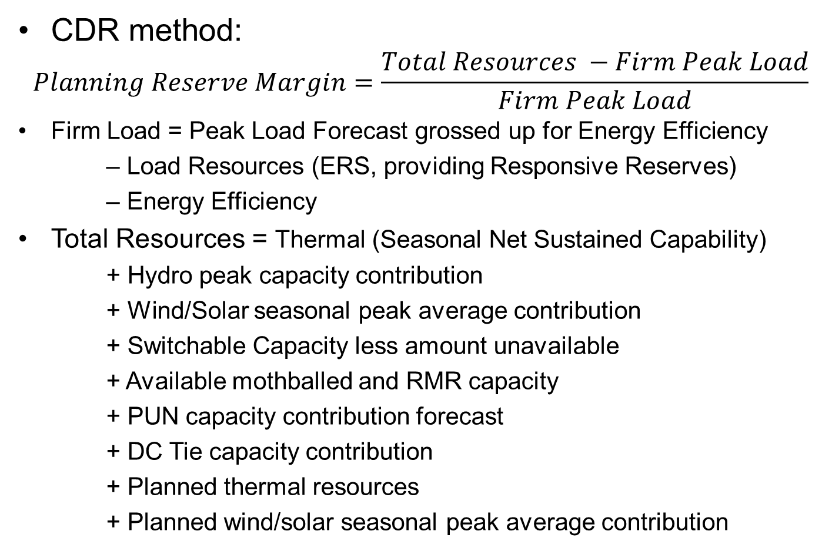
Reserve Margin Accounting
CDR method:
$$Planning Reserve Margin=\frac{Total Resources −Firm Peak Load}{Firm Peak Load}$$
Firm Load = Peak Load Forecast grossed up for Energy Efficiency
– Load Resources (ERS, providing Responsive Reserves)
– Energy Efficiency
Total Resources = Thermal (Seasonal Net Sustained Capability)
+ Hydro peak capacity contribution
+ Wind/Solar seasonal peak average contribution
+ Switchable Capacity less amount unavailable
+ Available mothballed and RMR capacity
+ PUN capacity contribution forecast
+ DC Tie capacity contribution
+ Planned thermal resources
+ Planned wind/solar seasonal peak average contribution

Slide 37
Reliability Based Reserve Margin Targets
NERC Assessment Metrics
  LOLH
  EUE
  EUE / Net Energy for Load
Industry Standard
  LOLE
    1 day in 10 year standard
    Equivalent to 0.1 LOLE

Slide 38

Reliability Based Reserve Margin Targets
Reserve Margins Required to Meet Alternative Physical Reliability Standards
Base Case

Slide 39

Reliability Based Reserve Margin Targets
EORM Study
LOLE w/ Differing 2011 Weather Weight
Base Case
  Assumptions:
    1% chance of 2011 weather
    Load forecast error consistent with 3 years forward
    CC as marginal technology
  14.1% reserve margin for 0.1 LOLE
Sensitivities
  If 2011 is given equal weather weight (1/15 chance), the reserve margin increases to 16.1%
  If non-weather LFE is excluded, the reserve margin drops to 12.6%
LOLE w/ Varying Forward Periods

Slide 40
Renewable Effective Load Carrying Capability
ELCC Simulations: Not conducted for NERC Assessment or previous EORM
  Average ELCC of wind and solar
    Calibrate system to 0.1 LOLE
    Remove entire wind/solar fleet and determine conventional capacity needed to maintain 0.1 LOLE
    Average ELCC = conventional capacity added/ nameplate capacity of wind/solar fleet
  Incremental ELCC of wind (coastal or non coastal) and solar (fixed vs. tracking)
    Start at 0.1 LOLE
    Add 1,000 MW of wind and remove conventional MW to maintain 0.1 LOLE
    ELCC = Conventional MW removed / 1,000 MW of wind

Slide 41
Renewable Capacity Contributions
Use historical output rather than Effective Load Carrying Capability (ELCC) method
Current CDR capacity contribution methodology for wind resources
  Develop a “Seasonal Peak Average” capacity factor (WINDPEAK%) by season and coastal/non-coastal regions
    Based on average historical availability (defined as a generator’s telemetered High Sustained Limit, or HSL) during the highest 20 seasonal peak load hours for an historical period of up to 10 years
    Capacity contribution values are re-calculated after each season with new seasonal historical data
    Coastal and non-coastal resources are calculated separately due to the significantly different diurnal wind patterns for these regions
  Multiply WINDPEAK% by installed nameplate capacity
For solar resources, similar approach; calculations done system-wide with only preceding three years of historical seasonal data

Slide 42
4. STUDY PROCESS AND SCOPE

Slide 43
Study Design Elements
EORM/MERM study updated every two years starting in mid-2018; aligns with current project schedule for conducting NERC’s biennial Probabilistic Assessments
Single simulation year, four years beyond study year (e.g., 2018 study would simulate the year 2022)
Continue to use CDR load and capacity variable definitions outlined in Protocols sections 3.2.6.2.1/ 3.2.6.2.2
Include all CDR planned resources with projected CODs as of December 31 of the year prior to the study year
Although not part of the EORM/MERM study effort, NERC requires a “Reference Margin Level” that serves as a resource adequacy performance benchmark
  If ERCOT declines to provide NERC with a Reference Margin Level, NERC will use a 15% default value

Slide 44
Economically Optimal Reserve Margin Results
Total System Costs across Planning Reserve Margins
Economically Optimal
Reserve Margin at 10.2%
Notes:
Total system costs include a large baseline of total system costs that do not change across reserve margins, including $15.2 B/year in transmission and distribution, $9.6 B/year in fixed costs for generators other than the marginal unit, and $10B/year in production costs.

Slide 45
Market Equilibrium Reserve Margin Results

Slide 46
Purpose and Scope of Potential Sensitivity Analysis and Scenarios
Definitions
  Sensitivity analysis: Used to test robustness and uncertainty in a particular finding given uncertainties in individual parameters
  Scenario analysis: Used to test the performance of decisions (e.g. transmission plans) against fundamentally different futures
For the purposes of the 2018 EORM/MERM study, ERCOT and stakeholders should focus only on sensitivity analysis for key drivers
  Develop a short prioritized list for consideration
Potential Sensitivities
(Drivers of EORM & MERM)
Forward period for load forecast uncertainty
Weighting of extreme weather years
Gross Cost of New Entry
Marginal resource type
Gas prices
Value of Lost Load (VOLL)
Quantity of intermittent resources

Slide 47
Vetting of Study Results
ERCOT Proposal
  Develop a study plan and project schedule to be presented to the Supply Analysis Working Group (SAWG)
    Study plan should document any proposed deviations from the study methodology document and explain the rationale
  Present the draft EORM/MERM study report to the SAWG, Wholesale Market Subcommittee, and PUCT staff for review and comment
Establish a new document section on the Resource Adequacy Webpage at ercot.com for making the final study report, associated public data, and report comments available for download
Codify, to the extent needed, this vetting process in the Nodal Protocols

Slide 48
Periodic Methodology Assessments and Updates
ERCOT Proposal
  During the study cycle off-year (2019, 2021, etc.), hold one or more SAWG meetings, with PUCT staff participation, by the end of Q3 to discuss the need for methodology updates
  If any updates are warranted, ERCOT will modify the EORM/MERM methodology document by year end
    ERCOT and SAWG meeting participants may agree on the need for sensitivity analysis prior to approving a change
  Changes may include:
    CDR-related Protocol revisions
    Market-design-related Protocol revisions
    Changes in key cost parameters such as CONE and VOLL
    Source and derivation of model inputs (not the inputs themselves)
  Updated methodology document posted to the Resource Adequacy Webpage at least two months prior to the start of the next study

Slide 49
5. Next Steps

Slide 50
Next Steps and Schedule
Agree on the need for a follow-up WebEx conference call (approximately mid-May or as determined by workshop participants)
Request for written follow-up comments: send them to Pete Warnken, Pete.Warnken@ercot.com
Establish a sensitivity analysis work plan based on workshop participant requests, analysis scope/complexity, and prioritization; use the SERVM model and NERC 2016 LOL study data set
Provide PUCT staff and SAWG participants with periodic updates on EORM/MERM methodology document development progress
Complete and post the document by the end of 2017, contingent on the sensitivity work plan

