Slide 1
2018 LTSA Workshop
Sandeep Borkar
May, 2017
RPG Meeting
Notes:
Welcome to

Slide 2
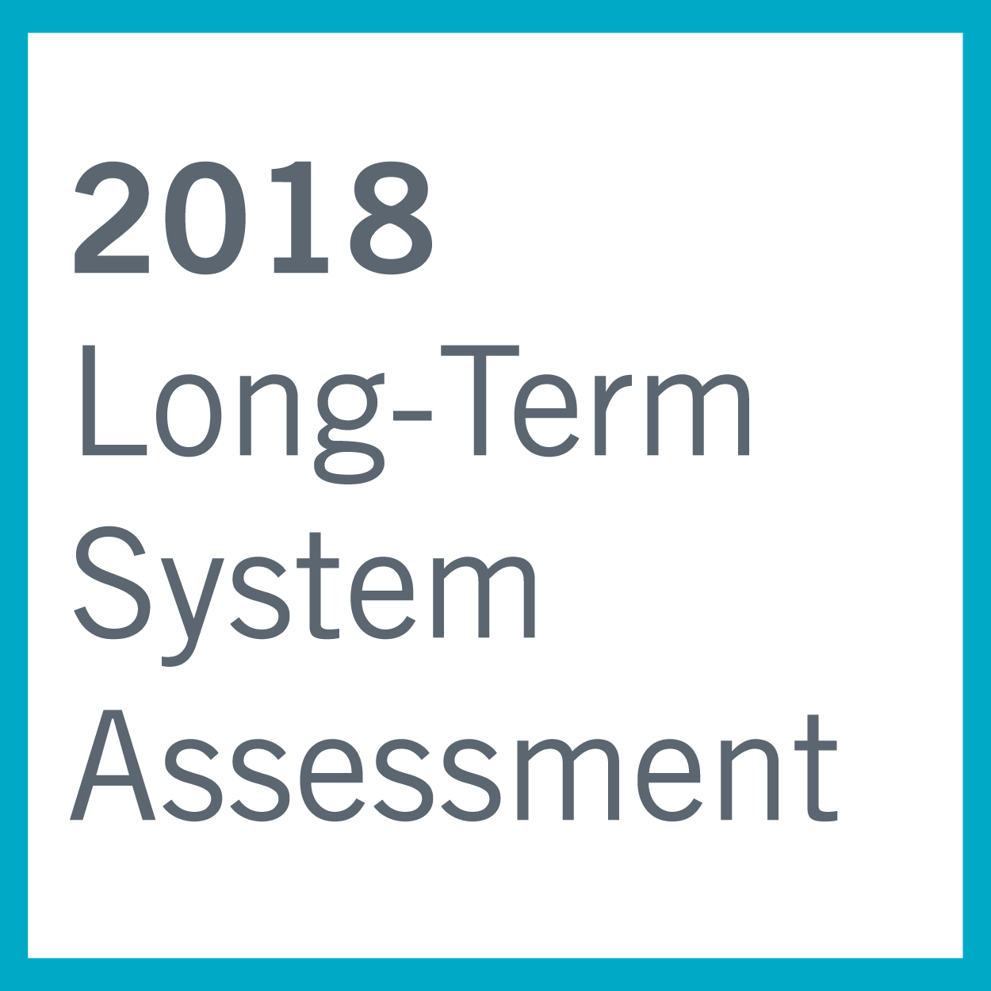
Agenda
2018 LTSA Process
LTSA Scenario Development
Schedule

Slide 3
2018 LTSA: The process
Scenario Development
• Review trends and forecasts
• Seek feedback from participants about key drivers and scenarios for LTSA
Load forecasting
• Develop 8760-hour load forecasts for each scenario with normal weather assumptions
Generation Expansion
• Identify amount of generation added and retired by technology based on scenario description
• Finalize scenario descriptions and assumptions for current LTSA
• Develop 90th percentile summer peak forecast for each scenario
• Identify potential sites for new generation
Transmission Analysis
• Build start cases based on the LTSA Scope and scenario descriptions
• Perform reliability analysis
• Perform economic analysis
• Identify transmission projects to address economic and reliability needs

Slide 4
2018 LTSA: Scenario Development
Expert presentation: Outlook on Oil and Gas growth in the ERCOT region by Gurcan Gulen from Bureau of Economic Geology
Independent research by ERCOT staff
Costs assumptions for new resources
Load forecast trends
Distributed PV
Storage
Energy Efficiency

Slide 5
2018 LTSA: Survey
Participants have opportunity to share their views about important drivers affecting the future of ERCOT grid
An online survey will be administered via Email (to the RPG mailing list)
Survey link: https://www.surveymonkey.com/r/NJVNFS8

Slide 6
2018 LTSA Scenario Workshop
Task | Date
Presentations on Trends and Forecasts | May 2017 RPG Meeting
LTSA Scenario Survey | May 2017 RPG Meeting
Identify scenarios to study | June 2017 RPG Meeting
Develop scenario assumptions (interactive workshop) | June 2017 RPG Meeting
Scenarios descriptions finalized | July 2017 RPG Meeting

Slide 7
2018 LTSA Schedule (tentative)
Task | Date
Draft LTSA Scope | March 2017
LTSA Workshop #1 | May 2017 RPG Meeting
LTSA Workshop #2 | June 2017 RPG Meeting
Finalize scenarios | July 2017 RPG Meeting
Current Trends Gen expansion and Load forecasting complete | 4th Quarter 2017
Current Trends transmission basecase ready | 4th Quarter 2017
Gen expansion and Load forecasting complete | 1st Quarter 2018
Transmission Expansion Complete | 2nd Quarter 2018

Slide 8
Next steps
Complete the Survey
Develop scenario assumptions

Slide 9
Questions
Sandeep Borkar
sandeep.borkar@ercot.com
512.248.6642
?
Doug Murray
douglas.murray@ercot.com
512.248.6908

