Slide 1
ERCOT-SPP Coordinated
Lubbock Power and Light
Integration Impact Study Results
Ben Richardson
May 16, 2017

Slide 2
Background
In June 2016, ERCOT completed Lubbock Power and Light (LP&L) Integration Study (filed in PUCT Project 45633)
In July 2016, memo from Former Chairman Nelson asked for ERCOT-SPP coordinated study of the impacts of an LP&L transition to ERCOT
In November 2016, ERCOT presented draft study scope and assumptions to RPG (http://www.ercot.com/content/wcm/key_documents_lists/77750/SPP_ERCOT_Lubbock_Scope_RPG_11_15_2016.pdf)
In February 2017, SPP and ERCOT finalized the study scope (filed in PUCT Project 45633)

Slide 3
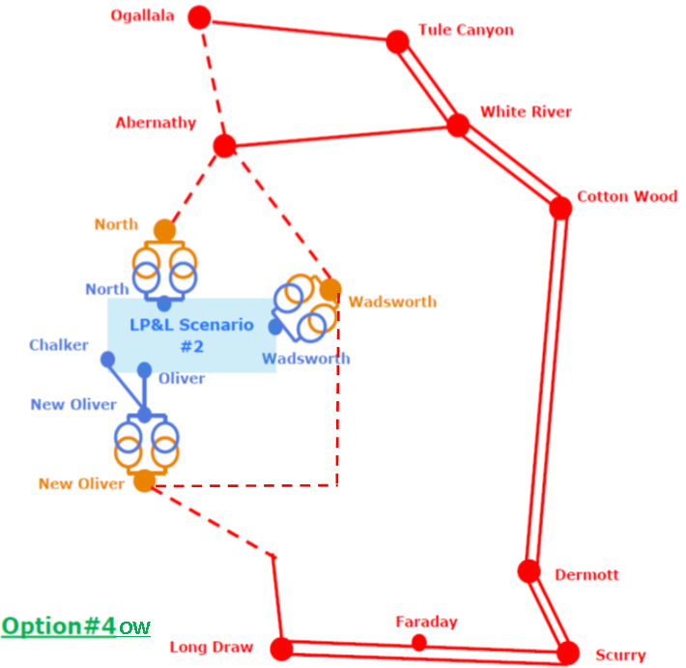
ERCOT LP&L Integration Study (June 2016)
ERCOT preferred Option 4ow for integrating the LP&L system
$364 million capital cost estimate

Slide 4
Results
The following slides will summarize the preliminary results of the analysis performed as part of the study scope
Final and detailed information will be available in the study report ERCOT plans to file with the PUCT in June
SPP is expected to file a separate report for their portion of the study scope

Slide 5
ERCOT production cost analysis
Year | Panhandle Interface Limit* | Production cost increase due to the addition of LP&L System into ERCOT
2020 (without LP&L) | 3629 MW | -
2020 (with LP&L) | 4067 MW | $63 million
2025 (without LP&L) | 3629 MW | -
2025 (with LP&L) | 4067 MW | $62 million
* Set at 90% of WSCR Stability Limit; Limit assumed no LP&L units online
Addition of load to ERCOT system causes increase in production cost
Production cost increase from load partially offset by decrease in Panhandle export congestion due to transmission assumed to connect LP&L
PRELIMINARY RESULTS

Slide 6
ERCOT avoided project analysis
TBD
PRELIMINARY RESULTS

Slide 7
Operational cost and reliability impact assessment
LP&L integration would introduce a new voltage level (115kV) into the ERCOT system, so modeling, documentation, and rules (for example, shadow price cap) will need to be updated
May impact outage coordination of facilities in the Panhandle due to load dependence on circuits
ERCOT’s preferred LP&L integration Option 4ow transmission will strengthen Panhandle system increasing transient and voltage stability
PRELIMINARY RESULTS

Slide 8
Ancillary services impact assessment
ERCOT evaluated LP&L integration impact on Regulation-Up, Regulation-Down, Responsive Reserve Service, and Non-spin Reserve Service
Impacts are expected to be minimal. The below charts show the delta on Regulation requirements:
PRELIMINARY RESULTS

Slide 9
Congestion rights impact analysis
May have an impact on CRR values
If LP&L does not opt into creating a separate Load Zone and is instead absorbed into an existing Load Zone, values for CRRs sourcing and sinking in that existing Load Zone will be affected for those sold for future years
LP&L integration decision may be made prior to affected auctions
PRELIMINARY RESULTS

Slide 10
Subsynchronous resonance impact analysis
LP&L integration would have no negative impact for existing generators
With LP&L integration:
  The number of outages for radial connection to series capacitors increased or remained the same for most generators
  Panhandle generation projects can be radially connected to Edison/Oersted series capacitors within 14 outages
    Significantly far away from Edison/Oersted series capacitors
    Panhandle generation projects already have SSR mitigation and/or protection in place
PRELIMINARY RESULTS

Slide 11
Analysis of whether or not to convert retiring LP&L generators to synchronous condensers
ERCOT found production cost savings that would justify the cost of converting retiring LP&L Coke Units 1 and 2 to synchronous condensers in 2025 (not found to be economic in 2020)
However, the overall impact on the Panhandle interface limit was less than 100 MW and installing new synchronous condensers at selected locations within the Panhandle would provide better economic benefit
ERCOT will not recommend converting LP&L units to synchronous condensers
PRELIMINARY RESULTS

Slide 12
Next steps
Present results to TAC on May 25 and to the Board on June 13
File final report with the PUCT

Slide 13
Questions?

