Slide 1
Freeport Area Master Plan Project
Presentation to ERCOT Regional Planning Group

Slide 2
Disclaimer
This presentation is being provided for informational purposes only and does not purport to be comprehensive. Neither CenterPoint Energy, Inc., together with its subsidiaries and affiliates (the “Company”), nor its employees or representatives, make any representation or warranty (express or implied) relating to this information. By reviewing this presentation, you agree that the Company will not have any liability related to this information or any omissions or misstatements contained herein. You are encouraged to perform your own independent evaluation and analysis.
This presentation and the oral statements made in connection herewith may contain statements concerning our expectations, beliefs, plans, objectives, goals, strategies, future operations, events, financial position, earnings, growth, revenues costs, prospects, objectives, capital investments or performance and underlying assumptions and other statements that are not historical facts. These statements are “forward-looking statements” within the meaning of the Private Securities Litigation Reform Act of 1995. You should not place undue reliance on forward-looking statements. Actual results may differ materially from those expressed or implied by these statements. You can generally identify our forward-looking statements by the words “anticipate,” “believe,” “continue,” “could,” “estimate,” “expect,” “forecast,” “goal,” “project,” “intend,” “may,” “objective,” “plan,” “potential,” “predict,” “projection,” “should,” “will,” or other similar words. The absence of these words, however, does not mean that the statements are not forward-looking.
Forward-looking statements in this presentation include statements about electric load growth and estimated costs. We have based our forward-looking statements on our management's beliefs and assumptions based on information currently available to our management at the time the statements are made. We caution you that assumptions, beliefs, expectations, intentions, and projections about future events may and often do vary materially from actual results. Therefore, we cannot assure you that actual results will not differ materially from those expressed or implied by our forward-looking statements.
Some of the factors that could cause actual results to differ from those expressed or implied by our forward-looking statements include but are not limited to the timing and impact of future regulatory, legislative and IRS decisions, financial market conditions, future market conditions, economic and employment conditions, customer growth and other factors described in CenterPoint Energy, Inc.’s Form 10-K for the period ended December 31, 2015 under “Risk Factors” and “Management’s Discussion and Analysis of Financial Condition and Results of Operations - Certain Factors Affecting Future Earnings” and in other filings with the SEC by CenterPoint Energy, which can be found at www.centerpointenergy.com on the Investor Relations page or on the SEC’s website at www.sec.gov.

Slide 3
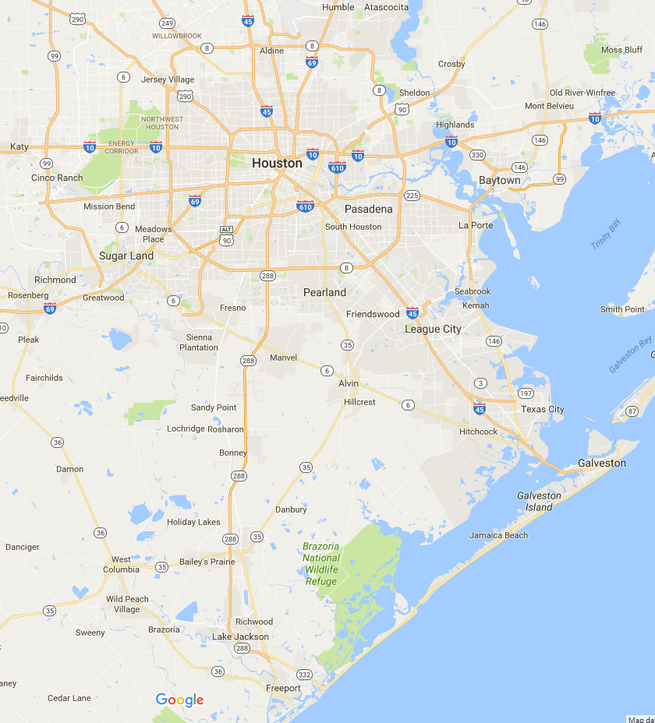
Freeport Area Master Plan Project
The Freeport Area
Highly industrialized area with several large chemical facilities as well as a major seaport on the Gulf of Mexico
Load pocket located approximately 60 miles south of the Houston metropolitan area
60 Miles
Gulf of Mexico

Slide 4
Freeport Area Master Plan Project
Need
Freeport Master Plan Project essential to:
  Serve new committed loads in the Freeport Area
  Maintain transmission grid reliability
  Provide for future load growth
  Increase transfer capability to the Freeport Area
  Allow operating flexibility to take 345 kV scheduled maintenance outages
Estimated Cost - $246.74 Million
  Bridge the Gap Upgrades - $ 32.34 Million (to be completed BP 2019)
    Includes looping 345 kV line into CenterPoint Energy Jones Creek Substation and installing: one 345/138 kV 800/1000 MVA Autotransformer, two in-line reactors, and three 138 kV capacitor banks at Jones Creek Substation
  New 345 kV Transmission Line - $ 214.4 Million (to be completed BP 2021)
    Includes building new 345 kV double circuit transmission line from CenterPoint Energy Bailey Substation and upgrading two 345 kV circuits in the area

Slide 5
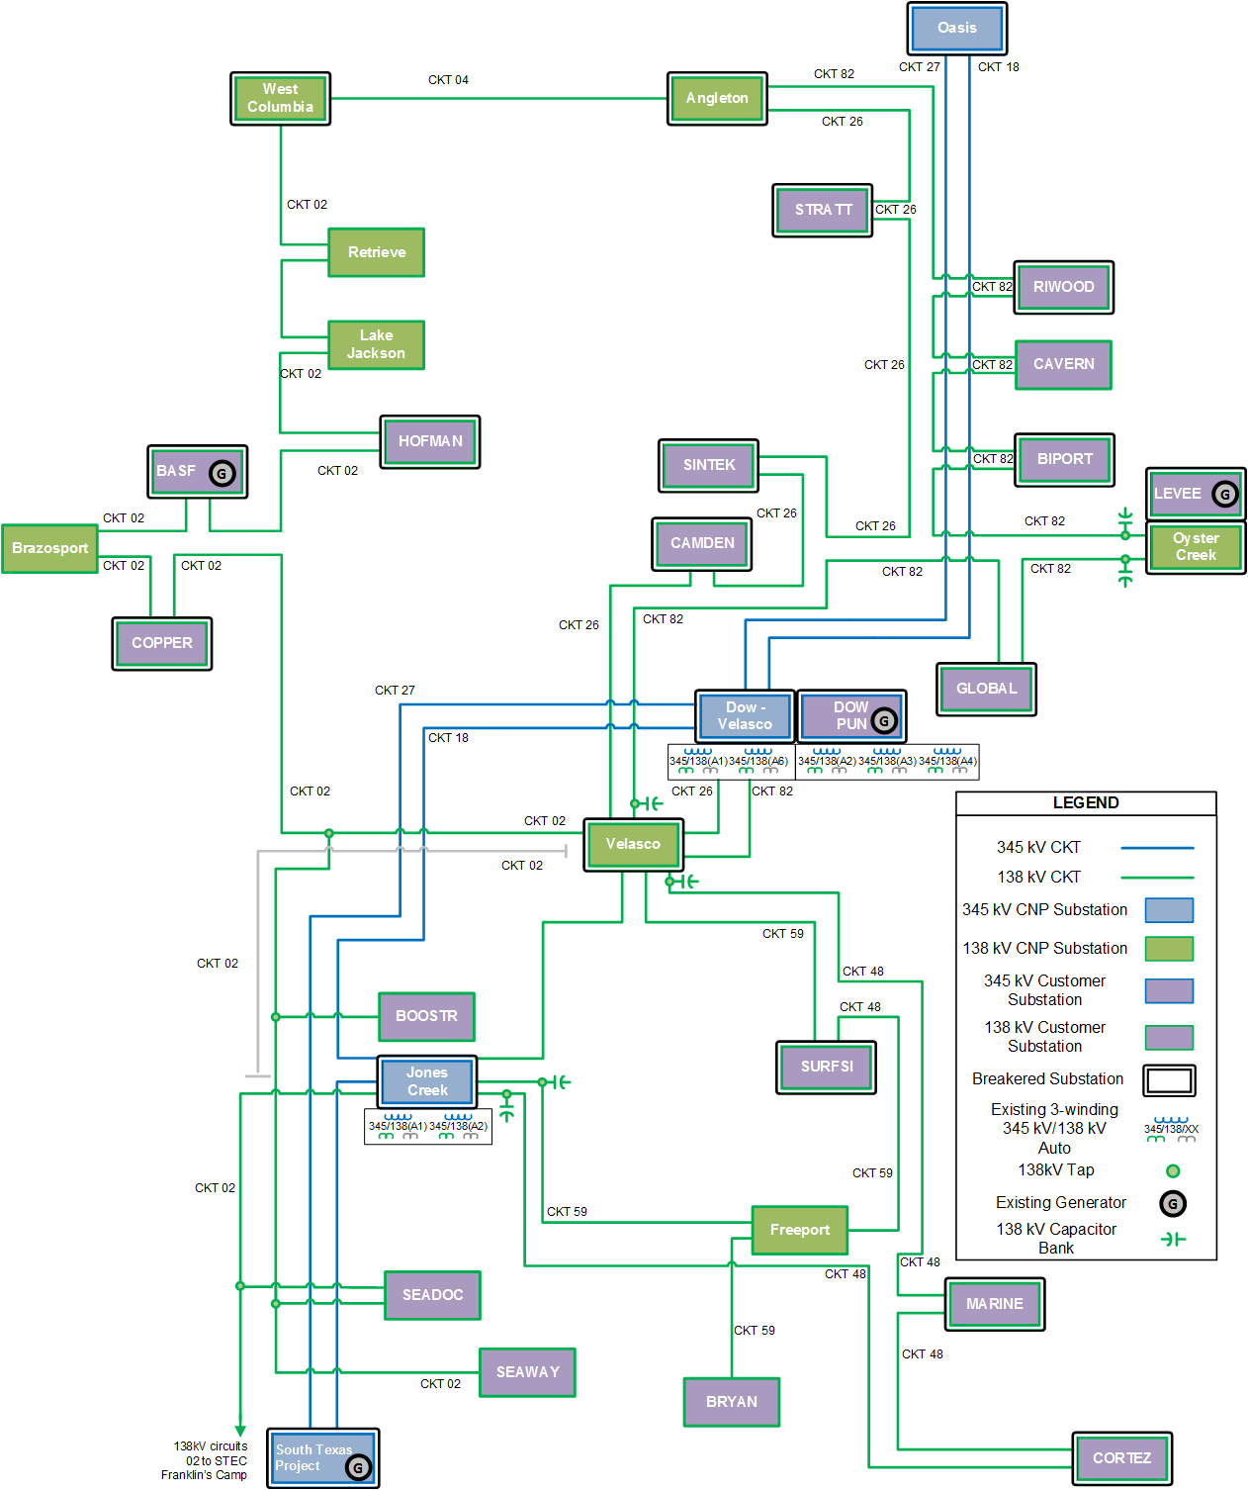
Freeport Area Master Plan Project
Background – Transmission Projects in Freeport Area since 2012
Freeport Area Upgrades Project
  Tier 3 Project (In-Service)
  Convert 69 kV infrastructure to 138 kV
Dow-Velasco 345/138 kV Autotransformer Addition Project
  Tier 3 Project (In-Service)
  Add 2nd 800/1000 MVA Auto
Jones Creek Project
  Tier 1 Project (In-Service)
  New 345/138 kV Substation with 2 autos
Oyster Creek Project (under construction)
  Required PUCT line certification (2Q2017)
  To serve generator and load customer
Projects identified by ERCOT 2016 RTP and 2016 LTSA in conjunction with CNP
  Four 138 kV capacitor banks at Jones Creek or Velasco

Slide 6
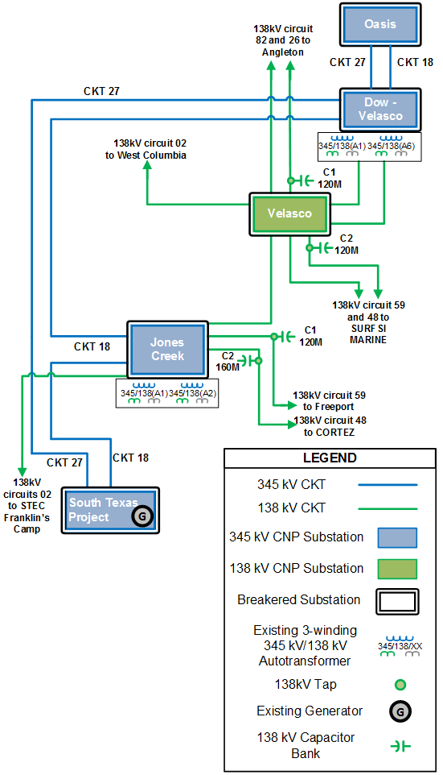
Freeport Area Master Plan Project
Background – Current and Expected 2018 Freeport Area Configuration
Current Freeport Area Configuration
  Freeport Area served primarily by:
    Four 345 kV double-circuit lines from STP and Oasis
    Four 345/138 kV 800/1000 MVA autotransformers
    Three 20 mile long 138 kV transmission lines
  Voltage support provided by
    345 kV lines and 345/138 kV autotransformers
    Small distribution capacitor banks
Expected 2018 Freeport Area Configuration
  1st 138 kV capacitor bank at Velasco – before peak 2017
  1st 138 kV capacitor bank at Jones Creek – December 2017
  2nd 138 kV capacitor bank at Velasco – before peak 2018
  2nd 138 kV capacitor bank at Jones Creek – before peak 2018

Slide 7
Freeport Area Master Plan Project
Background – New Committed Loads
New committed loads in Freeport Area:
  MARINE – 54 MW (2Q2016) – included in 2016 ALDR
  CAMDEN – 75 MW (2Q2016) – included in 2016 ALDR
  COPPER – 60 MW (4Q2016) – included in 2016 ALDR
  LEVEE – 139 MW (3Q2018) – included in 2016 ALDR
  CORTEZ – 656 MW (3Q2018) – included in 2016 ALDR
  GLOBAL – 48 MW (2Q2018) – included in 2017 ALDR Submission
  Dow – 322 MW by 2019 – will be included in: SSWG updates in 2017 and 2018 ALDR Submission
  Results in a 1340 MW increase (230% increase) to the load seen in the Freeport Area in 2016

Slide 8
Freeport Area Master Plan Project
Background – Load Inquiries Under Study
Load inquiries under study in Freeport Area:
  NEWSUB – 54 MW
  COPPER – 240 MW
  Freeport LNG New Substation 1 – 48 MW
  Freeport LNG New Substation 2 – 209 MW
  Total 550 MW of load inquiries under study in Freeport Area by 2021
  If load inquiries under study move forward, by 2021 load in the Freeport Area will add up to 2927 MW (280% increase) to the load seen in the Freeport Area in 2016

Slide 9
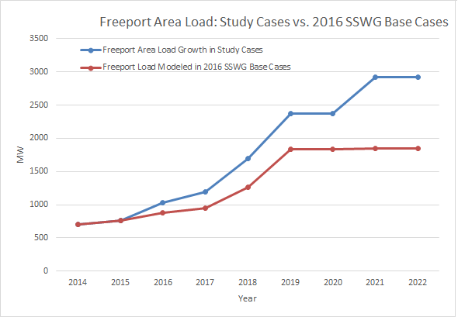
Freeport Area Master Plan Project
Load Summary
 | Historical Load |  |  |  |  | Load Projections
Year | 2012 | 2013 | 2014 | 2015 | 2016 | 2017 | 2018 | 2019 | 2020 | 2021 | 2022
Total (MW) | 777 | 718 | 791 | 904 | 1028 | 1194 | 1695 | 2369 | 2373 | 2925* | 2927*
Red line indicates Freeport area loads as modeled in 2016 SSWG cases
Blue line indicates Freeport area loads as modeled in the Study Cases
* Includes non-committed load inquiries under study

Slide 10
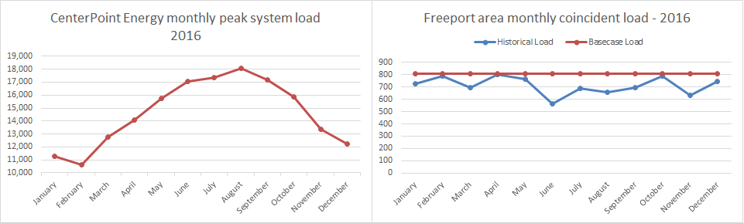
Freeport Area Master Plan Project
Background – Challenges and Concerns
The existing industrial load in the Freeport Area remains constant throughout the year (see below) and the new industrial loads are expected to as well
Transmission system challenges if load additions move forward as planned:
  Severe low voltage, potential voltage collapse
  Overload on existing 345 kV STP – Dow & STP – Jones Creek circuits
  Operating flexibility to take outages for maintenance is significantly restricted on 345kV circuit serving the Freeport area due to large portion of load being industrial
  Inability to serve future industrial load growth

Slide 11
Freeport Area Master Plan Project
Base Case vs. Study Case
Modeled all new committed loads and load inquiries under study
Performed analysis testing against applicable NERC, ERCOT and CenterPoint Energy Transmission System Design Criteria, including Maintenance Outage Scenarios
Results show severe loading and voltage concerns
  P0 (No Contingency):
    Low 345 kV voltages (< 0.95 pu) beginning in 2021
  P1 (Single Contingency):
    Low 345 kV voltages (< 0.95 pu) beginning in 2019, (< 0.87 pu) in 2020
    345 kV circuit overloads (115 - 120 %) beginning in 2021
  P2-P7 (Common Mode Contingency):
    Low 345 kV voltages (< 0.70 pu) beginning in 2019
    Overloading on 345 kV circuits (103 - 113 %)
    Non-convergence indicating voltage collapse beginning in 2019
  P6 – Maintenance Outage Scenario (Freeport Area 345 kV)
    Severe overloading (150 - 200 %)
    Non-convergence indicating potential voltage collapse beginning in 2019

Slide 12
Freeport Area Master Plan Project
Study Approach
Option 1 – Upgrade of existing system
  Upgrade at a minimum 100 miles of 345 kV lines
  Install large amount of dynamic/static reactive support
  Earliest completion 2020
Option 2-8 – New 345 kV Transmission Line
  Long-Term Solution:
    Build a new 345 kV double-circuit transmission line terminating at the Jones Creek Substation in Freeport Area
    To be completed before peak 2021
  Short-Term Solution:
    “Bridge the Gap” Upgrades
    To be completed before peak 2019

Slide 13
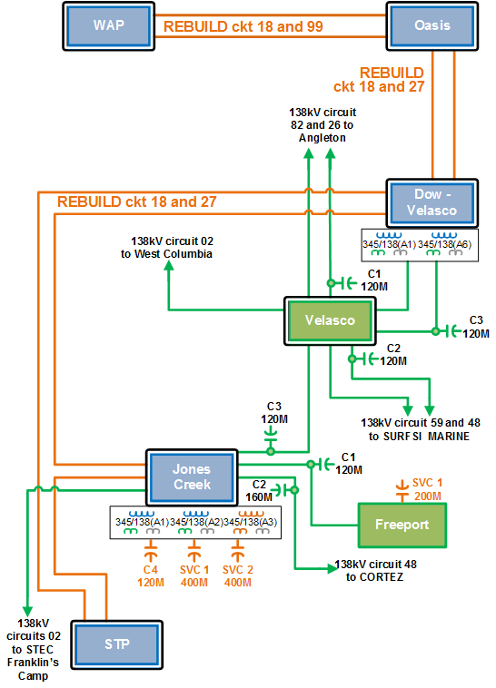
Freeport Area Master Plan Project
Option 1 – Existing System Upgrade
Option 1: Upgrade existing lines and transformers
  Rebuild (3) 345 kV double-circuit lines
  (1) 120 MVAr capacitor bank at Jones Creek
  3rd 345/138 kV autotransformer at Jones Creek
  (2) 400 MVAr SVC at Jones Creek
  (1) 200 MVAr SVC at Freeport
  Convert Freeport Substation to breaker and half
  Total Cost $ 453.17 Million
Option 1 Concerns
  Not cost competitive $ 450+ Million
  Earliest completion Summer Peak 2020
  Need for temporary construction
  Construction while minimizing outages

Slide 14
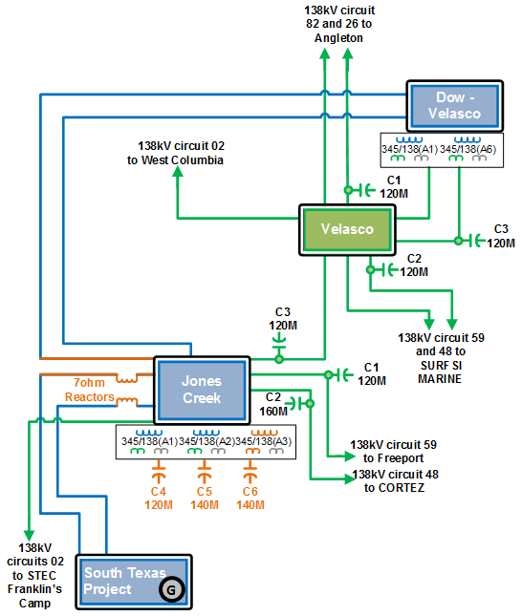
Freeport Area Master Plan Project
Option 2 – 8: Short-Term Solution
“Bridge the Gap” Upgrades
Upgrades solve all thermal loading and low voltage concerns for 2019 and 2020
  Loop in 345 kV STP – DOW circuit 27 into Jones Creek
  7-ohm in series reactor on both STP circuits
  (1) 120 MVAr capacitor bank at Jones Creek
  3rd 345/138 kV autotransformer at Jones Creek
  (2) 140 MVAr automatic switched capacitor banks at Jones Creek
  Upgrades Total Cost: $32.34 Million
However…does not address all needs
  Does not address maintenance outages
  Provides little margin for additional load growth beyond 2020

Slide 15
Freeport Area Master Plan Project
Option 2 – 8: Short-Term Solution
“Bridge the Gap Upgrades” – Transient Stability Analysis
Transient stability analysis indicate fast automatically switched capacitor banks were sufficient to achieve desired voltage recovery rather than dynamic reactive devices such as SVC

Slide 16
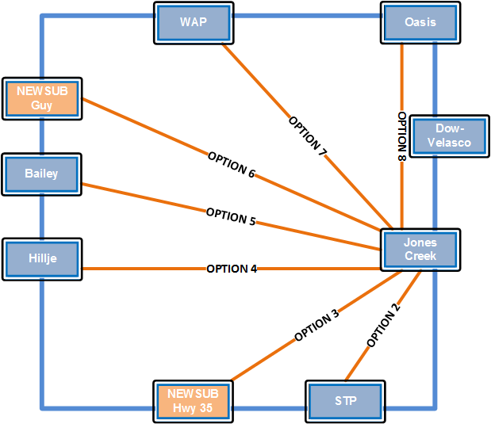
Freeport Area Master Plan Project
Option 2 – 8: Long-Term Solution
New Transmission Line Options
New 345 kV Transmission Line Options:
Option 2 – STP
Option 3 – “Hwy-35” New CNP Switching Station
Option 4 – Hillje
Option 5 – Bailey
Option 6 – “Guy” New CNP Switching Station
Option 7 – WAP
Option 8 – Oasis

Slide 17
Freeport Area Master Plan Project
Option 2 – 8: Long-Term Solution
New Transmission Line Options – Summary and Costs
Option 8 was eliminated: does not provide sufficient reactive support to the Freeport Area
Options 6 and 7 eliminated: due to inability to resolve all of the potential 345 kV circuit overloads
Options 2 – 5:
  show similar steady-state, short circuit, and transient stability performance
  provide twice as much AC transfer capacity as Options 6 - 8
  provide operating flexibility to take maintenance outages in the Freeport Area

Slide 18
Freeport Area Master Plan Project
Recommendation
CNP studied eight options in all, recommending Option 5 and rejecting the other seven.
Option 5:
  Consists of a new 345 kV double-circuit line from Bailey to Jones Creek and the Bridge the Gap upgrades at a total cost of $246.74 Million
  Successfully meets the design criteria requirements for steady-state, short circuit, and transient stability analysis
  Provides for future load growth
  Increases transfer capability to the Freeport Area
  Improves operating flexibility to take maintenance outages in the Freeport Area
CNP has requested that the project be designated as Critical to Reliability due to:
  Severity of the reliability concerns
  Magnitude of load growth in a small area within the near-term horizon
  Potential harm any delay in this project could have on the Texas economy

Slide 19
Freeport Area Master Plan Project
QUESTIONS?

