Slide 1
Economic Studies Financial Assumptions Update
May 16, 2017
RPG Meeting

Slide 2
Economic Studies- Financial Assumptions
ERCOT has reviewed the financial assumptions based on ERCOT Nodal Protocols, paragraph (5) of Section 3.11.2, Planning Criteria
“The current set of financial assumptions upon which the revenue requirement calculations is based will be reviewed annually, updated as necessary by ERCOT, and posted on the Market Information System (MIS) Secure Area.”
The information in the applications of TSP, filed to PUCT pursuant to subsection (h) of PUC Substantive Rules 25.192, Transmission Service Rates, was used to calculate the revenue requirement

Slide 3
Economic Studies- Financial Assumptions
Based on the review, ERCOT Economic studies will continue to use 15% of the capital cost of the project as the 1st year annual revenue requirement to determine societal benefit until next annual review.
Review Year | Weighted Average 1st Year Annual Revenue Requirement
2013 | 15.0%
2014 | 14.9%
2015 | 15.0%
2016 | 15.0%
2017 | 14.9%

Slide 4
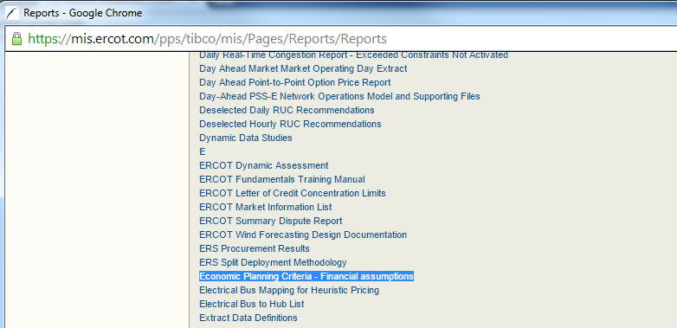
2016 Financial Assumptions – MIS posting
Table 1.1 Units requiring the upgrades of existing scrubbers by 2019
MIS --> Reports --> Reports and Extracts Index --> “Economic Planning Criteria - Financial assumptions”

