Slide 1
OCITF/OCWG Project Update
NPRR 758 Improved Transparency for Outages Potentially Having a High Economic Impact
Leo Castillo – ERCOT Project Manager
May 15, 2017

Slide 2
NPRR758 Improved Transparency for Outages Potentially Having a High Economic Impact
Scope includes:
Create a High Impact Transmission Elements (HITE) list upload/validation process
Create a new Outage Type
Enhancements to OS user interface and the automated submission process
Create an new MIS report and regression testing of existing reports
Progress to date:
Planning Phase – Complete
Vendor changes - Complete
Currently in testing – In Progress
Internal code changes and integration with vendor code – In Progress

Slide 3
NPRR758 Improved Transparency for Outages Potentially Having a High Economic Impact
Next Steps:
Testing (Functional, Integration, Load and Regression)
Release API specifications
Migrating components to MOTE
Production Readiness
Go-Live System Changes (R4 - 8/29 – 8/31)
Stabilization

Slide 4
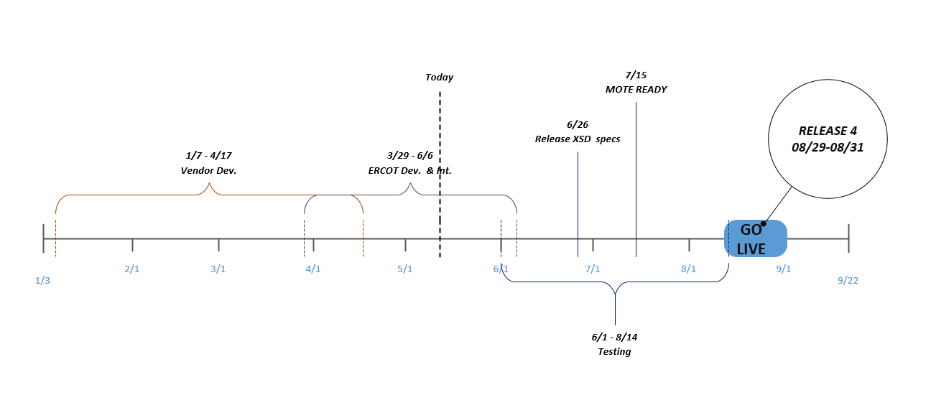
NPRR758 Improved Transparency for Outages Potentially Having a High Economic Impact
Project Timeline:

Slide 5
NPRR758 Improved Transparency for Outages Potentially Having a High Economic Impact
Questions?

