Slide 1
Northeast Denton County & Celina/Prosper Transmission Improvement Assessment
Brazos Electric Cooperative & Rayburn County Electric Cooperative

Slide 2
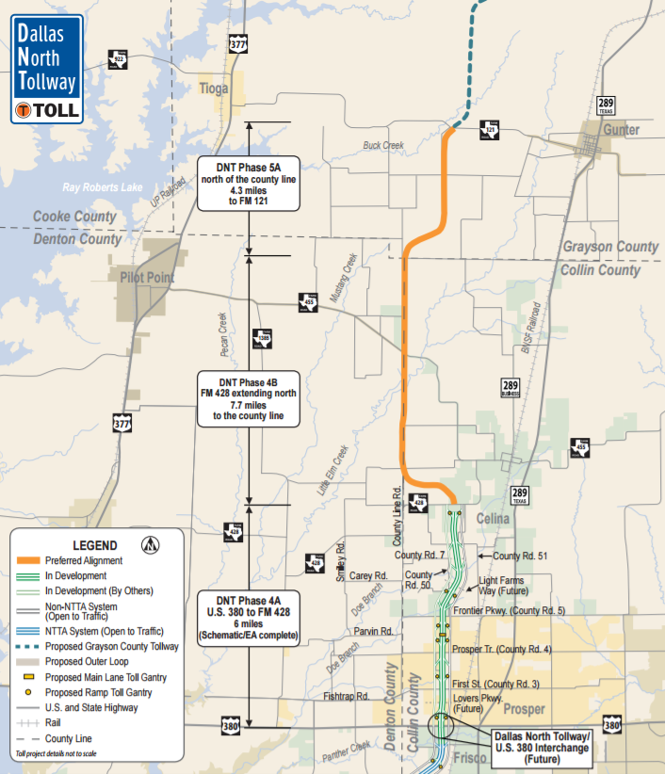
Background
Significant load growth observed by BEC and RCEC in NE Denton & Celina/Prosper corridor
  Strong economic growth in North DFW region
    Population and load growth following economic growth
  Expansion of Dallas North Tollway into Celina and future expansion into Grayson County
  Need for new load serving transmission
  New substations need to be built to pick up the load in residential development area
The new phases of Dallas North Tollway are on the boundary of Collin County and Denton County, between proposed Celina station and proposed Mustang station

Slide 3
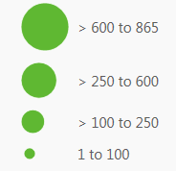
Background
DFW Housing Starts/Lot Development Activity, Q2 2016
Message from Co-op Members – Transmission Development is way behind the load growth in the region

Slide 4
Background
  Stress on existing transmission facilities
  Major sources into the region
    345kV sources from West Denton, Collin and Anna Switch
    Secondary sources include Allen, Renner, Lewisville, and NW Carrollton
  Collin 345/138kV autotransformer and Allen SW 345/138kV autotransformer were identified as highly loaded (>95%) in 2014, 2015 and 2016 RTP
    Addition of more 345/138kV autos at these locations while an obvious choice – but not a prudent one
    More dependency on these sources by adding additional 345/138kV autos at the existing sources
  Currently, only two 138kV breaker to breaker transmission lines deliver power to the study region
    138kV Collin – Payne single circuit (495 MVA rating)
    138kV Collin – Arco double circuit (total of 712 MVA rating)
  Utilize the need to serve new load in the region as an opportunity to create new 345kV sources in the region
    Long term reliability and resiliency of what is one of the fastest growing regions in the U.S.

Slide 5
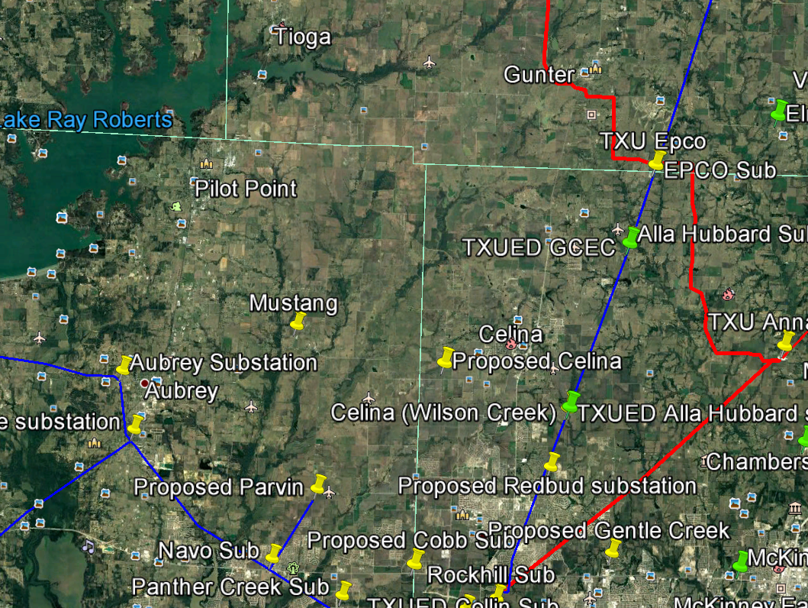
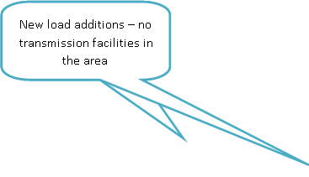
Background
Load growth along Collin – Epco corridor
Load growth along Collin – Arco corridor
Existing/Proposed Transmission Facilities in Study Region
Load Growth/Additions - Study Region

Slide 6
Options Development & Evaluation
  Seven (7) options were developed based on the following criteria (Refer appendix)
  Ability to serve new load/load growth
  Ability to reduce dependency on existing 345/138kV source(s)
  Ability to provide additional 345/138kV source(s) into the study region
  Ability to minimize brownfield upgrades
  Cost-effectiveness
  The following conditions are evaluated for all seven (7) options – ERCOT Planning Guide & NERC TPL
  N-1 conditions (including ERCOT_1)
  X-1+N-1 with the following auto outage as X-1
    345/138kV Collin auto
    345/138kV West Denton auto
    345/138kV Anna Switch auto
    New 345/138kV autos added for the option
  G-1+N-1 with the following generation outage as G-1
    Panda Sherman unit (CT1 + ½ ST)
    Kiamichi Plant

Slide 7
Options Development & Evaluation
  Option #1 and #4 were selected as preferred options
  Reliably serve the new load/existing load growth
  Effectively reduce loading on 345/138kV Collin and Anna Switch autos
  Provide two (2) additional 345/138kV sources into the study region
  Provide a solid foundation to serve additional load growth in the region reliably
  Additional analysis for two (2) preferred options
  Assuming breakers will be added to 138kV Collin – Arco double circuit in the future
    Under current topology, ~462MW of load will be lost under N-1 condition
  In future, the 462MW of load along Collin – Arco corridor will be served from Denton system and/or future transmission development under certain contingency conditions
  Option #4 outperforms option #1 in terms of alleviating overloads on Denton system

Slide 8
Recommended Option
  Option #4
  Phase 1
    Tap the 345kV Anna – W Krum line and add a new 345/138kV station (Manchen) with a 345/138kV, 750 MVA Autotransformer.
    Add new 0.5 mile 138kV line from the Manchen station to 138kV Epco station
    Add a new 21 mile 138kV line from the Manchen - Mustang – Proposed Celina – Parvin
    Tap 345kV Anna – Collin line and add a new 345/138kV station (Newton) with a 345/138kV Auto (750 MVA)
    Add new 3.5 mile 138kV line from the Newton station to 138kV Wilson Creek Station
  Phase 2
    Add a new 7 mile 138kV line from Redbud – Proposed Celina station
  Option #4 expected to have an estimated cost of $72.9M
  Expected COD of 2022

Slide 9
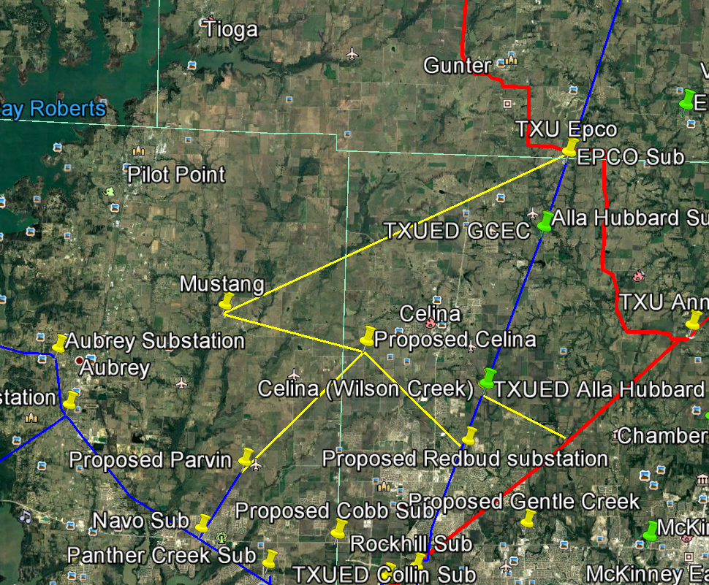
Recommended Option
Option #4: Estimated Cost $72.9M

Slide 10
Questions?

Slide 11
Appendix – Option Descriptions

Slide 12
Appendix – Option Descriptions

Slide 13
Appendix – Option Descriptions

