Slide 1
2017 RTP Update
Doug Murray
May, 2017
RPG Meeting
Notes:
Welcome to

Slide 2
Agenda
Natural Gas Price Assumption
Emission Prices

Slide 3
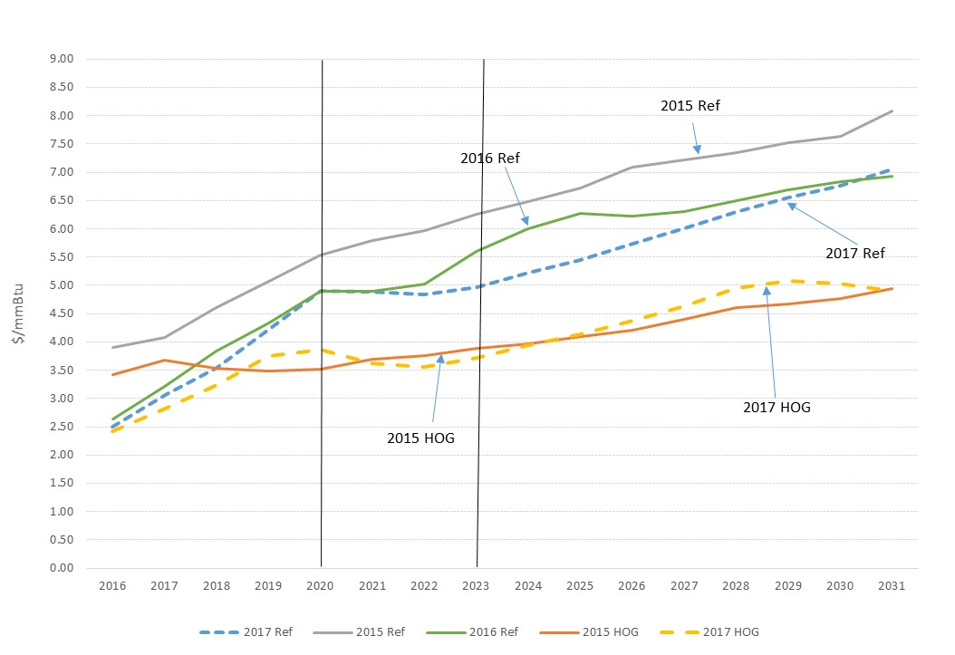
Natural Gas Price Assumptions
REF is the Reference Case and HOG is the High Oil and Gas Production Case from EIA Annual Energy Outlook

Slide 4
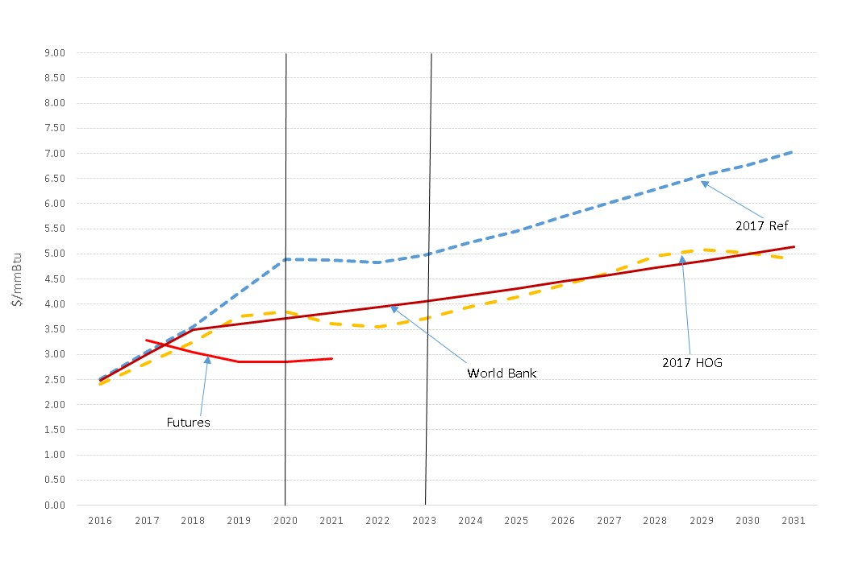
Natural Gas Price Assumptions
NYMEX futures and World Bank forecast from Mid April

Slide 5
Natural Gas Price Assumptions
After adding NYMEX futures and World Bank forecast decision was to use 2017 AEO High Oil and Gas Production Case forecast

Slide 6
Emission Costs
Recent auction prices from the EPA website show SO2 allowances dropping to below $0.10/ton in some cases. This is a stark difference from a few years ago when prices were above $1,000/ton.
Prices for seasonal and annual NOx allowances have also dropped recently. Annual NOx prices are now below $10/ton and seasonal prices in a range between $200 and $250 per ton.
For this analysis we will not be including costs for CO2 emissions

Slide 7
Questions
Doug Murray
douglas.murray@ercot.com
512.248.6908
?
Sandeep Borkar
sandeep.borkar@ercot.com
512.248.6642

