Slide 1
Obsolete Dynamic Models
ERCOT DMTF
05-09-2017

Slide 2
NERC Standardized Models
The industry should agree upon standardized component model structures and associated parameters for particular types of equipment.
Furthermore, an industry‐wide forum is also needed to identify the need for new component models and for tracking changes to existing model structures.
To address this problem, the Planning Committee (PC) directed the NERC Modeling Working Group (MWG) to develop, validate, and maintain a library of standardized component models and parameters for powerflow and dynamics cases.
Updates are posted at:
http://www.nerc.com/comm/PC/Pages/Model-Working-Group-(MWG)-2013.aspx

Slide 3
User Defined Models
MWG recognizes that the on‐going development of new technologies for generation and load will require a corresponding on‐going development of new dynamics component models.
…
In particular, “black box” models without proper documentation, including block diagrams, are not allowed to be used in Interconnection‐wide dynamics cases.

Slide 4
NERC Deprecated Models
Synchronous machines:
gensal
genroe
gensae
gencls
cgen1
gentra
frechg
Excitation System:
ex2000
Turbine-governor:
ieeeg1
ieeeg2
tgov2
tgov3
tgov5
ieesgo
[1] "IEEE Guide for Synchronous Generator Modeling Practices and Applications in Power System Stability Analyses," IEEE Std 1110-2002.
[6] IEEE Task Force on Overall Plant Response, “Dynamic Models for Steam and Hydro Turbines in Power System Studies”, IEEE Trans. on PAS, Vol PAS-92, Nov-Dec 1973, pp. 1904-1915.

Slide 5
NERC Deprecated Models in the ERCOT Cases

Slide 6
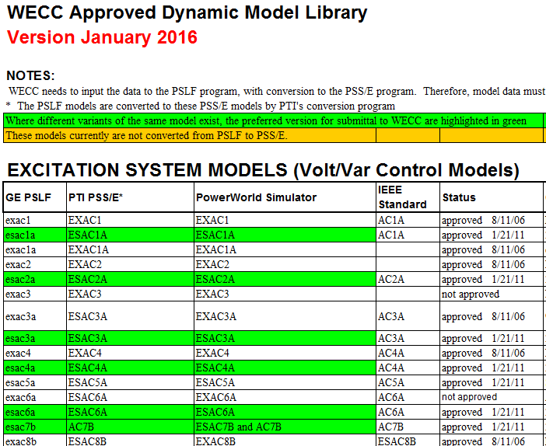
WECC Approved Dynamic Models
Link - WECC Approved Dynamic Models - 2016

Slide 7
Models in ERCOT Case - Not WECC Approved

