Slide 1
GIC System Model Workshop
May 10, 2017
Omar A. Urquidez
PGDTF Chairman

Slide 2
Thank you
Thank you to our hosts the Performance, Disturbance, Compliance Working Group especially Percy Galliguez and Roy Matthews
Thank you to our presenters CenterPoint Energy, Oncor Electric, and AEP
Thank you to our PGDTF members

Slide 3
PGDTF Introduction
On October 30, 2014, ROS approved the scope for the Planning Geomagnetic Disturbance Task Force (PGDTF)
Since that time, the Task Force has met monthly to discuss the ERCOT system’s approach to compliance with TPL-007-1.
A major effort by the Task Force since 2014, among other things necessary for compliance with TPL-007-1, has been to delineate the required data for the GIC System Model and help Task Force members, both TSPs and REs, prepare for gathering the required GIC data
These efforts have culminated in several key work products:
GIC System Model Procedure Manual, Approved 7-7-2016
RGRR 009, Approved 10-11-2016
PGRR 046, Approved 10-11-2016

Slide 4
Workshop Agenda
GIC System Model Walkthrough 30 min
Transformer Data Presentation 30-45 min
Substation Grounding Resistance Presentation 30-45 min
GIC System Model Supplemental Guidance 30 min
***Questions encouraged throughout presentations

Slide 5
1) GIC System Model Walkthrough 30 mins

Slide 6
GMD Resources
Planning Geomagnetic Disturbance Task Force (PGDTF)
http://www.ercot.com/committee/pgdtf
NERC GMD Task Force
http://www.nerc.com/comm/PC/Pages/Geomagnetic-Disturbance-Task-Force-(GMDTF)-2013.aspx
NERC TPL-007 Standard Drafting Team
http://www.nerc.com/pa/Stand/Pages/Project-2013-03-Geomagnetic-Disturbance-Mitigation.aspx
***Questions encouraged throughout presentations

Slide 7
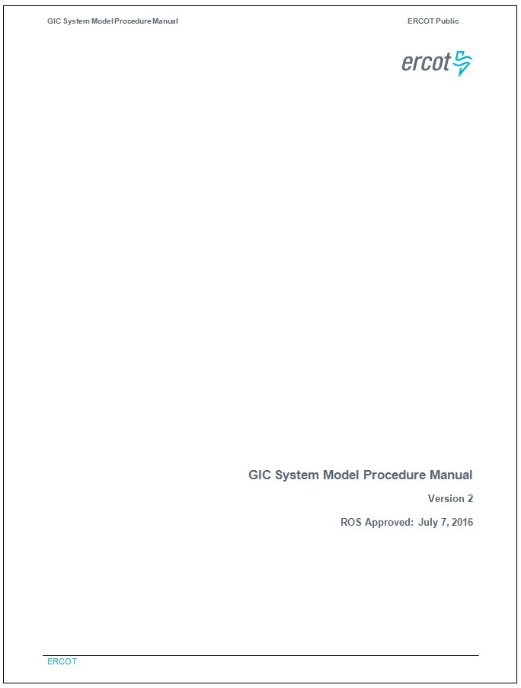
GIC System Model Procedure Manual
Outlines required data as well as guidance on kV levels and data descriptions

Slide 8
NERC Application Guide
**** Table 2 has component modeling guidance, best starting source

Slide 9
GIC Template

Slide 10
4) Supplementary Guidance 30 mins

Slide 11
Line Data FAQs
Line Data:
Should all lines below 200 kV be included in the GIC data? Is there a voltage threshold?
GIC System Model Procedure Manual governs what is required
All lines in the SSWG cases are included in the GIC System Model
For submission purposes, only lines that need resistance values updated or will have different induced voltages (steep pipe encased lines) need to be specified.
Does the request for Line Data apply to a Resource Entity (generation facility)? If so, where does that data come from, each of the radial lines that go to the point of interconnection?
Yes. See GIC Application Guide for source information and above answer for applicability.
Ownership governs submission responsibilities but coordination with interconnecting utility is necessary.

Slide 12
Line Data FAQs
Line Data:
How is the line DC resistance determined and is there a standard temperature specified for the line dc resistances?
See GIC Application Guide

Slide 13
Transformer FAQs
Transformer Data:
Which transformer winding is “Winding 1” vs “Winding 2”?
Winding order must match the power flow data.
For Auto-transformers, is the series winding – “Winding 1” and the common winding – “Winding 2”?
Winding I is series and Winding J is common, must match power flow data
If the transformer test report contains values of “H1-H2, H2-H3 & H1-H3”, is the Winding 1 - Ohms per phase equal to the Ohms per phase for “H1-H2” divided by 2?
Must follow appropriate winding diagram, may be included in report or may have to extrapolate from other resources (may need diagram here)

Slide 14
Transformer FAQs
Transformer Data:
Is there a standard temperature specified for the winding dc resistances?
See GIC Application Guide
Number of Cores in Transformer Core Design - Select the type of transformer core (Three Phase shell Form, Unknown, 3@Single Phase (separate cores), Three Phase 3-Legged Core Design, Three Phase 5-Legged Core Design, Three Phase 7-Legged Core Design) Is this data required for all transformer core designs?
GIC System Model Procedure Manual governs what data is required.

Slide 15
Transformer FAQs
Transformer Data:
Vector Group Identifiers - Winding connection designations – where do you get this information?
Shown in Xfrm presentation
Is the K factor required for transformers under 200 kV? Are we required to submit GIC data for transformers under 200 kV?
All transformers in the SSWG cases are included in the GIC System Model
GIC System Model Procedure Manual governs what data is required
Do we enter a value of 0.0 for transformers where the KFACTOR is not available, or should we enter the values given in the table based on the transformer core design?
Enter 0.0 for K factor when K factor is unknown
What is a GIC Blocking device? What value of grounding resistance is entered if there is a blocking device?
See GIC Application Guide

Slide 16
Transformer FAQs
Transformer Data:
For a solidly grounded wye, what value of grounding resistance is entered?
Depends on the meaning of “Solidly grounded wye”. If there is no resistance between the transformer and the ground grid the value is 0.
Why is the winding grounding DC resistance needed if we already have the winding resistance and the resistance of the grounding network? Is the winding grounding DC resistance something other than the sum of those two values?
GRDI, GRDJ, GRDK are meant for installations that have additional resistance between the transformer and the ground grid.

Slide 17
Shunt Device FAQs
Capacitor and Reactor Data:
For reactors, is the winding grounding DC resistance something other than the sum of the winding resistance and the resistance of grounding network?
RGRDFXSH is meant for installations that have additional resistance between the transformer and the ground grid.
What value is entered for capacitor banks for coil DC resistance and grounding resistance?
Capacitor data is not part of the GIC System Model Data

Slide 18
TSP/RE Interaction
If you are not already on the PGDTF Contact List, please email Omar Urquidez. Only those on the list have access to it. Contact list has primary and secondary GIC contacts for each entity.
Work with connecting TSPs’ contacts on boundary interfaces.
Example 1
Example 2
1
1
4
2
4
2
~ 6 miles
Zero impedance line representing breaker, switch, POI, change of ownership, etc.
~ 6 miles
Zero impedance line representing breaker, switch, POI, change of ownership, etc.
3
3
~ 4 miles
~ 4 miles
5
5
6
Ground Grid
6
Zero impedance line
Zero impedance line

Slide 19
Questions and Answers

