Slide 1
PDCWG Report to ROS
Chair: Percy Galliguez, Brazos Electric Power Cooperative, Inc.
Vice Chair: Lei Ye, Austin Energy
ROS
May 4th, 2017

Slide 2
Report Overview & Notes
Meeting Minutes
BAL-001-TRE-1 FMEs & IMFR
  1 FME in the month of March
  2 other Frequency events that were evaluated
Frequency Control Report
  Starting next months ROS, Frequency Control Report for two months prior will be reported.
  April Frequency Control Report can be found in April PDCWG Report to ROS.
ERCOT’s CPS1 score for the month of April 2017 is 172.09%. The 12-month rolling average CPS1 score as of the end of April 2017 is 175.41%.

Slide 3
Meeting Minutes
PDCWG Meeting 4/12/17
  Regulation & Frequency Control Reports
  GREDP Performance Analysis
  NPRR 815 Discussion
  MOD-026-1 & MOD-027-1 Discussion
    NOGRR Proposal/Review Status – waiting on ERCOT comments
  BAL-001-TRE-1 Review Committee
  Reviewed Frequency Events
    3/9/2017 18:36:50 (FME)
      Loss of 642MW
      1,069 MW/0.1HZ Response
      0 of 36 Generation Resources providing RRS had less than 75% of their expected Initial Primary Frequency Response.
      1 of 36 Generation Resources providing RRS had less than 75% of their expected Sustained Primary Frequency Response.

Slide 4
Meeting Minutes (cont.)
  Reviewed Frequency Events (cont.)
    3/15/2017 1:36:21
      Loss of 811MW and then 544MW within 60s
      Not identified as an FME
      Took 0:09:53 to recover to 60Hz
      Possible causes:
        Limited feedback in GTBD to SCED due to regulation being exhausted, etc.
    3/29/2017 19:54:27
      Loss of 770MW
      Not identified as an FME
      Took 0:10:53 to recover to 59.965Hz
      Possible causes:
        Occurred at top of the hour – AS changes including 100MW reduction in regulation, DC tie import ramping down, etc.
        Limited feedback in GTBD to SCED.
        Wind ramping down.
Frequency events that had longer recovery periods.

Slide 5
Frequency Measurable Events Performance

Slide 6
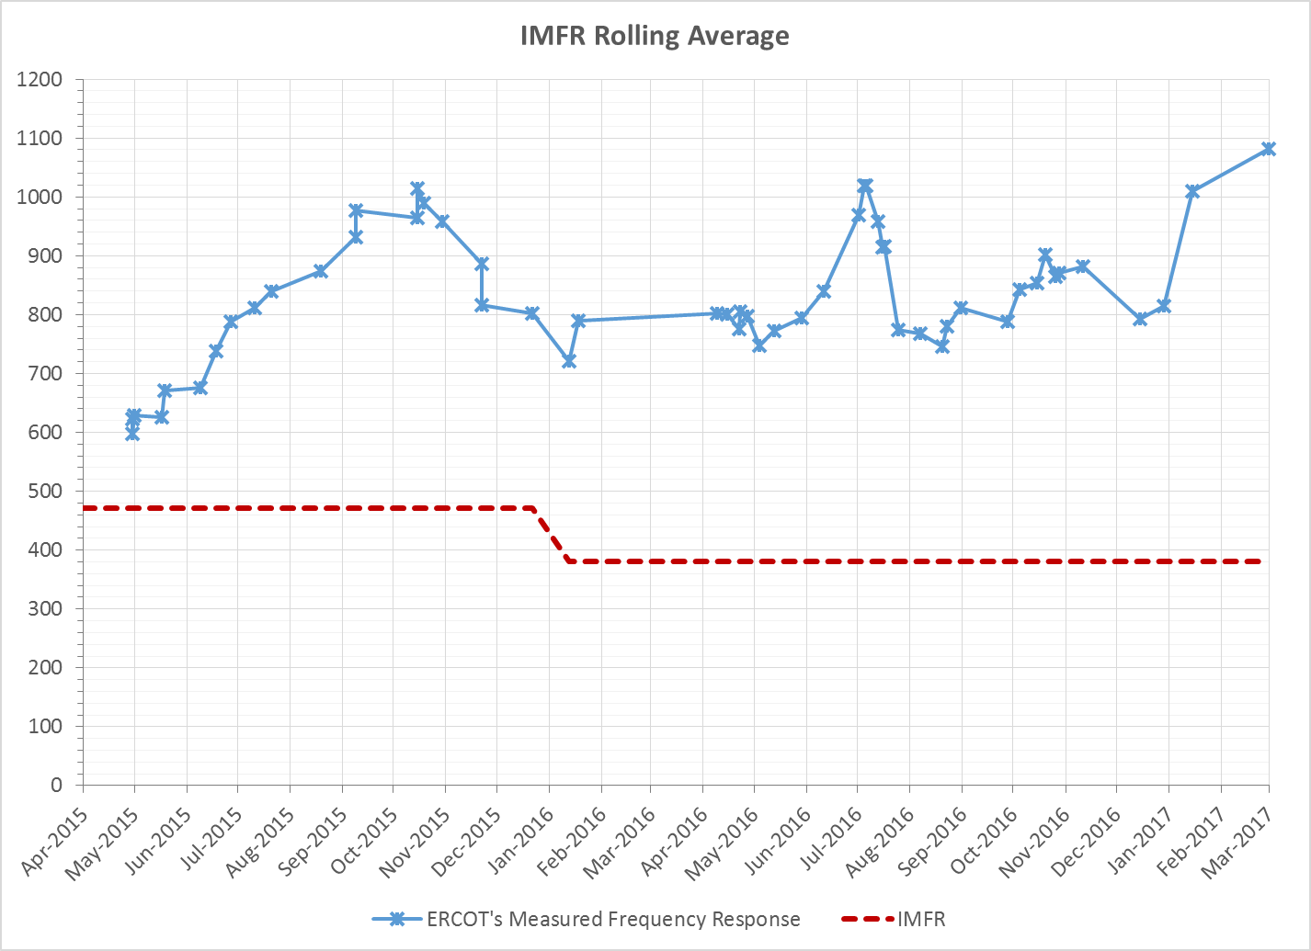
Interconnection Minimum Frequency Response (IMFR) Performance
IMFR Performance currently 1081.57 MW/0.1Hz

Slide 7
Questions?

