Slide 1
Private Use Network Load Distribution Factors
Steve Reedy
Potomac Economics
Deputy Director, ERCOT IMM
May 3rd, 2017

Slide 2
PUN Loads are not included in Load Distribution Factors
Load Zone Load
PUN Resource Node
PUN Load

Slide 3
Mechanics of the Problem
Load zone energy purchased in the Day-Ahead Market does not “flow” in the network model to PUN Loads
Leaves more transmission capacity open near PUN Loads than if properly modeled
Energy Only bids/ PTP Obligation bids sinking at PUN resource nodes do not compete with Load Zone flows
More can be sold than should be
High prices at PUN loads are not factored into appropriate Load Zone prices
No revenue to fund payout to EO bids/PTPs sunk at PUN RNs
Causes Revenue Neutrality hit

Slide 4
Not Very Similar to “Dead Bus” Issue
Dead Bus | PUN Loads
Limited only by Breaker Ratings (9999MW available) | Limited by appropriate network ratings
Extremely low risk to bidders | Standard risk to bidders
Volume got very high very quickly | Volume not particularly high
Affects Revenue Neutrality | Affect Revenue Neutrality

Slide 5
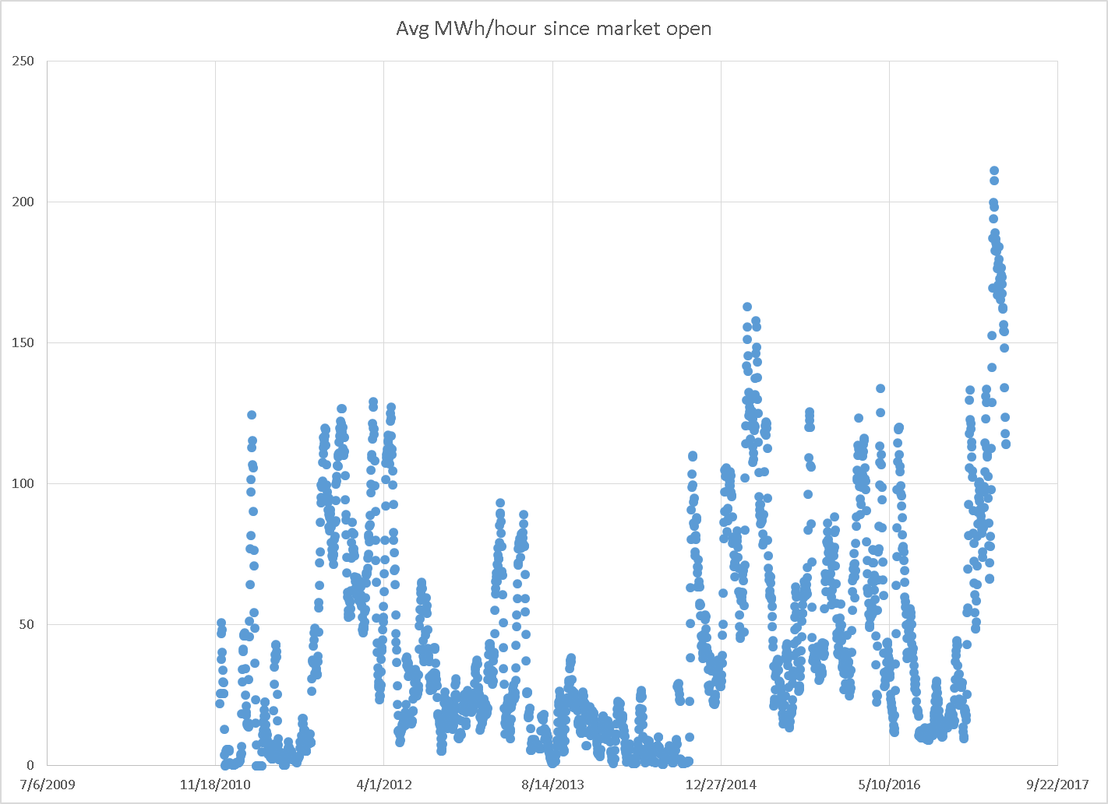
PTP OBL MWs Sunk at “Poster Child” PUN RN – Nodal

Slide 6
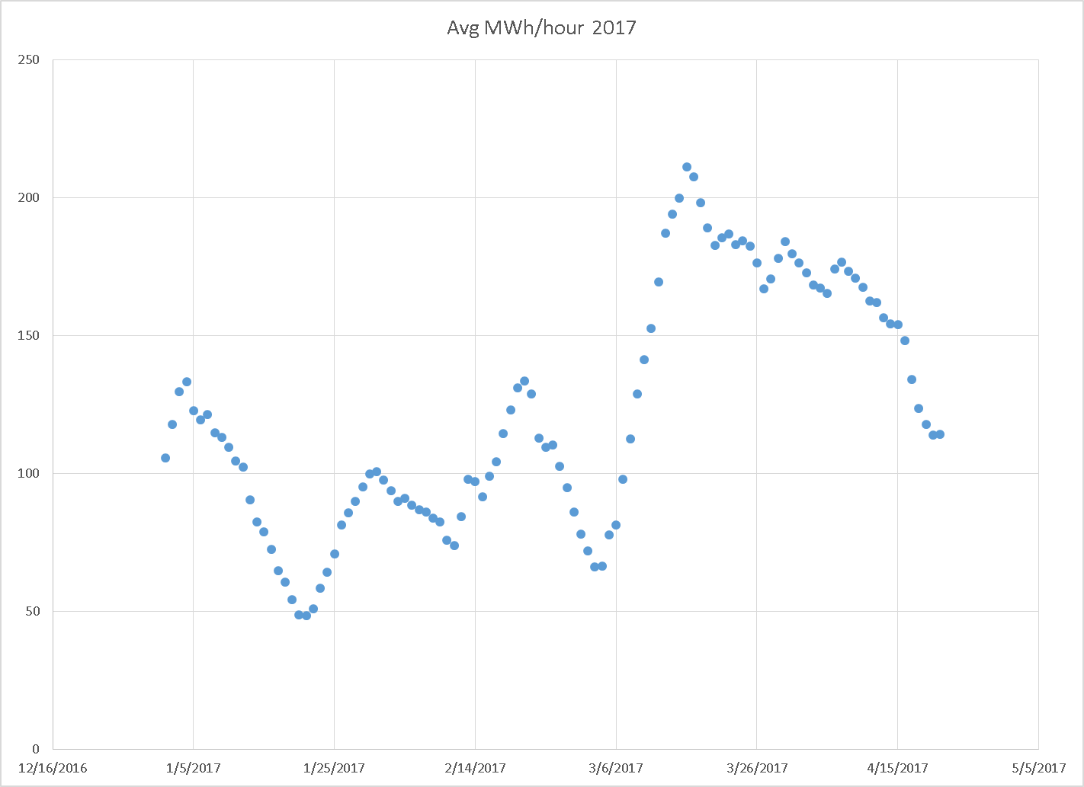
PTP OBL MWs Sunk at “Poster Child” PUN RN – 2017

