Slide 1
Point-to-Point Obligation (PTP) Settlements and Clearing Difference
QMWG
May 1, 2017

Slide 2
PTP Clearing and Settlement Difference
  Concern: Price difference between clearing and settlement of PTPs
  A contingency de-energizes one side of the PTP and causes an constraint to bind at high shadow price and hence high price at energized side
  To maintain power balance under PTP analysis, DAM creates an exception to exclude this contingency/constraint’s impact in PTP clearing due to one side being de-energized
  LMP at the energized side takes into account this constraint’s impact
Proposed Change: To maintain power balance under PTP analysis, Instead of ignoring the congestion impacts of one side de-energized PTPs, modify DAM optimization to distribute the PTP MW from the disconnected Settlement Point to all the other online generators
  Makes optimization and settlement price consistent within a small tolerance
  Pickup effect ensures power balance in the post-contingency power flow and has minimal impact on the congestion pattern based on historic analysis
  Binding constraints under N-1 are mainly due to power flow redirections caused by the topology change under N-1 contingency and not due to the pickup effect of the tripped generator

Slide 3
Implementation in Other ISOs
 | MISO | ISO-NE | CAISO Proposed | PJM | ERCOT proposal
Model G-1 in DAM? | No | No | No | Yes | No
Model N-1 that outages generator | Yes | Yes | Yes | Yes | Yes
How MWs redistributed in DAM? | AGC units based on participation factor | AGC units based on participation factor | AGC units based on max power capability | All online resources based on headroom | All online resources based on HRL
What is the SF of de-energized bus to N-1 contingency? | Set to zero | Set to zero | Set to zero | Set to zero | Set to zero
  *SPP have identified issues with current implementation and are changing it to be consistent with other ISOs

Slide 4
N-1 Example
BASE CASE
GRID
Station A
Station B
RNsi
Station C
Station G
Station D
RNsi
RNso
Station F
Station E
Outage
Gen Station

Slide 5
N-1 Example
Congestion Due to Power Flow Change and not due to pickup effect
CONTINGENCY 1
GRID
Station A
Binding
Station B
RNsi
Station C
Station G
Station D
RNsi
RNso
Station F
Station E
Outage
Gen Station

Slide 6
NPRR827
If the desire for implementation for this urgent NPRR is to zero out awards that are greater than their bid price
  Need to set a lower limit to decrease manual work
  Language change needed: PTP Obligation bids shall not be awarded where the DAM clearing price for the PTP Obligation is greater than the PTP Obligation bid price within a small threshold.
Impacts of zeroing out awards
  Could remove hedging opportunities for other constraints and therefore cannot be a long-term solution: this is not a base case issue, it is post contingency for one constraint
  Can cause shortfall because removed PTP bids could be providing counter flow

Slide 7
NPRR827
Frequency of PTP awards above bid prices, 2016 & 2017 through February:(without pickup effect implemented)
Range ($) | 2017 Frequency
0-0.1 | 21
0.1-0.5 | 39
0.5-1 | 25
1-5 | 188
5-10 | 421
10-50 | 1241
50-100 | 99
100-500 | 413
500-1000 | 213
Over 1000 | 297
Range ($) | 2016 Frequency
0-0.1 | 296
0.1-0.5 | 262
0.5-1 | 105
1-5 | 359
5-10 | 76
10-50 | 11
More | 0

Slide 8
Appendix

Slide 9
Pick-up effect example for virtuals, TPOs
When a generator is disconnected from the rest of the system under a contingency case
  The MWs from the generator are redistributed to the connected, online generators to maintain power balance under the contingency
  The generator’s MWs have impact based on the impact of the resources to which the MW is distributed. Hence, the generator has an equivalent shift factor to the constraint (distributed MW weighted SF of all resources - “pickup effect shift factor” – a very small value) even though it is disconnected
Gen 1
MWs flowing
from generator
in base case
This line is
outaged
This line is
disconnected
under contingency
Other generators
Redistributed MWs
The rest of the system

Slide 10
Pick-up effect example for virtuals, TPOs
Example of MW weighting. When distributing to all generators in the system, the equivalent impact to constraint will be near zero.
All generators in system | Generator HRL (MW) | HRL-weighted distribution factor | Each generator’s shift factor on constraint | HRL-weighted shift factor
Gen 1 (disconnected) | n/a | - | - | -
Gen 2 (offline) | n/a | - | - | -
Gen 3 | 50 | .25 | -.02 | -.0050
Gen 4 | 70 | .35 | .01 | .0035
Gen 5 | 80 | .40 | .01 | .0040
Disconnected settlement point’s shift factor on binding constraint (sum of HRL-weighted shift factors) = |  |  |  | .0025

Slide 11
April 13, 2017 QMWG WEBEX presentation

Slide 12
Other Related Issues
A concern has been raised about explicit G-1 contingencies
  This issue is different from the PTP implementation concern in that the contingencies causing the PTP implementation concern are
    Transmission contingencies which outage a Resource Node as well and hence no concern with difference in optimization price and RN SPP
    Consistently modeled across CRR/DAM/RT and hence there are no systemic uplift possibilities
  There is further discussion needed about explicit G-1 contingencies in Real-Time causing potential overselling but this is a different issue which could be addressed later.

Slide 13
Clarification Needed for NPRR827
Key to determine implementation to determine the exact language
Implementation options discussed-
  Zero out awards which are affected
    Could remove hedging opportunities for other constraints and therefore cannot be a long-term solution: this is not a base case issue, it is post contingency for one constraint
    Can cause shortfall because removed PTP bids could be providing counter flow
  Settle at the optimization price
    Concerns with gaming
    Will not be able to implement manually

Slide 14
Alternative Language for NPRR827
Other long term implementation options discussed
  Removing the contingencies
    Need to be evaluated for reliability
    Removing from SCED/DAM/CRR and do Out of Market action
      Not a preferred option by ERCOT operations
      Requires extensive system changes and testing
      Increases out of market actions
      Cause Uplift
    Removing from just DAM/CRR and keeping in SCED
      would cause overselling and revenue neutrality charges
  ERCOT proposed optimization change
    Language change needed - PTP Obligation bids shall not be awarded where the DAM clearing price for the PTP Obligation is greater than the PTP Obligation bid price within a small threshold.

Slide 15
Merits of ERCOT option
Contingencies that cause PTP implementation concern
  Must be considered for reliability in Real-Time to ensure there are no transmission equipment violations.
  Must be in SCED to avoid Uplift from Out of market actions
  Hence must be consider in DAM to ensure consistency and maintain revenue neutrality.
To maintain power balance in the post-contingency power flow, DAM optimization will be changed to distribute the PTP MW from the disconnected Settlement Point to all the other connected generators
  Would make optimization price and settlement price consistent within a small tolerance
  The post contingency flows based on simulated governor response
  ERCOT design calculates prices based on pre-contingency dispatching of resources to meet post contingency overloads.
  Contingencies that cause PTP implementation concern are considered the same and hence are not over constraining
  Similar to implementation by other ISOs

Slide 16
Appendix

Slide 17
Overview
A PTP is modeled as a simultaneous injection and withdrawal – a linked bid and offer
Clearing price and SPP difference diverge when
  Under a contingency a settlement point associated with either the PTP’ sink or source is disconnected
  A constraint becomes violated/binding under the contingency
  The shift factor for the connected settlement point is non-trivial
  The constraint remains binding for the final DAM solution

Slide 18
Modeling DAM PTPs in Contingency Analysis
Under contingency analysis a contingency disconnects one of the source/sink settlement points
In order to keep post-contingency power balance, any PTP containing a disconnected settlement point will be ignored in the post-contingency power flow.
PTPsource PTPsink

Slide 19
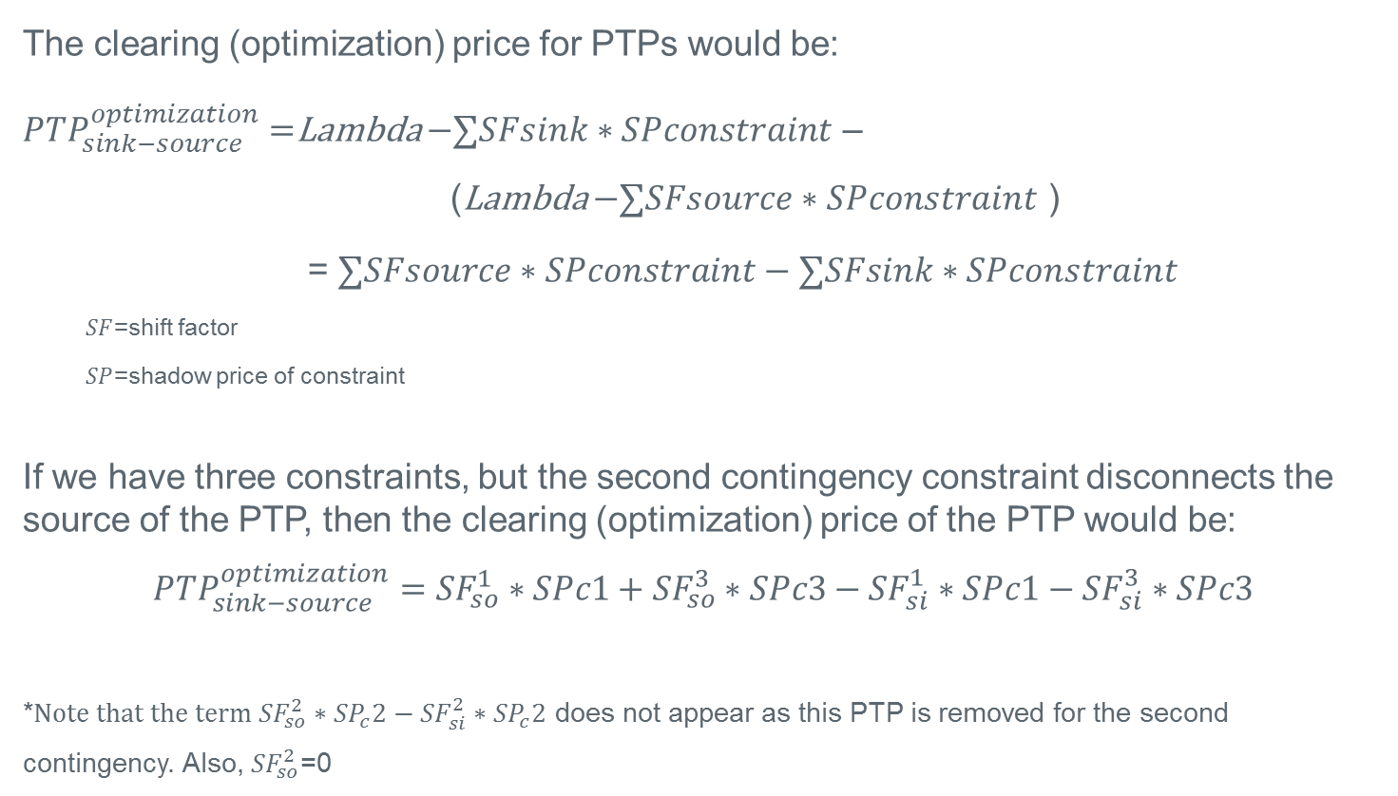
Clearing Price for PTP with source disconnected in a contingency
The clearing (optimization) price for PTPs would be:
${PTP}_{sink−source}^{optimization}=$Lambda $−∑SFsink∗SPconstraint$ –
(Lambda $−∑SFsource∗SPconstraint$ )
= $∑SFsource∗SPconstraint−∑SFsink∗SPconstraint$
  $SF$=shift factor
  $SP$=shadow price of constraint
If we have three constraints, but the second contingency constraint disconnects the source of the PTP, then the clearing (optimization) price of the PTP would be:
$${PTP}_{sink−source}^{optimization}={SF}_{so}^{1}∗SPc1+{SF}_{so}^{3}∗SPc3−{SF}_{si}^{1}∗SPc1−{SF}_{si}^{3}∗SPc3$$
*$Note that the term {SF}_{so}^{2}∗{SP}_{c}2−{SF}_{si}^{2}∗{SP}_{c}2$ does not appear as this PTP is removed for the second contingency. Also, ${SF}_{so}^{2}$=0

Slide 20
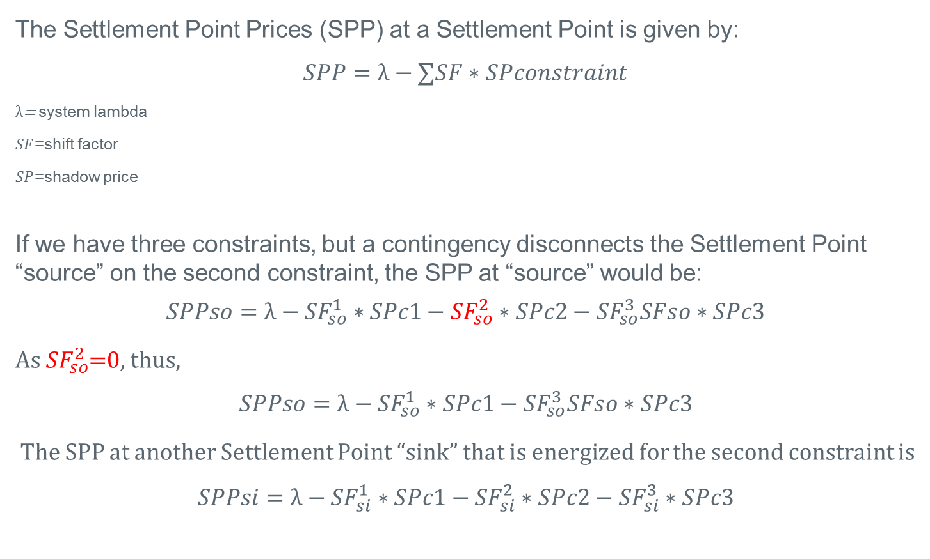
DAM Settlement Point Price
The Settlement Point Prices (SPP) at a Settlement Point is given by:
$$SPP=λ−∑SF∗SPconstraint$$
$λ$= system lambda
$SF$=shift factor
$SP$=shadow price
If we have three constraints, but a contingency disconnects the Settlement Point “source” on the second constraint, the SPP at “source” would be:
$$SPPso=λ−{SF}_{so}^{1}∗SPc1−{SF}_{so}^{2}∗SPc2−{SF}_{so}^{3}SFso∗SPc3$$
As ${SF}_{so}^{2}$=0, thus,
$$SPPso=λ−{SF}_{so}^{1}∗SPc1−{SF}_{so}^{3}SFso∗SPc3$$
The SPP at another Settlement Point “sink” that is energized for the second constraint is
$$SPPsi=λ−{SF}_{si}^{1}∗SPc1−{SF}_{si}^{2}∗SPc2−{SF}_{si}^{3}∗SPc3$$

Slide 21
PTP settlement discrepancy when source disconnected in a contingency
The DAM settlement for PTPs is the difference of the sink SPP and the source SPP:
The clearing price / DAM optimization price for PTPs would be:
Difference between what the PTP is settled at and what the DAM clearing/optimization sees is:
End result – Under certain conditions, the awarded PTP could be settled at a price different from the clearing/optimization price

Slide 22
Possible alternatives
Preferred option - Change how DAM processes PTP in contingency analysis when a contingency disconnects the source or sink
To maintain power balance in the post-contingency power flow, rather than ignoring PTP in post-contingency power flow, distribute the PTP MW from the disconnected Settlement Point to all the other connected generators
  Would make optimization price and settlement price consistent within a small tolerance
  Considerations:
    PTP flow could contribute to congestion far removed from the path
    Would have to consider changing CRR auction to make consistent
    Requires system change and extensive testing

Slide 23
Possible alternatives
Alternative option - Change settlement price for PTP bids to the optimization price
  Makes the DAM clearing engine and settlements consistent
    Buyer will never see clearing higher than bid
  Considerations:
    CRR value and PTP cost would diverge
    Would affect Balancing Account
    Gaming opportunities exist
    Requires NPRR and integrated system changes
CRR | DAM | RT
CRR charged at optimization price | CRR settles on SPP difference
 | PTP pays optimization price | PTP settles on SPP difference
 | Over/under goes to Balancing Account | Over/under goes to RT Rev. Neutrality Allocation

