Slide 1
Overview and Implementation of NPRR744-RUC Trigger for the Reliability Deployment Price Adder and Alignment with RUC Settlement
ERCOT
QMWG
May 1, 2017

Slide 2
Outline
NPRR744 Schedule Update
Current Implementation and Issues
Overview of NPRR744
Implementation of NPRR744
APPENDIX
  NPRR744 Examples

Slide 3
NPRR744 Schedule Update
NPRR744 approved by Board on April 19, 2016
NPRR744 code is currently under testing
Update of NPRR744 implementation and training overview to QMWG (today)
WebEx Training for NPRR744 is scheduled for 2-3 PM on May 16, 2017. A market notice will be sent next week.
Implementation in production scheduled for June 1, 2017. Market notices will be sent ahead of implementation.

Slide 4
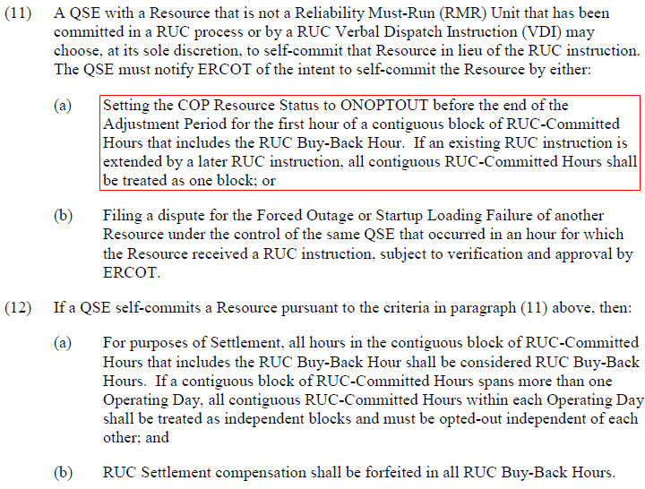
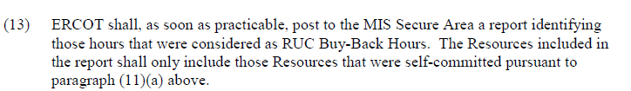
Current (pre-NPRR744) Protocol Language

Slide 5
Current (pre-NPRR744) Implementation
QSE needs to buyback the RUC-committed Resource by submitting ONOPTOUT status in COP before the end of adjustment period of the first hour of the RUC block
Currently SCED performs a validation against the telemetered ONRUC status
  SCED reads the RUC commitment information for current hour
  If the ONRUC Resource is not in the RUC commitment list, SCED will override the ONRUC status to ON and will not trigger Real-Time On-Line Reliability Deployment Price Adder (RTORDPA) calculation

Slide 6
Issues with Current (pre-NPRR744) Implementation
  A QSE cannot buy back an HRUC commitment for the next hour or VDI commitment for current hour or next hour
  Because COP submission windows close at end of adjustment period
  Resource telemetry status not consistent with Resource RUC commitment status or buyback status
  Buy back in COP but telemeter ONRUC in Real-Time
  Not buy back in COP but telemeter ONOPTOUT or ON in Real-Time
  Causes issues for the RTORDPA pricing run

Slide 7
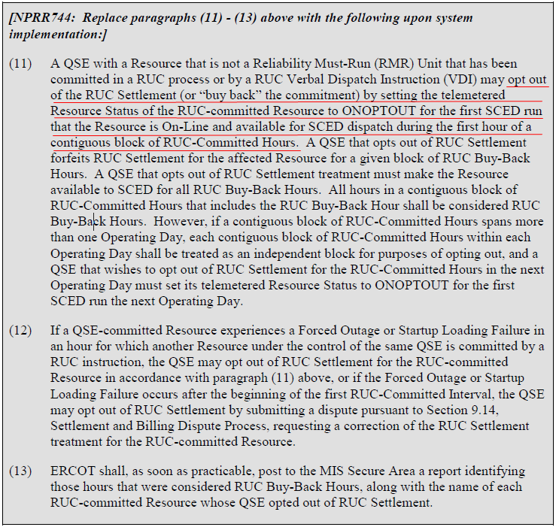
NPRR744 Protocol Language

Slide 8
Overview of NPRR744 Buy-Back Process
Regardless of when the RUC is communicated, SCED will take a Resource status telemetry snapshot when the following are ALL TRUE:
  Resource has a confirmed RUC commitment block
  The first hour of the RUC commitment block
  First SCED run when Resource is On-Line and available for SCED dispatch
      Statuses treated as not available for SCED dispatch are: EMR, OFF, OFFNS, OFFQS, OUT, STARTUP, SHUTDOWN, ONTEST, ONRR

Slide 9
Overview of NPRR744 Buy-Back Process
This Resource status telemetry snapshot will be used to determine the buyback flag for the entire RUC block and any extensions of the RUC commitment block, unless the RUC goes into the next operating day.
This determined buyback flag will be used in the QSE’s settlement for the entire RUC commitment block as well as the RUC trigger for the RTORDPA pricing run.
  If snapshot is ONOPTOUT then Resource is opted-out of RUC settlement and RTORDPA pricing run will not be initiated. The buyback flag will be set to YES.
  If any other online status , since unit is RUC-committed, then Resource will be settled as per RUC settlement and the RTORDPA pricing runs will be initiated for the entire block. The buyback flag will be set to NO.

Slide 10
Benefits of NPRR744
Addresses current implementation issues
  Can Buyback RUC commitment for next Operating Hour and possible current hour
  Use one single buyback flag for the entire RUC block
    Override the telemetry status if it is different from the determined buyback flag
  Fix the RUC and buyback inconsistency between SCED and Settlement by use one single Buyback flag set by SCED

Slide 11
NPRR744 Buy-Back Scenarios
Off-line Scenario (STARTUP->ONOPTOUT):
  If the Resource is starting up from Off-Line status to the first hour of the RUC block, it shall telemeter STARTUP and then ONOPTOUT right after it is started up
    Already started up before the beginning of the first hour
    Not yet started up at the beginning of the first hour
    On-Line Scenarios (ON->ONOPTOUT):
      If the Resource is RUC committed for a block immediately following a QSE self-commitment block, it shall telemeter ONOPTOUT before the beginning of the first hour of the RUC block

Slide 12
NPRR744 Implementation-RUC Block
RUC Block
  A contiguous block of RUC-Committed Hours for a specific Operating Day
  If a contiguous block of RUC-Committed Hours spans more than one Operating Day, each contiguous block of RUC-Committed Hours within each Operating Day is treated as an independent block
  RUC_START_HOUR is the first hour of the block in Hour Ending Format
  RUC_END_HOUR is the last hour of the block in Hour Ending Format
  BUYBACK_FLAG default is NULL, it will be set by SCED
  Examples
DELIVERY_DATE | RESOURCE_NAME | RUC_START_HOUR | RUC_END_HOUR | BUYBACK_FLAG
04/30/2017 | UNIT1 | 12 | 24 | YES
04/30/2017 | UNIT2 | 10 | 20 | NO
05/01/2017 | UNIT3 | 11 | 12 | YES
05/01/2017 | UNIT3 | 18 | 21
05/01/2017 | UNIT4 | 17 | 24
05/01/2017 | UNIT5 | 21 | 24
05/01/2017 | XYZ_CC1 | 17 | 20
05/02/2017 | UNIT5 | 1 | 7

Slide 13
NPRR744 Implementation-SCED Changes
SCED will take a snapshot of the telemetered Resource status of the RUC-committed Resource for the first SCED run that the Resource is On-Line and available for SCED dispatch during the first hour of the RUC block
SCED will determine the buyback flag for the entire RUC block based on the telemetered status snapshot
  If the snapshot status is ONOPTOUT, SCED will set the buyback flag to YES indicating that the Resource successfully bought back the RUC block
  Otherwise SCED will set the buyback flag to NO indicating that the Resource did not successfully buy back the RUC block
SCED will use the RUC block and determined buyback flag to validate telemetered Resource status and override the telemetered status if it is inconsistent with the determined buyback flag
SCED will use the determined buyback flag and the validated Resource status to trigger RTORDPA calculation for the RUC block

Slide 14
NPRR744 Implementation-SCED Workflow

Slide 15
NPRR744 Implementation-CDR Report and Notifications
ERCOT will publish a CDR report to the MIS Secure Area for the RUC buyback information
  Changes to the existing report NP5-513-CD RUC Buy-Back Hours (Report Type ID 13102)
  Report is running every hour for current Operating Day
  Post all the RUC buyback blocks in current Operating Day if any at the time of the report execution
  No report if no buyback for current Operating Day
MMS will send XML notification messages to the affected QSE
  When the buyback flag is set by SCED
  When there is a Resource status override by SCED

Slide 16
NPRR744 Implementation-Settlement Changes
Settlements will consume a new data element that identifies when a QSE has successfully opted out of RUC settlement. This new bill determinant, BUYBACK, will equal
  1 if the opt-out attempt is successful,
  2 if the opt-out attempt is un-successful or no attempt is made,
  0 for hours that are not RUC-committed.
RUC Buy-Back hours will still be communicated to the Market via the current RUC Bill Determinant with an hourly value of 5 for each RUC-committed hour found eligible for the RUC Resource Buyback provision.
RUC hourly values of 5 will still be considered not RUC-Committed for Settlement purposes.
Bill Determinant | Short Description | Extract | Extract Table
BUYBACK | RUC Buyback Flag | RTM CODE | MKTINPUTHEADER MKTINPUTINTERVAL

Slide 17
APPENDIX

Slide 18
NPRR744 Examples
Off-Line Buyback with snapshot at start of first hour
Off-Line Buyback with snapshot during first hour
On-Line Buyback with snapshot at start of first hour
Off-Line ONRUC with snapshot at start of first hour
On-line ONRUC with snapshot at start of first Hour
Buyback for Current Day and Next Day
Buyback for Current Day and ONRUC for Next Day
Telemetry Resource Status Override
Buyback for Combined Cycle Resources
Unsuccessful Buyback due to Missed First SCED Interval
Unsuccessful Buyback due to Missed First SCED Interval

Slide 19
NPRR744 Example 1: Off-line Buyback with Snapshot at Start of First Hour
Scenario
  08:20:00 HRUC commits an Off-Line Resource for HE11-HE12
  08:25:00 QSE updates COP status for the Resource to ONOPTOUT for HE11-HE12
  09:37:00 QSE telemeters status of STARTUP for this resource
  09:53:00 QSE telemeters status of ONOPTOUT for this resource
  10:00:00 SCED reads the ONOPTOUT status and sets the BUYBACK_FLAG=YES for the block
  SCED
SCED_EXECUTION_TIME | TELEMETRY_STATUS | RUC_COMMITMENT | BUYBACK_FLAG | STATUS_OVERRIDE | COMMENT
09:35:00 | OFF | NO |  |  | Off-Line
09:40:00 | STARTUP | NO |  |  | Startup
09:45:00 | STARTUP | NO |  |  | Startup
09:50:00 | STARTUP | NO |  |  | Startup
09:55:00 | ONOPTOUT | NO |  |  | Startup complete
10:00:00 | ONOPTOUT | YES | YES |  | Buyback flag is set
10:05:00 | ONOPTOUT | YES | YES |  | Use set buyback flag
10:10:00 | ONOPTOUT | YES | YES |  | Use set buyback flag
10:15:00 | ONOPTOUT | YES | YES |  | Use set buyback flag

Slide 20
NPRR744 Example 2: Off-line Buyback with Snapshot during First Hour
Scenario
  08:20:00 HRUC commits an Off-Line Resource for HE11-HE12
  08:25:00 QSE updates COP status for the Resource to ONOPTOUT for HE11-HE12
  09:37:00 QSE telemeters status of STARTUP for this resource
  10:03:00 QSE telemeters status of ONOPTOUT for this resource
  10:05:00 SCED reads the ONOPTOUT status and sets the BUYBACK_FLAG=YES for the block
  SCED
SCED_EXECUTION_TIME | TELEMETRY_STATUS | RUC_COMMITMENT | BUYBACK_FLAG | STATUS_OVERRIDE | COMMENT
09:35:00 | OFF | NO |  |  | Off-Line
09:40:00 | STARTUP | NO |  |  | Startup
09:45:00 | STARTUP | NO |  |  | Startup
09:50:00 | STARTUP | NO |  |  | Startup
09:55:00 | STARTUP | NO |  |  | Startup
10:00:00 | STARTUP | YES |  |  | Startup, no status override
10:05:00 | ONOPTOUT | YES | YES |  | Buyback flag is set
10:10:00 | ONOPTOUT | YES | YES |  | Use set buyback flag
10:15:00 | ONOPTOUT | YES | YES |  | Use set buyback flag

Slide 21
NPRR744 Example 3: On-line Buyback with Snapshot at Start of First Hour
Scenario
  08:20:00 HRUC commits an On-Line Resource for HE11-HE12 and the Resource is self-committed for HE09-HE10
  08:25:00 QSE updates COP status for the Resource to ONOPTOUT for HE11-HE12
  09:00:00 QSE telemeters status of ON for this resource
  09:58:00 QSE telemeters status of ONOPTOUT for this resource
  10:00:00 SCED reads the ONOPTOUT status and sets the BUYBACK_FLAG=YES for the block
  SCED
SCED_EXECUTION_TIME | TELEMETRY_STATUS | RUC_COMMITMENT | BUYBACK_FLAG | STATUS_OVERRIDE | COMMENT
09:35:00 | ON | NO |  |  | self-schedule On-Line
09:40:00 | ON | NO |  |  | self-schedule On-Line
09:45:00 | ON | NO |  |  | self-schedule On-Line
09:50:00 | ON | NO |  |  | self-schedule On-Line
09:55:00 | ON | NO |  |  | self-schedule On-Line
10:00:00 | ONOPTOUT | YES | YES |  | Buyback flag is set
10:05:00 | ONOPTOUT | YES | YES |  | Use set buyback flag
10:10:00 | ONOPTOUT | YES | YES |  | Use set buyback flag
10:15:00 | ONOPTOUT | YES | YES |  | Use set buyback flag

Slide 22
NPRR744 Example 4: Off-line ONRUC with Snapshot at Start of First Hour
Scenario
  08:20:00 HRUC commits an Off-Line Resource for HE11-HE12
  08:25:00 QSE updates COP status for the Resource to ONRUC for HE11-HE12
  09:37:00 QSE telemeters status of STARTUP for this resource
  09:53:00 QSE telemeters status of ONRUC for this resource
  10:00:00 SCED reads the ONRUC status and sets the BUYBACK_FLAG=NO for the block
  SCED
SCED_EXECUTION_TIME | TELEMETRY_STATUS | RUC_COMMITMENT | BUYBACK_FLAG | STATUS_OVERRIDE | COMMENT
09:35:00 | OFF | NO |  |  | Off-Line
09:40:00 | STARTUP | NO |  |  | Startup
09:45:00 | STARTUP | NO |  |  | Startup
09:50:00 | STARTUP | NO |  |  | Startup
09:55:00 | ONRUC | NO |  | ON | Status override
10:00:00 | ONRUC | YES | NO |  | Buyback flag is set
10:05:00 | ONRUC | YES | NO |  | Use set buyback flag
10:10:00 | ONRUC | YES | NO |  | Use set buyback flag
10:15:00 | ONRUC | YES | NO |  | Use set buyback flag

Slide 23
NPRR744 Example 5: On-line ONRUC with Snapshot at Start of First Hour
Scenario
  08:20:00 HRUC commits an On-Line Resource for HE11-HE12 and the Resource is self-committed for HE09-HE10
  08:25:00 QSE updates the COP status for the Resource to ONRUC for HE11-HE12
  09:00:00 QSE telemeters status of ON for this resource
  09:58:00 QSE telemeters status of ONRUC for this resource
  10:00:00 SCED reads the ONRUC status and sets the BUYBACK_FLAG=NO for the block
  SCED
SCED_EXECUTION_TIME | TELEMETRY_STATUS | RUC_COMMITMENT | BUYBACK_FLAG | STATUS_OVERRIDE | COMMENT
09:35:00 | ON | NO |  |  | self-schedule On-Line
09:40:00 | ON | NO |  |  | self-schedule On-Line
09:45:00 | ON | NO |  |  | self-schedule On-Line
09:50:00 | ON | NO |  |  | self-schedule On-Line
09:55:00 | ON | NO |  |  | self-schedule On-Line
10:00:00 | ONRUC | YES | NO |  | Buyback flag is set
10:05:00 | ONRUC | YES | NO |  | Use set buyback flag
10:10:00 | ONRUC | YES | NO |  | Use set buyback flag
10:15:00 | ONRUC | YES | NO |  | Use set buyback flag

Slide 24
NPRR744 Example 6: Buyback for Current Day and Next Day
Scenario
  18:20:00 HRUC commits an Off-Line Resource from HE21 to next Operating Day HE07
  18:25:00 QSE updates the COP status for the Resource to ONOPTOUT for HE21 to OD+1 HE07
  19:37:00 QSE telemeters status of STARTUP for this resource
  19:53:00 QSE telemeters status of ONOPTOUT for this resource
  20:00:00 SCED reads the ONOPTOUT status and sets the BUYBACK_FLAG=YES for the block of current OD
  00:00:00 OD+1 SCED reads the ONOPTOUT status and sets the BUYBACK_FLAG=YES for the block of OD+1
  SCED
SCED_EXECUTION_TIME | TELEMETRY_STATUS | RUC_COMMITMENT | BUYBACK_FLAG | STATUS_OVERRIDE | COMMENT
19:35:00 | OFF | NO |  |  | Off-Line
19:40:00 | STARTUP | NO |  |  | Startup
19:45:00 | STARTUP | NO |  |  | Startup
19:50:00 | STARTUP | NO |  |  | Startup
19:55:00 | ONOPTOUT | NO |  |  | Startup complete
20:00:00 | ONOPTOUT | YES | YES |  | Buyback flag is set
20:05:00 | ONOPTOUT | YES | YES |  | Use set buyback flag
… | … | … | … |  | Use set buyback flag
23:55:00 | ONOPTOUT | YES | YES |  | Use set buyback flag
00:00:00 | ONOPTOUT | YES | YES |  | Buyback flag is set for the new block
00:00:05 | ONOPTOUT | YES | YES |  | Use set buyback flag

Slide 25
NPRR744 Example 7: Buyback for Current Day and ONRUC for Next Day
Scenario
  18:20:00 HRUC commits an Off-Line Resource from HE21 to next Operating Day HE07
  18:45:00 QSE updates the COP status for the Resource to ONOPTOUT for HE21-HE24 and ONRUC for OD+1 HE01-HE07
  19:37:00 QSE telemeters status of STARTUP for this resource
  19:53:00 QSE telemeters status of ONOPTOUT for this resource
  20:00:00 SCED reads the ONOPTOUT status and sets the BUYBACK_FLAG=YES for the block of current OD
  23:58:00 QSE telemeters status of ONRUC for this resource
  00:00:00 OD+1 SCED read the ONRUC status and set the BUYBACK_FLAG=NO for the block of OD+1
  SCED
SCED_EXECUTION_TIME | TELEMETRY_STATUS | RUC_COMMITMENT | BUYBACK_FLAG | STATUS_OVERRIDE | COMMENT
19:35:00 | OFF | NO |  |  | Off-Line
19:40:00 | STARTUP | NO |  |  | Startup
19:45:00 | STARTUP | NO |  |  | Startup
19:50:00 | STARTUP | NO |  |  | Startup
19:55:00 | ONOPTOUT | NO |  |  | Startup complete
20:00:00 | ONOPTOUT | YES | YES |  | Buyback flag is set
20:05:00 | ONOPTOUT | YES | YES |  | Use set buyback flag
… | … | … | … |  | Use set buyback flag
23:55:00 | ONOPTOUT | YES | YES |  | Use set buyback flag
00:00:00 | ONRUC | YES | NO |  | Buyback flag is set for the new block
00:00:05 | ONRUC | YES | NO |  | Use set buyback flag

Slide 26
NPRR744 Example 8: Telemetry Resource Status Override
Scenario
  08:20:00 HRUC commits an Off-Line Resource for HE11-HE12
  08:25:00 QSE updates the COP status for the Resource to ONOPTOUT for HE11-HE12
  09:37:00 QSE telemeters status of STARTUP for this resource
  09:53:00 QSE telemeters status of ONOPTOUT for this resource
  10:00:00 SCED reads the ONOPTOUT status and sets the BUYBACK_FLAG=YES for the block
  10:05:00 QSE telemeters status of ON for this resource. SCED overrides status to ONOPTOUT.
  10:15:00 to 11:55:00 QSE telemeters status of ONRUC for this resource. SCED overrides status to ONOPTOUT.
  12:00:00 QSE telemeters status of ONRUC for this resource. SCED overrides status to ON.
  SCED
SCED_EXECUTION_TIME | TELEMETRY_STATUS | RUC_COMMITMENT | BUYBACK_FLAG | STATUS_OVERRIDE | COMMENT
09:35:00 | OFF | NO |  |  | Off-Line
… | … | … | … | … | …
09:50:00 | STARTUP | NO |  |  | Startup
09:55:00 | ONOPTOUT | NO |  |  | Startup complete
10:00:00 | ONOPTOUT | YES | YES |  | Buyback flag is set
10:05:00 | ON | YES | YES | ONOPTOUT | Override status
10:10:00 | ONRUC | YES | YES | ONOPTOUT | Override status
… | … | … | … | … | …
11:55:00 | ONRUC | YES | YES | ONOPTOUT | Override status
12:00:00 | ONRUC | NO |  | ON | Override status

Slide 27
NPRR744 Example 9: Buyback for Combined Cycle Resources
Scenario
  08:20:00 HRUC commits an Off-Line CCGR XYZ_CC1_1 for HE11-HE12
  08:25:00 QSE updates COP status for the Resource to ONOPTOUT for HE11-HE12
  09:37:00 QSE telemeters status of STARTUP for CCGR XYZ_CC1_2
  09:53:00 QSE telemeters status of ONOPTOUT for XYZ_CC1_2
  10:00:00 SCED reads the ONOPTOUT status and sets the BUYBACK_FLAG=YES for the block
  10:05:00 QSE telemeters status of ON XYZ_CC1_2. SCED overrides status to ONOPTOUT.
  10:10:00 QSE telemeters status of ONRUC for XYZ_CC1_3. SCED overrides status to ONOPTOUT.
  12:00:00 QSE telemeters status of ONRUC for this resource. SCED overrides status to ON.
  SCED
SCED_EXECUTION_TIME | RESOURCE_NAME | CCGR_NAME | TELEMETRY_STATUS | RUC_COMMITMENT | BUYBACK_FLAG | STATUS_OVERRIDE | COMMENT
09:35:00 | XYZ_CC1 | XYZ_CC1_1 | OFF | NO |  |  | Off-Line
… | … | … | … | … | … | … | …
09:50:00 | XYZ_CC1 | XYZ_CC1_2 | STARTUP | NO |  |  | Startup
09:55:00 | XYZ_CC1 | XYZ_CC1_2 | ONOPTOUT | NO |  |  | Startup complete
10:00:00 | XYZ_CC1 | XYZ_CC1_2 | ONOPTOUT | YES | YES |  | Buyback flag is set
10:05:00 | XYZ_CC1 | XYZ_CC1_2 | ON | YES | YES | ONOPTOUT | Override status
10:10:00 | XYZ_CC1 | XYZ_CC1_3 | ONRUC | YES | YES | ONOPTOUT | Override status
… |  |  | … | … | … | … | …
11:55:00 | XYZ_CC1 | XYZ_CC1_3 | ONRUC | YES | YES | ONOPTOUT | Override status
12:00:00 | XYZ_CC1 | XYZ_CC1_3 | ONRUC | NO |  | ON | Override status

Slide 28
NPRR744 Example 10: Unsuccessful Buyback due to Missed First SCED Interval
Scenario
  08:20:00 HRUC commits an Off-Line Resource for HE11-HE12
  08:25:00 QSE updates COP status for the Resource to ONOPTOUT for HE11-HE12
  09:37:00 QSE telemeters status of STARTUP for this resource
  09:53:00 QSE telemeters status of ON for this resource
  10:00:00 SCED reads the ON status and sets the BUYBACK_FLAG=NO for the block
  10:03:00 QSE telemeters status of ONOPTOUT for this resource
  10:00:00+ SCED overrides status to ONRUC
  SCED
SCED_EXECUTION_TIME | TELEMETRY_STATUS | RUC_COMMITMENT | BUYBACK_FLAG | STATUS_OVERRIDE | COMMENT
09:35:00 | OFF | NO |  |  | Off-Line
… | … | … | … | … | …
09:50:00 | STARTUP | NO |  |  | Startup
09:55:00 | ON | NO |  |  | Startup complete
10:00:00 | ON | YES | NO | ONRUC | Buyback flag is set
10:05:00 | ONOPTOUT | YES | NO | ONRUC | Use set buyback flag
10:10:00 | ONOPTOUT | YES | NO | ONRUC | Use set buyback flag

Slide 29
NPRR744 Example 11: Unsuccessful Buyback due to Missed First SCED Interval
Scenario
  08:20:00 HRUC commits an Off-Line Resource for HE11-HE12
  08:25:00 QSE updates COP status for the Resource to ONOPTOUT for HE11-HE12
  09:37:00 QSE telemeters status of STARTUP for this resource
  09:53:00 QSE telemeters status of ONOPTOUT for this resource
  09:57:00 QSE telemeters status of ON for this resource
  10:00:00 SCED reads the ON status and sets the BUYBACK_FLAG=NO for the block
  10:00:00+ SCED overrides status to ONRUC
  SCED
SCED_EXECUTION_TIME | TELEMETRY_STATUS | RUC_COMMITMENT | BUYBACK_FLAG | STATUS_OVERRIDE | COMMENT
09:35:00 | OFF | NO |  |  | Off-Line
… | … | … | … | … | …
09:50:00 | STARTUP | NO |  |  | Startup
09:55:00 | ONOPTOUT | NO |  |  | Startup complete
10:00:00 | ON | YES | NO | ONRUC | Buyback flag is set
10:05:00 | ON | YES | NO | ONRUC | Use set buyback flag
10:10:00 | ON | YES | NO | ONRUC | Use set buyback flag

