Slide 1
NPRR817: Panhandle Hub
Alfredo Moreno
May 1, 2017

Slide 2
Panhandle Hub
ERCOT was asked assist in evaluating whether there were any other 345kV buses that may be candidates for inclusion in the Panhandle Hub
Stations identified in NPRR-
 | ERCOT Operations
No. | Hub Bus | kV | Hub
1 | ABERNATH | 345 | PAN
2 | AEEC | 345 | PAN
3 | AJ_SWOPE | 345 | PAN
4 | ALIBATES | 345 | PAN
5 | BRISCOE | 345 | PAN
6 | COTPLNS | 345 | PAN
7 | GRANDVW1 | 345 | PAN
8 | HRFDWIND | 345 | PAN
9 | LHORN_N | 345 | PAN
10 | MARIAH | 345 | PAN
11 | OGALLALA | 345 | PAN
12 | ROUTE_66 | 345 | PAN
13 | SPLAIN1 | 345 | PAN
14 | SPLAIN2 | 345 | PAN
15 | SSPURTWO | 345 | PAN
16 | TESLA | 345 | PAN
17 | TULECNYN | 345 | PAN
18 | W_CW_345 | 345 | PAN
19 | WAKEWE | 345 | PAN
20 | WHIT_RVR | 345 | PAN
21 | WINDMILL | 345 | PAN

Slide 3
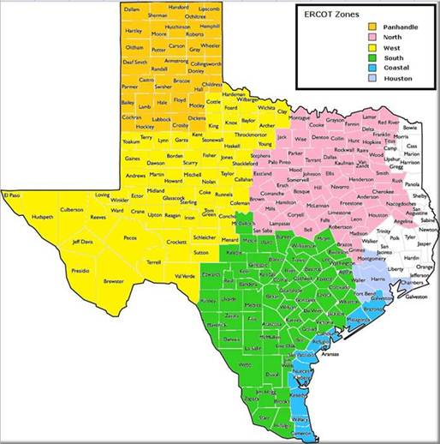
Source: ERCOT Renewable Regions by Bill Blevins

Slide 4
Panhandle Hub
Counties (36) based on map

Slide 5
Panhandle Hub
These 9 stations are 345kV stations in LZ_WEST that:
Are not currently assigned to a Hub
Exist in counties identified as Panhandle
Not included in the NPRR
County | Station
Gray | ALN_CRK
Randall | ASTRA
Hall | CTT_CROS
Gray | CTT_GRAY
Gray | MIAM1
Carson | PH1
Carson | PH2
Carson | RAILHEAD
Donley | SALTFORK

Slide 6
Panhandle Hub
Questions?

