Slide 1
Analysis of Load Reductions Associated with 4-CP Transmission Charges
and
Price Responsive Load/Retail DR
Carl L Raish
Principal Load Profiling and Modeling
RMS – May 2, 2017

Slide 2
Overview
  4CP Analysis
    Competitive and NOIE Areas
    2015 update and 2016 results
  Price Response and Retail DR (Based on annual REP survey since 2013)
    Block and Index Pricing (BI)
    Other Load Control (OLC)
    Other Voluntary DR (OTH)
    Peak Rebate (PR)
    Real Time Pricing (RTP)
    Time-of-Use Pricing (TOU)
  Still to come – updated analysis of the interaction of 4CP and price response

Slide 3
Analysis Methodology
Identify 4CP and Near-CP days.
  4CP days reported by ERCOT.
  Near-CP days identified by significant reductions in the total load of competitive transmission ESIIDs.
Identify High-Price days (to exclude from baseline determination).
Identify specific NOIEs and ESIIDs that respond based on frequency and magnitude of response
Calculate baselines and load reductions for each 4CP/Near-CP day.

Slide 4
Competitive 4 CP Days - 2016
CP Reduce = 436
CP Reduce = 452
CP Reduce = 626
CP Reduce = 577

Slide 5
NOIE 4 CP Days - 2016
CP Reduce = 440
CP Reduce = 481
CP Reduce = 783
CP Reduce = 552

Slide 6
Competitive + NOIE Response 2009 - 2016

Slide 7
Max CP/NearCP Reductions - Hour Ending 17:00
Slope = 21
Slope = 2
Slope = 88

Slide 8
Growth of ESIIDs and NOIEs with 4CP Response
Slope = 10

Slide 9
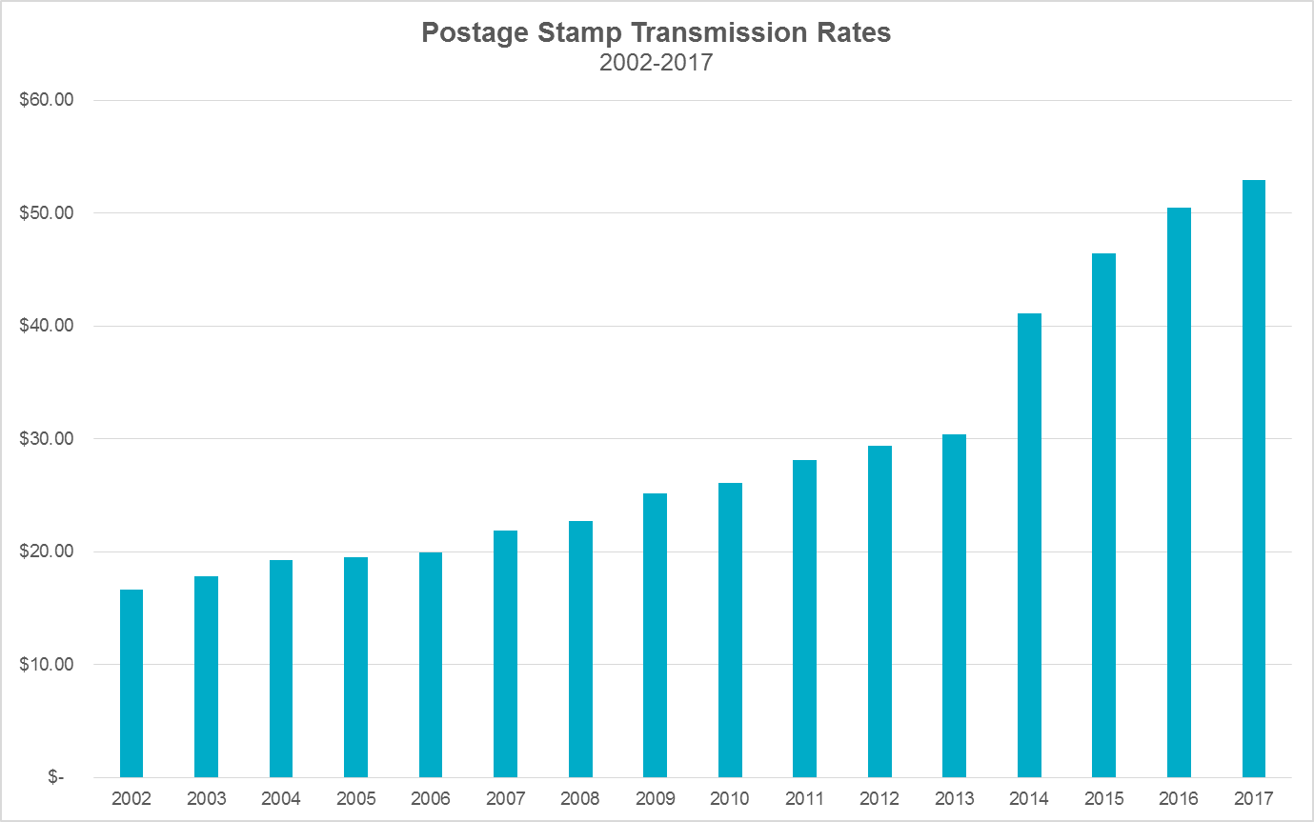
Max CP/NearCP Reductions - Hour Ending 17:00
Postage Stamp rate for Transmission Cost of Service has more than tripled since 2002
>$7B in Competitive Renewable Energy Zone (CREZ) transmission investment
  $4.9B of CREZ activated in 2013 alone
>$2B in projects activated in 2016
Postage Stamp Transmission Rates
2002-2017
Currently $52.91
Source: PUCT Dockets
Slope = 2
The postage stamp rate (per 4CP kW) is charged to DSPs, who in turn reimburse TSPs for their transmission investments

Slide 10
REP DR Total Participation
ESIID counts
  2014: 763,000
  2015: 848,000 (+85,000)
  2016: 907,000 (+59,000)
REP counts
  2014: 33 (combining Sub-LSEs 23)
  2015: 32 (combining Sub-LSEs 25)
  2016: 35 (combining Sub-LSEs 27)

Slide 11
Block and Index ESIID Participation

Slide 12
2015 Block & Index Analysis
14 Reps with 8,643 Business ESIIDs on high-price day
6 Weekday high-price events were analyzed
Reductions 0 – 200 MW
Jul 30, 2015
199.9 MW Reduce

Slide 13
2016 Block & Index Analysis
18 Reps with 13,117 Business ESIIDs on high-price day
2 Weekday high-price events were analyzed
Aug 2, 2016
80.0 MW Reduce
Nov 29, 2016
157.1 MW Reduce

Slide 14
Other Load Control ESIID Participation BUS

Slide 15
Other Load Control ESIID Participation RES

Slide 16
2015 Other Load Control Analysis
Both Reps reported 14 deployments affecting 11,516 Res and 8 Bus ESIIDs
Both REPs deployed 5 times on the same days, July 30, August 5, 11, 12 and 13
Reductions 2.3 – 7.3 MW
Aug 11, 2016
7.3 MW Reduce

Slide 17
2016 Other Load Control Analysis
2 Reps reported 4 BUS and 8,720 RES ESIIDs on annual survey
1 Rep reported 10 deployments in 2016 affecting 1,780 Res customers
Reductions 0.5 – 4.0 MW
Aug 2, 2016
4.0 MW Reduce

Slide 18
2016 Other Voluntary DR Analysis
1 Rep reported 23 deployments in 2016 affecting 33,872 Res and 50 Bus customers
Program description does not align with the other categories
Reductions ranged from 0 – 15.4 MW
Aug 4, 2016
15.4 MW Reduce

Slide 19
Peak Rebate ESIID Participation BUS

Slide 20
Peak Rebate ESIID Participation RES

Slide 21
2015 Peak Rebate Analysis
7 Reps reported 19 deployments in 2015 affecting 1,759 Bus and 43,602 Res ESIIDs
5 REPs deployed on Aug 10
Composite graph shows total response if all REPs had deployed on the same day
Aug 10, 2015
23.6 MW Reduce
Composite Deployment 2015
30.4 MW Reduce

Slide 22
2016 Peak Rebate Analysis
3 Reps reported 22 deployments in 2016 affecting 75,568 Res and 2,938 Bus customers
No days with deployments by all 3 REPs
Composite graph shows total response if all REPs had deployed on the same day
Composite Deployment 2016
28.2 MW Reduce

Slide 23
Real Time Pricing ESIID Participation BUS

Slide 24
Real Time Pricing ESIID Participation RES

Slide 25
2015 Real Time Pricing Analysis
9 Reps with 4,009 Business and 851 Res ESIIDs on high-price day
6 Weekday high-price events were analyzed
Reductions 1.2 – 11.1 MW
Aug 12, 2015
11.1 MW Reduce

Slide 26
2016 Real Time Pricing Analysis
11 Reps 1,321 Res and 8,255 Bus customers on high-price day
2 Weekday high-price events were analyzed
Aug 2, 2016
0.6 MW Reduce
Nov 29, 2016
0.4 MW Reduce

Slide 27
Time of use Pricing ESIID Participation BUS

Slide 28
Time of Use Pricing ESIID Participation RES

Slide 29
Time-of-Use Pricing Analysis
Analysis not started
Analysis goal will be to determine response levels on high-price and peak days

Slide 30
Summary
 | 2015 MW | 2016 MW | ESIIDs Deployed 2015 | ESIIDs Deployed 2016 | ESIIDs Not Deployed 2015 | ESIIDs Not Deployed 2016
4CP | 1,321 | 1,409 | 1,800 | 1,700 | 9,500 | 9,700
BI | 200 | 157 | 9,000 | 13,000 | - | -
OLC | 7 | 4 | 12,000 | 2,000 | 3,000 | 7,000
OTH | - | 15 | - | 34,000 | - | 34,000
PR | 30 | 28 | 45,000 | 79,000 | 452,000 | 435,000
RTP | 11 | 1 | 5,000 | 10,000 | - | -
TOU | - | - | 322,000 | 331,000 | - | -

Slide 31
Still to Come
Interaction of high prices and 4CP response
  ESIIDs on Block & Index or Real Time Pricing that are also subject to 4CP charges
  NOIEs with significant response on high-price non-4CP days
  NOIEs with significant response on high-price days and 4CP days
TOU analysis

Slide 32
Questions?
ON
OFF
craish@ercot.com 512/248-3876

