Slide 1
Series Capacitors Update
ROS/WMS
May, 2017

Slide 2
NPRR562 Timeline
May TAC
June
BOD
July
Effective

Slide 3
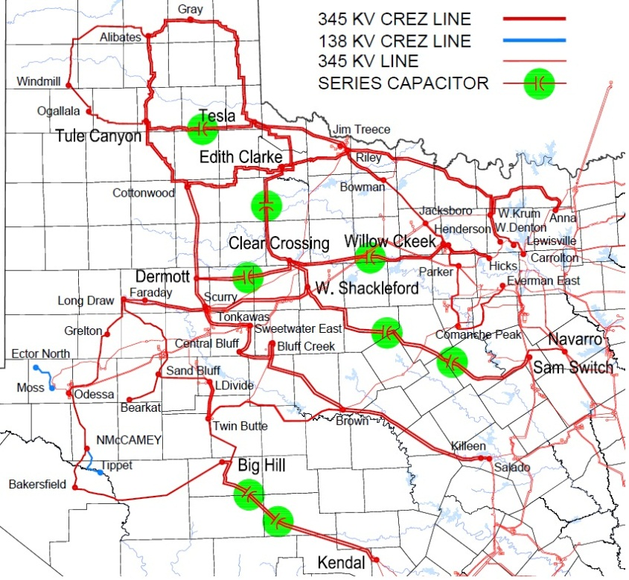

Series Capacitors with No SSR Risk (Place In Service)
Romney
Kopperl
Valley

Slide 4
Series Capacitors with SSR Risk within N-4 (Bypass)
Gauss (1)
Edison / Oersted
(Bypass Edison or Oersted)

Slide 5
Series Capacitors with SSR Risk N-5 or N-6 (Place In Service and Monitor)
Cross
Gauss (1)
Kirchhoff
Edison / Oersted
(Bypass Edison or Oersted)

Slide 6
Operation Monitoring and Outage Coordination (N-5/N-6 Risk)
Three Contingencies away from SSR vulnerability
Two Contingencies away from SSR vulnerability
Normal Operation (Review Action Plan)
Implement Action Plan
The ERCOT EMS system will be utilized to monitor transmission outages
A double circuit transmission outage is considered as one contingency in Operations

Slide 7
Series Capacitor Operation
Initially, placing series capacitors in-service will improve Panhandle GTC export capability ~150 MW
In process of sharing operating plan with REs of units N-5 and N-6 vulnerable
Will coordinate with TSPs to identify transmission options for generators with SSR vulnerability within N-4 outages

Slide 8

Acknowledgement
ERCOT Resource Entities
Developers, Vendors
Consultants, Expertise
ERCOT Transmission Planners, Operators

