Slide 1
Planning Geomagnetic Disturbance Task Force (PGDTF) Meeting Material
April 26, 2017
Omar A. Urquidez
PGDTF Chairman

Slide 2
2017 PGDTF Goals
R1 PGRR Approval
Target: ROS Approved, PRS Endorsed at April Meetings & On TAC Agenda for ?? Board Approval at June Meeting
NERC Enforceable from July 1, 2017
PGDTF Contact List
GIC Model Completion & Review
Assessment/Model Building Timeline Recommendation
Procedure Manual Update
Vulnerability Assessment Scope/Criteria Recommendation
Corrective Action Plan development and “approval” process Recommendation

Slide 3
PGRR057 posted on 02-06-2017
02-22-2017
03-22-2017
04-06-2017
04-27-2017 ???
06-13-2017

Slide 4
Last Schedule for GIC System Model
12/31/2016 – TSP Data for 345 kV System Based on 2021 Summer Peak Case Released on 10/15/2016 Provided to ERCOT. Complete
3/31/2017 – TSP Data for 138 kV and 69 kV Systems and Update to 345 kV System Data Based on 2021 Summer Peak Case Released on 10/15/2016 Due to ERCOT. Complete
4/30/2017 – REs’ Updated RARF with GIC System Model Data Due to ERCOT.
6/1/2017 – ERCOT Provides First Pass of GIC System Model for Review to TSPs and REs.
7/1/2017 – TSPs and REs Provide Changes to GIC System Model to ERCOT.
Subsequent Model Review Passes Will be Scheduled as Needed.
1/1/2018 – Complete 2021 Summer Peak and 2021 Minimum GIC System Models Using July 2017 SSWG 2021 Summer Peak and 2021 Minimum Base Cases.

Slide 5
Updated Schedule for GIC System Model
12/31/2016 – TSP Data for 345 kV System Based on 2021 Summer Peak Case Released on 10/15/2016 Provided to ERCOT. Complete
3/31/2017 – TSP Data for 138 kV and 69 kV Systems and Update to 345 kV System Data Based on 2021 Summer Peak Case Released on 10/15/2016 Due to ERCOT. Complete
6/30/2017 – REs’ Updated RARF with GIC System Model Data Due to ERCOT. Delayed…
6/1/2017 – ERCOT Provides First Pass of GIC System Model for Review to TSPs and REs. Delayed to when? Discuss…
7/1/2017 – TSPs and REs Provide GIC Model Changes/Updates to ERCOT. Delayed to when? Discuss…
Subsequent Model Review Passes Will be Scheduled as Needed.
1/1/2018 – Complete 2021 Summer Peak and 2021 Minimum GIC System Models Using July 2017 SSWG 2021 Summer Peak and 2021 Minimum Base Cases. Possible Delay- NERC Deadline 7/1/2018 Discuss…

Slide 6
GIC Data Questions
On our transformer test data report, the vector group on our transformer is YyN (auto) d1, what is PTI equivalent name for this?

Slide 7
GIC Submission Questions
What is the expectation of the TSPs role in providing the RE’s GMD related data in their RARF?
Substation submission overlap in coordinates, grounding resistance, & number?

Slide 8
GIC Data Workshop
Background: At its April meeting, ROS requested that the PGDTF revisit GIC data items for those that are still/beginning the data acquisition process
When: Wednesday, May 10th 9:30 am -12:00 pm
Where: PDCWG Meeting, Rm 206A & WebEx
What: Review of GIC Procedure Manual and select presentations on data items
PGDTF member volunteers requested…
Suggested Presentation Topics:
Substation Grounding
Transformer/Shunt Data

Slide 9
Data Validation Topics
GIC Data File Creation
Bus Assignments to Stations
All buses assigned
Physically located non-electrically connected buses
TSP-RE connected stations
Sanity checks
Coordinates
DC Resistance range values
Vector Groups
RARF Business Rules

Slide 10
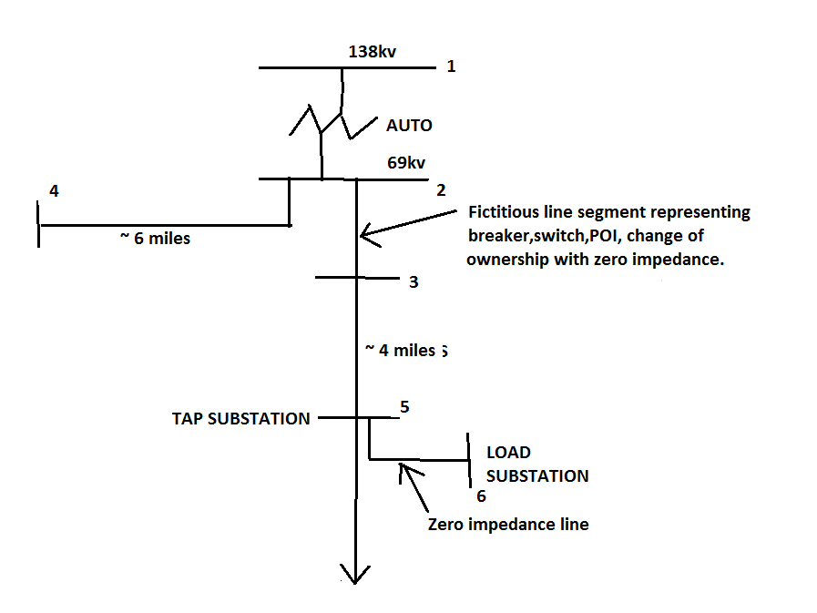
Example

Slide 11
Brainstorming Session: Criteria & Vulnerability Assessment Documents
Guiding Questions:
What form does the R3 Criteria document take and what is the expected process for approval?
What form does the R4 Vulnerability Assessment Process/Scope/Assumptions document take and what is the expected process for approval?

Slide 12
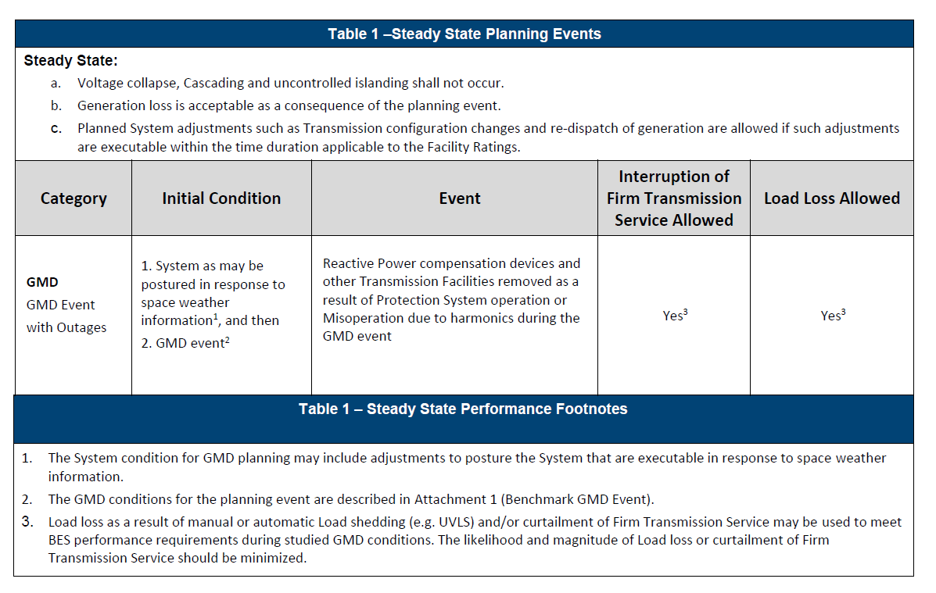
TPL-007-1 Table 1

Slide 13
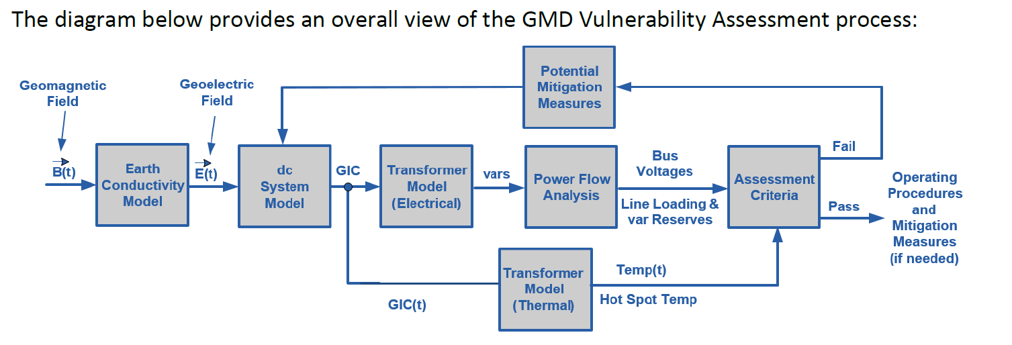
Vulnerability Assessment Process Overview
R4
Preliminary CAP
R2
R5
R3
R7
R6
24 Months

Slide 14
PDGTF Implementation Plan to meet NERC Requirements
PDGTF Implementation Plan to Meet the Requirements of NERC TPL-007-1
R1
Identify Individual and Joint Responsibilities
To be completed by 07/01/2017
Enforceable as of 07/01/2017
R5
Determine GIC Flow Information to be used for the transformers thermal assessment
To be completed by
07/01/2018
Enforceable as of 01/01/2019
R3
Determine System Steady State Voltage Criteria for System Performance
Per Table 1.
To be completed by
07/01/2018
Enforceable as of 01/01/2022
R7
Corrective Action
Plan
To be completed by
TBD
Enforceable as of
01/01/2022
R2
Develop System Models and GIC System Models
To be completed by 01/01/2018
Enforceable as of 07/01/2018
R4
Complete GMD Vulnerability Assessment every 60 month
To be completed by
TBD
Enforceable as of 01/01/2022
R6
Perform Thermal Assessment for Transformers Experiencing ≥75 A GIC
To be completed by
07/01/2019
Enforceable as of 01/01/2021

Slide 15
PGDTF Meeting Schedule
Next Meetings:
May or June?
July
August

