Slide 1
Market Credit Working Group update to the Wholesale Market Subcommittee
Bill Barnes NRG, Chair
Josephine Wan AE, Vice Chair
5/03/2017

Slide 2
MCWG update to WMS
General Update
April 19th Joint MCWG/CWG Meeting
4 NPRRS reviewed for their credit impacts
562 NPRR Subsynchronous Resonance
820 NPRR Allow Curtailment of DC Tie Load Prior to Declaring Emergency Condition
796 NPRR Extended Character Set Clean Up
824 NPRR Alignment of EEA Level 3 with NERC Reliability Standards EOP-011-1 and BAL-001-2
All operational without any credit impact

Slide 3
MCWG update to WMS
Discuss concept to: Incorporate Real-Time Telemetered Net Generation for Non-Modeled Generation into Credit Calculation
It is difficult for non-modeled generation to hedge in the Day-Ahead market due to potential superfluous collateral calls during high priced Real-Time market events
Current ERCOT Credit (collateral) calculation doesn’t account for non-modeled generation in the real time estimates or in the initial settlements invoices
The non-modeled generation is captured in the credit calculation once it is invoiced in the final settlement invoices
ERCOT does not know the true position of a QSE for a given operating day until the IDR meter data is submitted to them from the TDSP (once a month)
ERCOT does not know what the QSE have produced to offset any Day Ahead activity QSE may have undertaken, and thus, ERCOT requires a significant amount of collateral to back up their positions.
As a result:
Payments for energy aren’t received until the Final Statement
55 days after the operating day
A large part of calculating collateral calls stems from Invoice timing

Slide 4
MCWG update to WMS
Discuss concept to: Incorporate Real-Time Telemetered Net Generation for Non-Modeled Generation into Credit Calculation (Conti.)
The group agreed include non-modeled generation into the ERCOT credit calculation does benefit the market, which can
Increase Day-Ahead market liquidity due to increased participation of non-modeled generation in the Day-Ahead market
Allow ERCOT to gain near real-time transparency into non-modeled generation which could increase their ability in analyzing real-time system conditions
Allow ERCOT better understand the true position of the QSE by operating day and will also better understand their cash flow
Help non-modeled generation QSE to better capture their credit exposure
Next Step
The group will further discuss this topic upon a draft NPRR post with ERCOT

Slide 5
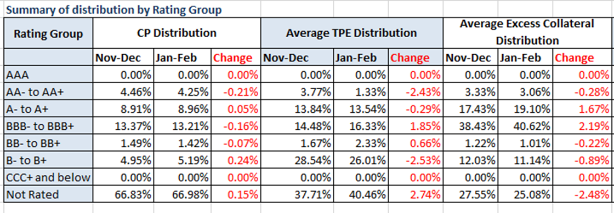
MCWG update to WMS
Credit Exposure Summary of Distribution by Rating Group
Changes from Dec 2016 to Feb 2017
Number of active Counter-Parties has increased from 202 to 212.
Market-wide TPE has increased from 262 million to 277 million while market-wide Excess Collateral has decreased from 1,663 million to 1,646 million.
TPE of Load and Gen category has decreased by 6.3% while the TPE of Gen only category has increased by 5.5%.
The excess collateral increased by 3.6% for Load and Gen Category and decreased by 6% for Traders.

Slide 6
MCWG update to WMS
ERCOT Credit Updates
- CMM Tech Refresh
Project (phrase 1) execution in process
Project (phrase 2) planning in process
After May 2018 continue:
Phase 2 - look into treasury function
Phase 3 -upgrade credit and look into improve the process
- Seasonal Adjustment Factor (SAF) revision:
June 110%
July 125%
August 200%
September 100%
- Other Updates can be found at the April 19th ERCOT presentation at http://ercot.com/calendar/2017/4/19/114049-CREDITWG-MCWG

