Slide 1
ERCOT Stakeholder User Personae Update Aprii 24, 2017
Notes:
Amy

Slide 2
April 24, 2017 Update
ERCOT Client Services provided User Experience team with roughly 40 contacts. Big thanks to that team!
Team has started screening process to ensure that we have the right representation.
Once screening is complete, will begin to schedule interviews.
Notice sent to Notice_general@lists.ercot.com on April 17.

Slide 3
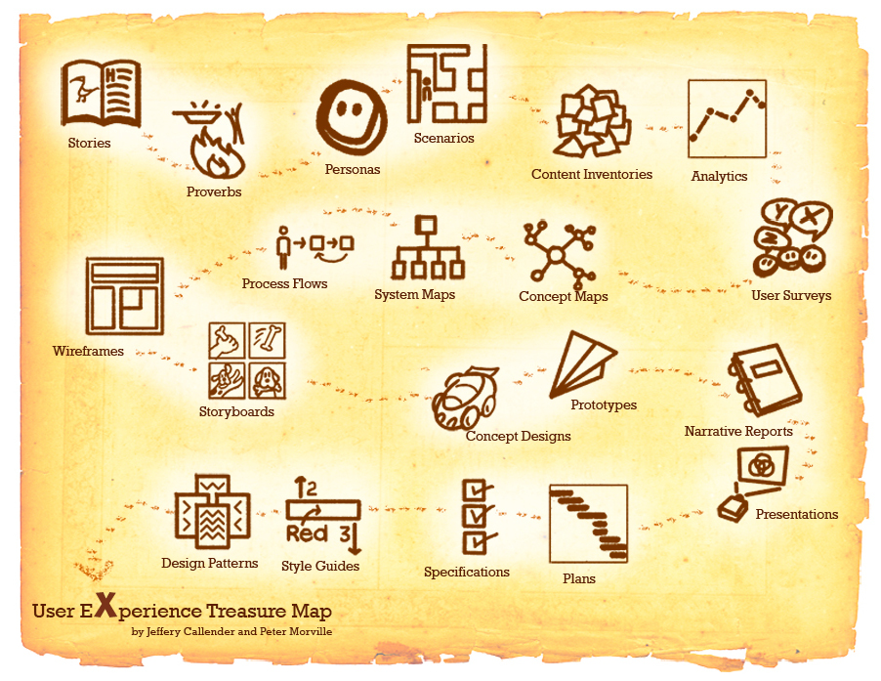
User-Centered Design

Slide 4
What is the first step?
In an effort to understand the needs and goals of users who interact with ERCOT systems, the ERCOT User Experience (UX) team is working to identify a broad spectrum of MPs that can be interviewed to develop user personas.

Slide 5
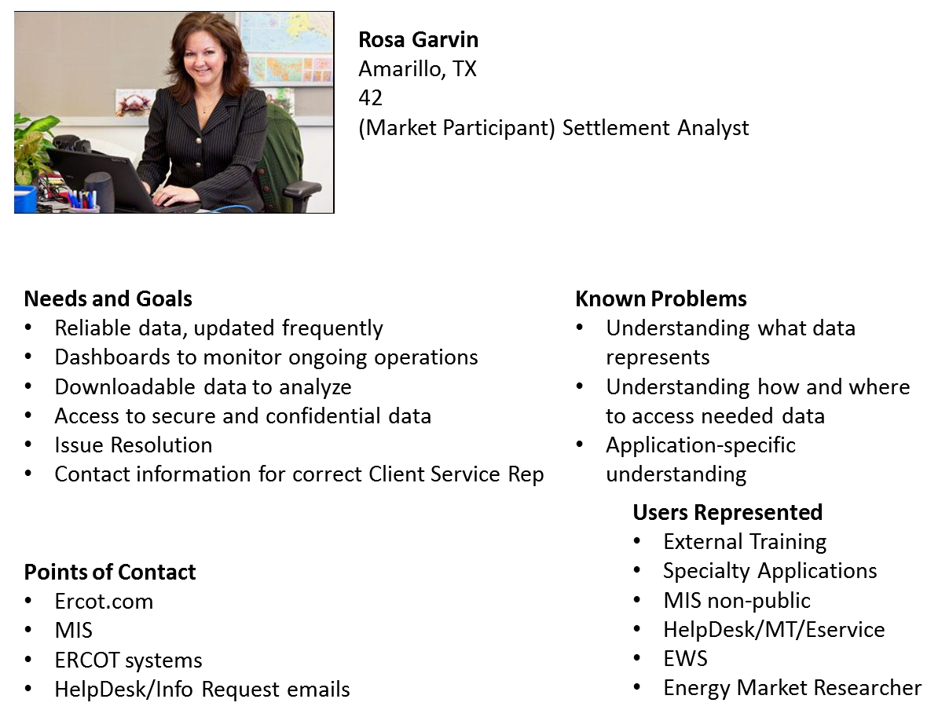
What is a User Persona?

Slide 6
What’s the Ask?
Interview subjects (25-35 MPs) should collectively represent the full span of MP activities and come from different sized companies.
30-60 minute interviews will be conducted over the phone or in person and may be followed up with requests for online feedback.

