Slide 1
Project Update and Summary of
Project Priority List (PPL) Activity
April 13, 2016

Slide 2
Project Update Agenda
Project Portfolio Update p. 3-8
  Recent / Upcoming Project Implementations
  2017 Release Targets
  2018 Release Targets
  2017 Project Spending Forecast
  Revision Request Funding Placeholder Status
  Impact Analysis Results Review
  Priority/Rank Options for Revision Requests with Impacts
Appendix
  Project Portfolio Gantt Chart p. 9-17
Location of Project Priority List (PPL): http://www.ercot.com/services/projects/index

Slide 3
Recent / Upcoming Project Implementations
2017 May Release – 5/1/2017-5/11/2017 In Flight
  SCR790 – Wind Resource Power Production and Forecast Transparency
  NPRR746 – Adjustments Due to Negative Load
  NPRR786 – Consumption Data Adjustments for Negative Load
  NPRR792 – Changing Special Protection System (SPS) to Remedial Action Scheme (RAS)
  NOGRR164 – Alignment with NPRR792, Removing SPS and adding (RAS)
  PGRR051 – Alignment with NPRR792, Changing SPS to RAS
2017 May Off-Cycle Release – 5/15/2017 In Flight
  RRGRR003 – Modifications to Improve Wind Forecasting
  RRGRR006 – Clarification of Descriptions and Alignment with RARF Forms
  RRGRR007 – Adding Solar Resource Registration Inputs
  RRGRR009 – Adding Voltage Limit Sets, Relay Loadability, MLSE, and GMD Data
  PGRR046 – Addition of Geomagnetically Induced Current (GIC) Model Building Reqs
Go-Live date in Q2 2017 In Flight
  NMMS Upgrade project
Note: Projected Go-Live dates are subject to change.
Please watch for market notices as the effective dates approach.

Slide 4
2017 Release Targets – Board Approved NPRRs / SCRs / xGRRs
March 3/7 – 3/9 | May 5/1 – 5/11 | June 6/27 – 6/29 | August 8/29 – 8/31 | October 10/31 – 11/2 | December 12/5 – 12/7
NPRR272 NPRR649 NPRR753 NPRR764 NPRR785 RMGRR134 NPRR790 | SCR790 NPRR746 NPRR786 NPRR792 NOGRR164 PGRR051 RRGRR003 RRGRR006 RRGRR007 RRGRR009 PGRR046 | NPRR573 NPRR744 NPRR782 NPRR789 NPRR797 NPRR801 NPRR744 | NPRR758 NPRR775 NPRR782 SCR777 | NPRR778 | SCR789
7 | 11 | 5 | 3 | 1 | 1
ü
ü
ü
ü
ü
ü
ü
E
E
E
E
E
E
E
E
E
E
E
E
E
E
P
NS
NS
9/16 – 9/17
(Retail)
5/15
E
E
E
E
E
6/1
10/2 – 10/3
(Off-Cycle)
11/11 – 11/12 (Retail)
12/9 – 12/10 (Retail)
2/1
Q2 – NMMS Upgrade
Moved to 2018-R1
TBD Items (and point at which they became “TBD”)
2014 | 2015 | 2016 | 2017
NOGRR084, NPRR664 | None | SCR781 P | NPRR702 P, NPRR776, NPRR808, NPRR809, NPRR810, NPRR812, PGRR052
Go-live dates can differ from Protocol effective dates – Please refer to market notices for more details
APPENDIX
Red Text: New additions and target release changes
Strike-Through Text: Previous target release changes
(a), (b), etc. indicates multiple phases
Project Status Codes
NS = Not Started
I = Initiation
P = Planning
E = Execution
H = On Hold
Release targets are subject to change

Slide 5
2018 Release Targets – Board Approved NPRRs / SCRs / xGRRs
March Dates TBD | May Dates TBD | June Dates TBD | August Dates TBD | October Dates TBD | December Dates TBD
NPRR749 SCR777 | NPRR519 NPRR620 NPRR683 NPRR741 NPRR743 NPRR755 NPRR760 NPRR800
2 | 8 | 0 | 0 | 0 | 0
NS
E
E
E
E
E
E
E
E
E
CMM Release 1
Dates TBD
(Retail)
Dates TBD
(Retail)
Dates TBD
(Retail)
Dates TBD
(Retail)
Dates TBD
(Retail)
Dates TBD
(Retail)
Go-live dates can differ from Protocol effective dates – Please refer to market notices for more details
APPENDIX
Red Text: New additions and target release changes
Strike-Through Text: Previous target release changes
(a), (b), etc. indicates multiple phases
Project Status Codes
NS = Not Started
I = Initiation
P = Planning
E = Execution
H = On Hold
Release targets are subject to change

Slide 6
2017 Project Spending
2017 PPL Budget = $20.5M
“Potential Demand” represents internal ERCOT projects that have not been fully approved

Slide 7
Revision Request Funding Placeholder Status
In 2017, ERCOT forecasted $4.0M for Revision Request work
Yearly Revision Request Spending Forecast Summary
Project Status | 2017
YTD Actuals | $0.39M
Approved – In-Flight / Complete | $1.87M
Approved – On Hold | $0.00M
Approved – Not Started | $0.15M
Remaining Funding | $1.98M
Total Allocation | $4.00M
As of 2/28/2017

Slide 8
Impact Analysis Results Review
Annual review of Impact Analysis Results
Three years of data
  2016 added / 2013 removed
  51 Revision Requests implemented in 2014-2016
This year duration estimation performance is also included
See final slide for legend
Observations / Notes
  Process improvements implemented in 2016 won’t appear until next year
  Cost Estimates
    Continued evidence that historical IA cost ranges have been too narrow
  Duration Estimates
    Note: Bundled projects compare against the sum of the individual durations
    Tendency to under-estimate project durations

Slide 9

Variance from IA Cost Range – Revision Request Projects
17
Exceeds = 1
Within = 5
Below = 1
Exceeds = 2
Within = 2
Below = 7
Exceeds = 5
Within = 2
Below = 4
Exceeds IA Range
8 Projects
18
28
29
27
Actual $ Variance from IA Range
21
26
Within IA Range
9 Projects
3
1
2
4
6
7
10
11
13
15
20
23
24
9
12
19
22
8
16
25
Below IA Range
12 Projects
5
14
2014
7 Projects
12 Revision Requests
2015
11 Projects
21 Revision Requests
2016
11 Projects
18 Revision Requests
If actual spend falls within the IA range the variance is 0
Note: Graph compares the posted IA cost range with the actual project spend
9

Slide 10
Variance from IA Duration Range – Revision Request Projects
Exceeds = 4
Within = 2
Below = 1
Exceeds = 6
Within = 2
Below = 3
Exceeds = 4
Within = 4
Below = 3
12
Exceeds IA Range
14 Projects
11
28
4
5
16
27
2
9
17
22
1
Within IA Range
8 Projects
8
21
Number of Months from IA Range
3
6
10
13
19
20
24
29
26
23
Below IA Range
7 Projects
25
18
14
15
7.
PR117-01 2014 Market System Enhancements came in below the IA Range (completed 2014).
2016
11 Projects
18 Revision Requests
2014
7 Projects
12 Revision Requests
2015
11 Projects
21 Revision Requests
If actual duration falls within the IA range the variance is 0.
Note: Graph compares the posted IA duration range with the actual project duration
10

Slide 11
Revision Request Project Legend
(E) ERCOT Sponsored
(M) Market Sponsored
(V) Various
PR112-01 Generation Resource Frequency Response Test Procedure, NOGRR105 (M)
PR093-01 Market Submitted Energy Offer Curves Disclosures, NPRR476 (M)
PR136-01 Align Credit Lock for CRR Auctions with Transaction Submission Deadline, NPRR586 (M)
PR124-01 CRRAH Digital Certificate New Role for Read Only Access, SCR769 (M)
PR087-01 Creation of a WGR Group for GREDP and Base Point Deviation Evaluation, NPRR425 (E)
PR078-01, NPRR416NPRR575 (M)
PR117-01 2014 Market System Enhancements, NPRR240, NPRR555, NPRR532, NPRR598, NPRR564, NPRR568 (V)
PR151-01 Posting of Generation that is Off but Available, NPRR500 (M)
PR152-01 Message for Confirmed E-Tags, NPRR543 (M)
PR178-01 Allow QSEs to Self-Arrange AS Quantities Greater Than Their AS Obligation, NPRR680 (E)
PR160-01 Posting Results of Real-Time Data in a Display Format, SCR775 (M)
PR126-01 New Extract for Five Minute Interval Settlement Data, SCR772 (M)
PR176-01 Resource Adequacy During Transmission Equipment Outage, NPRR556 (M)
PR149-02 Clarifications to NPRR595, RRS Load Resource Treatment In ORDC, NPRR698, NPRR595, NPRR706, NPRR710 (V)
PR154-01 2014 CMM NPRRs and SCRs, NPRR559, NPRR597, NPRR601, NPRR639, SCR778 (V)
PR138-01 Increase to the CRR Auction Transaction Limit, SCR779 (E)
PR010-03 MarkeTrak Enhancements - Remaining SCR756 Items, SCR756 (M)
PR149-01 Market System Enhancements 2015, NPRR665, NPRR626, OBD, NPRR645 (V)
PR208-01 SCR788 Addition of Integral ACE Feedback to GTBD Calculation, SCR788 (M)
PR204-01 Revise Load Distribution Factors Report Posting Frequency, NPRR754 (E)
PR182-01 NPRR419 Revise Real Time Energy Imbalance and RMR Adjustment Charge, NPRR419 (E)
PR192-01 Retail Market Test Environment, SCR786 (M)
PR199-01 NOGRR147 and SCR787 NDCRC Enhancement, NOGRR147, SCR787 (M)
PR186-01 NPRR662 Proxy Energy Offer Curves, NPRR662 (M)
PR195-01 NPRR495 and NPRR736 Changes to Ancillary Services Capacity Monitor, NPRR495, NPRR736, NPRR770 (V)
PR184-01 NPRR617 and 700 Implementation, NPRR617, NPRR700 (M)
PR175-01 NPRR515 Day-Ahead Market Self-Commitment of Generation Resources, NPRR515 (E)
PR161-01 NPRRs 588 and 615, NPRR588, NPRR615 (M)
PR174-01 2015 Outage Scheduler Enhancements, NPRR219, SCR783, NOGRR050 (V)

Slide 12
Priority / Rank Options for Revision Requests with Impacts
Options for…
Revision Request | Description | Priority | Rank | Comments
NPRR562 | Subsynchronous Resonance | 2017 | 1990 | Small project with minor system impacts Add to end of project list – work into the plan without disrupting in-flight projects
PGRR057 | Responsibilities for Performing Geomagnetic Disturbance (GMD) Vulnerability Assessments | 2017 | 150 | REGULATORY Recommend this not be tracked against market Revision Request funding

Slide 13
Appendix
  3/31/2017 Project Gantt
    In-flight items sorted by Project End Date
    “On Hold” projects listed separately
      None at this time
    “Not Started” items sorted by Project Start Date

Slide 14
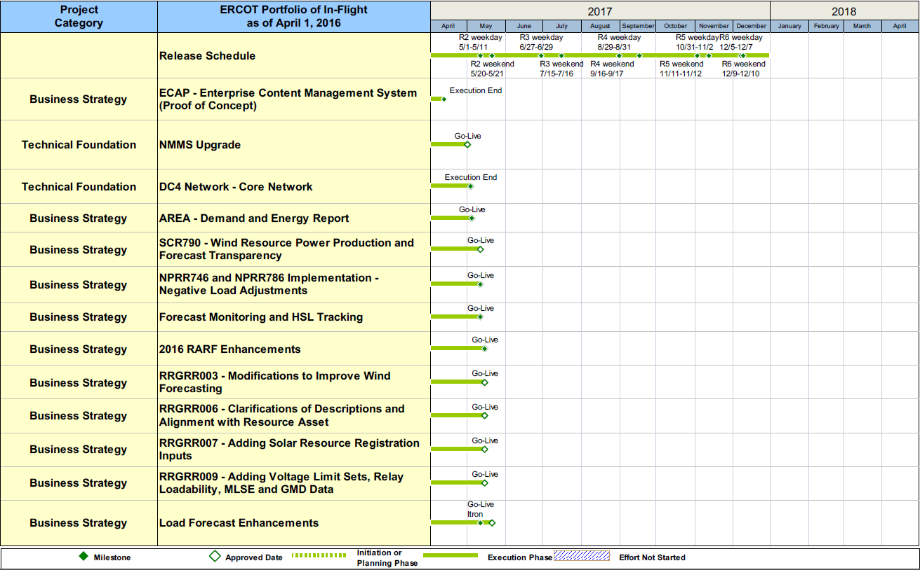
Project Portfolio Status – as of 3/31/2017

Slide 15
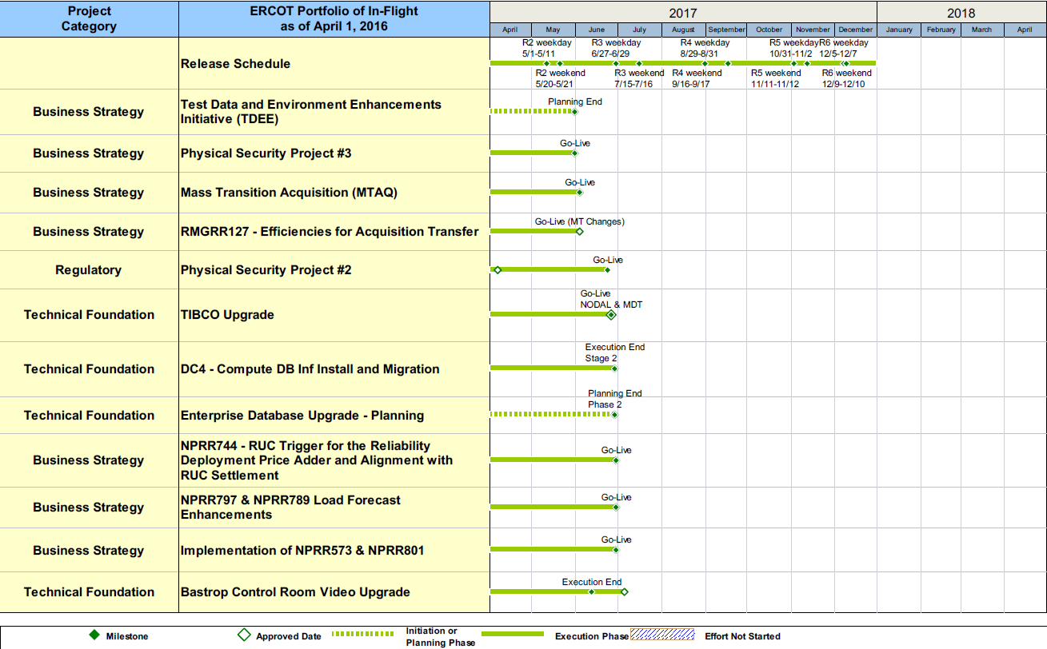
Project Portfolio Status – as of 3/31/2017

Slide 16
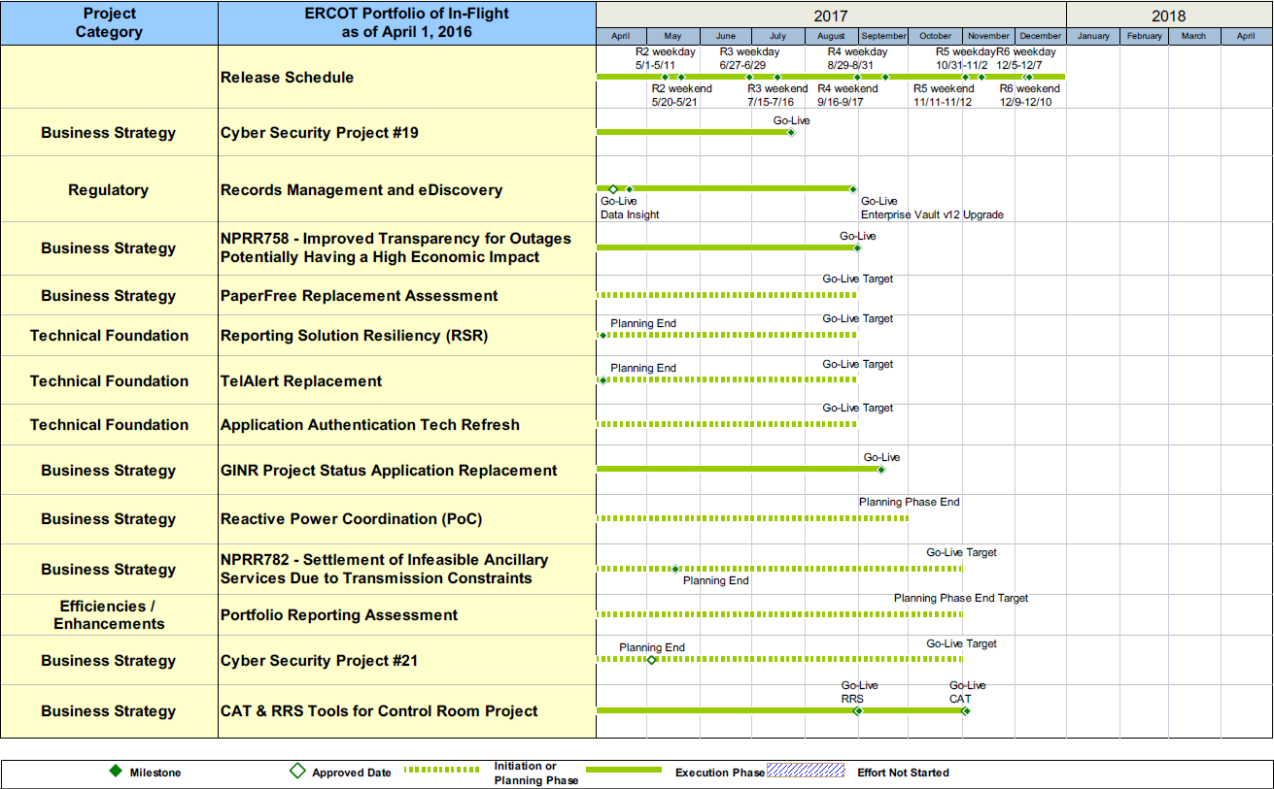
Project Portfolio Status – as of 3/31/2017

Slide 17
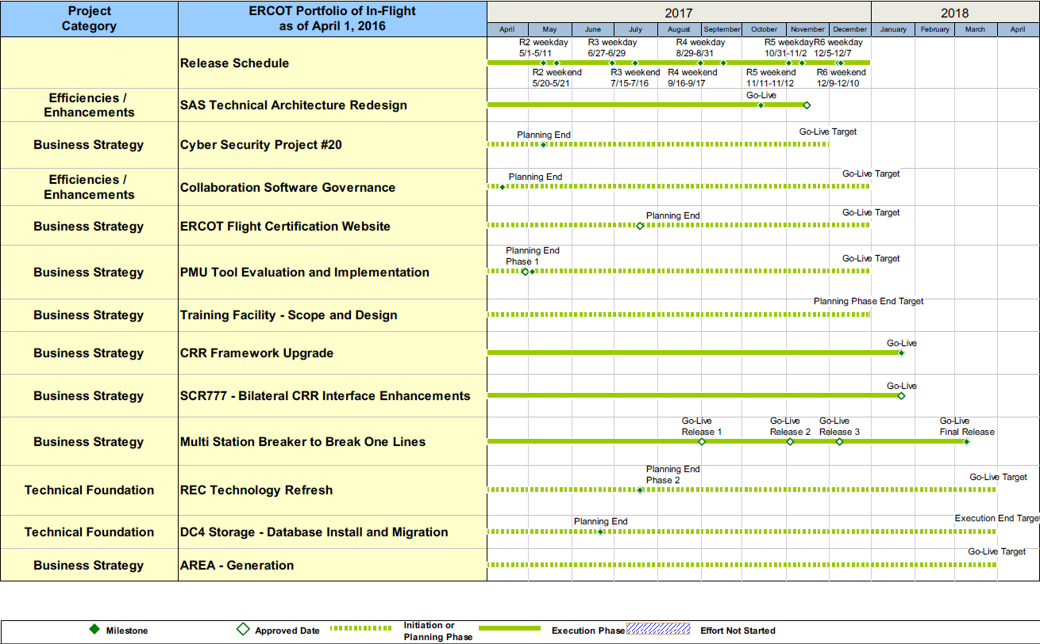
Project Portfolio Status – as of 3/31/2017

Slide 18
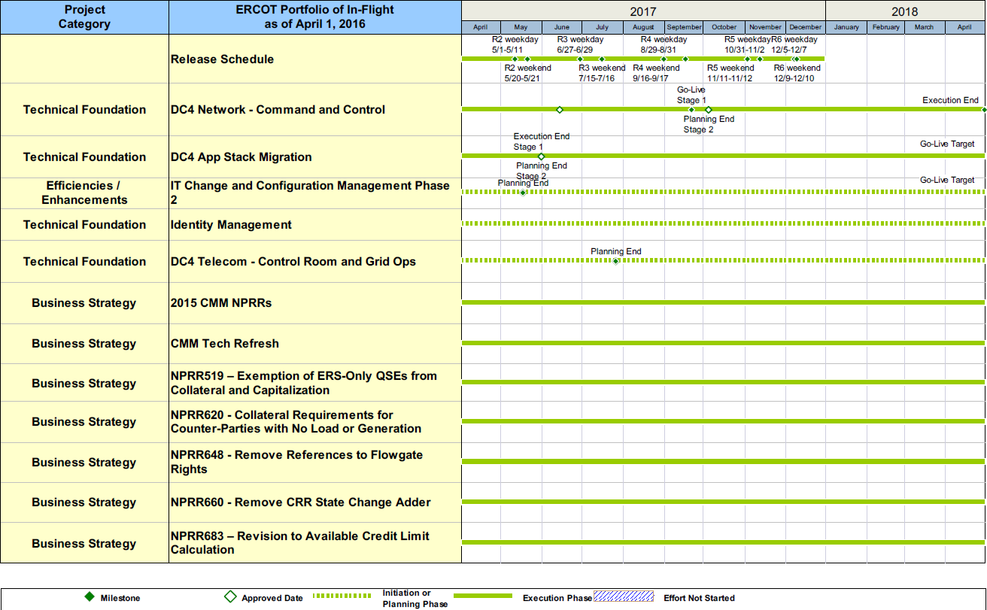
Project Portfolio Status – as of 3/31/2017

Slide 19
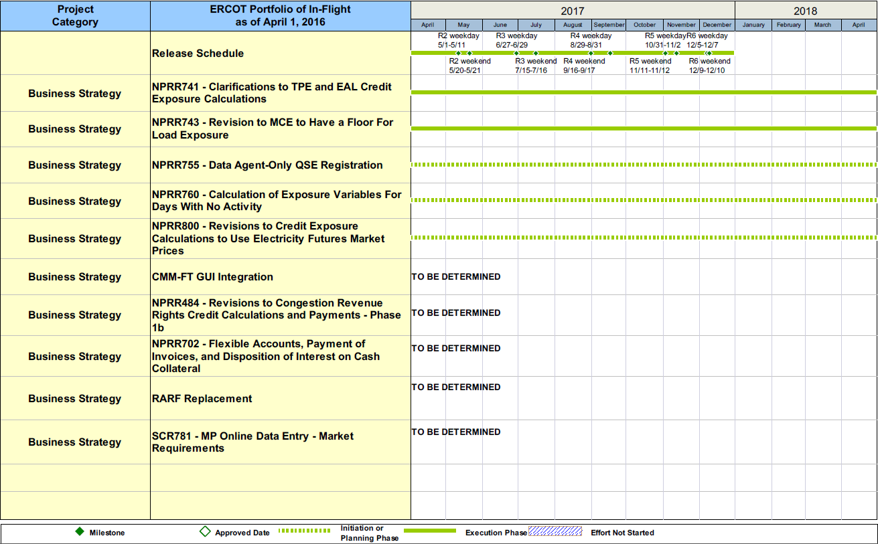
Project Portfolio Status – as of 3/31/2017

Slide 20
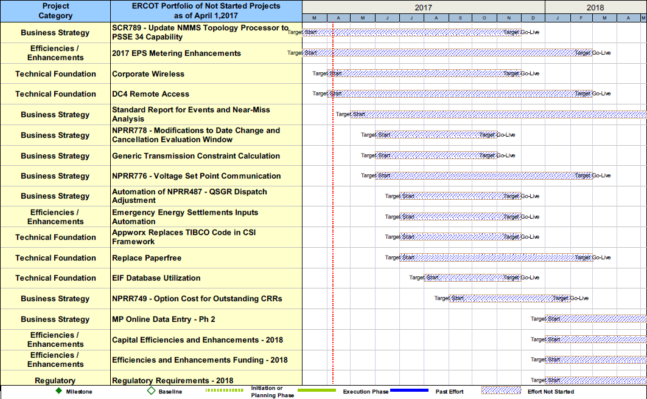
Project Portfolio Status – as of 3/31/2017

Slide 21
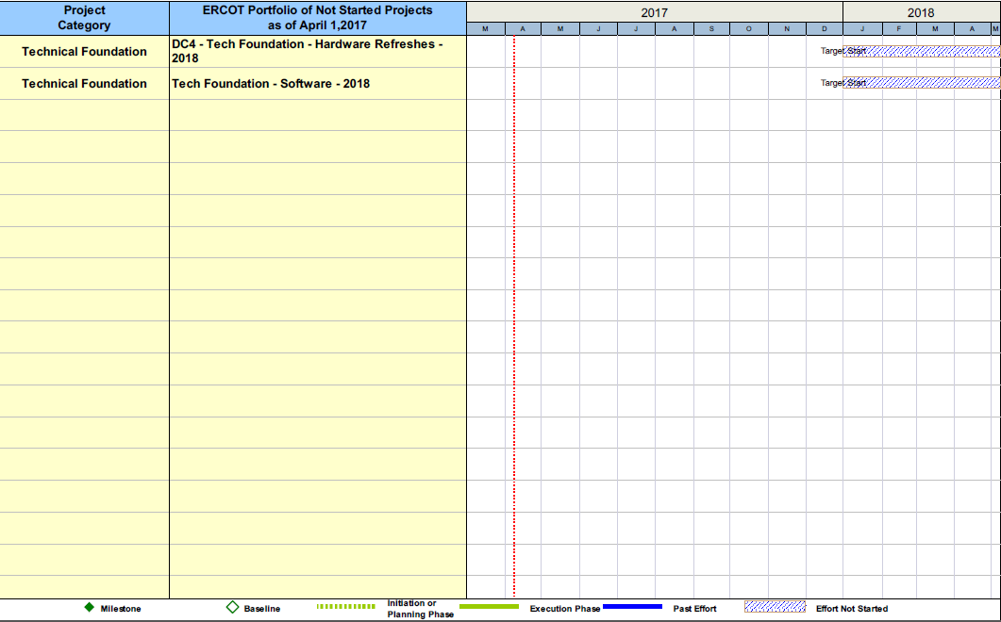
Project Portfolio Status – as of 3/31/2017

