Slide 1
SMT Update To AMWG
MAR 2017

Slide 2
Monthly SMT Data Timelines AMWG CR 2014 002 End to End File Processing Completeness – MAR 2017
% Timely Market Delivery - % of files posted to market (FTPS) by 11:00pm out of # of files received by SMT by 11:00pm.
% Portal Data Availability - % of files loaded to the database for data availability on portal by 6:00am next day for the files received by 11:00pm
* A LSE file includes usage data for up to 50,000 ESIIDs.
2

Slide 3
SMT API and FTPS Services Availability – MAR 2017
The service availability is measured as a percentage of number of minutes the service was available out of the total number of minutes in a month, excluding planned outages.
Observed Anomalies:
Mar-Apr 2015: SMT outage and subsequent recovery/catch-up impacted API availability. FTPS was available for most of the part except on 03/21-03/22 for 36 hours.
26 Jul 2015: Services were unavailable for 12 hours due to Flash storage issue
25 Jan 2016: Services were unavailable for 19 hours due to storage configuration issue
07 Mar 2016: API Services were unavailable for 7hours due to Oracle archiver issue.
Notes:
3

Slide 4
SMT Number of Accounts by Type AMWG CR 2014 009 – MARCH 2017
Registered Users | ONC | CNP | AEPN | AEPC | TNMP | TOTAL
Active Residential Accounts | 46430 | 27506 | 1919 | 5558 | 3006 | 84419
Active Residential English Accounts | 46174 | 27300 | 1913 | 5434 | 2996 | 83817
Active Residential Spanish Accounts | 256 | 200 | 6 | 124 | 10 | 596
Non Active Residential Accounts | 22146 | 14876 | 1750 | 3913 | 886 | 43163
Total Residential Accounts | 68576 | 42382 | 3669 | 9471 | 3892 | 127582
TDSP User | 344 | 33 | 12 | 18 | 1 | 408
TDSP Admin | 4 | 4 | 4 | 4 | 3 | 19
Small Business User | 122 | 63 | 1 | 4 | 5 | 195
Small Business Admin | 2972 | 1590 | 85 | 328 | 140 | 5257
Total Agreements (Includes Active and Pending) | 826 | 1866 | 19 | 116 | 94 | 2921
Energy Data Agreements (Includes Active and Pending) | 826 | 1620 | 19 | 116 | 94 | 2675
Han Device Agreements (Includes Active and Pending) | 0 | 245 | 0 | 0 | 0 | 245
Han Service Agreements (Includes Active and Pending) | 0 | 1 | 0 | 0 | 0 | 1
IN SMT
ESI IDs | 3526376 | 2452324 | 198073 | 865120 | 24580 | 7287699
Meters | 3464906 | 2452246 | 198876 | 865425 | 245373 | 7226826
HAN Devices | 3605 | 4615 | 142 | 288 | 29 | 8679
Acknowledgement | 0 | 0 | 0 | 0 | 0
Pending | 0 | 6 | 0 | 0 | 0
Meter Ready | 3 | 4 | 42 | 106 | 17
Provisioned | 3602 | 4605 | 100 | 182 | 12
HAN Messages (MTD) | 0 | 0 | 0 | 0 | 0 | 0
HAN Messages (YTD) | 1 | 0 | 0 | 0 | 0 | 1
HAN Messages (Cumulative) | 381 | 7405 | 0 | 0 | 0 | 7786
Simple Text Messages | 140 | 2930 | 0 | 0 | 0
Load Control Messages | 100 | 2658 | 0 | 0 | 0
Pricing Messages | 97 | 53 | 0 | 0 | 0
Cancellation Messages | 44 | 1764 | 0 | 0 | 0
Supplemental – (Friends)
Total Agreements | 7 | 1429 | 78 | 91 | 61 | 3502
Accepted Agreements | 778 | 554 | 35 | 29 | 20 | 1416
Pending Agreements | 5 | 1 | 0 | 0 | 0 | 6
Revoked Agreements | 319 | 277 | 10 | 8 | 6 | 620
Expired Agreements | 703 | 566 | 31 | 54 | 35 | 1389
Terminated Agreements | 38 | 31 | 2 | 0 | 0 | 71
 | TDSPs | REP | Small Business | Regulatory | Third Party
Registered Entities | 5 | 116 | 5099 | 2 | 136
Registered Users | 408 | 1002 | 195 | 8 | 32
Registered Admins | 19 | 180 | 5115 | 4 | 142
HAN Messages Sent By | 344 | 7418

Slide 5
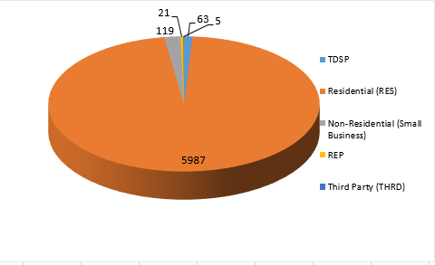
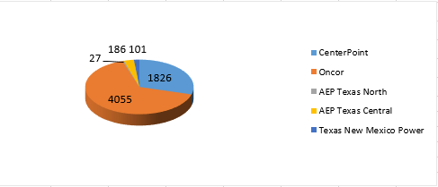
SMT ODR Details – MAR 2017
Total ODR Requests TDSP wise statistics:
Total ODR Requests User type statistics:

