Slide 1
Credit Exposure Update
Spoorthy Papudesi
ERCOT Credit
April 19, 2017

Slide 2
Agenda
Inputs and assumptions
Exposure and collateral distributions
Observations

Slide 3
Credit Exposure Update
Inputs and Assumptions:
Only Active Counter-Parties are included
Counter-Parties are classified by rating and market activity
TPE and collateral balances used are averages for January and February 2017
Counter-Parties that are subsidiaries of, or guaranteed by, rated entities are given the parent/guarantor’s rating, adjusted down one notch

Slide 4
Credit Exposure Update
Changes from Dec 2016 to Feb 2017 *
Number of active Counter-Parties has increased from 202 to 212.
Market-wide TPE has increased from 262 million to 277 million while market-wide Excess Collateral has decreased from 1,663 million to 1,646 million.
TPE of Load and Gen category has decreased by 6.3% while the TPE of Gen only category has increased by 5.5%.
The excess collateral increased by 3.6% for Load and Gen Category and decreased by 6% for Traders.
*Numbers presented are averages of Nov-Dec 2016 and Jan-Feb 2017

Slide 5
Credit Exposure Update
Summary statistics by market category

Slide 6
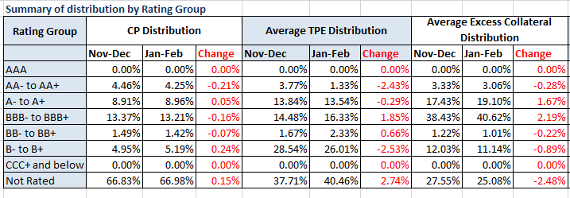
Credit Exposure Update
Summary statistics by rating group

Slide 7
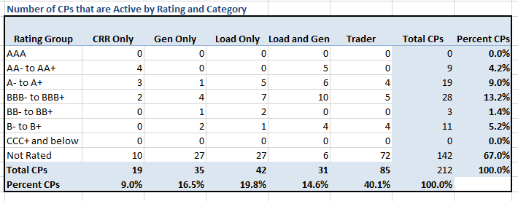
Credit Exposure Update
Active Counter-Parties distribution by rating and category

Slide 8
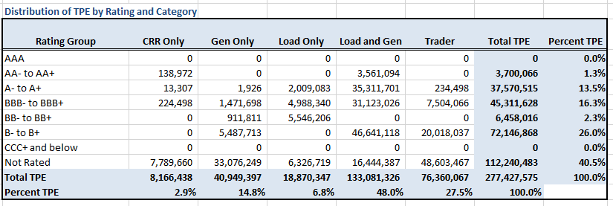
Credit Exposure Update
Average Total Potential Exposure distribution

Slide 9
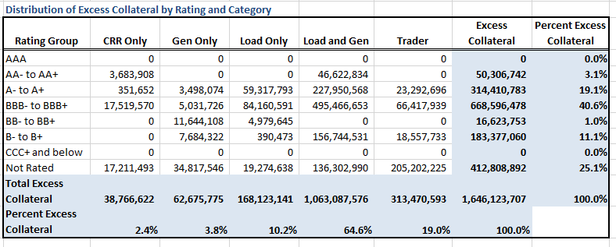
Credit Exposure Update
Average Excess Collateral distribution

Slide 10
Credit Exposure Update
Questions

