Slide 1
Inadvertent Switch & Customer Rescission Market Training

Slide 2
Antitrust Admonition
To avoid raising concerns about antitrust liability, participants in ERCOT activities should refrain from proposing any action or measure that would exceed ERCOT’s authority under federal or state law. For additional information, stakeholders should consult the Statement of Position on Antitrust Issues for Members of ERCOT Committees, Subcommittees, and Working Groups, which is posted on the ERCOT website.¹

Slide 3
Housekeeping
Welcome to IGL Training
Facilities / Restrooms
Lunch / Refreshments
Attendance sheet
Audio
Questions

Slide 4
Agenda
Antitrust Admonition (Debbie)
Welcome & Introductions (Debbie)
Inadvertent Gain/Loss (IGL) Overview (Tomas)
  Causes of IAS & Impacts to customer experience (Tomas)
Customer Rescission Walkthrough (Jim)
IAS Resolution Process Walkthrough (Tomas)
Best Practices/Quick Tip Scenarios (Tomas)
Reconciliation & Verification Process (Synetrick)
ERCOT Live Demonstration (Carolyn/Monica/Sheri facilitate/ERCOT to DEMO)
Market Reporting & Closing (Sheri)
Adjourn

Slide 5
Future Training Information
Retail Market Training Task Force
For information on future retail market training please subscribe to the following list_serve:
http://lists.ercot.com/scripts/wa-ERCOT.exe?SUBED1=RMTTF&A=1
Or visit ercot.com > about ERCOT > News and Publications > click on the ‘email list manager’ for a complete list of all notification groups
Current Training Topics:
  Retail Market 101
  MarkeTrak Subtypes On line Training
  Inadvertent Gain Classroom Training
Future Training Topics:
  Transaction Flows

Slide 6
Inadvertent
Gain/Loss (IGL)
Overview

Slide 7
What is an IGL?
An Inadvertent Gain/Loss (IGL) is an unauthorized
change of a customer’s Retail Electric Provider
Commonly referred to as either an Inadvertent Gain (IAG) or Inadvertent Loss (IAL), an inadvertent situation occurs when a customer or a premise is changed to a REP that is different than their expected REP of choice.
When resolving IGL issues, the ultimate goal is to return the Customer to their REP of choice in a quick and efficient manner with minimal inconvenience to the Customer.

Slide 8
Reference Documents
PUCT Subst. Rule §25.495, Unauthorized Change of Retail Electric Provider
ERCOT Retail Market Guide Section 7.3, Inadvertent Gain Process
MarkeTrak User’s Guide, Section 2

Slide 9
How does an IGL occur?
An Inadvertent Gain or Loss can occur under various circumstances:
Incorrect information provided by the Customer during enrollment – service address or ESI ID
Incorrect information entered by the REP during enrollment
Unauthorized enrollments – slamming
Variety of different enrollment processes used by REPs

Slide 10
Who does an IGL impact?
Customer
Gaining REP
ERCOT
Losing REP
TDU

Slide 11


How is the market impacted?
Customer
  Confusion as to who is their REP
  Delayed Billing
  Possible Lights Out Situation
  Poor Customer Experience
Market
  Most used MT Subtype -represents over 40% of all MTs
  One of the longest MT issues to resolve
  Can create distrust and confusion in the Market
Cost
  Resource Commitments
  Consumption Write-offs
  IAG Fees from TDSP’s

Slide 12

Questions

Slide 13
Customer Rescission
Walkthrough

Slide 14
Right of Rescission
PUCT Subst. Rule 25.474(j) - Right of Rescission
A REP shall promptly provide the applicant with the terms of service document after the applicant has authorized the REP to provide service to the applicant and the authorization has been verified. For switch requests, the REP shall offer the applicant a right to rescind the terms of service without penalty or fee of any kind for a period of three federal business days after the applicant's receipt of the terms of service document. The provider may assume that any delivery of the terms of service document deposited first class with the United States Postal Service will be received by the applicant within three federal business days. Any REP receiving an untimely notice of rescission from the applicant shall inform the applicant that the applicant has a right to select another REP and may do so by contacting that REP. The REP shall also inform the applicant that the applicant will be responsible for charges from the REP for service provided until the applicant switches to another REP. The right of rescission is not applicable to an applicant requesting a move-in.

Slide 15
Right of Rescission
In other words …
Applicable to Switch requests only, not Move-Ins.
After receiving the Terms of Service, Customer is allowed three (3) federal business days to rescind without penalty or fees from the Gaining REP.
Ultimate goal is to return the Customer to their REP of choice quickly and efficiently with minimal inconvenience to the Customer.

Slide 16
Rescission vs. Inadvertent Switch
Strongly recommended that involved CRs share as much information as possible at the onset of issue creation to aid in resolution of Customer Rescission issue quickly and efficiently (e.g. Customer Name, Meter #, etc.)
Although Customer Rescission is part of the Inadvertent Switch ‘family’ within the MarkeTrak tool, resolution of a Customer Rescission does not follow the same criteria nor follow the same completion timeline.
The research and investigation normally pursued during resolution of an Inadvertent Switch is not utilized when resolving Customer Rescission.
If/when the customer requests rescission (within the 3 federal business day window), the ‘losing’ REP must promptly regain the Customer – no questions asked.

Slide 17
Rescission vs. Inadvertent Switch
Handling of Fees/Charges Associated with IAG vs Rescission:
Fees (if applicable per TDSP Tariffs):
  For a customer rescission, TDSPs may charge CRs a fee; but there shall be no fees passed through to the customer.
  For IAG, TDSPs may charge Gaining CRs an IAG fee; but the CR’s internal business practices will dictate if IAG fees are passed to the customer.
Consumption (usage) charges:
  Rescission reinstatement date is automatically set at DOL + 1, Gaining CRs shall not pass these charges to the customer
  IAG reinstatement date is driven by the Losing CR and is set at a minimum of DOL + 1 to Date of MT submission +10, Gaining CRs may choose to pass these charges to the customer

Slide 18
Customer Rescission Guidelines
Only the Gaining CR in a rescission scenario may utilize the rescission-based MarkeTrak process to initiate reinstatement of a customer to its original CR.
In order for an issue to be submitted through this subtype, it must be submitted on or before the twenty-fifth (25th) calendar day following ERCOT’s established First Available Switch Date (FASD).
If a Customer Rescission issue has not been submitted within the specified timeframe above, the two CRs should work to resolve the rescission issue through the Inadvertent Gaining subtype.

Slide 19
Completion Timeline for Customer Rescission
Once a Customer Rescission MarkeTrak (MT) issue has been submitted, the losing CR has two (2) business days to agree to the Customer Rescission MT issue.
Once the Transmission and/or Distribution Service Provider (TDSP) has updated the MT issue to “Ready to Receive”, the losing CR has another two (2) business days to send a backdated 814_16, Move-In Request.

Slide 20
Rescission Walkthrough – Gaining CR
The Gaining CR selects the Submit tab.
From the Submit Tree, select Customer Rescission.
Note: The submitter should include any details (ex. customer name) in the comments section which may expedite resolution of the issue.

Slide 21
Rescission Walkthrough – Gaining CR
The following fields must be populated:
ESI ID
Original Tran ID
Comments (Recommended)

Slide 22
Rescission Walkthrough - Validations
ERCOT validates ESI ID, submission timeframe and valid originating transaction.
Upon passing validation, MarkeTrak issue is created and ERCOT updates the issue with the following information:
  Losing CR Name and Duns
  TDSP Name and Duns
  Gaining CR ROR = Y or N
  Gaining CR Start Date
  Regain Date – auto populated by ERCOT.
  (Gaining CR Start Date +1 calendar day)
MarkeTrak issue is assigned to the state of ‘New (Losing CR)’ with the Losing CR as the Responsible Party.
[Starts the 2 Business Day clock for Losing CR to Agree]
Losing CR user selects ‘Begin Working’.

Slide 23
Rescission Walkthrough – Losing CR
MarkeTrak issue is assigned to the state of ‘In Progress (Losing CR)’ with the Losing CR as the Responsible Party.
Losing CR selects ‘Send to TDSP’.
[Implies “Agreement” & ends the 2 Business Day clock]

Slide 24
Rescission Walkthrough – TDSP
Issue is in a state of ‘New (TDSP)’ with TDSP as Responsible MP.
TDSP selects ‘Begin Working’.
Issue is in a state of ‘In Progress (TDSP)’ with TDSP as Responsible MP.

Slide 25
Rescission Walkthrough - TDSP
TDSP selects ‘Ready to Receive’
[Starts the 2 Business Day clock for Losing CR to submit BDMVI]

Slide 26
Rescission Walkthrough – Losing CR
Issue is in a state of ‘New (Losing CR Submit)’ with the Losing CR as Responsible MP.
Losing CR selects ‘Begin Working’.
Issue is in a state of ‘In Progress (Submit Regaining)’ with the Losing CR as Responsible MP.

Slide 27
Rescission Walkthrough – Losing CR
Losing CR selects ‘Provide Regaining BGN02’.

Slide 28
Rescission Walkthrough – Losing CR
Losing CR populates all required information:
  Regaining Transaction Submit Date
  Regaining BGN 02

Slide 29
Rescission Walkthrough - Resolution
Issue is in a state of ‘Regaining Transaction Submitted (PC)’ with the Gaining (Submitting CR) as Responsible MP.
Once the regaining transaction (Backdated 814_16 MVI) has been successfully sent by (Losing/Original CR), Siebel will automatically:
  Check Regaining Transaction Siebel Status every 30 minutes using the BGN 02 from the new initiating transaction.
  Update the issue with the current Regaining Transaction Siebel Status.
The issue will move to a state of ‘Complete’ with the Submitting MP as the Responsible Party once the Regaining Transaction Siebel Status is Complete.
[Ends the 2 business day clock for the Losing CR]

Slide 30

Checkpoint Question #1
Who can submit a Rescission MarkeTrak?
  The Losing REP
  The Gaining REP
ANSWER
The Gaining REP – only the Gaining REP may initiate the Rescission process

Slide 31
Checkpoint Question #2
In order to efficiently process a Rescission MT, the customer name should be stated in the comments.
  True
  False
ANSWER
TRUE – providing any relevant information assists in the timely resolution of the MT

Slide 32
Checkpoint Question #3
A customer who has exercised their ‘right of rescission’ may receive fees from the Gaining REP.
  True
  False
ANSWER
FALSE – per PUC Subst. Rule 25.474(j), a customer has the right to rescind the terms of service without penalty or fee of any kind

Slide 33
Checkpoint Question #4
Once the Losing REP has agreed to the Rescission, they have _______ days to submit the BDMVI.
  10 days
  5 business days
  2 business days
  14 days
ANSWER
2 business days – once the TDSP has transitioned the MT to “Ready to Receive”

Slide 34
Questions

Slide 35
Break

Slide 36
Inadvertent Gain (IAG)
MarkeTrak
Walkthrough

Slide 37
Inadvertent Gain
An inadvertent issue begins upon the discovery of an Inadvertent Gain or Move-In transaction submission.
Upon identification of an Inadvertent Gain, the CR will check the transaction status via the ERCOT MIS.
  If transaction Status is “In Review” or “Scheduled” with a ‘key date’ > 1 day and the Inadvertent CR is the submitting CR, then the CR will cancel their submitting transaction either by submitting an 814-08 EDI cancel transaction or by submitting a Cancel with Approval MarkeTrak issue.
  For “Completed” or “Scheduled” status where the ‘key date’ is the same day, or if the CR is not the submitter of the transaction, the CR will log a MarkeTrak Inadvertent issue.
814_08
Cancel w/ approval
IGL MarkeTrak
DOT – 1
DOT
Date of Transition

Slide 38
Inadvertent Gain
CR’s will work together in a manner outlined in Section 7.2 of the Retail Market Guide (RMG) to determine appropriate resolution.
  CRs, both Losing and Gaining Reps, must investigate the matter and provide all necessary/relevant information – customer name, service address, meter number
If resolution requires a backdated move-in (BDMVI), the regain date should be Date of Loss + 1 (DOL+1) or at the latest 10 days from the date the MarkeTrak was submitted to avoid creating transaction business process exceptions at ERCOT and the TDSP.
  The Losing Rep shall submit the BDMVI 814_16 no later than 12 days after submittal of the MarkeTrak and shall be dated with the ‘proposed regain date’ as agreed in the MarkeTrak.

Slide 39
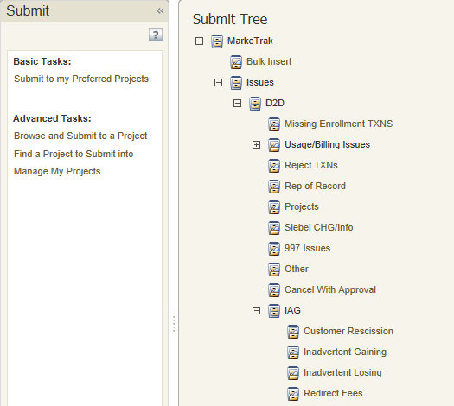
Inadvertent Gain
Submitting an Inadvertent Gain – CR Submits as the Gaining CR
From the Submit Tree, select IAG – Inadvertent Gaining

Slide 40
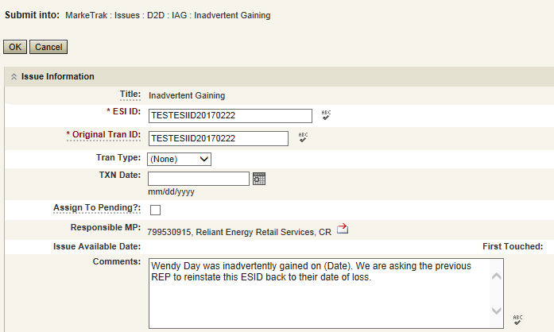
Inadvertent Gain
CR1 (Gaining/Original CR) will enter all required information.
  ESIID
  Original Tran ID – The original tran id of the other CR’s enrollment. (BGN06 of the 814_06).
  CRITICAL: The Comments field is technically optional; however, not providing the required information referenced in RMG Section 7.3.2(1) could result in a delay of issue resolution.
  Please include any additional information in this box.
        Customer Name (Always)
        Meter Number (If available)
        Any other pertinent information that will help expedite resolution

Slide 41
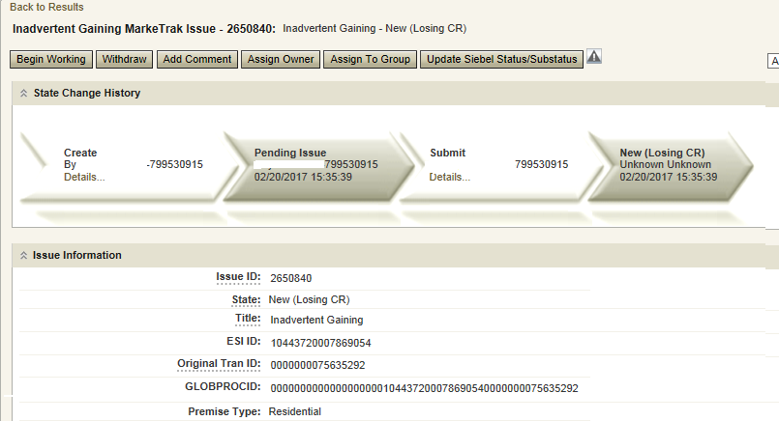
Inadvertent Gain
Select OK to create the IAG – Inadvertent Gaining MarkeTrak Issue. The issue enters the state of New (ERCOT) and is visible only by the Submitting CR and ERCOT.
The Submitting CR has the option to Withdraw the issue at this point
ERCOT will select Begin Working to provide the Gaining CR Start Date, if the Gaining CR is still the rep of record (Gaining CR ROR), assign CR2 (Gaining CR) and TDSP. ERCOT will then select “OK” to move the issue to CR2 (Gaining CR).

Slide 42
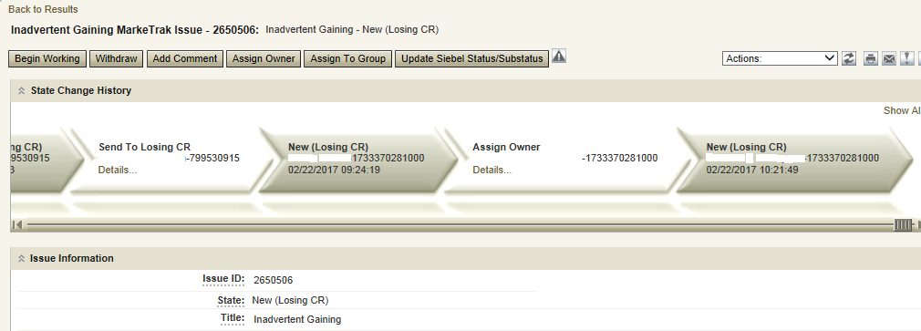
Inadvertent Gain
CR2 (Losing CR) will select Begin Working and Issue details and Investigate Market Conditions to determine the appropriate regain date.
CR2 (Losing CR) will select Begin Working and Issue details and Investigate Market Conditions to determine the appropriate regain date.

Slide 43

Inadvertent Gain
If CR2 (Losing/Original CR) determines that an Inadvertent Gain has NOT taken place, they have the option to select “Unexecutable” to stop the Inadvertent Gain process as outlined in Section 7.3.2.4 of the Retail Market Guide.
7.3.2.4 Valid Reject/Unexecutable Reasons
The Losing CR may reject the return of an inadvertently gained ESI ID from the Gaining CR for one of the following reasons only:
  A new transaction has completed in the market, including, but not limited to the following transactions:
    The 814_16, Move In Request; or
    The 814_01, Switch Request.
    Use “3rd Party CR has regained/transaction completed”
Duplicate Inadvertent Gaining issue in MarkeTrak for the same Customer on the same ESI ID.
Use “Duplicate Issue”
“Authorized enrollment confirmed”
and “Other” should not be used

Slide 44

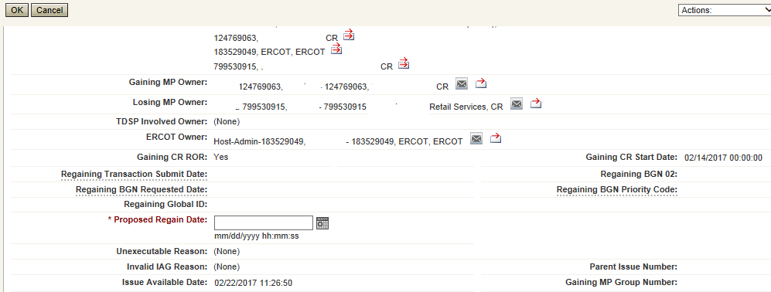
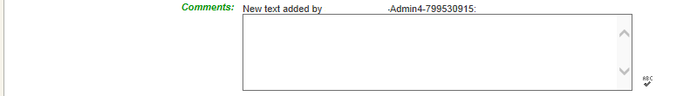
Inadvertent Gain
If CR2 (Losing/Original CR) determines they will need more information from CR1 (Gaining CR), then they will need to select Send to Gaining CR. This transition allows both CR’s to talk back and forth while transitioning the issue back and forth before a resolution is made.
If CR2 (Losing/Original CR) determines that an Inadvertent Gain has taken place, they will select Send to TDSP, enter the proposed regain date, add comments and select “OK” to move the issue to the TDSP. A validation will occur on the Proposed Regain Date: Validate that the date is less than “Submit Date” + 10 days. If not the following error message will be displayed “Proposed Regain Date is greater than 10 Calendar days from the submittal of MarkeTrak Issue, please update with valid Proposed Regain date.”

Slide 45
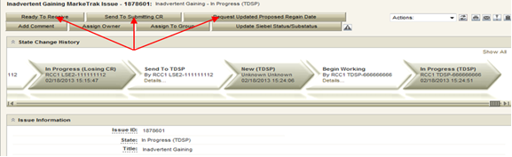
Inadvertent Gain
The TDSP will select Begin Working, investigate the issue details, then select one of the following:
Ready to Receive – The TDSP would select this transition to send the issue back to CR1 (Losing/Original CR). It is extremely important that CR1 (Losing/Original CR) wait for the TDSP to select Ready to Receive indicating TDSP’s systems have been prepared to receive the Original MP’s transaction before the EDI is actually sent. If not, the EDI will be rejected at the TDSP.
Send To Submitting CR – The TDSP would select this transition if they needed further information from CR1 (Losing/Original CR).
Request Updated Proposed Regain Date – The TDSP would select this transition if they do not agree with the proposed regain date that was provided. They would suggest a new date and send the issue back to CR1 (Losing/Original CR).

Slide 46

Inadvertent Gain
CR2 (Losing/Original CR) will select Begin Working then select Provide Regaining BGN 02. CR2 (Losing/Original CR) will provide the Regaining BGN02 and then select “OK”. When the regaining transactions process into ERCOT’s registration system, the Regaining Transaction Submit Date, Regaining BGN Requested Date and Regaining BGN Priority Code will be auto-populated on the MarkeTrak issue.
All parties should continue to monitor MIS and internal systems for the successful delivery and completion of the EDI transaction being sent by CR1 (Losing/Original CR) to the Market to regain a premise and resolve the associated Inadvertent Gain MarkeTrak issue.
Once the regaining transaction has been successfully sent to the Market by CR2 (Losing/Original CR), Siebel will update the status automatically.

Slide 47
Key Points to Remember
Provide as much information when opening Inadvertent Gain/Loss MarkeTrak in order to help facilitate quick resolution to the issue.
Suggested Information includes:
Customer Name (Always)
Meter Number (If available)
Any other pertinent information you may have that is crucial to help resolve issue.
Regain date should be:
Date of Loss (DOL) + 1
Date of Loss (DOL) less than or equal to 10 days from date MT was submitted when gaining on a prospective basis.

Slide 48
Valid Reject / Unexecutable Reasons
7.3.2.4 Valid Reject / Unexecutable Reasons
The Losing CR may reject the return of an inadvertently gained ESI ID from the Gaining CR for one of the following reasons only:
  A new transaction has completed in the market, including, but not limited to the following transactions:
The 814_16, Move In Request; or
The 814_01, Switch Request.
Duplicate Inadvertent Gaining issue in MarkeTrak for the same Customer on the same ESI ID.

Slide 49
Valid Reject / Unexecutable Reasons
7.3.2.4 Valid Reject / Unexecutable Reasons (Con’t)
The Gaining CR may reject returning an inadvertently gained ESI ID to the Losing CR for one of the following reasons only:
A new transaction has completed in the market, including, but not limited to the following transactions:
The 814_16 transaction; or
The 814_01 transaction.
Duplicate Inadvertent Losing issue in MarkeTrak for the same Customer on the same ESI ID;
Gaining CR has confirmed with the Customer that the Customer’s CR of choice is the Gaining CR:
Gaining CR has a valid enrollment with the same Customer and provides the Customer name, service address and meter number (if available) in the comments section of the MarkeTrak issue.
Customer has successfully completed an enrollment regarding the same ESI ID and the Gaining CR has the most recent effective date; or
In cases of Customer rescission, Inadvertent Losing MarkeTrak issue is rejected/unexecuted and a Rescission MarkeTrak issue is created

Slide 50
Key Points to Remember: Invalid Reject Reasons
7.3.2.5 Invalid Reject / Unexecutable Reasons
The Losing CR shall not reject the return of an inadvertently gained ESI ID due to:
Inability to contact the Customer;
Past due balances or credit history;
Customer no longer occupies the Premise in question;
Contract expiration or termination;
Pending TX SETs; or
Losing CR serving the Premise under a Continuous Service Agreement (CSA).

Slide 51
Checkpoint Question #1
If a Losing CR receives an IAG MT and their customer does not occupy the premise, the Losing CR should Unexecute the IAG.
  True
  False
ANSWER
FALSE – this is not a valid reject reason, the Losing CR should regain the ESI ID and execute the Current Occupant process

Slide 52
Checkpoint Question #2
If a Losing CR has agreed to regain an ESI ID yet their customer at the time of the IAG no longer occupies the premise, the Losing CR may propose the following regain date:
  DOL + 1
  Date of MT submittal + 10
  either
ANSWER
Either is applicable and is dependent upon the Losing CR’s business practices

Slide 53
Checkpoint Question #3
A back dated MVI (BDMVI) for an IAG must be submitted within _____ days.
  2 days of “ready to receive” status
  Date of MT submittal + 10
  12 days of MT submittal
  21 days
ANSWER
Per the RMG 7.3.2.3.1 Reinstatement Date, the Losing REP shall submit the BDMVI no later than 12 days after submittal of the MarkeTrak.

Slide 54
Checkpoint Question #4
A customer enrolled for service at the wrong apartment number. Their REP of choice should issue a MVO on the incorrect address and issue a MVI on the correct address.
  True
  False
ANSWER
Generally speaking, FALSE, issuing a MVO on an active ESI will create a light out situation at the incorrect address. An Inadvertent Gain MT should be submitted to resolve the incorrect address.

Slide 55
Questions

Slide 56
Common IGL Issues,
Best Practices, & Quick Tips

Slide 57
MVO vs IGL
Issue:
MVO’s are incorrectly being submitted for IGL situations
Solution:
CR’s SHOULD NOT issue MVOs for ESI IDs when IGL situations occur and/or while the MarkeTrak IAG/IAL process is in progress.
Best Practices:
Ask probing questions to ensure proper customer action is taken. (i.e. “Do you currently live here?”; “Was the original address given incorrect?”

Slide 58
3rd Party Transactions
Issue:
3rd party transaction has occurred, nullifying the IAG MarkeTrak therefore causing the Gaining CR to be left with charges they may not be able to recover.
Solution:
Utilize the applicable market approved process to regain a lost ESI ID via MarkeTrak. Educate the customer as to what the process entails and set proper expectations with the customer.
Best Practices:
Identify IGLs in progress for ESI IDs by:
Identifying IGLs on daily basis utilizing ERCOT MarkeTrak reporting or notification
Flagging within your own system the ESI IDs that have been IAG/IAL to ensure subsequent transactions are not submitted to the market until the IGL is completed.
Timely resolution of IAG/IAL MarkeTraks

Slide 59
Non-timely resolution of IGL’s
Issue:
MTs and/or Escalated MTs are not receiving responses or being completed in a timely manner
Solution:
Market participants should update their “rolodex” with the appropriate escalation contacts
Best Practices:
Designate one of the escalation contacts as a departmental mailbox instead of an individual
Audit the Rolodex list on Quarterly basis
Expected level of performance:
    After 3 calendar days if a MarkeTrak issue remains in “New Status” an automatic escalation email is generated.
    Initial Response – 10 calendar days
    Updating the issue thereafter – 7 calendar days
    Per 7.3.2.3.1 “Reinstatement Date” - The Backdate MVI must be sent No later than 12 days after the submittal of the Inadvertent MarkeTrak

Slide 60
No Current Occupant
Issue:
Losing REP responds to an IGL indicating “their customer no longer occupies the premise” and attempts to ‘unexecute’ the IAG MT issue.
Solution:
“Customer no longer occupies the Premise” is NOT a valid reason for unexecuting MT (RMG 7.3.2.5 Invalid Reject/Unexecutable Reasons)
Best Practice:
Losing REP must regain ESI ID and initiate a “current occupant” process
  Reference: PUCT Subst. R. 25.489(i)

Slide 61
Switch Hold on IGL
Issue:
A switch hold is active on account which has been identified as having an IGL
Solution:
When IGL is submitted and accepted, the switch hold should be removed in order prevent BDMVI from being rejected and any delay in completing the MarkeTrak
Best Practice:
When working IAL/IAG issues identify if your ESI ID currently has a Switch Hold active and remove as needed

Slide 62
Questions

Slide 63
Lunch

Slide 64
Reconciliation & Verification Process

Slide 65
Reconciliation & Verification
All parties involved in any Inadvertent Gain related MarkeTrak issue should build in some sort of Reconciliation and Verification process.

Slide 66
Reconciliation & Verification
In other words …
In addition to researching that an actual Inadvertent Gain has taken place, also verify the state/status of the actual issue and what action needs to take place from what party.
Verify the current status of the account and research the transactions that may impact the resolution of the issue.
Perform a reconciliation of the transactions sent to the Market to ensure that the transactions are being sent, received and processed successfully as agreed upon by all parties.
Ultimate goal is to return the Customer to their REP of choice quickly and efficiently with minimal inconvenience to the Customer.

Slide 67
CR Reconciliation & Verification
All parties have a role in researching the issues on their end, however for the Losing CR/Original, the following verification process can assist in making the resolution of an Inadvertent Gain MarkeTrak run smoothly when the following checks are performed:
Any Subsequent transactions in the Market?
  Yes – STOP the transaction if possible by submitting an 814_08, Cancel Request (or “Cancel w/Approval” MarkeTrak).
  No – Proceed to the next step
Any Holds?
  Yes – Submit 650_01 to remove any Holds
  No – Proceed to the next step
Proposed Regain Date =< Gaining CR Start Date?
(Proposed Regain Date: no greater than 10 days from MT submittal date)
  Yes – Update “Proposed Regain Date”
  No – Proceed by “Send to TDSP”

Slide 68
TDSP Reconciliation & Verification
When received by the TDSP, the issue goes through a verification process similar to the CR process. Once those preliminary checks are made, the TDSP will go on to perform the following steps:
Check for Permit Requirements and override if any exist
Add ESI ID, Original CR and Proposed Regain Date to the TDSP system to allow a backdated MVI and verify loaded correctly
Update MarkeTrak issues with comments indicating readiness
Press the “Ready to Receive” button which will move the issue to a state of New Losing CR (Submit)
Review the Critical Care status of the account

Slide 69
CR Reconciliation & Verification
Once the TDSP completes their portion of the research, the issue is sent back to the Losing CR/Original who will send an EDI transaction (Backdated MVI) and thus more verification will need to take place:
Ensure that the MarkeTrak issue is in a State of “New (Losing CR Submit)”
Any Subsequent transactions in the Market?
  Yes – Cancel W/Approval if possible
  No – Proceed
Send EDI for the Proposed Regain Date that the Original CR entered within the issue
Verify the EDI was processed successfully by consulting the ERCOT Market Information System (MIS) as well as any internal systems used for verifying transactions.

Slide 70
Final CR Reconciliation & Verification
The backdated MVI can be verified as successful per the receipt of an 814_05 Accept
Add the Regaining BGN information into the MarkeTrak issue only after verifying that it was successfully received
DO NOT click the “Send to TDSP” transition as this will prevent the issue from Auto-completion

Slide 71
Checkpoint Question #1
Once an IAG situation has been discovered it is the responsibility of both the Gaining and Losing CR to verify if there are any new MVI/Switch or MVO transactions pending for the impacted ESI ID?
  True
  False
ANSWER
TRUE – Any completed MVI/Switch or MVO transactions received after the initial transaction that caused the IAG will render the IAG regain process invalid.
Note - If the new transaction is still pending and was sent by either the Gaining or Losing CR every effort should be made to cancel the transaction before it completes.

Slide 72
Checkpoint Question #2
Although the RMG officially states a back dated MVI (BDMVI) for an IAG must be submitted within 12 days in order to lessen the possibility of a new transaction being sent to the market what is considered the best practice for Losing CR’s to submit their BDMVI?
  As soon as the TDSP updates the MarkeTrak giving the Losing CR the ok to send the BDMI
  Whenever it becomes convenient to do so
  12 days of MT submittal as the RMG states
ANSWER
a) The best practice is for Losing CR’ to send their BDMVI’s as soon as the TDSP gives the ok to send the BDMI. With each passing day there is an increased risk of new transactions being sent on the impacted ESI ID.

Slide 73
Checkpoint Question #3
If either the Losing CR or the Gaining CR discovers they are unable to communicate with the other party to move the IAG regaining process forward, what resource is available to both CR’s to reengage communication with the other CR?
  Contacting ERCOT to intervene
  Contacting the TDSP to intervene
  Using the MarkeTrak Rolodex tool to identify escalation contacts within the non communicating CR’s organization
ANSWER
c) Using the MarkeTrak Rolodex tool to identify and reach out to escalation contacts within the non communicating CR’s organization.

Slide 74
Questions

Slide 75
Break

Slide 76
ERCOT Live Demo

Slide 77
IGL Reduction
Market Challenge 2015

Slide 78
Market Challenge – Q2 2015
Goals
Collectively, by the end of 2015, reduce IGLs by at least 25% from today’s volume
Speed up the resolution cycle = minimize the customer impact as much as possible

Slide 79
Did we achieve our goal?
Volume of Enrollments = 0.5% increase
Volume of IAG/IAL/RESC = 7.5% decrease

Slide 80
Did we achieve our goal?
 | Enrollments |  |  | IAG, IAL, Rescission
Year | SWI | MVI | Total | IAG | IAL | Rescission | IAG,IAL,Res Total | Overall %
2015 | 901,409 | 2,593,096 | 3,494,505 | 22,337 | 18,861 | 11,574 | 52,772 | 1.51%
2016 | 864,357 | 2,647,635 | 3,511,992 | 22,397 | 16,246 | 10,182 | 48,825 | 1.39%

Slide 81
Did we achieve our goal?
 | Days to Resolution
Year | IAG | IAL | Rescission
2015 | 11 | 16 | 10
2016 | 9 | 11 | 7
Overall improvement in timeliness from 2015 to 2016

Slide 82
What has changed?
The ERCOT market stakeholder process recommends changes to Market Rules and Operating Guides.
Retail Market Guide Revision Request (RMGRR) | Title | Approved Date | Description
RMGRR 139 | Date Change & Evaluation Window | 5/23/16 | Removal of the 1-day evaluation window for ERCOT and now allows for Date change (814_12) and cancel (814-08) transactions to be sent the day prior to a scheduled transaction
RMGRR 133 | Clarification of IAG Valid Reject Reasons | 9/21/15 | Removed ‘customer intent’ from the valid reject reasons for a Losing REP and clarified ‘customer intent’ for the Gaining CR
RMGRR 129 | Customer Rescission Timeline | 2/2/15 | Revised the timeline for the processing of Customer Rescissions from the normal IGL processing timeline to 2 Business Days for the Losing CR to ‘Agree’ followed by another 2 Business Days to submit a BDMVI once the TDSP is ‘Ready to Receive’
RMGRR 128 | Reinstate Critical Care Status after IGL | 12/22/14 | TDSP will restore a critical care status to an ESI that may have been removed due to an IGL
RMGRR 121 | Clarification of IAG Process | 2/17/14 | Clarified the valid reject reasons for both the Gaining CR and the Losing CR

Slide 83

Why is this important to the market?
These recommendations are opportunities to refine processes, seek efficiencies, and ultimately improve the customer experience.
REPs should be willing to be accountable to each other regarding IGLs, working together to continue to drive solutions to the market.
Reduce customer complaints
Address customer issues faster
Consume fewer back-office resources for REPS, TDSPs, ERCOT, & PUCT

Slide 84
How can we drive efficiency?
What can we all do to reduce the number of Inadvertent Gains/Losses in the market?
Analyzing why they occurred – trending, categorizing, and root causing
Execute techniques for preventing them going forward
Streamline management of MarkeTraks
Reporting to measure success

Slide 85
How can we drive efficiency? Analyzing
Analyzing why IGLs occurred …
Review the data and categorize root causes of the issue, such as:
Customer issue/error (wrong address- mailing vs service address)
Agent issue/error (wrong address- mailing vs service address)
System issue (order not processing)
Error by other REP (losses)
Back office error
Web portal error ( house meter/building service ESI ID vs apartment)
Each of these root causes may be further broken down and addressed accordingly:
  Coaching, coaching, coaching for agents who fail to comply with approved processes (issuance of MVOs to correct errors)
  Internal reporting identifying offending REPs and reaching out with opportunities to solution gaps in processes
  Education of agents on proper transactions

Slide 86
How can we drive efficiency? Execution
Execute techniques for preventing IGLs going forward …
Confirm service address via ERCOT, meter number, etc.
  Mailing address vs Service address vs 911 address confusion
  simply restating address prior to authorization of enrollment (Third Party Verification)
  ensure self-service web portals have proper validations (an apartment unit that may inadvertently enroll the house/building services meter)
Alerts on ESI IDs for which an IGL is in progress to ensure improper transactions do not occur to break IGL or create a lights out situation
Issuance of proper transaction – utilize a Cancel w/Approval MT, if applicable, in lieu of an IGL situation

Slide 87
How can we drive efficiency? Streamline
Streamline management of MarkeTraks …
Utilize customized MarkeTrak reporting features to organize “your buckets” into the following categories to allow for prioritization of your daily work such as:
  “ready to receive” – will display any MTs requiring BDMVIs
  “unexecuted” – gains – requiring closure
  “unexecuted” – losses – requiring closure
  “begin working” – gains
  “begin working” – losses
  Setting up personalized dashboard for multi-views

Slide 88
How can we drive efficiency? Reporting
Reporting to measure success … New format!!
Impact by REP
% of IAG/IALs to total enrollments by REP
Each REP is assigned a REP # - this # won’t change
Enrollments are MVIs+SWIs for IAG/IALs
For Rescissions, enrollments are SWIs only
IAG/IAL totals & % are calculated using the counts of the acknowledged Inadvertent Gaining REP only for both IAG & IAL issues.
If the Gaining REP in a submitted IAL issue does not agree they are the Gaining REP, that issue will not be counted
The Losing REP is not represented in any of the totals or % in any data
Two month lag in reporting to allow for IAG/IALs to be tied to enrollment transaction
MVI sent in November that resulted in an IAG MT submitted in December, will be reported on the % IAG/IAL total for November

Slide 89
IGL Reporting

Slide 90
Monthly IAG/IAL Reporting
What information is reported?
Monthly IAG/IAL Statistics
Top 10 Monthly – IAG/IAL
Top 10 – 12 Month Average IAG/IAL
  % of the aggregated totals for the last 12 months
Explanation of the IAG/IAL Stats
Top REPs – 12 Month Average Rescission
% of the aggregated totals for the last 12 months
Explanation of Rescission Stats
18 Month Running Market Totals

Slide 91
December 2016 – IAG / IAL Statistics
Total IAG+IAL % of Total Enrollments: 1.11%
IAG/IAL % Greater Than 1% of Enrollments
Total IAG+IAL Count: 1,530
IAG/IAL % Less Than 1% of Enrollments
Total IAG+IAL Count: 1,404
Retail Electric Provider Counts
 | Percent of Enrollments Resulting in IAG/IAL
Enrollment Total | .00% to .25% | .26% to .50% | .51% to .75% | .76% to 1.00%
<= 500 | 2 | 5 | 1 | 1
> 500 and <= 2500 | 5 | 5 | 7 | 4
> 2500 | 0 | 1 | 4 | 8
The above chart shows a count of REPs whose IAG/IAL percentage of their total enrollments is below 1%.
    Blue row shows counts of REPs that have less than 500 total enrollments by their % ranges
    Orange row shows counts of REPs that have between 500 and 2500 total enrollments by their % ranges
    Purple row shows counts of REPs that have greater than 2500 total enrollments by their % ranges

Slide 92
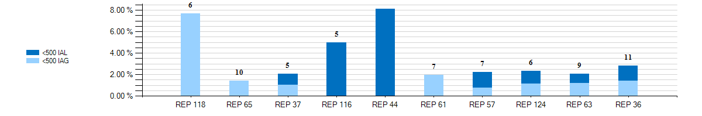
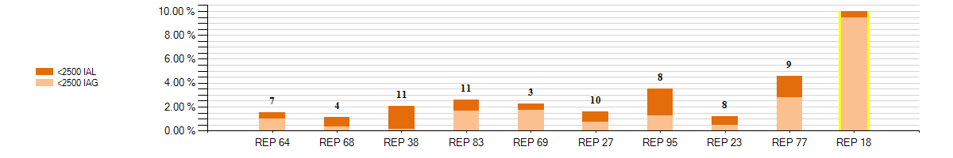
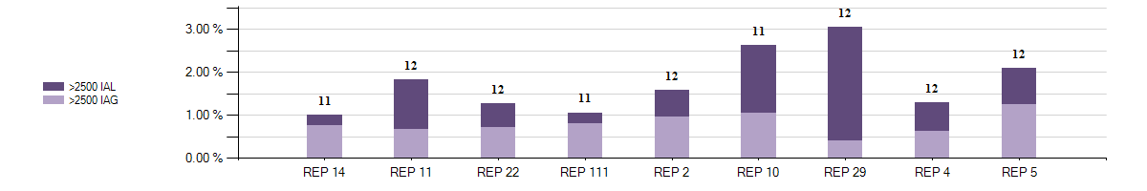
2016 – IAG / IAL Statistics
Top 10 - December 2016 – IAG / IAL % Greater Than 1% of Enrollments With number of months Greater Than 1%

Slide 93
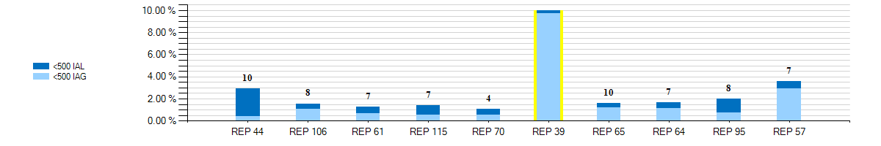
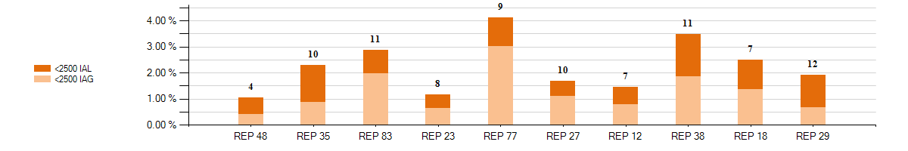
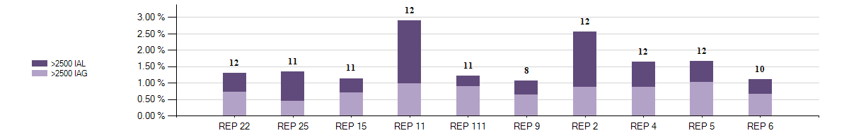
2016 – IAG / IAL Statistics
Top 10 - 12 Month Average IAG / IAL % Greater Than 1% of Enrollments thru December 2016 With number of months Greater Than 1%

Slide 94
Explanation of IAG / IAL Slides Data
Slide 88 charts show the top 10 REPs whose IAG/IAL percentage of their total enrollments is above 1%.
  The blue chart shows enrollment totals of less than 500 for the month being reported
  The orange chart shows enrollment totals between 500 and 2500 for the month being reported
  The purple charts show enrollment totals of over 2500 for the month being reported
  REPs with the lowest AG/IAL totals start on the left, and move to the highest counts on the right
Slide 89 charts show the top 10 REPs whose 12 month average IAG/IAL percentage of their total enrollments is above 1%.
  The blue chart shows enrollment total averages of less than 500 for the month being reported
  The orange chart shows enrollment total averages between 500 and 2500 for the month being reported
  The purple charts show enrollment total averages of over 2500 for the month being reported
  REPs with the lowest IAG/IAL averages start on the left, and move to the highest counts on the right
  Number labels represent the number of months the REP has been over 1% during the 12 month period

Slide 95
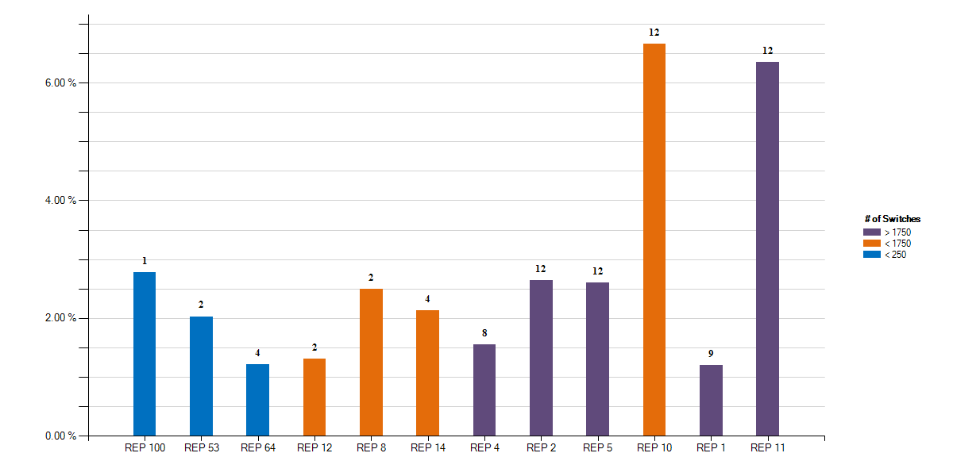
2016 – Rescission Statistics
Top - 12 Month Average Rescission % Greater Than 1% of Switches thru December 2016 With number of months Greater Than 1%

Slide 96
Explanation of Rescission Slide Data
NOTE:
A 10% chart range limit has been set. REPs data points that exceed 10% will be bordered in yellow. Please see the spreadsheet for actual percentages of these REPs.
Slide 91 charts show the top REPs whose 12 month average Rescission percentage of their total Switches is above 1%.
  The blue shades show switch totals of less than 250 for the month being reported
  The orange shades show switch totals between 250 and 1750 for the month being reported
  The purple shades show switch totals of over 1750 for the month being reported
  The REPs with the lowest count of rescission totals start on the left, and move to the highest counts on the right
  Number labels represent the number of months the REP has been over 1% during the 12 month period

Slide 97
18 Month Running Market Totals
 | Enrollments |  |  | IAG, IAL, Rescission |  |  |  |  | Days to Resolution
Month | SWI | MVI | Total | IAG | IAL | Rescission | IAG,IAL,Res Total | Overall % | IAG | IAL | Rescission
2015-07 | 91,211 | 263,233 | 354,444 | 2,220 | 1,589 | 888 | 4,697 | 1.33% | 11 | 15 | 10
2015-08 | 81,674 | 248,124 | 329,798 | 1,933 | 1,433 | 820 | 4,186 | 1.27% | 11 | 15 | 11
2015-09 | 70,342 | 229,405 | 299,747 | 1,780 | 1,339 | 860 | 3,979 | 1.33% | 11 | 13 | 9
2015-10 | 65,276 | 215,908 | 281,184 | 1,761 | 1,345 | 842 | 3,948 | 1.40% | 10 | 13 | 8
2015-11 | 52,887 | 181,098 | 233,985 | 1,591 | 1,314 | 785 | 3,690 | 1.58% | 11 | 14 | 10
2015-12 | 61,486 | 189,862 | 251,348 | 1,702 | 1,521 | 755 | 3,978 | 1.58% | 11 | 13 | 9
2016-01 | 63,954 | 193,716 | 257,670 | 1,536 | 1,391 | 1,055 | 3,982 | 1.55% | 9 | 10 | 7
2016-02 | 68,057 | 212,474 | 280,531 | 1,672 | 1,509 | 848 | 4,029 | 1.44% | 9 | 11 | 7
2016-03 | 76,235 | 218,245 | 294,480 | 1,784 | 1,613 | 839 | 4,236 | 1.44% | 8 | 10 | 7
2016-04 | 70,300 | 199,804 | 270,104 | 1,784 | 1,457 | 855 | 4,096 | 1.52% | 8 | 9 | 6
2016-05 | 75,323 | 214,383 | 289,706 | 1,845 | 1,466 | 912 | 4,223 | 1.46% | 8 | 11 | 6
2016-06 | 86,376 | 247,481 | 333,857 | 2,332 | 1,661 | 1,026 | 5,019 | 1.50% | 9 | 11 | 6
2016-07 | 82,923 | 241,844 | 324,767 | 2,151 | 1,322 | 904 | 4,377 | 1.35% | 8 | 11 | 6
2016-08 | 86,656 | 268,781 | 355,437 | 2,185 | 1,386 | 819 | 4,390 | 1.24% | 8 | 12 | 7
2016-09 | 67,323 | 231,999 | 299,322 | 1,846 | 1,225 | 731 | 3,802 | 1.27% | 8 | 11 | 7
2016-10 | 64,452 | 220,958 | 285,410 | 1,818 | 1,150 | 726 | 3,694 | 1.29% | 9 | 12 | 7
2016-11 | 56,202 | 201,714 | 257,916 | 1,931 | 1,132 | 724 | 3,787 | 1.47% | 9 | 13 | 8
2016-12 | 66,556 | 196,236 | 262,792 | 1,792 | 1,142 | 745 | 3,679 | 1.40% | 10 | 14 | 11

Slide 98
Market Challenge
CHALLENGE:
Reduce the total volume by another 10%!!
Drive % volume to below 1.5% !!

Slide 99

Market Challenge
Together we can make it a ...
“is there a better graphic? this one is pretty low res and looks bad” ~ Matt

Slide 100
Checkpoint Question #1
An Inadvertent Loss MT submitted by the Losing REP will count toward which REP’s % total?
  The Losing REP
  The Gaining REP
ANSWER
The Gaining REP – valid IAG & IAL MTs will only count toward the Gaining REP’s total

Slide 101
Checkpoint Question #3
The assigned REP’s # on the IGL report will change each month.
  True
  False
ANSWER
FALSE – Assigned REP #s will remain consistent for the market reporting

Slide 102
Checkpoint Question #4
Driving down the number IAGs / IALs / Rescissions in the market will result in which of the following:
  Fewer customer complaints
  Improved customer experience
  Addressing customer issues faster
  Fewer back-off resources
  All of the above
ANSWER
All of the above – If all REPs work to drive efficiencies in their processes, the market will benefit

Slide 103
Questions

Slide 104
2017
Inadvertent Switch & Customer Rescission
Market Training
APPENDIX

Slide 105
Appendix
Process Flow – Inadvertent Loss
Process Flow – Inadvertent Gain
Customer Rescission Exceptions
Customer Rescission – Re-submit
Reference Documents – summaries
  PUCT Subst. Rule §25.495. Unauthorized Change of Retail Electric Provider
  Retail Market Guide Section 7.3 Inadvertent Gain Process
  MarkeTrak User’s Guide Index

Slide 106
Process Flow: IAL (Losing)
Process Flow - Inadvertent Losing MarkeTrak Issue
 | Transition | By | State | Owner
 | Create | Submitter (Losing CR) / Original CR | Pending Issue | Submitter (Losing CR) / Original CR
 | â
 | Submit | Submitter (Losing CR) / Original CR | New (Gaining CR) | (Gaining CR) / Inadvertent CR
 | â
 | Assign Owner | (Gaining CR) / Inadvertent CR | New (Gaining CR) | (Gaining CR) / Inadvertent CR
 | â
 | Begin Working | (Gaining CR) / Inadvertent CR | In Progress (Gaining CR) | (Gaining CR) / Inadvertent CR
 | â
 | Agree | (Gaining CR) / Inadvertent CR | New (Losing CR) | Submitter (Losing CR) / Original CR
 | â
 | Begin Working | Submitter (Losing CR) / Original CR | In Progress (Losing CR) | Submitter (Losing CR) / Original CR
 | â
Submitter (Losing CR) / Original CR to Perform Research / Reconciliation / Verification Process: þ Subsequent transactions? Yes - Cancel W/Approval, No - Proceed þ Holds? Yes – Submit 650_01, No - Proceed þ Proposed Regain Date =< Gaining CR Start Date? Yes – Update, No – Proceed Send to TDSP
 | â

Slide 107
Process Flow: IAL (Losing)
 | â
 | Send To TDSP | Submitter (Losing CR) / Original CR | New (TDSP) | TDSP
 | â
 | Begin Working | TDSP | In Progress (TDSP) | TDSP
 | â
TDSP to Perform Research / Reconciliation / Verification Process: þ Subsequent transactions? Yes – Send back to CRs, No - Proceed þ Holds? Yes – Send back to CRs, No - Proceed þ Proposed Regain Date =< Gaining CR Start Date? Yes – Send back to CRs, No – Proceed þ Check for Permit Requirements and override if any exist þ Add ESIID, Original CR and Proposed Regain Date to Safety Net and verify loaded correctly þ Update MarkeTrak issues with comments indicating readiness
 | â
 | Ready To Receive | TDSP | New (Losing CR Submit) | Submitter (Losing CR) / Original CR
 | â
 | Begin Working | Submitter (Losing CR) / Original CR | In Progress (Submit Regaining) | Submitter (Losing CR) / Original CR
 | â

Slide 108
Process Flow: IAL (Losing)
 | â
Submitter (Losing CR) / Original CR to Perform Research / Reconciliation / Verification Process: þ Subsequent transactions? Yes - Cancel W/Approval, No - Proceed þ Send EDI for the Proposed Regain Date that the Original CR entered within the issue þ Verify the EDI was processed successfully by consulting the ERCOT MIS as well as any internal systems used for verifying transactions. þ Add the Regaining BGN information into the MarkeTrak issue only after verifying that it was successfully received þ DO NOT click the Send to TDSP transition as this will prevent the issue from Auto-completion
 | â
 | Provide Regaining BGN02 | Submitter (Losing CR) / Original CR | Regaining Transaction Submitted (PC) | Submitter (Losing CR) / Original CR
 | â
 | Update | ERCOT | Auto Complete | Submitter (Losing CR) / Original CR

Slide 109
Process Flow: IAL (Gaining)
Process Flow - Inadvertent Gaining MarkeTrak Issue
 | Transition | By | State | Owner
 | Create | Submitter (Gaining CR) / Inadvertent CR | Pending Issue | Submitter (Gaining CR) / Inadvertent CR
 | â
 | Submit | Submitter (Gaining CR) / Inadvertent CR | New (Losing CR) | (Losing CR) / Original CR
 | â
 | Assign Owner | (Losing CR) / Original CR | New (Losing CR) | (Losing CR) / Original CR
 | â
 | Begin Working | (Losing CR) / Original CR | In Progress (Losing CR) | (Losing CR) / Original CR
 | â
(Losing CR) / Original CR to Perform Research / Reconciliation / Verification Process: þ Subsequent transactions? Yes - Cancel W/Approval, No - Proceed þ Holds? Yes – Submit 650_01, No - Proceed þ Proposed Regain Date =< Gaining CR Start Date? Yes – Update, No – Proceed Send to TDSP
 | â

Slide 110
Process Flow: IAL (Gaining)
 | â
 | Send To TDSP | (Losing CR) / Original CR | New (TDSP) | TDSP
 | â
 | Begin Working | TDSP | In Progress (TDSP) | TDSP
 | â
TDSP to Perform Research / Reconciliation / Verification Process: þ Subsequent transactions? Yes – Send back to CRs, No - Proceed þ Holds? Yes – Send back to CRs, No - Proceed þ Proposed Regain Date =< Gaining CR Start Date? Yes – Send back to CRs, No – Proceed þ Check for Permit Requirements and override if any exist þ Add ESIID, Original CR and Proposed Regain Date to Safety Net and verify loaded correctly þ Update MarkeTrak issues with comments indicating readiness
 | â
 | Ready To Receive | TDSP | New (Losing CR Submit) | (Losing CR) / Original CR
 | â
 | Begin Working | (Losing CR) / Original CR | In Progress (Submit Regaining) | (Losing CR) / Original CR
 | â

Slide 111
Process Flow: IAL (Gaining)
 | â
(Losing CR) / Original CR to Perform Research / Reconciliation / Verification Process: þ Subsequent transactions? Yes - Cancel W/Approval, No - Proceed þ Send EDI for the Proposed Regain Date that the Original CR entered within the issue þ Verify the EDI was processed successfully by consulting the ERCOT MIS as well as any internal systems used for verifying transactions. þ Add the Regaining BGN information into the MarkeTrak issue only after verifying that it was successfully received þ DO NOT click the Send to TDSP transition as this will prevent the issue from Auto-completion
 | â
 | Provide Regaining BGN02 | (Losing CR) / Original CR | Regaining Transaction Submitted (PC) | Submitter (Gaining CR) / Inadvertent CR
 | â
 | Update | ERCOT | Auto Complete | Submitter (Gaining CR) / Inadvertent CR

Slide 112
Customer Rescission – Exceptions
If the regaining transaction remains in a Siebel status other than Complete in the ERCOT Registration System for greater than five calendar days, the issue will automatically transition back to the Losing CR, and an email generated to notify the Losing CR of the transition.
If the regaining Siebel status is still Scheduled status, the Losing CR should repopulate the regaining BGN field with the same information.
If the Siebel status is blank within the MarkeTrak issue, the Losing CR should verify the status of the regaining transaction and submit/repopulate a new transaction if necessary.
This functionality is to ensure the issue is not closed before the premise has been regained, due to the time restriction on submission of new issues within this subtype.

Slide 113
Customer Rescission – Re-submit

Slide 114
Customer Rescission – Re-submit

Slide 115
Reference Documents
PUCT Subst. Rule §25.495, Unauthorized Change of Retail Electric Provider
ERCOT Retail Market Guide Section 7.3, Inadvertent Gain Process
MarkeTrak User’s Guide

Slide 116
Reference Documents
PUCT Subst. Rule §25.495. Unauthorized Change of Retail Electric Provider
http://www.puc.texas.gov/agency/rulesnlaws/subrules/electric/Electric.aspx
Either the original REP (Losing REP) or the switching REP (Gaining REP) shall file a MarkeTrak issue as promptly as possible
Affected REPs, ERCOT, and TDSP shall take all actions necessary to return the customer to the original REP as quickly as possible
Gaining REP shall pay all transmission and distribution charges associated with returning the customer to the Losing REP
Gaining REP shall refund within 5 days all charges paid by the customer for the time period the Losing REP regains and ultimately rebills the customer
The REP that ultimately bills the customer is responsible for the non-bypassable charges and wholesale consumption for the customer
The customer shall pay no more than the price at which the customer would have been billed had the unauthorized switch or move-in not occurred

Slide 117
Reference Documents
ERCOT Retail Market Guide
http://www.ercot.com/mktrules/guides/retail/current
7.3 Inadvertent Gain Process
  7.3.1 Escalation Process
  7.3.2 Competitive Retailer’s Inadvertent Gain Process
    7.3.2.1 Buyer’s Remorse
    7.3.2.2 Prevention of Inadvertent Gains
    7.3.2.3 Resolution of Inadvertent Gains
    7.3.2.4 Valid Reject / Unexecutable Reasons
    7.3.2.5 Invalid Reject / Unexecutable Reasons
    7.3.2.6 Out-of-Sync Conditions
    7.3.2.7 No Losing Competitive Retailer of Record
  7.3.3 Charges Associated with Returning the Customer
  7.3.4 Transmission and / or Distribution Service Provider Inadvertent Gain Process
    7.3.4.1 Inadvertent Dates Greater than 150 days
    7.3.4.2 Inadvertent Order is Pending
    7.3.4.3 Third Party has Gained Electric Service Identifier (Leapfrog Scenario)
    7.3.4.4 Transmission and/or Distribution Service Provider Billing
  7.3.5 Customer Rescission after Completion of a Switch Transaction
    7.3.5.1 Additional Valid Reasons for Rejection of a Rescission-based Issue

Slide 118
Reference Documents
Retail Market Guide Section 7.3 Inadvertent Gain Process
Guidelines for ensuring that inadvertently gained ESI IDs are returned to the Losing REP in a quick and efficient manner with minimal inconvenience to the Customer as required by PUC Subst. Rule 25.495 Unauthorized Change of Retail Electric Provider
Escalation Process:
Each Market Participant is responsible for it’s own compliance with the PUCT rules and RMG procedures & timelines.
Each Market Participant shall maintain and update escalation contacts within the MarkeTrak Rolodex
MarkeTrak will send escalation emails to the escalation contacts whenever an issue has remained in a ‘New’ or ‘Pending’ state for more than 3 calendar days

Slide 119
Reference Documents
Section 7.3, Inadvertent Gain Process - continued
CRs, both Losing and Gaining Reps, must investigate the matter and provide all necessary/relevant information – customer name, service address, meter number
An untimely rescission is not treated as an inadvertent gain or loss
The IGL process shall not be used to resolve an issue which an authorized enrollment causes a breach of contract between Customer and Losing Rep
Utilize the Cancel w/ Approval MarkeTrak to prevent an IGL if within one Retail Business Day prior to MVI or switch
If future dated MVI or switch and earlier than one Retail Business Day prior to transaction, utilize 814_08 Cancel Request
814_08
Cancel w/ approval
IGL MarkeTrak
DOT – 1
DOT
Date of Transition

Slide 120
Reference Documents
Section 7.3, Inadvertent Gain Process - continued
Do not issue a MVO on an ESI ID that was gained in error
Do not issue an Inadvertent Loss MarkeTrak until the Gaining Rep’s transaction has completed
The Losing Rep ultimately determines the reinstatement date
Reinstatement date shall be at the earliest DOL + 1 (Date of Loss) and at the latest 10 days from the date the MarkeTrak was submitted
The Losing Rep shall submit the BDMVI (back-dated move in) 814_16 no later than 12 days after submittal of the MarkeTrak and shall be dated with the ‘proposed regain date’ as agreed in the MarkeTrak
The MT will auto-close if remains untouched for 20 days from the date the TDSP selects ‘Ready to Receive’
Reinstatement date
DOL
DOL + 1
MT date +10

Slide 121
Reference Documents
Section 7.3, Inadvertent Gain Process - continued
Be mindful of the Valid and Invalid Reject/Unexecutable reasons
Each Rep shall be responsible for all non-bypassable TDSP charges and wholesale consumption costs for the periods that the Rep bills the customer
If a lights out in error situation occurs (the Gaining Rep issues a MVO or DNP) the Losing Rep may submit a Redirect Fee MarkeTrak within 3 Retail Business Days following an 810_02 from the TDSP. Keep in mind, not all TDSPs have MVI fees for standard meters.
TDSP shall not issue billing corrections more than 150 days in the past from the date of receipt of the BDMVI due to settlement issues. Losing Rep must resubmit the BDMVI with a new date.
Leapfrog Scenario – when a legitimate third party transaction has occurred to an inadvertently gained ESI ID or if the BDMVI’s proposed regain date is more than 2 Retail Business Days prior to scheduled transaction, TDSP shall respond this is no longer an inadvertent issue.

Slide 122
Reference Documents
MarkeTrak User Guide
http://www.ercot.com/content/services/client_svcs/mktrk_info/MarkeTrak%2520User%2520Guide[1]%20(2).zip
  2.1 Day to Day Issues – Inadvertent Gain
  2.1.1 Required Fields for Inadvertent Gain
  2.1.2 Definition of Inadvertent Gain
  2.1.3 Submitting an Inadvertent Gain
  2.1.4 Submitting a Customer Rescission Issue
  2.1.5 Redirect Fees Subtype

Slide 123
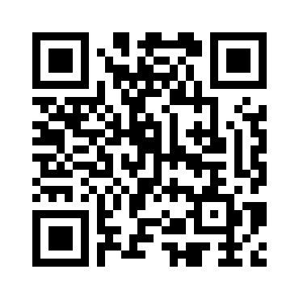
Got Feedback?
Scan this QR code to take the course survey!

Slide 124
Checkpoint Answers
Slide | Answer
30 | b) The Gaining REP - only the Gaining REP may initiate the Rescission process.
31 | True - providing any relevant information assists in the timely resolution of the MT.
32 | False - per PUC Subst. Rule 25.474(j), a customer has the right to rescind the terms of service without penalty or fee of any kind.
33 | c) 2 business days - once the TDSP has transitioned the MT to “Ready to Receive”.
51 | False - this is not a valid reject reason, the Losing CR should regain the ESI ID and execute the Current Occupant process.
52 | c) Either - is applicable and is dependent upon the Losing CR’s business practices.
53 | c) 12 days of MT submittal - Per the RMG 7.3.2.3.1 Reinstatement Date, the Losing REP shall submit the BDMVI no later than 12 days after submittal of the MarkeTrak.
54 | False - Generally speaking issuing a MVO on an active ESI will create a light out situation at the incorrect address. An Inadvertent Gain MT should be submitted to resolve the incorrect address.

Slide 125
Checkpoint Answers
Slide | Answer
71 | True - Any completed MVI/Switch or MVO transactions received after the initial transaction that caused the IAG will render the IAG regain process invalid.
72 | a) The best practice is for Losing CR’ to send their BDMVI’s as soon as the TDSP gives the ok to send the BDMI. With each passing day there is an increased risk of new transactions being sent on the impacted ESI ID.
73 | c) Using the MarkeTrak Rolodex tool to identify and reach out to escalation contacts within the non communicating CR’s organization.
100 | b) The Gaining REP – valid IAG & IAL MTs will only count toward the Gaining REP’s total
101 | False – Assigned REP #s will remain consistent for the market reporting
102 | e) All of the above – If all REPs work to drive efficiencies in their processes, the market will benefit

