Slide 1
Emerging Technologies Working Group update to the Wholesale Market Subcommittee
04/05/2017

Slide 2
ETWG update to WMS
NERC DER Summary
IEEE1547 Update
ETWG Scope
Next Meeting

Slide 3
ETWG update to WMS: NERC DER Reliability Whitepaper

Slide 4
ETWG update to WMS: NERC DER Reliability Whitepaper

Slide 5
ETWG update to WMS: IEEE1547 Revision Update
“General Definitions” Updates to IEEE1547
Standard went from 16 pages to 113 pages.
DER/DG Size limit (10 MW) removed
Doesn’t impact Texas—previously defined by PUCT.
DER defined as sources of electric power
Does not include demand response
Different Settings/classifications based on equipment performance and application
Class I - Synchronous machines
Class II- Inverters
Class III- Inverters in High penetration areas
Considers Different Interconnections for DERs
Stand alone
Part of a local EPS
“Stability” Updates to IEEE1547
BES stability features (New “Smart Inverter” functions)
Voltage Regulation/Reactive power capability
absorb or inject VARs
Volt/VAR function
power factor modes
Voltage Regulation/Active power control
Volt/watt function
Wider operating voltage/freq. window
Mandates Voltage/frequency ride through functions
Other stability features
Soft start reconnect
ramping function
random times

Slide 6
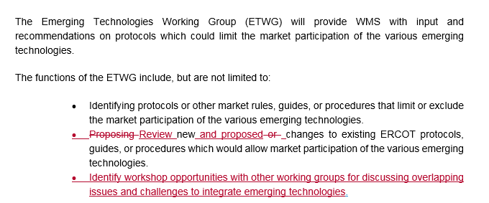
ETWG update to WMS: Suggested Scope Changes

Slide 7
ETWG update to WMS: Next Meetings
May 2, 2017, Tuesday, 9:30-12:00
June 6, 2017, Tuesday, 9:30-12:00

